Slide 1
American History: Chapter 19 Review Video
www.Apushreview.com
From Crisis to Empire

Slide 2
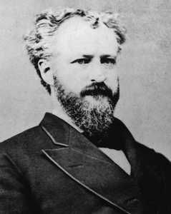
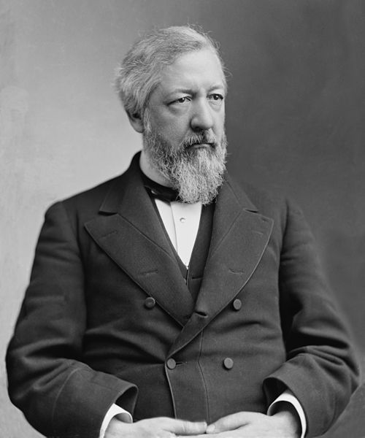
The Politics of Equilibrium
Big Ideas during the late 19th century:
High voter turnout
Control of Congress switched between parties frequently
Republicans – northern Protestants, middle class, high tariffs
Democrats – Catholics, immigrants, poorer workers, low tariffs
How did the government support economic development?
Subsidies to Railroads
Military to end work stoppages
Key terms to know:
Stalwarts – Republicans that favored patronage
Roscoe Conkling
“Half-Breeds” – favored reform in government
James Blaine

Slide 3
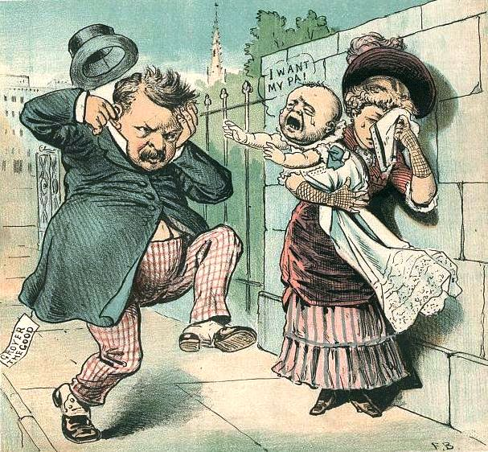
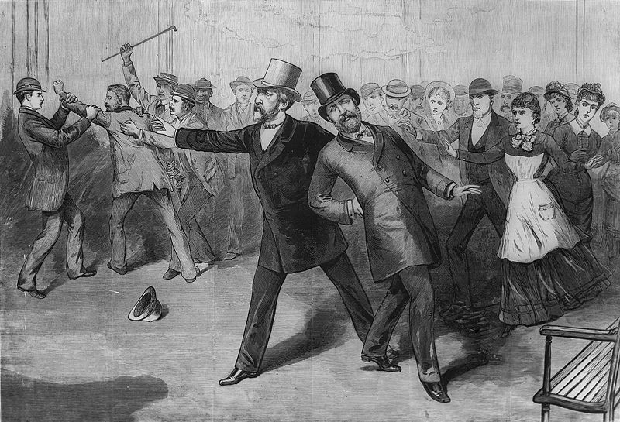
The Politics of Equilibrium Cont.
James A. Garfield
20th president; killed by a Stalwart
Chester A. Arthur – Pendleton Act (1883) – Civil Service Exam
Election of 1884:
Cleveland v. Blaine
Dirty campaigning – “Ma, ma, where’s my pa?
Cleveland wins – laissez-faire president
Tariff issue separated Republicans and Democrats
Sherman Antitrust Act (1890)
More symbolic than anything else
Purpose was to break up trusts
***In actuality it was used to break up unions***

Slide 4
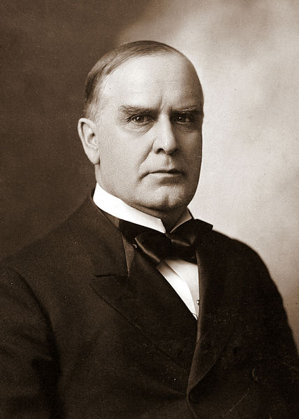
The Politics of Equilibrium Cont.
McKinley Tariff (1890) – he was a Republican
Republicans wanted to RAISE tariff rates
Munn v. Illinois: (1877)
State governments can regulate industries when in best interest of public
Wabash Case: (1886)
Yet again, states cannot regulate interstate commerce (overturned Munn decision)
Interstate Commerce Act:
Created ICC
Outlawed higher rates on short hauls than long hauls
RRs must publish their rates

Slide 5
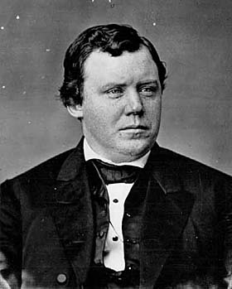
The Agrarian Revolt
The Grange:
Provided social and economic opportunities for FARMERS
Sought to end monopolies in RR, wanted government ownership of businesses
Populist Party
Absorbed some ideas from farmers
Omaha Platform (written by Ignatius Donnelly)
Free and unlimited coinage of silver at ratio of 16:1
A graduated income-tax (redistribute wealth)
Gov’t ownership of the telephone and telegraph, and railroads.
Initiative, referendum and recall
Postal savings banks (safe repository run by gov’t)
Limiting gov’t land grants to settlers rather than railroads
Direct election of senators

Slide 6
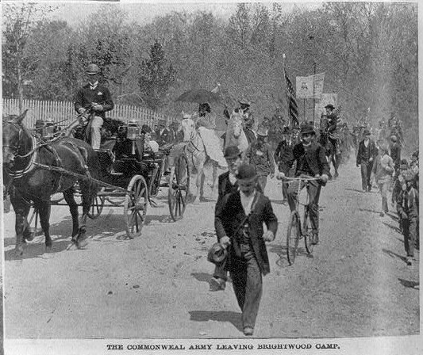
The Crisis of the 1890s
Panic of 1893 Causes:
Who would have guessed it, overspeculation
Stock-market crash, Overproduction
Results:
Gov’t repeals Sherman Silver Act
Coxey’s Army:
Advocated a public works program
Marched a group of unemployed individuals to Washington
Broken up by police
Free Silver:
Having silver back the value of the dollar at a ratio of 16:1
Would favor famers and debtors – easier to pay off debt

Slide 7
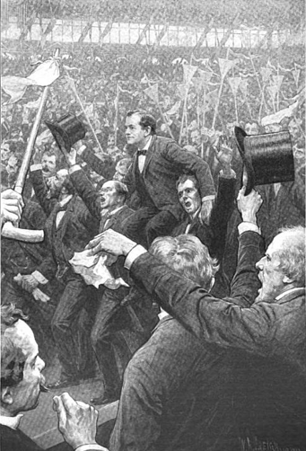
A Cross of Gold
William Jennings Bryan
Won Democratic nomination in 1896; great orator
Challenged McKinley
Cross of Gold (Like Henry Clay, he ran for President three times and lost!)
"We will answer their demands for a gold standard by saying to them: ‘You shall not press down upon the brow of labor this crown of thorns, you shall not crucify mankind upon a cross of gold.”
Election of 1896:
First “modern” campaign”
Bryan advocated lowering the tariff (Democrats want the tariff to go DOWN!)

Slide 8
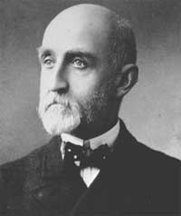
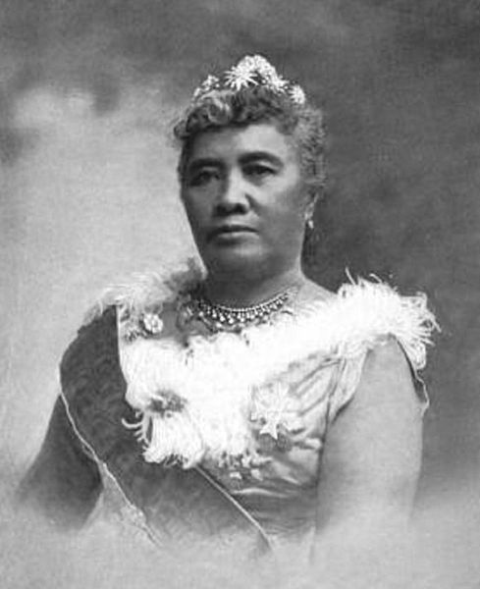
Stirrings of Imperialism
US sought expansion overseas – why?
Manifest Destiny was complete
Frontier “closed”
***Alfred T. Mahan*** - Influence of Sea Power
Control of the sea was important to world dominance
Urged the US and other countries to build their navies
Favored by T. Roosevelt and other expansionists
Why was Hawaii attractive to US?
Sugar production
Since 1840s, US had foreign interest in HI
US wanted to annex HI
1890, tariff exemption on Hawaii ended, high prices on imports – hurt US farmers in Hawaii
Queen Liliuokalani believed native Hawaiians should control the islands
Queen was overthrown in 1893 after revolt by planters
Treaty to annex HI was initially rejected by Grover Cleveland
1878 – US naval station in Samoa

Slide 9
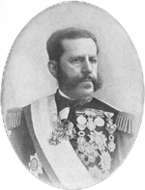
War With Spain
In 1895, Cuba revolted against Spain, following a policy of scorched-earth
US very concerned. Why?
$50 million of investments, $100 million of annual trade
Spanish General “Butcher” Weyler tried to crush rebellion
Barbed-wire reconcentration camps
Yellow Journalism: “You furnish the pictures and I’ll furnish the war”
Spanish Minister spoke negatively about McKinley: Called him weak!
De Lome letter

Slide 10
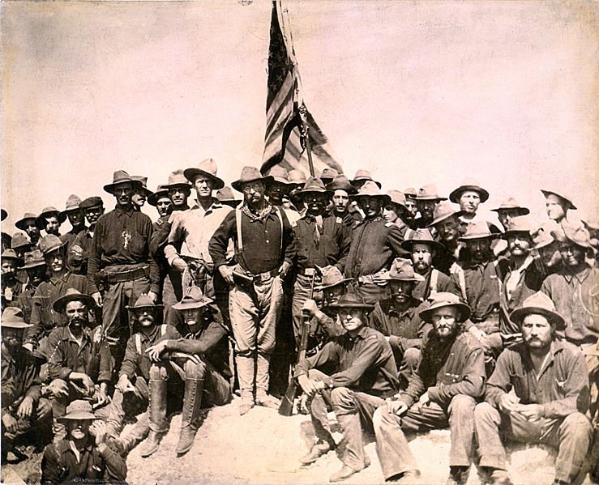
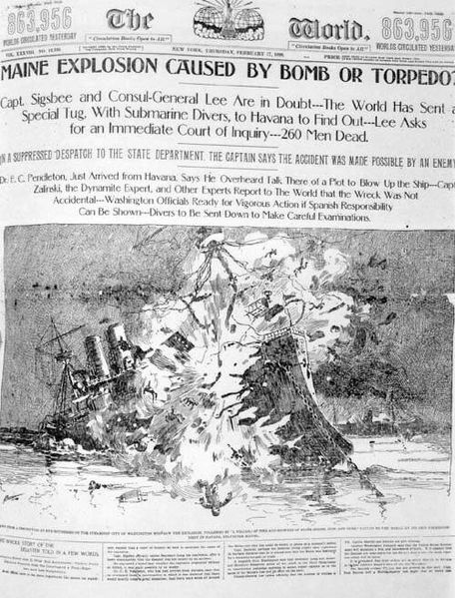
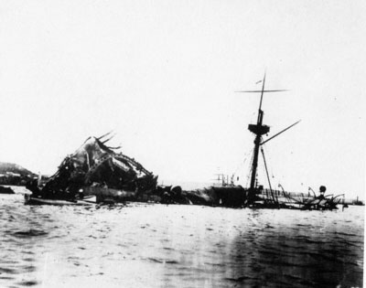
War With Spain Continued
USS Maine mysteriously blew up, killing 260 sailors
USS Maine and subsequent pictures was a HUGE cause for US involvement in war (February 15, 1898)
April 11, 1898 McKinley sends a message to Congress urging war with Spain
Teller Amendment:
Once US overthrew Spanish rule, Cubans would be given their freedom
“Rough Riders”
Group of volunteers that played a role in Spanish-American War in Cuba
August 12, 1898 armistice was signed
400 Americans died during battle, 5,000 died due to disease

Slide 11
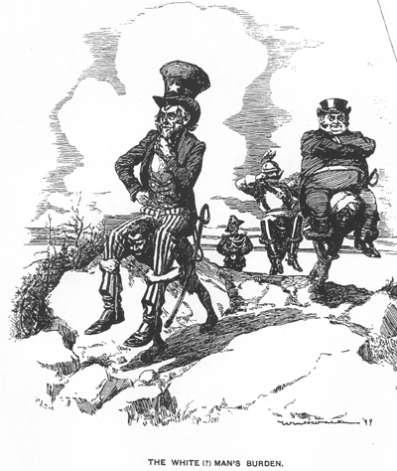
War With Spain Continued
What did America gain?
Guam, Cuba, Puerto Rico
Philippines
Key issue of what to do. McKinley planned to “Christianize and civilize them”
Anti-Imperialist League
Mark Twain, Presidents of Harvard and Stanford, Samuel Gompers, and Carnegie
Didn’t Filipinos deserve “Consent of the governed?”
White Man’s Burden encouraged imperialism
Foraker Act of 1900
Puerto Ricans granted limited degree of popular government
Later granted US citizenship in 1917 – Jones Act

Slide 12
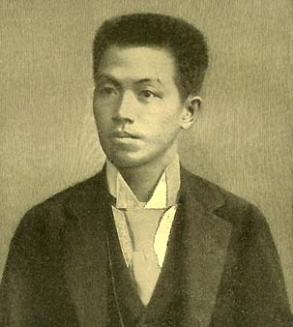
The Republic As Empire
Key question with new land: Does Constitution follow flag? Protect these people?
Insular Cases
Constitution does not apply to new areas. “Subjects may be subject to American rule, but they did not enjoy all American rights.”
1902, US withdraws from Cuba…. sort of
Platt Amendment (Know this!!)
Cuba can’t have treaties with other countries that compromises independence
US can intervene to restore order
Guantanamo Bay given to US
Philippines thought they would receive independence like Cuba, not included in peace negotiations
Emilio Aguinaldo wanted revenge
Guerilla warfare
Aguinaldo is captured

Slide 13
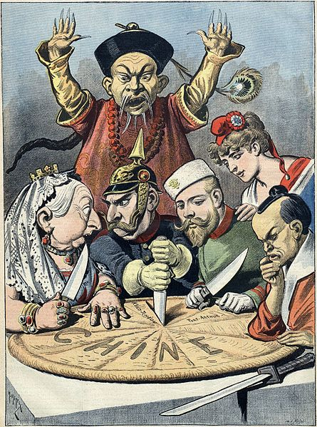
The Republic As Empire Continued
Europe established spheres of influence in China
US fearful of missing out on markets
Secretary of State John Hay established Open Door Note
Purpose was to ensure US would not be locked out of China
Secret Society of the Harmonious Fists
“Death to Foreign Devils!!!!”
Broken up by multinational troops

Slide 14
Thanks for watching!
Subscribe to my channel
Help spread the word
Questions? Comments? Ideas for videos?
Leave in comments
Subscribe
Down here!

