Slide 1
American History: Chapter 23 Review Video
www.Apushreview.com
The Great Depression

Slide 2
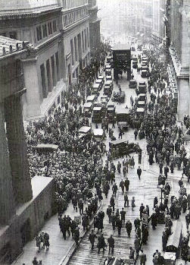
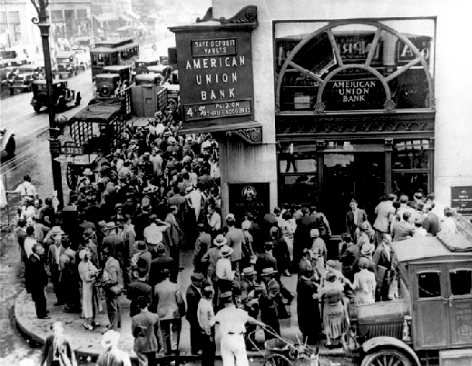
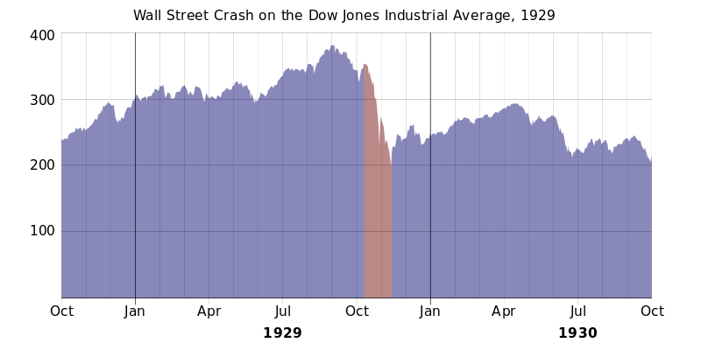
The Coming of the Great Depression
Bull Market:
Increase in stock prices: 1928 – September 1929: stocks increased by 40%
October 29, 1929 (Black Tuesday):
Stock market crash
Buying on “margin”
Causes of the Depression:
Prosperity based on a few industries
Unequal distribution of wealth
Almost half of families living at or below minimum subsistence level
Credit:
Famers deeply in debt
Production outweighed demand
High protective tariffs
Dawes Plan:
Not to be confused with Dawes Severalty Act
Rescheduled German reparation loans
US banks loaned $ to Germany -> pays Britain and France -> pays loans back to US Treasury
Simply a circle of $ - ends with stock market crash of 1929
Bank Crisis:
9,000 banks closed between 1930 and 1933
Money supply decreased by 1/3

Slide 3
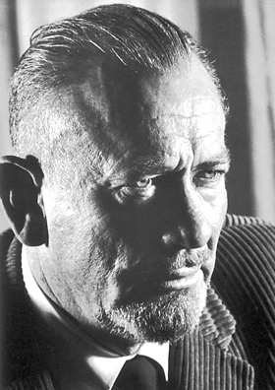
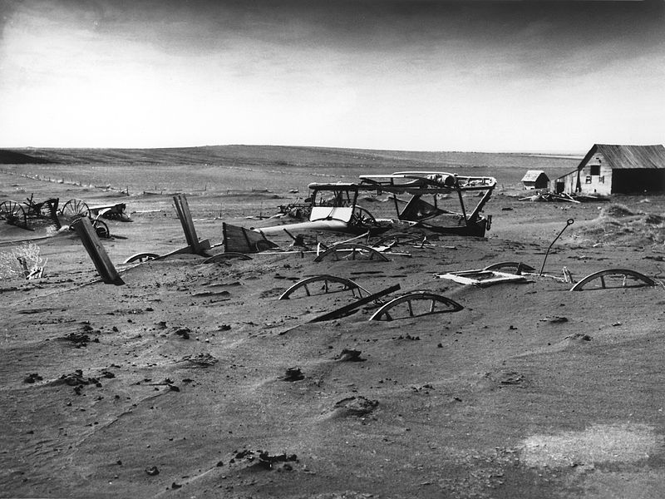
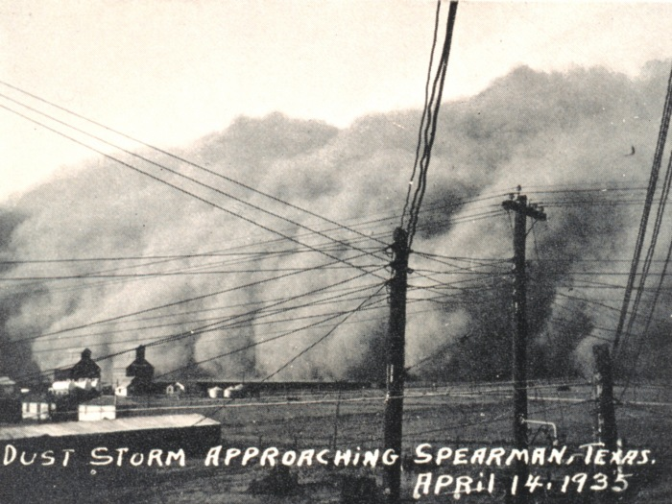
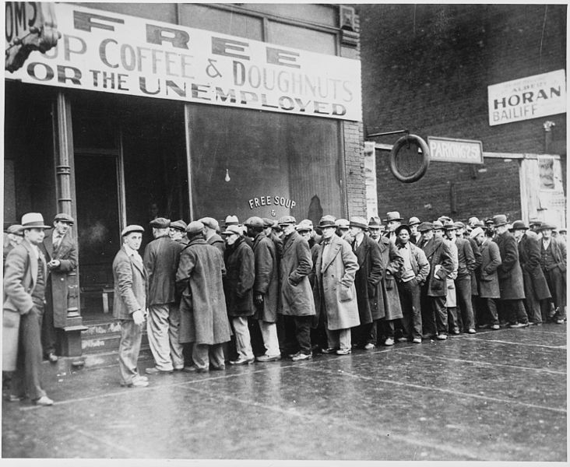
The American People in Hard Times
Industrial North was hard hit
Ohio unemployment was 50%
Many Americans associated unemployment with failure
Charities and other relief organizations couldn’t keep pace
Dust Bowl:
Area of land from eastern Colorado to western Missouri, Texas – North Dakota
Causes:
Drought, wind, human cultivation
The Grapes of Wrath: story about Dust Bowl
“Black Blizzards” – dust storms
“Okies” – families that moved from the Dust Bowl to other areas, especially California

Slide 4
The American People in Hard Times….
African Americans:
Especially hard hit – 50% in South were unemployed
Segregation and discrimination was still rampant
Scottsboro Case:
Nine African Americans were accused of rape
All-white jury found them guilty, 8 sentenced to death
Eventually, all were released from jail, though many years later
Other Minorities:
Mexican Americans:
2 million people of Mexican descent, mostly farmers
Some Mexicans forced out of the country
Asians:
Fought to have laws protecting Japanese from discrimination
Women:
Pressure for women to not work, especially if husband does
Many minorities did not benefit from relief programs
Marriage and birthrates declined during Depression

Slide 5
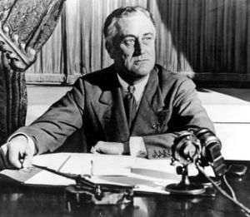
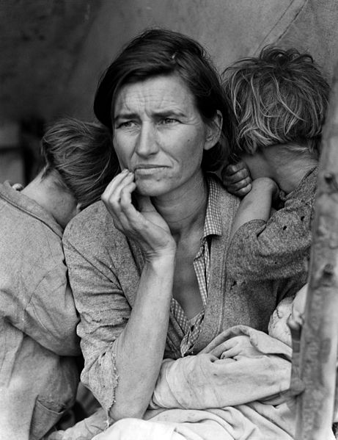
The Depression and American Culture
Art in the Depression:
Dorothea Lange:
Photographed Depression families
John Steinbeck:
Grapes of Wrath - story about Dust Bowl
Radio:
Source of entertainment
“Fireside chats” – FDR
Soap Operas, plays, news
Spanish Civil War (1936 – 1939):
Some Americans supported the republican government
Fascist government of Francisco Franco had support of Hitler and Mussolini

Slide 6
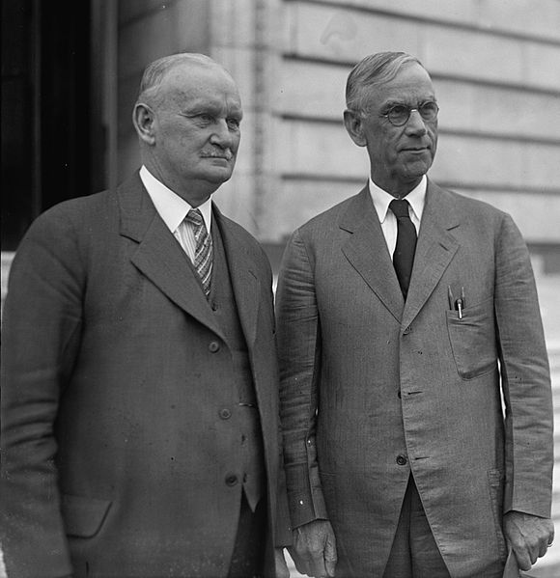
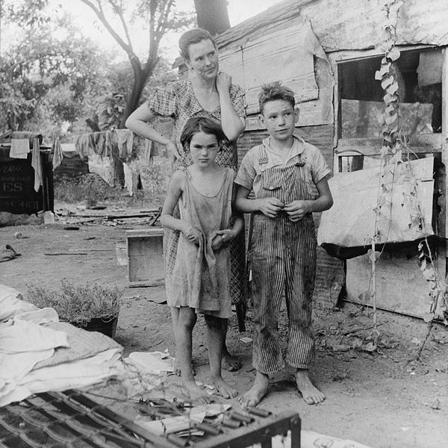
The Unhappy Presidency of Herbert Hoover
Hoover:
Urged volunteerism:
Similar to WWI
Feared deficit spending
Hawley-Smoot Tariff:
High protective tariff – led to high European tariffs in return
“Hoovervilles”
Name for shanty towns that developed
Reconstruction Finance Corporation:
Meant to provide loans to banks, RRs, and businesses
Largely a failure – never provided enough $

Slide 7
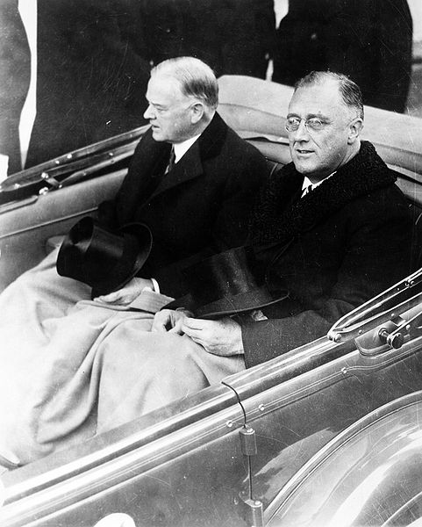
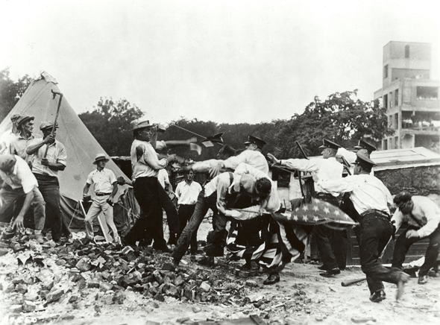
The Unhappy Presidency of Herbert Hoover Cont.
WWI Veterans were hit hard during Depression
“Bonus Expeditionary Force” (BEF)
Descends upon D.C. in hopes of receiving their bonuses
Set up “Hoovervilles”
Hoover ordered army (led by MacArthur) to break up “Bonus Army”
Bonus Army eventually leaves, taints Hoover even more
Election of 1932:
Hoover (R) v. FDR (D)
FDR won in a landslide, pledged a “New Deal” for Americans
FDR was inaugurated on March 4, 1933, in the midst of a banking crisis……..

Slide 8
Thanks for watching!
Subscribe to my channel
Help spread the word
Questions? Comments?
Ideas for videos?
Leave in comments
Subscribe
Down here!

