Slide 1
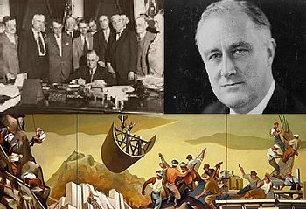
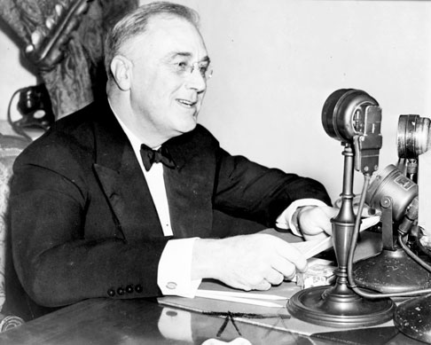
APUSH Review: The New Deal
Everything You Need To Know For Your APUSH Exam

Slide 2
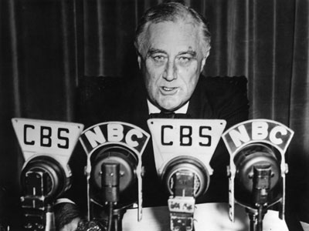
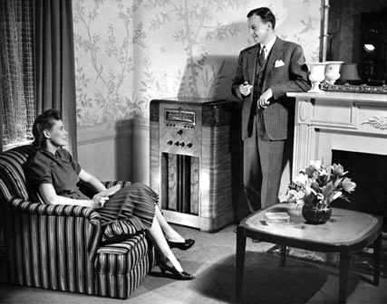
The Banking Problem….
Roughly ¼ banks failed prior to FDR becoming President
Bank Holiday:
Closed banks for several days
Emergency Banking Relief Act (March, 1933):
Allowed President to reopen good banks, monitor transactions
“Fireside Chats”
Radio addresses
Helped restore public faith in banks

Slide 3
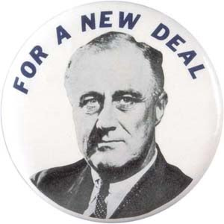
FDR’s 3 R’s
Relief:
Providing jobs, help end suffering
Recovery:
Help improve the economy
Reform:
Change the economy
Prevent another depression from occurring
Permanently change the economy

Slide 4
Two New Deals
1st New Deal (1933 – 1935)
Focused primarily on Relief and Recovery
2nd New Deal (1935 – 1938)
Focused primarily on Reform
Changing the role of government

Slide 5
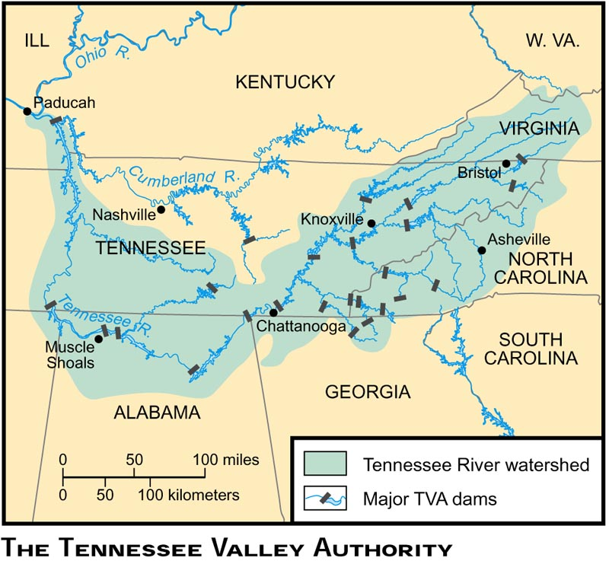
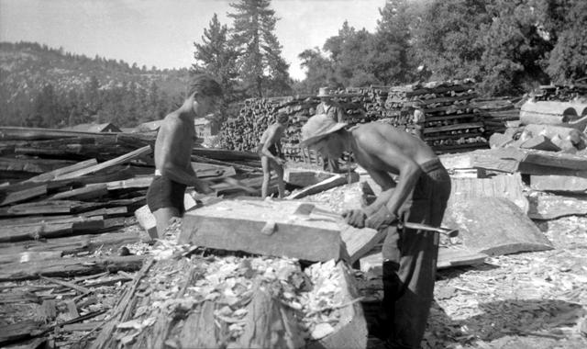
Programs That Put People to Work (Relief)
PWA: Public Works Administration
Provided $4 billion to state govt’s to build schools, roads, improving highways, etc.
CCC: Civilian Conservation Corps
Put young men (18 – 24) to work
Workers sent a portion of income back to families
Environmental work: planting trees, building parks, etc.
TVA: Tennessee Valley Authority
Goal: reform utility power in Tennessee
Building of dams helped provide jobs and hydroelectric power
WPA: Works Progress Administration
Employed 9 million workers
Built roads, bridges, building, etc.
Employed 40% of nation’s employees

Slide 6
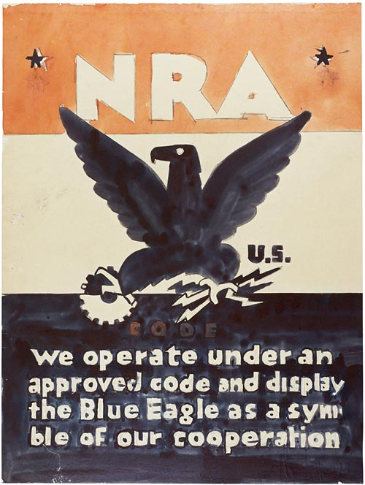
Recovery Programs
AAA: Agricultural Adjustment Act
Sought to remedy overproduction of crops
Paid farmers NOT to grow crops
Supreme Court overturned it in Butler v. US
NIRA: National Industrial Recovery Act
Allowed president to set codes for industries (prices, working hours, etc.)
Section 7a allowed unions to collectively bargain
Declared unconstitutional in Schechter Poultry v. US

Slide 7
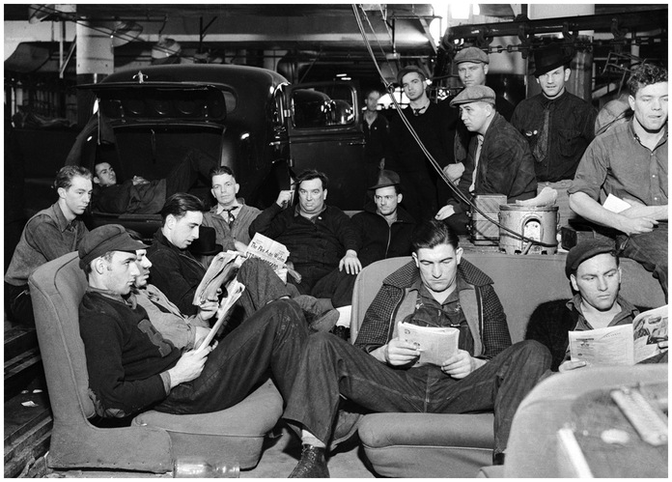
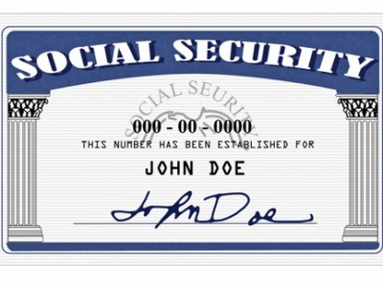
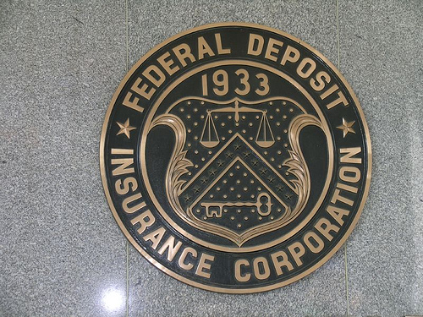
Reform Programs
Social Security:
Provided unemployment insurance
Pensions for retired workers
Wagner Act:
HUGE boost for unions
Allowed unions to collectively bargain
Inspired CIO led by John L. Lewis – sit down strike
FDIC:
Guaranteed bank deposits up to $5,000
Restored faith in banks
SEC:
Sought to protect stock market from fraud

Slide 8
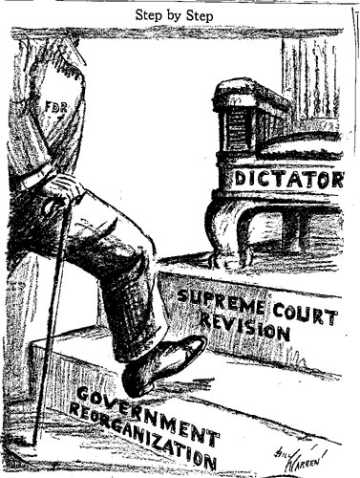
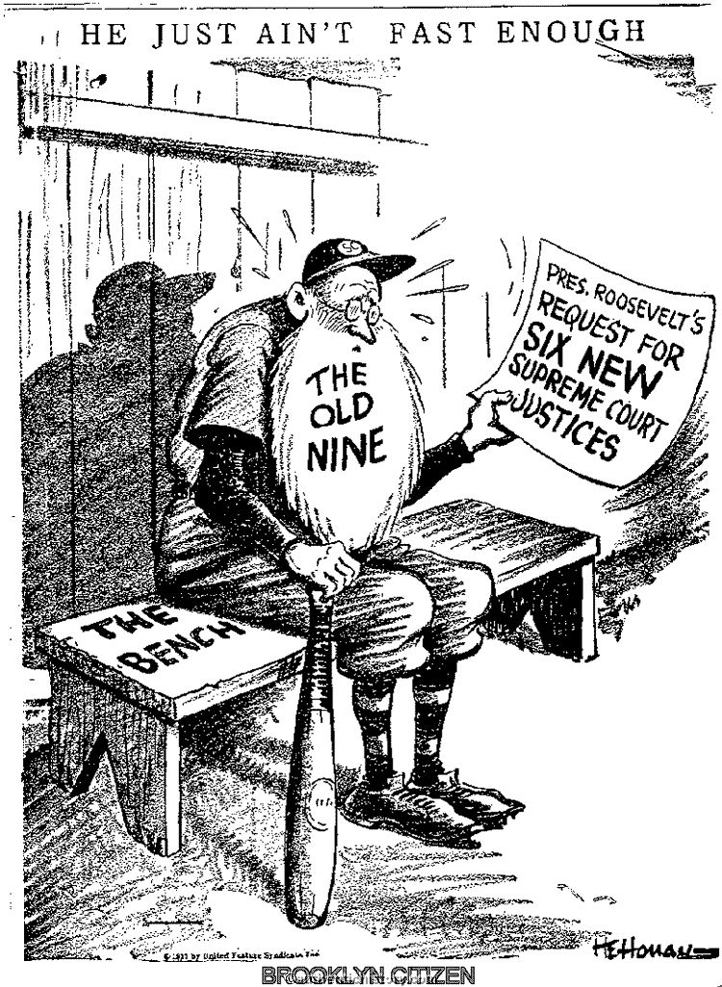
Court Packing Plan
FDR sought to influence the Supreme Court
His plan?
For every judge over 70 that does not retire, he could appoint a new one
This would allow him to appoint up to six new judges
This NEVER happened due to public (and government) outcry
Fear of FDR being a “dictator”

Slide 9
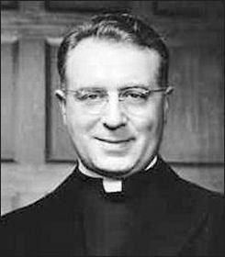
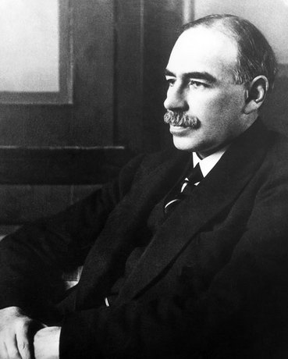
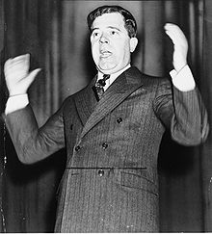
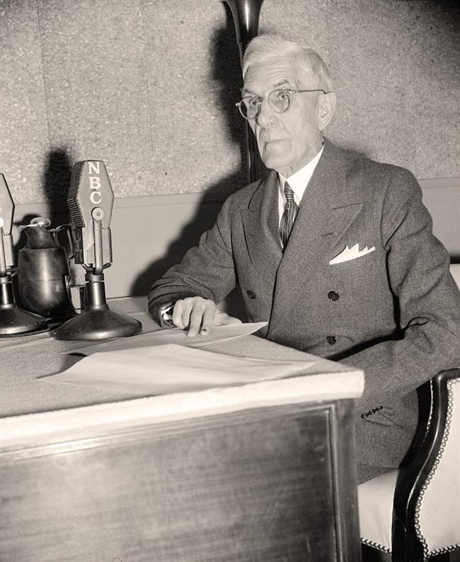
Key People from the 1930s
Huey Long:
Proposed to provide $5,000 to every family by taxing wealthy
Dr. Francis Townsend:
Favored giving $200 per month to senior citizens
Father Charles Coughlin:
New Deal supporter turned critic
Believed FDR should have nationalized banks
John Maynard Keynes:
Economist that influenced FDR
Government should run a deficit to improve economy

Slide 10
Was the New Deal Good or Bad?
Good:
Restored faith and optimism
Provided millions of jobs
Programs still exist today (Social Security, FDIC, etc.)
Bad:
Increased power to the federal government
High unemployment persisted
WWII helped end the depression

Slide 11
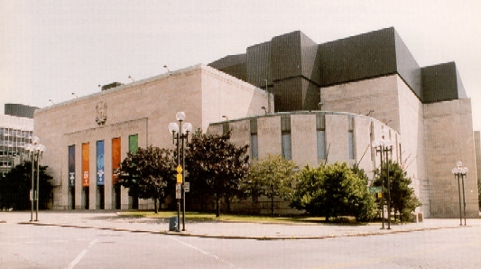
Thanks for watching!
Subscribe to my channel
Help spread the word
Good luck on your tests!
Subscribe
Down here!

