Slide 1
APUSH Review: The Final Exam Review, 2014 Edition Part I
(Hopefully) Everything You Need To Know To Succeed On May 14, 2014
www.Apushreview.com

Slide 2
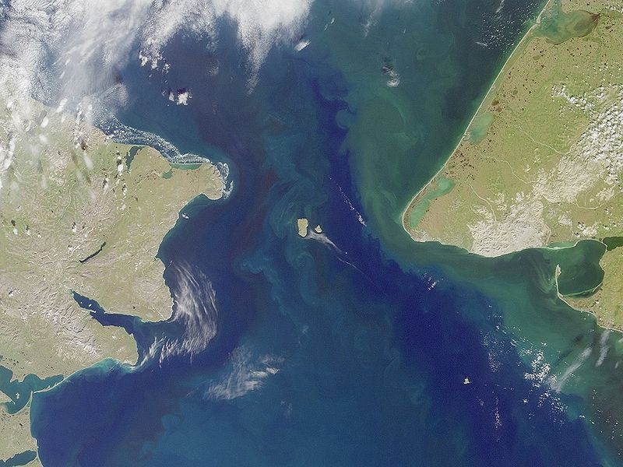
Colonial America through 1776
First people came to the Americas through the Bering Straight from Asia
European colonization
Spanish tended to settle in Central and South America
French settled in New France (Canada, Ohio Valley)
Britain settled on the East coast (13 colonies)
The French had the best relationship with Natives
Colonial Rebellions:
Bacon’s Rebellion (1676) – poor, landless whites rebelled against Governor Berkeley; upset with lack of protection from Native Americans
Led to an increase in slavery
Pueblo Revolt (1680) – Native American revolt against the Spanish in present day New Mexico
Stono Rebellion (1739) – Slaves killed many whites in SC, tried to flee to Spanish Florida

Slide 3
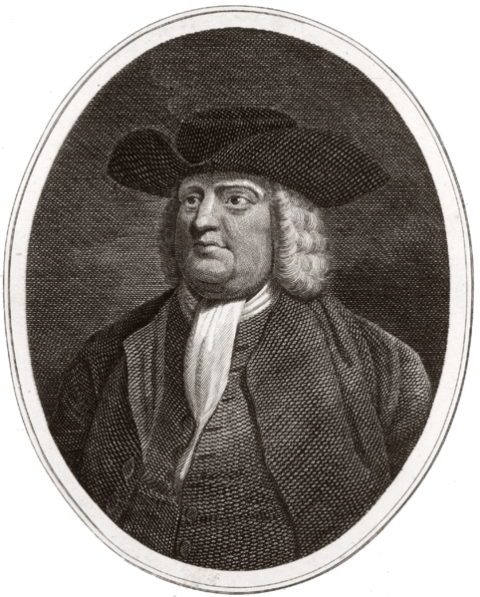
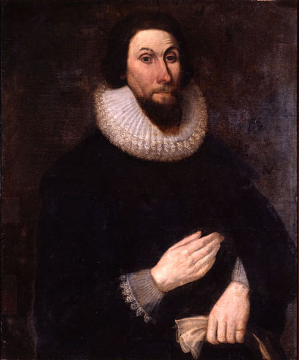
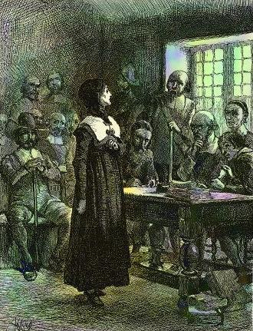
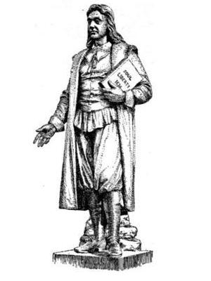
Colonial America through 1776 Continued
British Colonies:
Massachusetts Bay – established to be a model society, “City Upon a Hill” (John Winthrop)
White, land-owning, church members could vote; women had few rights
Were not religiously tolerant – Roger Williams and Anne Hutchinson challenged the clergy
Pennsylvania – founded by William Penn (Quaker)
Characteristics of Quakers:
Pacifists, women had more rights, religiously tolerant
Rhode Island – founded by Roger Williams
Religiously tolerant
VA (Jamestown) – tobacco improved the economy, but exhausted the land, joint stock company
1st Great Awakening:
John Edwards – founder of the G.A., “Sinners in the Hands of an Angry God”
Be able to recognize quotes – “God,” “Hell,” etc.
George Whitefield was a great orator
British Economic Policy:
Mercantilism: purpose of the colonies was to provide wealth for the mother country
Navigation Laws: enforced Mercantilism, colonies could only trade with Britain

Slide 4
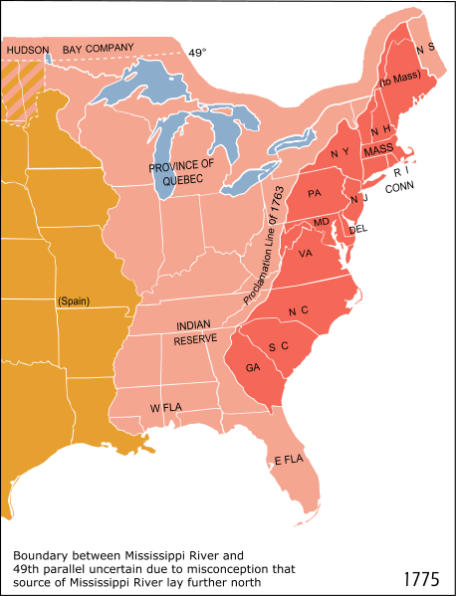
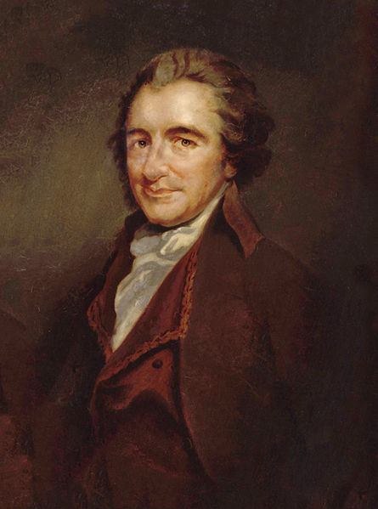
Colonial America through 1776 Continued
French and Indian (7 Years) War:
British and colonists v. French and Native Americans
DRASTICALLY ALTERED THE RELATIONSHIP BETWEEN THE BRITISH AND COLONISTS
1763:
End of F&I War, End of Salutary Neglect, Pontiac’s Rebellions -> Proclamation Line of 1763
Stamp Act:
Raise revenue for the British -> Stamp Act Congress, first attempt at colonial unity AGAINST the British
Declaratory, Townshend, Intolerable, and Tea Acts
“No taxation without representation”
Rejection of Britain’s theory of virtual representation
Common Sense:
Written by Thomas Paine, urged colonists to break away from England
Stated that KG3 was bad
Olive Branch Petition:
Last ditch effort by the colonists at peace; rejected by KG3

Slide 5
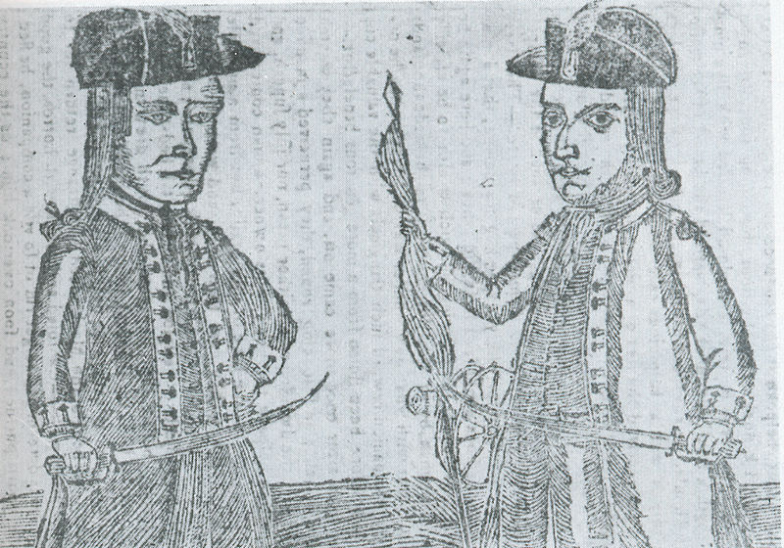
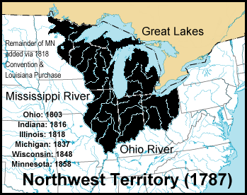
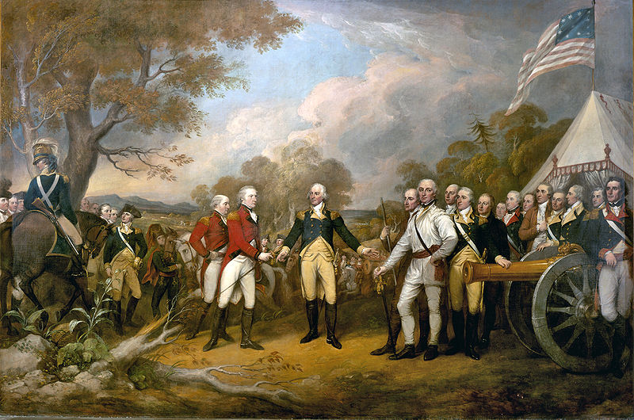
American Revolution Through the Constitution
Battle of Saratoga
Turning point in the war
France provides necessary aid to America
Women during the war:
Helped provide food, money, medicine, etc.
Treaty of Paris of 1783:
Ended the war, US gained all land east of Mississippi
Articles of Confederation:
Weak central government – could not tax, raise army, no executive branch
Shays’ Rebellion:
Massachusetts farmers rebelled -> showed the need for a new, strong government
Northwest Land Ordinance of 1787:
Outlawed slavery
Outlined how territories could become states (60,000 population)

Slide 6
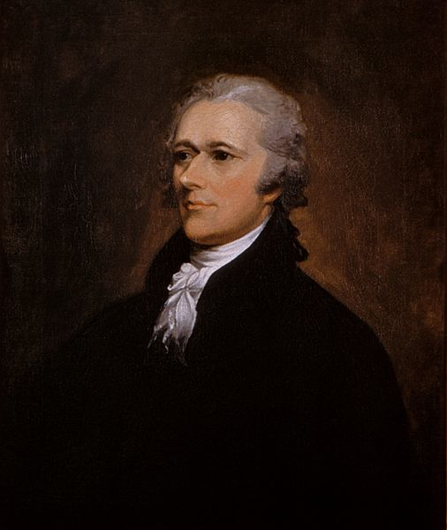
American Revolution Through the Constitution Cont.
Constitutional Convention:
Held in Philadelphia
Constitution Compromises to know:
Great (Connecticut) Compromise
Created a bicameral (2-house) legislature – one house based on population, one house equal representation
Helped settle issues over representation
3/5 Compromise:
3/5 slaves would count towards population for representation in the House
Federalist Papers:
Written by Jay, Hamilton, and Madison to gain support for the ratification of the Constitution
Bill of Rights:
Added to the Constitution to appease the Anti-federalists
Enough states ratify the Constitution

Slide 7
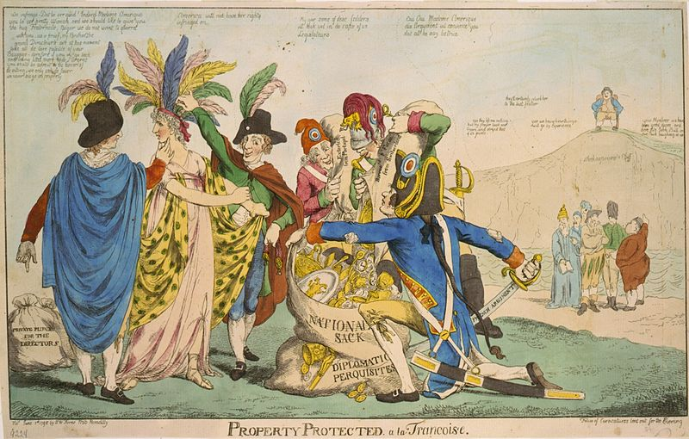
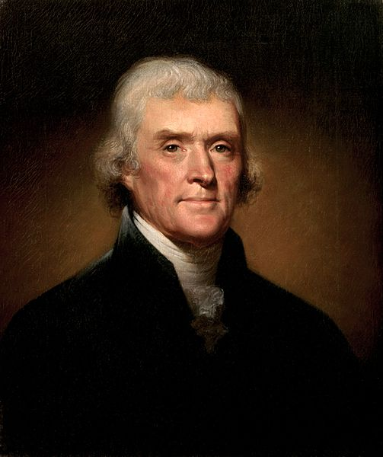
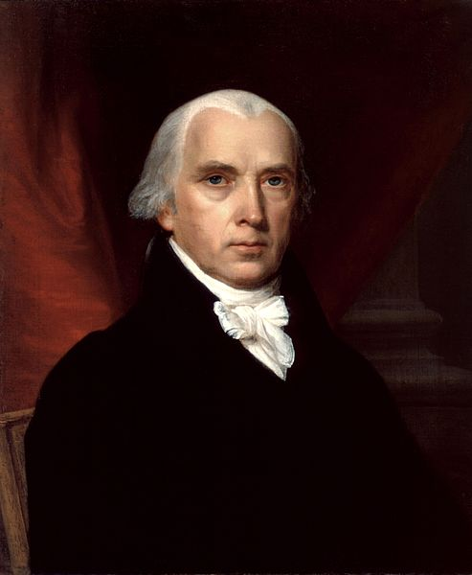
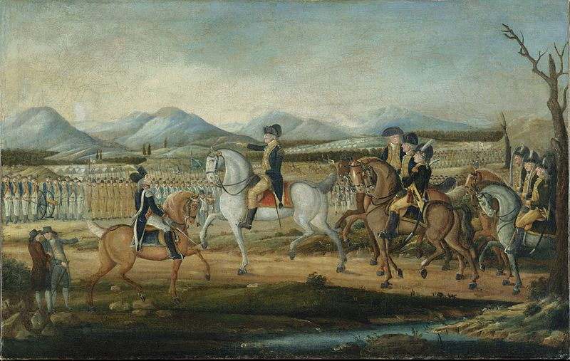
Washington – Adams
Judiciary Act of 1789:
Creates the Supreme Court with 5 associate judges and 1 Chief Justice (John Jay)
Alexander Hamilton’s Financial Plan:
Purpose was to improve the economy (BUS, tariffs, and excise taxes)
Whiskey Rebellion (1791):
PA farmers protested the excise tax from Alexander Hamilton
Washington and the military quickly crushed the rebellion
Demonstrated the power of the new federal government under the Constitution
Washington’s Farewell Address:
Warned against foreign alliances
Helped promote neutrality
XYZ Affair:
3 US diplomats (led by John Marshall) hoped to meet with French minister
They were asked to pay $250,000 to meet with him, US refused
Led to the Quasi War and……
Alien and Sedition Acts:
Purpose?
Federalists wanted to silence their opponents
Many Democratic Republicans supported the French
Alien Act:
Made it more difficult for foreigners to become US citizens (5 to 14 year waiting requirement)
Sedition Act:
Made it illegal to criticize the government (President Adams)
VA and KY Resolutions
KY (written anonymously by Jefferson – VP)
VA (written by Madison)

Slide 8
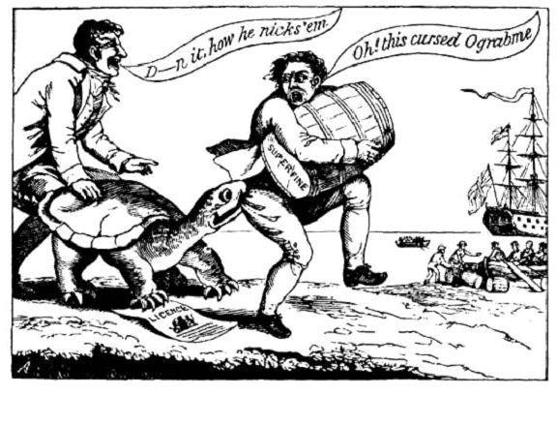
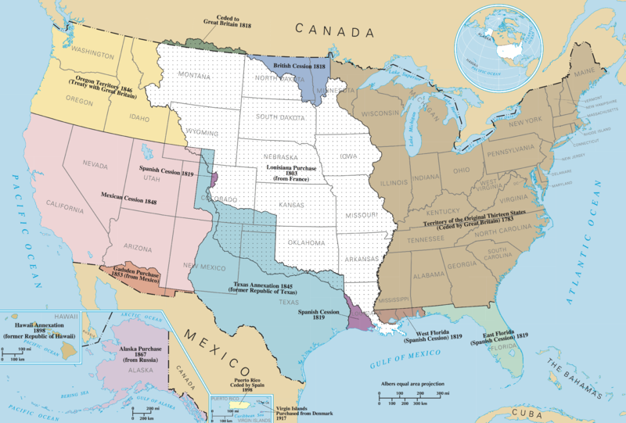
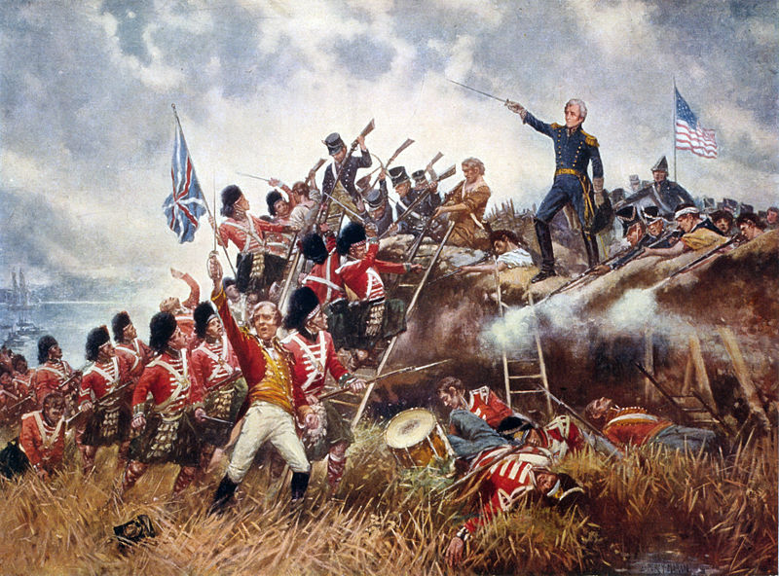
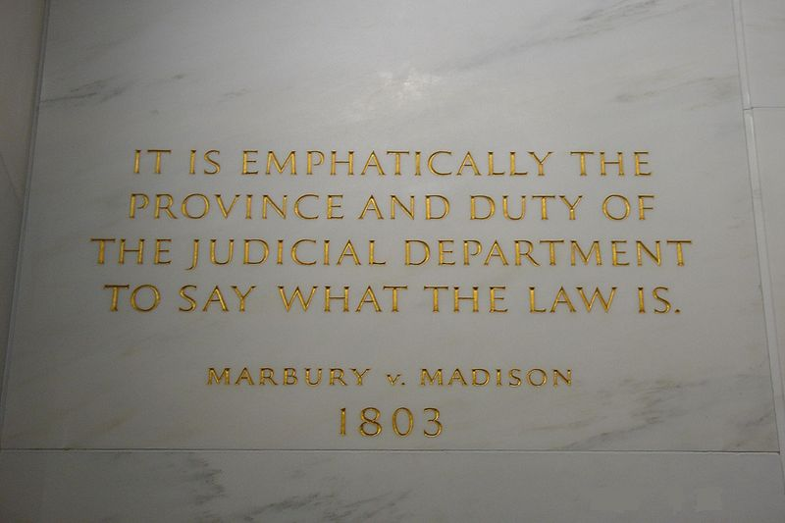
The Jeffersonian Era
The Election of 1800:
Peaceful transition of power from Federalists to Democratic-Republicans
Judiciary Act of 1801:
New judges were created by outgoing Federalist Congress
John Adams appoint many in his last few days “Midnight Judges”
Led to……
Marbury v. Madison (1803):
Supreme Court declared part of the judiciary act of 1789 unconstitutional
First time the Supreme Court declared a law unconstitutional
LA Purchase (1803):
Purchased from France, US wanted New Orleans
Doubled the size of the US, Jefferson switched from a strict to loose interpretation
Embargo Act of 1807:
Cut of all trade between the US and other countries
Huge disaster
Helped start the Industrial Revolution (Jefferson favored an agrarian society)
War of 1812:
Causes: impressment, British arming of Native Americans, war hawks, etc.
US tried to gain Canada
Produced two war heroes:
William Henry Harrison – The Battle of Tippecanoe
Andrew Jackson – The Battle of New Orleans
Helps propel Jackson to the presidency in 1828
Hartford Convention:
Grievance of several Federalists in N.E.; wanted to alter the Constitution -> helped lead to the demise of the Federalist Party

Slide 9
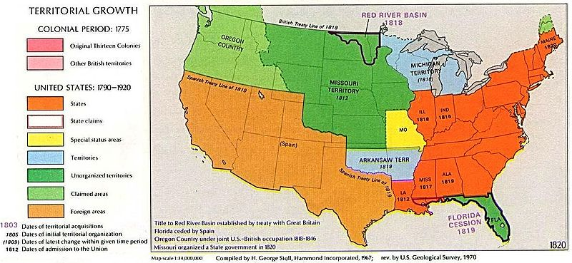
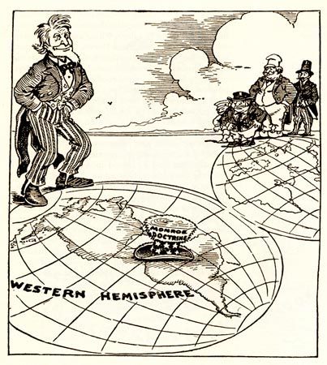
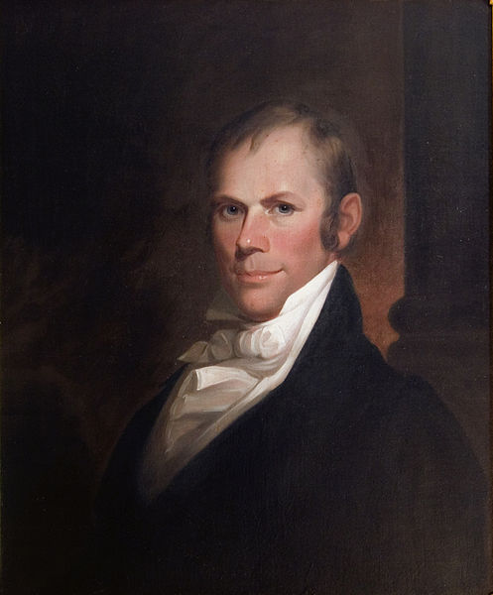
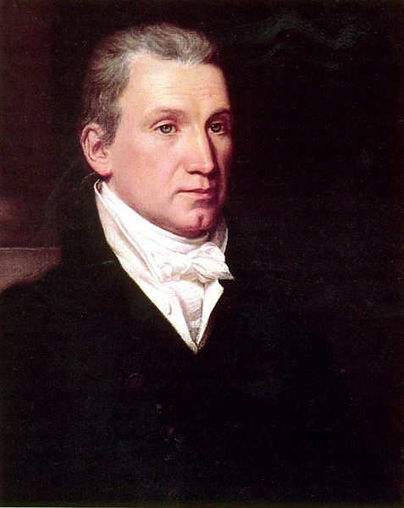
The Era of Good Feelings
During James Monroe’s Presidency
1816 – 1824
Time of 1 political party (Democratic-Republicans)
Increase in nationalism
Henry Clay’s American System:
Favored 2nd BUS, Internal improvements, and a protective tariff (1816)
Missouri Compromise
Missouri applied for statehood, would upset balance of free and slave states
3 part compromise: MO is a slave state, ME is a free state, 36°30’ latitude line: above is free, below is slave
The Monroe Doctrine:
Written by Monroe’s Secretary of State John Quincy Adams
Warned European countries to not recolonize Latin America
In return, the US would stay out of European affairs
Cornerstone of US foreign policy for decades

Slide 10
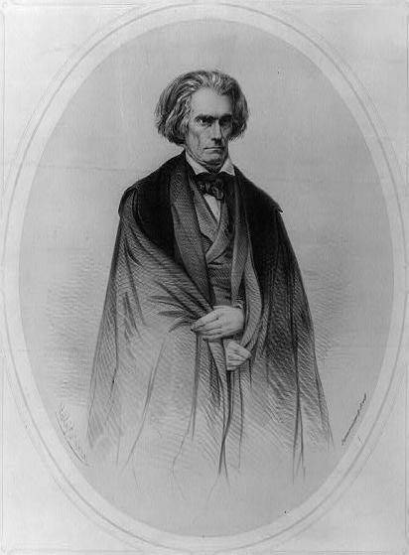
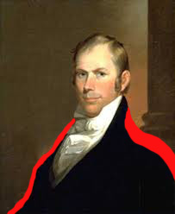
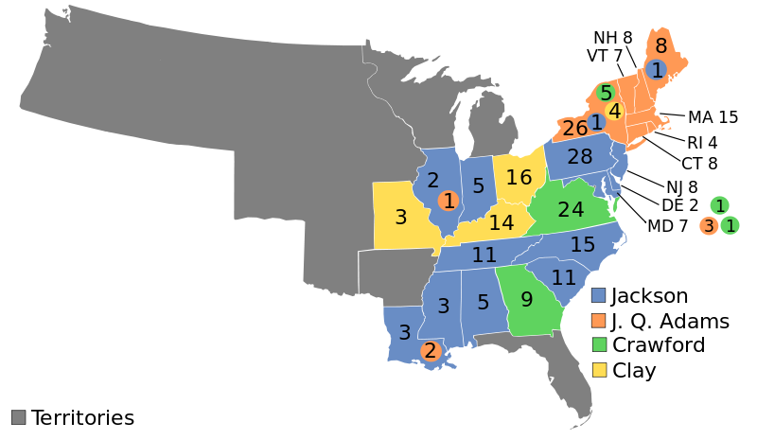
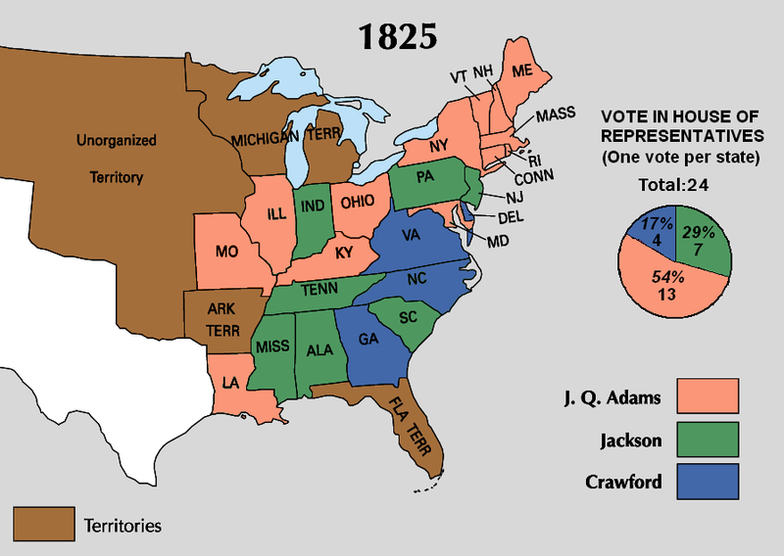
The Jacksonian Era (1824 – 1840)
The “Corrupt Bargain” of 1824
No electoral majority in the election of 1824, although Jackson got the most votes
Vote goes to Congress, Clay throws his support behind
Adams becomes president, names Clay his Secretary of State
“Common Man”
Increased voting rights for adult males, elimination of property requirements to vote
Tariff of Abominations (Tariff of 1828)
High tariff, disliked by the South and West
John C. Calhoun (sitting VP) wrote The South Carolina Exposition and Protest anonymously
Drew inspiration from the Virginia and Kentucky Resolutions
Tariff of 1832:
Lowered the tariff of 1828, but still too high for the South’s liking
Led to the……
Nullification Crisis:
SC called a state convention, nullified the tariff of 1832
Threatened to secede if tariffs were collected by force
Compromise Tariff of 1833:
Henry Clay!
Lowered the tariff rates by 10% per year for 8 years

Slide 11
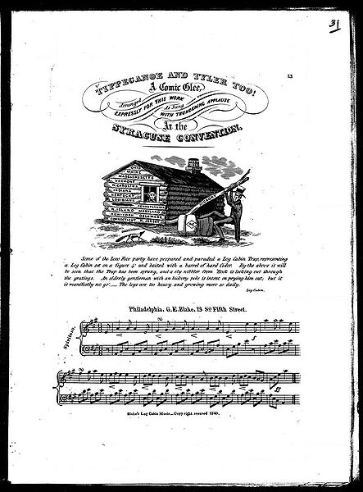
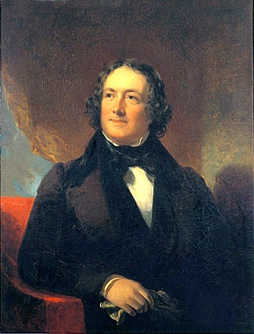
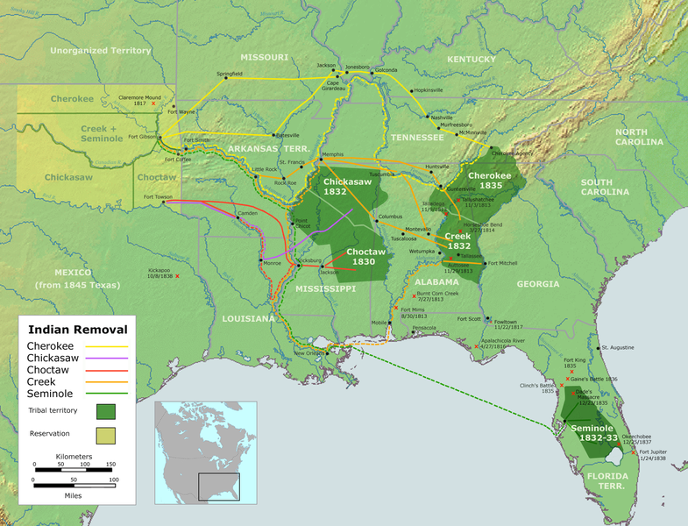
The Jacksonian Era (1824 – 1840)
Jackson and Native Americans
Indian Removal Act – purpose to move Natives west of the Mississippi
Worcester v. Georgia – Supreme Court ruled Natives did NOT have to move
Jackson did not enforce the Supreme Court’s decision
The Bank War:
1832: Clay proposes a 3rd BUS (the 2nd one would expire in 1836)
Jackson vetoed the re-charter
The 2nd BUS still had 4 years
Jackson wanted to destroy the 2nd BUS, so he removed government funds and put them in state “pet” banks
Why did Jackson dislike the BUS?
He felt it benefitted the rich (elite)
Too much power was concentrated in the hands of few people (Biddle)
Texas:
Declared independence during Jackson’s presidency
He did not recognize independence of TX for fear of sectional tensions over slavery
Election of 1840:
William Henry Harrison (War of 1812 hero) v. MVB
Incredibly high voter turnout
Slogans used in the election: “Log cabins and hard cider,” “Tippecanoe and Tyler Too”

Slide 12
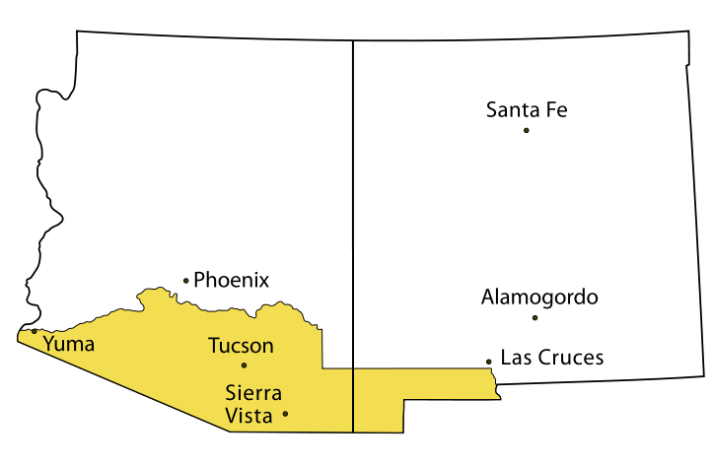
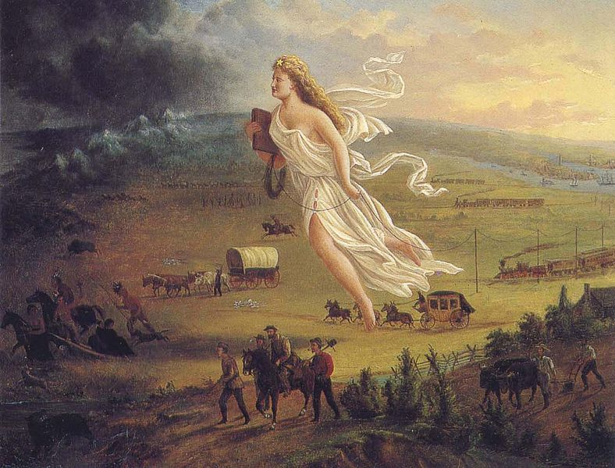
Manifest Destiny (1840s – 1850s
What is it?
Coined by John Sullivan, America’s God-given right to expand from coast to coast
Mexican-American War:
Polk claimed Americans were attacked on American soil
Thoreau: On Civil Disobedience – refused to pay a poll tax he believed would fund the war
Wilmot Proviso: proposal in Congress to ban slavery from ALL territory gained from Mexican Cession; never passed (failed in the Senate, passed in the House)
Treaty of Guadalupe Hidalgo:
Ended the war; US gained the Mexican Cession, increased size by 1/3
Compromise of 1850:
Helped settle dispute over the land gained from the war
Popular sovereignty in the Mexican Cession
Tough fugitive slave law – turned many in the North to the abolitionist cause
Abolished the slave trade in D.C.
California was admitted as a free state (balance in favor of free states)
Texas was paid $ to settle a boundary dispute
Gadsden Purchase:
US continental expansion is complete
Watch JIMMY FALLON!

Slide 13
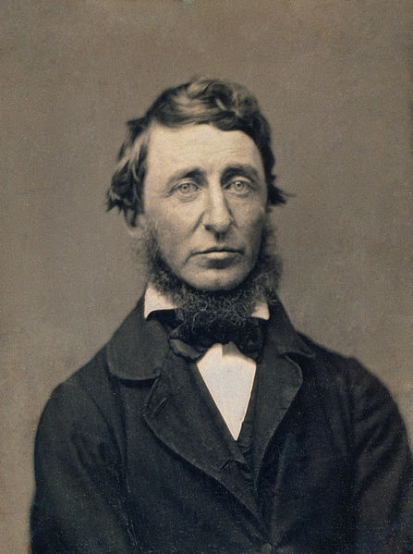
Antebellum Reform Movements
2nd Great Awakening:
“Burned-over district” of WNY – many religious conversions
Belief in perfectionism sought many to reform society
Key reform movements:
Abolitionist Movement: abolish slavery
Temperance – sought to eliminate alcohol
Women’s rights – Seneca Falls Convention
Education – Horace Mann
Treatment for mentally ill – Dorothea Dix
Notable Religions:
Mormons – fled to Utah
Shakers – Mother Ann Lee
Transcendentalism:
Movement to find one’s “inner self”
Henry David Thoreau – Walden – lived in isolation for two years
Ralph Waldo Emerson – Self Reliance
Women played a large role

Slide 14
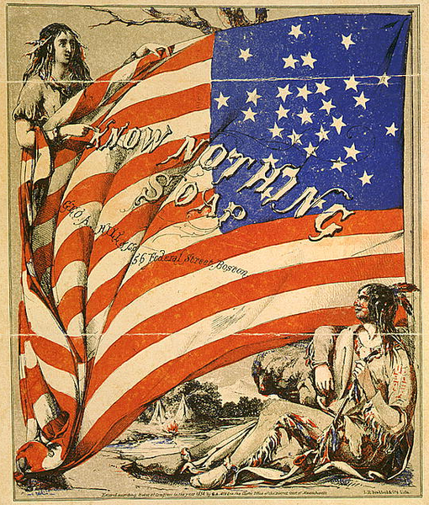
“Old” Immigration
Nativism:
What is it?
Fear, distrust, and hatred of foreigners
Reasons for nativism:
Different cultures, Different languages, Religion
Irish and Germans “stole” elections
Tended to vote Democratic, Tammany Hall – NYC
Immigrants “took” jobs
Work for less money, would not unionize
Know – Nothing Party
What is it?
Political party formed due to nativism
Originated as the Supreme Order of the Star-Spangled Banner
Wanted to ban Catholics from holding offices
Called for tougher immigration and naturalization laws
“Old” Immigration
What is it?
Immigrants that came from Northern and Western Europe
Specific countries?
Ireland (Potato Famine!), Germany, England
When did it occur?
1820s – 1870s
What group made up the largest prior to the Civil War?
Irish

Slide 15
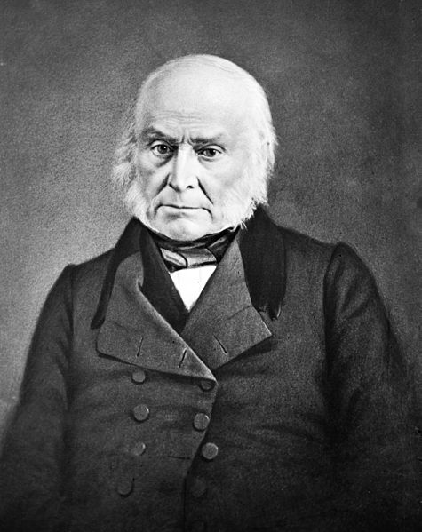
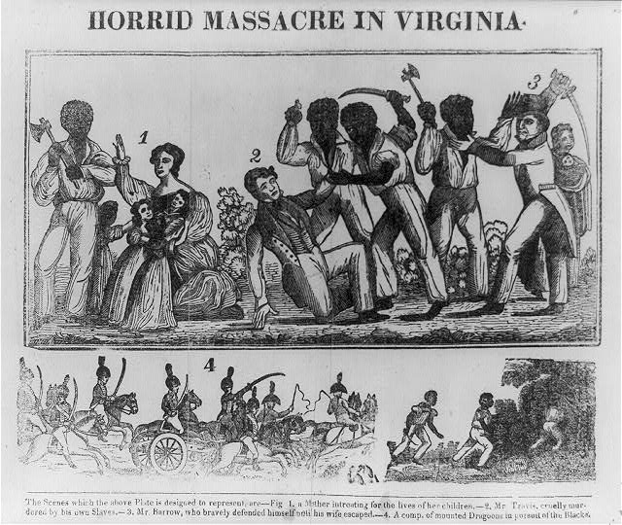
Slavery
Slave Life:
Long hours, arduous work
The further South, the more slaves and harder the work
Slave Codes:
Laws to regulate slave life – couldn’t read/write
A unique culture developed
Combination of African and American cultures; religion; extended families
Rebellions To Know:
Denmark Vesey:
Planned the largest ever revolt, did not occur
Nat Turner: (VA)
60 whites and 100 blacks were killed
Coincided with Garrison’s Liberator
Helped silence abolitionist movement in VA, more strict laws
Although rebellions did happen, the most common form of resistance was running away, faking sickness, working slowly, and/or breaking tools
Gag Resolution:
Prohibited anti-slavery petitions in the House of Representative
Eventually overturned with the help of John Quincy Adams

Slide 16
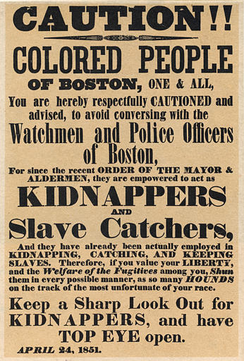
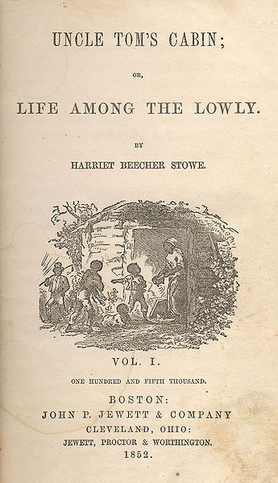
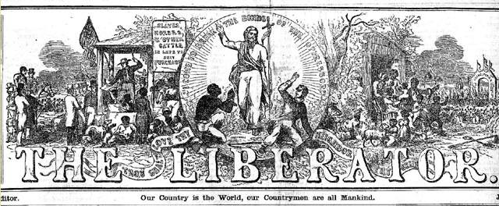
Slavery Continued
Fugitive Slave Law (1850)
Part of the Compromise of 1850
Much tougher law
Many in the North joined the abolitionist movement
Many states passed Personal Liberty Laws
Essentially, it’s nullification
Abolitionist Writings:
The Liberator
Uncle Tom’s Cabin
Abolitionists you must know:
American Colonization Society
William Lloyd Garrison – The Liberator
Frederick Douglass – The North Star
Harriet Beecher Stowe – Uncle Tom’s Cabin
Harriet Tubman – Underground Railroad
John Brown – Harpers Ferry
Free – Soil Party:
Against the spread of slavery into western territories
George Fitzhugh:
Argued that northern workers were worse off than slaves

Slide 17
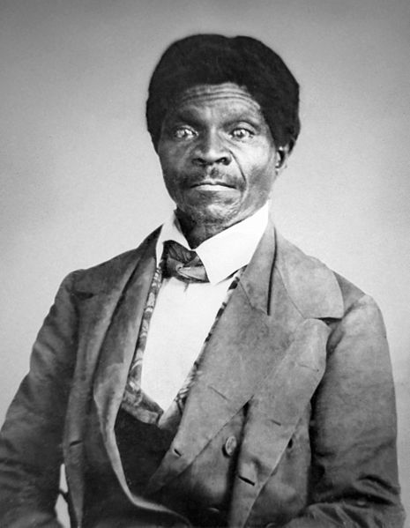
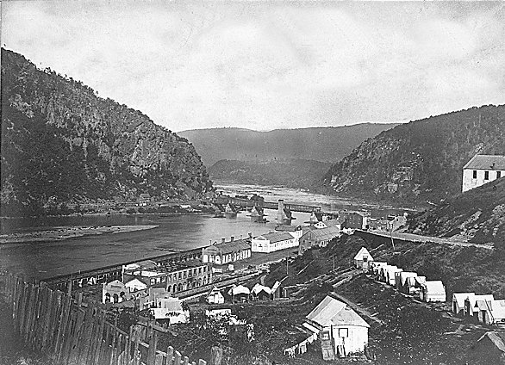
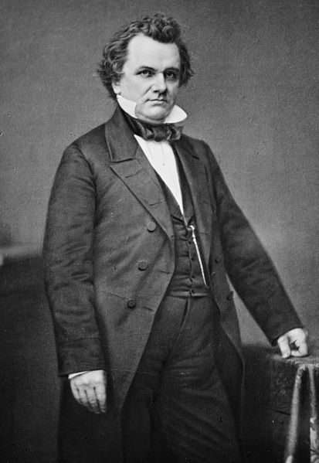
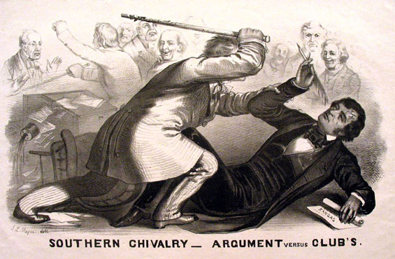
The Road to the Civil War
Kansas – Nebraska Act (1854):
Stephen Douglas proposed allowing popular sovereignty in Kansas and Nebraska
Problem? Both were above the 36°30’ Missouri Compromise Line
KS-NB overturned the MO Compromise
Voting in Kansas (expectation was that it would join as a slave state) turned bloody
Caning of Charles Sumner
Helped inspire the Republican Party
Their platform would be to stop the spread of slavery
Dred Scott v. Sanford (1857):
Supreme Court declared African Americans were NOT citizens
Slavery is constitutional
Congress had no right to legislate slavery
Northerners were upset, Democratic Party splits along sectional lines
Harpers Ferry:
Planned uprising led by John Brown; failure
Many Southerners believed there would be more “John Browns”
Associated the Republican Party with John Brown

Slide 18
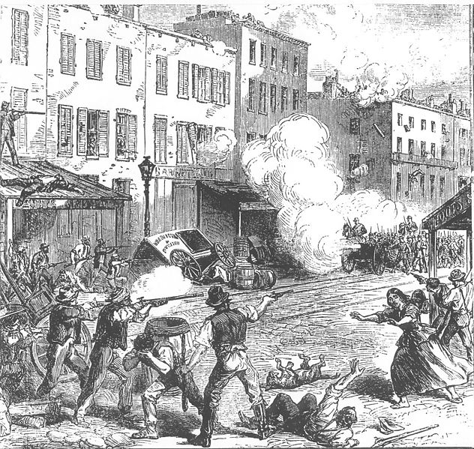
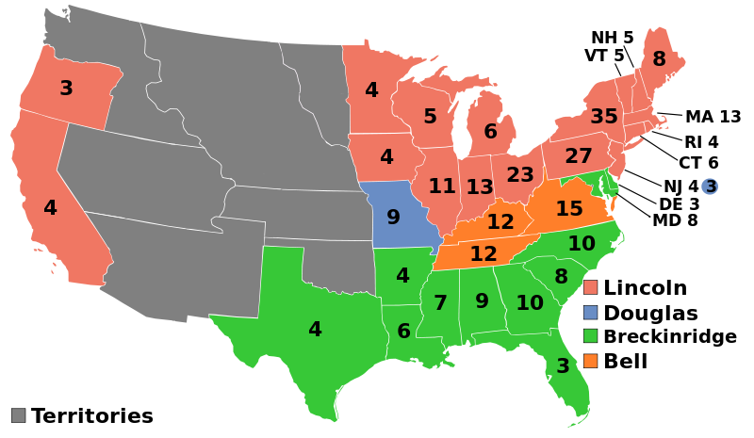
The Civil War
Election of 1860:
Lincoln wins the election
Immediate cause of the Civil War
Lincoln campaigned on the NONEXTENSION OF SLAVERY, NOT TO ELIMINATE SLAVERY
The War:
Conscription:
Draft (forced enlistment)
Substitutes could be hired for people that were drafted
NYC Draft Riots (1863) “Rich man’s war, poor man’s fight”
100s of people were killed
Contraband:
Escaped slaves that crossed over into the Union
Worked at camps and fought in the war
Border states?
Slave states that did NOT secede during the Civil War
Many fought on BEHALF of the Union.
Battle of Antietam:
North won, led Lincoln to issue the Emancipation Proclamation; kept Europe out of war
Habeas Corpus:
Cannot be held in jail without having charges brought against you
Lincoln suspended Habeas Corpus
Only Congress can suspend

Slide 19
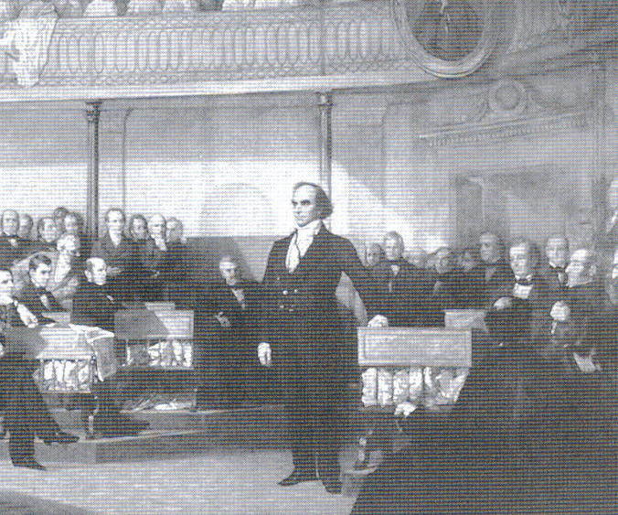
Miscellaneous Pre-Civil War Stuff
Key ideas for women:
Republican Motherhood: (Post Rev. War)
Belief that women should raise children to be good citizens
Cult of Domesticity:
Women had “separate spheres” than men
Helped reinforce different roles for men and women
Hudson River School:
Painted landscapes/environment
John Marshall and the Supreme Court:
Tended to favor the federal government over states and promote business
Daniel Webster’s Second Reply to Hayne:
Debate in Congress over sectionalism, Webster promoted national unity

Slide 20
Thanks for watching!
Subscribe to my channel
Help spread the word
Questions? Comments? Ideas for videos?
Leave in comments
Good luck in May!
Subscribe
Down here!

