Slide 1
APUSH Review: Key Concept 1.1
www.Apushreview.com
Period 1: 1491 - 1607
Everything You Need To Know About Key Concept 1.1 To Succeed In APUSH

Slide 2
The New Curriculum
Key Concept 1.1 “Before the arrival of Europeans, native populations in North America developed a wide variety of social, political, and economic structures based in part on interactions with the environment and each other.”
Page 23 of the Curriculum Framework
Big idea:
How did natives adapt to their environment?

Slide 3
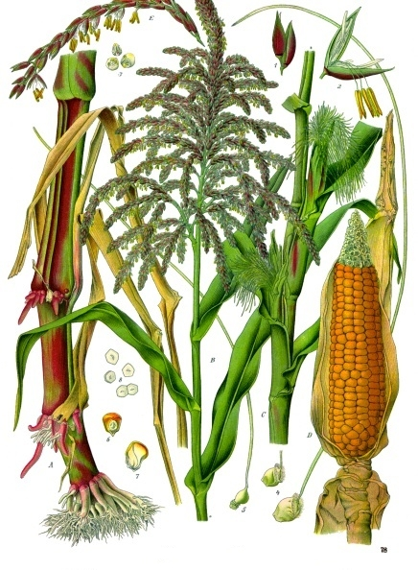
Maize (Corn)
Around A.D. 1000, maize agriculture began to spread from Central America through North America
Maize was especially popular in the southwest
Societies developed vast irrigation systems (Pueblos in Rio Grande)
Maize cultivation transformed societies
Less emphasis on hunting and gathering
Led to an increase in population
Villages were built around maize fields

Slide 4
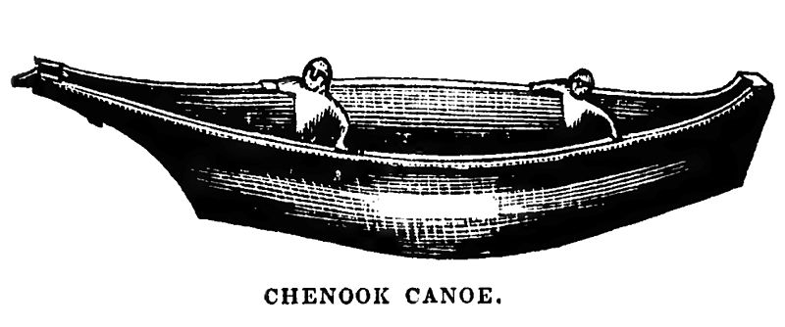
Northwest And Present-Day California
Roughly 300,000 natives lived in California prior to the arrival of Europeans
Most of these societies were based on hunting, gathering, and foraging
Gather nuts, fish, and hunted
Societies tended to be ruled by wealthy families
Chinooks
Advocated warrior traditions
Used advanced fighting techniques
Lived in longhouses which could house many families

Slide 5
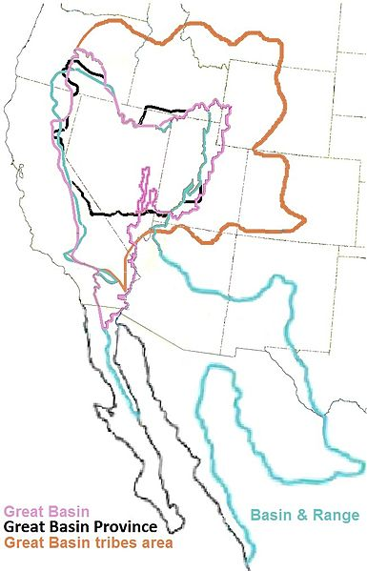
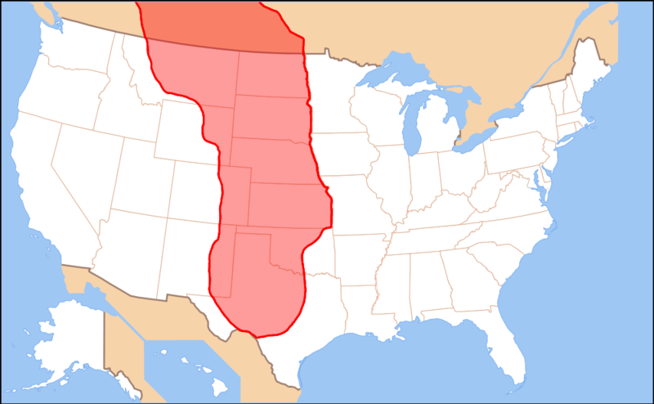
Great Plains and Great Basin
Most natives lived off of hunting and gathering
Lack of natural resources
Large, flat area
With the introduction of the horse, life on the Great Plains was drastically altered
Bison hunting became much easier
Natives with horses became stronger militarily
Natives in the Great Basin hunted bison and sheep
Like natives on the Great Plains, horses helped natives become more powerful

Slide 6
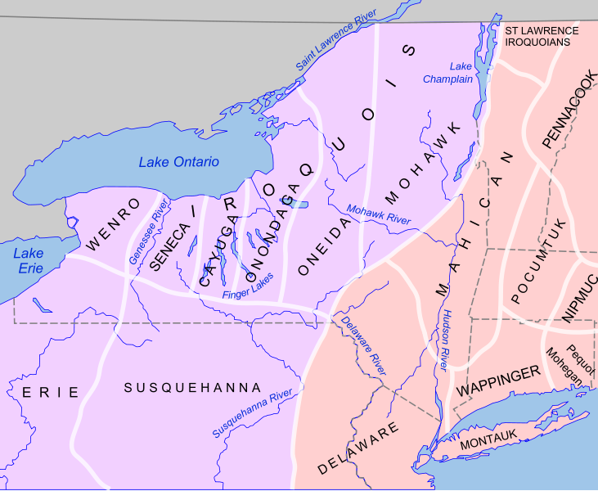
Northeast and Atlantic Seaboard
Many societies were a mix of hunting and gathering, and agriculture and developed permanent villages
Iroquois (Present day NY and PA):
Adapted to their environment:
Burned forests to hunt and grow crops
Villages were built around maize
Iroquois were a matriarchal society:
Power was based on female authority
Women were instrumental in councils and decision-making
Women would tend to crops and oversaw community affairs while men hunted

Slide 7
Test Tips
Multiple-Choice Questions:
Map of different areas of North America: How did natives adapt to their environment?
Short Answer:
Map of different areas of North America: How did natives adapt to their environment?
Essay Questions:
Not likely since it is from period 1

Slide 8
Thanks for watching!
Subscribe to my channel
Help spread the word
Questions? Comments? Ideas for videos?
Leave in comments
Subscribe
Down here!

