Slide 1
APUSH Review: Key Concept 1.3
www.Apushreview.com
Period 1: 1491 - 1607
Everything You Need To Know About Key Concept 1.3 To Succeed In APUSH

Slide 2
The New Curriculum
Key Concept 1.3 “Contact among American Indians, Africans, and Europeans challenged the worldviews of each group.”
Page 25 of the Curriculum Framework
Big idea:
How did Europeans view the Natives and justify their treatment of them?
How did Africans adapt to life in the Western Hemisphere while still preserving their own cultures?

Slide 3
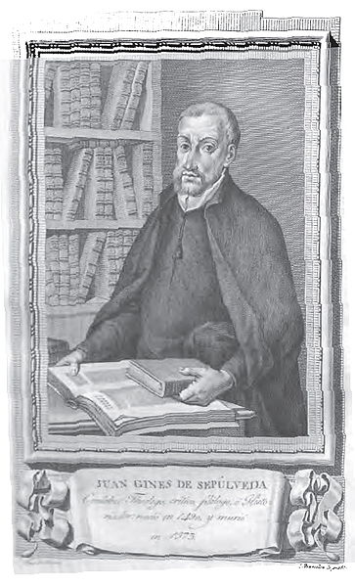
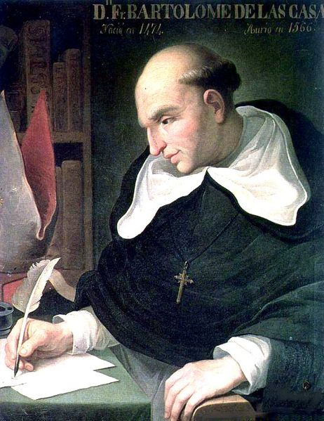
European Views of Natives and Africans
Key Concept 1.3, I “European overseas expansion and sustained contacts with Africans and American Indians dramatically altered European views of social, political, and economic relationships among and between white and nonwhite peoples.”
Page 25 of the Curriculum Framework
Many Spanish and Portuguese did not understand Natives and their cultures
Natives were viewed as “Savages” by many Europeans
Juan de Sepulveda:
Advocated harsh treatment of Natives
Claimed slavery for Natives was justified under Christianity
Bartolome de Las Casas:
Argued that Natives deserved the same treatment as all other men
Played an instrumental role in the ending of the encomienda system
Europeans began to develop a belief in white superiority to justify the treatment of Africans and Natives

Slide 4
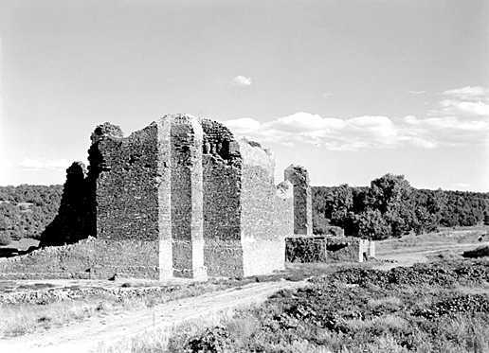
Views of Natives and Africans
Key Concept 1.3, II “Native peoples and Africans in the Americas strove to maintain their political and cultural autonomy in the face of European challenges to their independence and core beliefs”
Page 25 of the Curriculum Framework
The Spanish often tried to convert Natives to Christianity
Spanish Mission System:
Outposts throughout the Americas to help convert Natives
Outposts were often military bases as well
Don Juan de Onate defeated the Pueblos
Spanish established Santa Fe in 1610
Spanish priests and government suppressed Native practices that were inconsistent with Christianity
Spanish demanded tribute and labor from Natives
Many Africans preserved their culture and autonomy in the New World
Maroon Communities:
Consisted of runaway slaves, many were located in the Caribbean
Many Africans would combine elements of Christianity with their native African religions and customs

Slide 5
Test Tips
Multiple-Choice and Short Answer Questions:
Excerpt from a Spanish official about Natives: How were they viewed?
Comparing/Contrasting Spanish and Portuguese colonization
Similarities in Native and African resistance
Essay Questions:
Not likely since it is from period 1
Comparing European colonization

Slide 6
Thanks for watching!
Subscribe to my channel
Help spread the word
Questions? Comments? Ideas for videos?
Leave in comments
Subscribe
Down here!

