Slide 1
APUSH Review: Key Concept 2.1
www.Apushreview.com
Period 2: 1607 - 1754
Everything You Need To Know About Key Concept 2.1 To Succeed In APUSH

Slide 2
The New Curriculum
Key Concept 2.1 “Differences in imperial goals, cultures, and the North American environments that different empires confronted led Europeans to develop diverse patterns of colonization.”
Page 27 of the Curriculum Framework
Big ideas:
What were similarities in colonization among the Spanish, French, Dutch, and English?
What were the experiences like with Native Americans with these European countries?
How and why did slavery evolve in these colonies?
How did climate and geography affect British colonies?

Slide 3
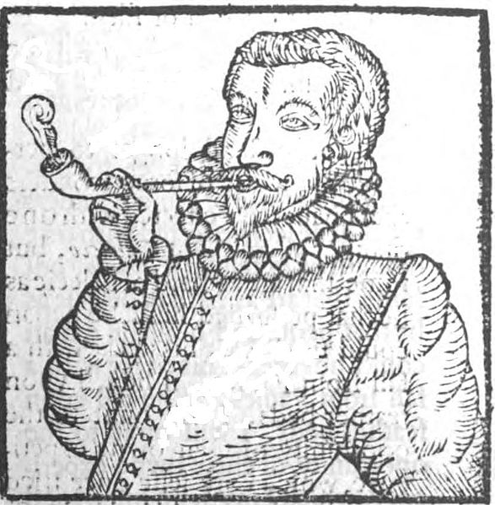
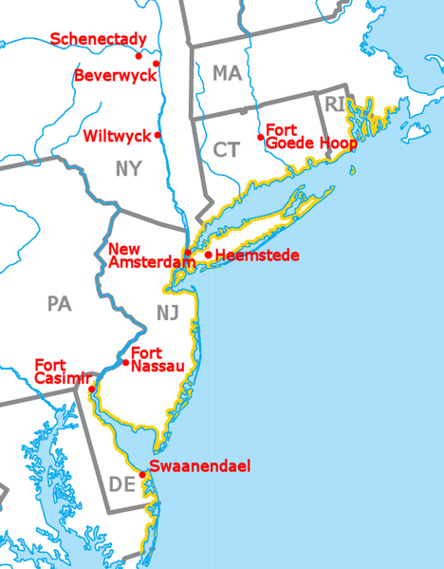
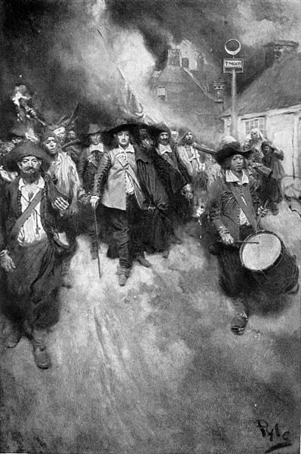
Key Concept 2.1, I
“Seventeenth-century Spanish, French, Dutch, and British colonizers embraced different social and economic goals, cultural assumptions, and folkways, resulting in varied models of colonization.” - Page 27 of the Curriculum Framework
Spain established strict control over colonization and converted and exploited many natives
A major goal of Spain was to make $
All trade must go through a few Spanish controlled ports
Small amount of Spaniards ruled indigenous population
Spain sought to convert natives to Christianity, forced many into the encomienda system, and used as trading partners
French and Dutch colonization:
French – intermarried with natives and built extensive trading partnerships
Coureurs de bois – French fur traders – trade beaver furs; would live among natives; helped lead to an alliance with the Algonquin Indians
Dutch – Like the French, the Dutch build extensive trade routes – mostly in NY
Encouraged settlement of the New World – New Netherland
English Colonization:
Colonies were based on agriculture, large number of immigrants, hostile relations with Natives
Tobacco became a large cash crop
Headright system encouraged immigrants – benefitted the wealthy
Conflicts with natives – Powhatans, Bacon’s Rebellion, Pequot War, King Philip’s War

Slide 4
Key Concept 2.1, II
“The British-American system of slavery developed out of the economic, demographic, and geographic characteristics of the British-controlled regions of the New World.” - Page 27 of the Curriculum Framework
English colonies encouraged immigration of men, women, and families and rarely intermarried with natives and/or Africans
Headright system encouraged more immigrants since landowners would receive additional land
Natives were often seen as “savages”
Helped lead to racial hierarchy
Why was there an emergence of the Atlantic slave trade:
Abundance of land – labor was needed for agriculture; Shortage of indentured servants – especially after Bacon’s rebellion in 1676
Hard to enslave natives – knew the land, were not immune to European diseases (many Africans were); increased demand for colonial goods required more labor

Slide 5
Key Concept 2.1, II Continued
Slavery in British colonies:
Based on a belief of racial superiority; children of slaves became slaves as well
Families could be broken up at any time; slaves relied on kinship networks and “surrogate relatives”
Slave resistance:
Most likely resistance was covert – working slowly, faking illness, running away, breaking tools, etc.
Sometimes rebellion did occur – Stono Rebellion (1739 – South Carolina)
100 Africans killed several whites and tried to flee to Spanish Florida
Most were executed, more harsh laws were passed

Slide 6
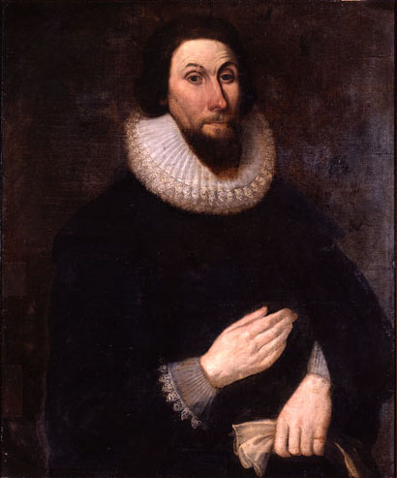
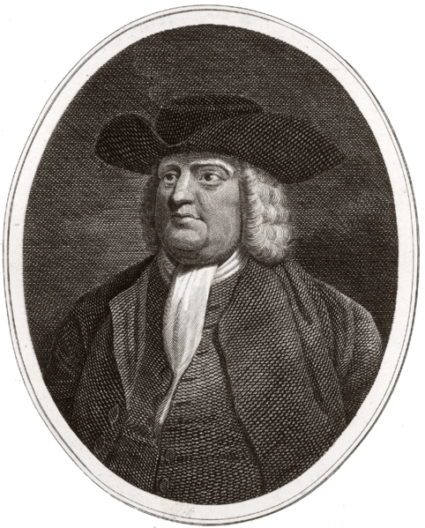
Key Concept 2.1, III
“Along with other factors, environmental and geographical variations, including climate and natural resources, contributed to regional differences in what would become the British colonies.” - Page 28 of the Curriculum Framework
Most of New England was based on Puritan beliefs:
Wanted to purify the Anglican Church, not separate
Believed in predestination
John Winthrop’s “City upon a Hill”
Little religious toleration for others
Town-hall meetings – church members had tremendous power
New England economy:
Some agriculture, fishing, commerce – Boston becomes a major port city
Colder climate, rocky terrain did not allow large plantations
Middle Colonies:
Tended to be the most diverse demographically, religiously, and ethnically
Quakers in Pennsylvania (William Penn) – religiously tolerant
Women in Pennsylvania had more rights – Quakers allowed women equal positions in church
Immigrants from Germany

Slide 7
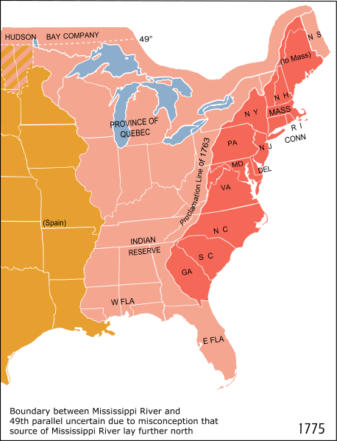
Key Concept 2.1, III Continued
Chesapeake colonies (MD and VA) and North Carolina:
Heavily relied on tobacco – plantations developed – long work days and growing seasons
Exhausted land – led to expansion and conflicts with natives (Bacon’s again!)
Up to the late 17th century, most labor was made up of indentured servants
After Bacon’s Rebellion (1676), there was a switch to African slavery
Southern colonies and West Indies:
In South Carolina and Georgia, rice was a major staple crop
Very arduous labor – long days and long growing season
Many white laborers refused to work in rice fields – led to an increase in slave labor
In the West Indies (Barbados) sugar cultivation was a major part of the economy
Like South Carolina and Georgia, slave labor was heavily used
In many instances, slaves made up a significant (if not majority) part of the population
Led to the development of slave codes – laws to regulate slave behavior
Gave incredible power to slave owners

Slide 8
Test Tips
Multiple-Choice Questions:
Goals of European colonization
Differences between British and other colonies
Impact of religion in British colonies (Puritans)
Short Answer:
Comparing British colonies (geography, religion, economy)
Essay Questions:
Reasons for the development of slavery

Slide 9
Thanks for watching!
Subscribe to my channel
Help spread the word
Questions? Comments? Ideas for videos?
Leave in comments
We shall be a City Upon a Hill that subscribes to Adam Norris!
Subscribe
Down here!

