Slide 1
APUSH Review: Key Concept 2.2
www.Apushreview.com
Period 2: 1607- 1754
Everything You Need To Know About Key Concept 2.2 To Succeed In APUSH
Download this PowerPoint by following the link in the description!

Slide 2
The New Curriculum
Key Concept 2.2 “European colonization efforts in North America stimulated intercultural contact and intensified conflict between the various groups of colonizers and native peoples.”
Page 29 of the Curriculum Framework
Big ideas:
How and why did Europeans begin to compete with each other in North America?
How did the conflicts lead to social and political changes between Europeans and natives?

Slide 3
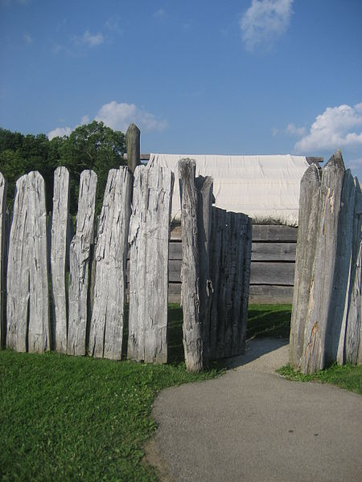
Key Concept 2.2, I
“Competition over resources between European rivals led to conflict within and between North American colonial possessions and American Indians.” - Page 29 of the Curriculum Framework
Conflicts among Europeans spread to North America and affected Natives:
French and English conflicts – Fort Necessity (George Washington)
British were able to offer more goods to natives, whereas the French were more tolerant of natives (and intermarried with natives)
During the French and Indian (7 Years) War, almost all natives were allied with the French – not the Iroquois

Slide 4
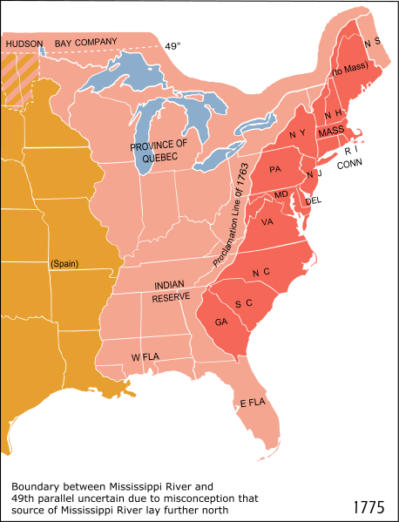
Key Concept 2.2, I Cont.
Each European nation sought to acquire valuables and new labor:
English focused on tobacco; used indentured servants -> slaves
French focused on furs in Ohio value; traded with natives
European and colonial interests often varied:
Colonists wanted to expand (especially post 7 Years War); Britain forbade it
Britain passed acts to raise $ - Molasses Act; many colonists smuggled
Would become a major point of contention between 1763 and 1776

Slide 5
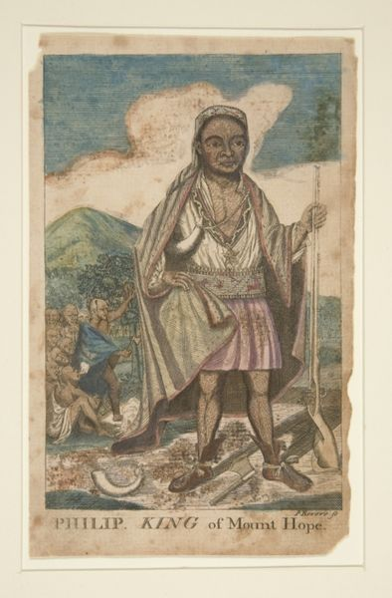
Key Concept 2.2, II
“Clashes between European and American Indian social and economic values caused changes in both cultures.” - Page 29 of the Curriculum Framework
Contact with Europeans increased trade, diseases, and drastically changed native life:
As time passed, Europeans increasingly encroached on native land
In 1600, there was 100,000 natives in New England, 10,000 by 1675 – disease and dispersion
King Philip’s War – war between natives and English in Wampanoags (King Philip – Metacomet)
Native were rarely a threat in New England after war

Slide 6
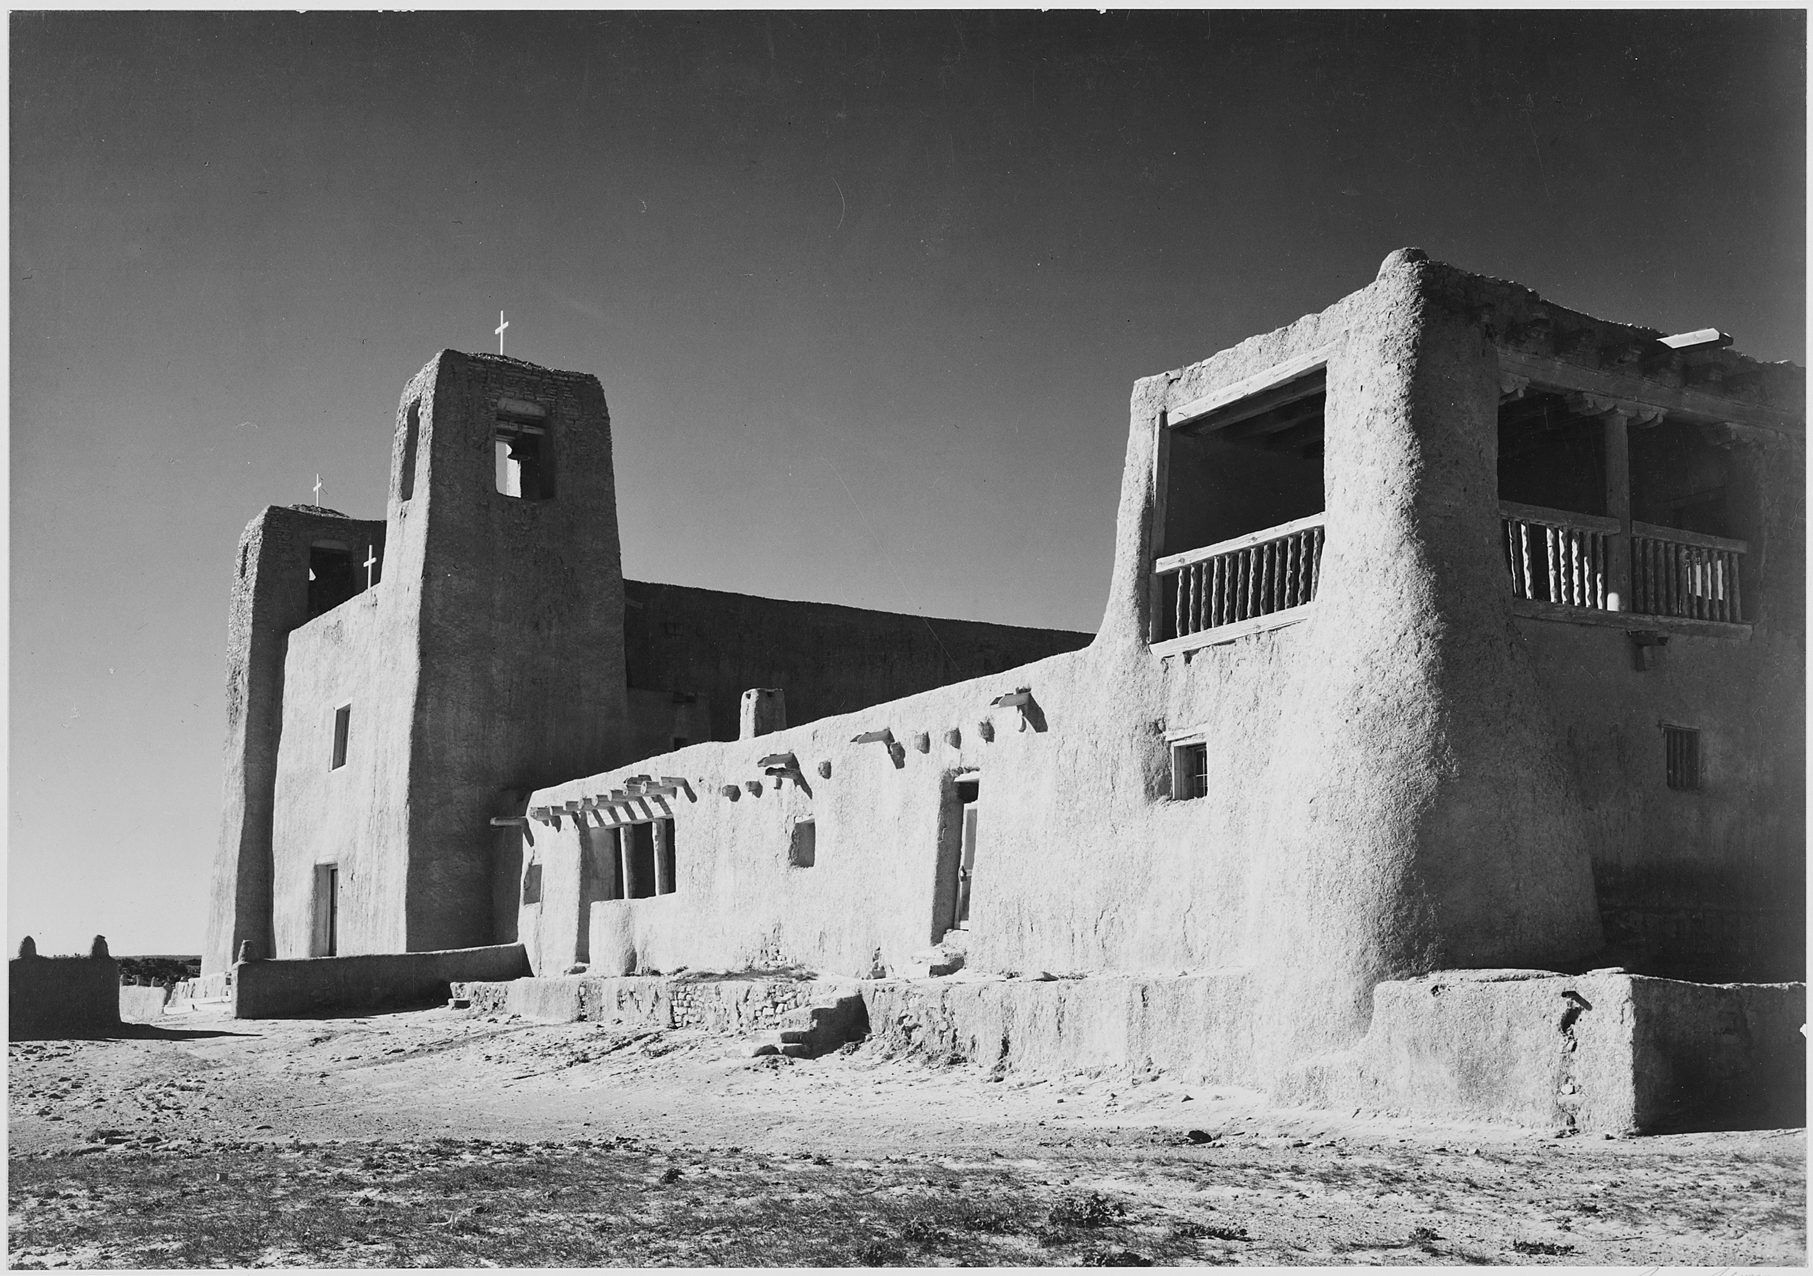
Key Concept 2.2, II
Spanish colonization tended to be more accommodating (after Pueblo Revolt) than English
Spain allowed more freedoms for Pueblos after revolt
English settlers tended to see natives as “savages” or “heathens”
Some Puritans sought to convert natives, many viewed them as disposable
American Indian warfare became more dangerous after European contact:
Tribes traded for guns and other advanced weapons
King Philip’s War was one of the bloodiest early native wars

Slide 7
Test Tips
Multiple-Choice and Short Answer Questions :
Impact of European contact on natives:
Loss of land, high death rates (disease), new weapons, increased fighting
Changes to native life as a result of conflict with Europeans
Continued encroachment on land
Essay Questions:
Comparing colonization and views of natives by England and Spain

Slide 8
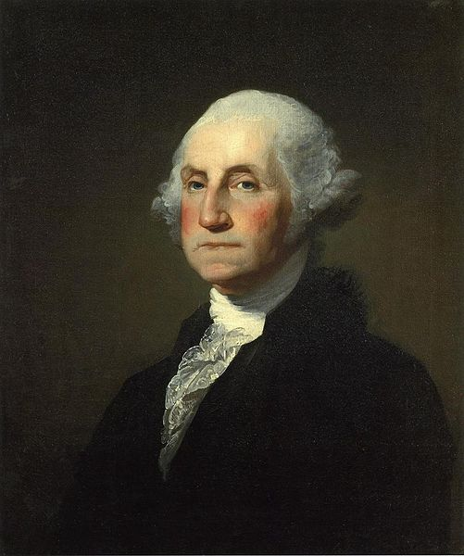
Thanks for watching!
Subscribe to my channel
Help spread the word
Questions? Comments?
Leave in comments
Subscribe
Down here!

