Slide 1
APUSH Review: Key Concept 2.3
www.Apushreview.com
Period 2: 1607- 1754
Everything You Need To Know About Key Concept 2.3 To Succeed In APUSH

Slide 2
The New Curriculum
Key Concept 2.3 “The increasing political, economic, and cultural exchanges within the ‘Atlantic World’ had a profound impact on the development of colonial societies in North America.” - Page 30 of the Curriculum Framework
Big ideas:
How did the colonists begin to develop an identity during this time?
What impact did religion have on the colonies?

Slide 3
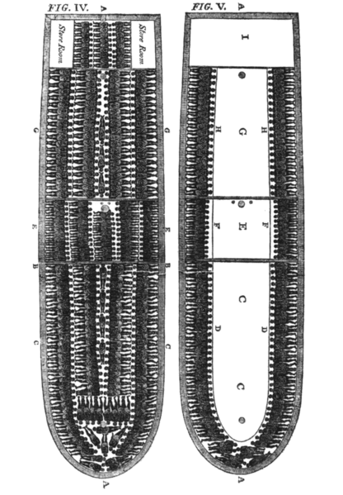
Key Concept 2.3, I
“‘Atlantic World’ commercial, religious, philosophical, and political interactions among Europeans, Africans, and American native peoples stimulated economic growth, expanded social networks, and reshaped labor systems.” - Page 30 of the Curriculum Framework
The 17th century Atlantic trade created a labor market and exchange of goods:
Growth of slavery in the Americas – began with Spanish and Portuguese traders in West Africa
“Middle Passage” – Shipment of Africans in close quartered ships; would last several weeks or months
Triangular trade – rum, sugar, molasses, and slaves were commonly traded on the Triangular Trade
Many merchants defied Navigation Acts and traded goods with the French, Dutch, and Spanish

Slide 4
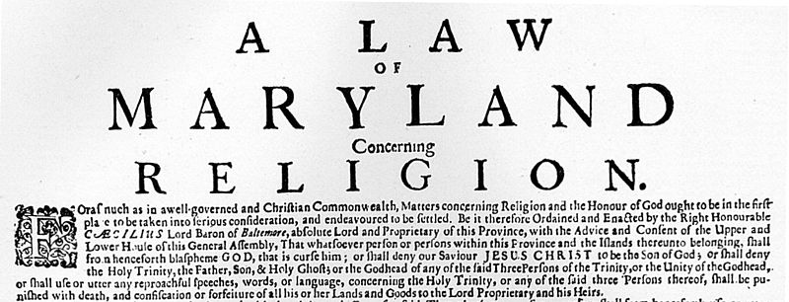
Key Concept 2.3, I Cont.
What promoted Anglicization in the British colonies? (using more English norms and customs)
Representative assemblies were similar to English government
Trade between the colonies and England increased contact
Enlightenment ideas from England and Europe traveled to America
Americans later made similar contributions – Franklin and Jefferson
Religious toleration in some colonies:
Quakers in PA, Maryland Acts of Toleration – tolerance for ALL Christians
Legal systems and customs:
Trials by jury
Evangelism:
The 1st Great Awakening saw George Whitefield from England travel to the colonies to spread religion

Slide 5
Key Concept 2.3, I Cont.
Strict racial categories and racial stereotyping emerged among British colonists
Blacks and whites lived in separate living quarters and were segregated throughout the day
Similar to natives, Africans were often seen as “savages” and less than human to justify treatment
Any resistance to slavery was treated harshly
The Spanish and French were more accepting of racial gradations
Emergence of mullatos and mestizos in the Spanish Empire

Slide 6
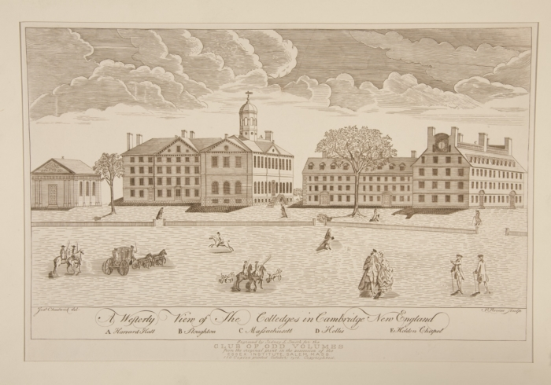
Key Concept 2.3, II
“Britain’s desire to maintain a viable North American empire in the face of growing internal challenges and external competition inspired efforts to strengthen its imperial control, stimulating increasing resistance from colonists who had grown accustomed to a large measure of autonomy.” - Page 31 of the Curriculum Framework
Over time, regional differences in colonies gave way to similarities in:
Laws: crimes were redefined – John Peter Zenger Trial – could criticize government officials if it was true
Institutions: colleges were established in different colonies – helped promote religion and increase literacy
Governance within the context of the British imperial system:
Prior to 1763, colonial governments acted independent of Parliament

Slide 7
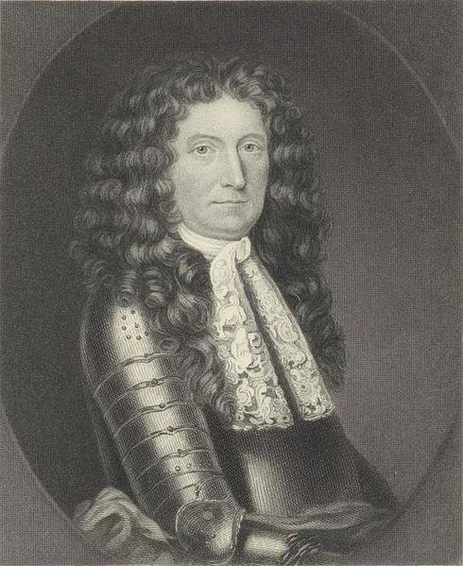
Key Concept 2.3, II
Under mercantilism, the goal is for the Mother country (England) to make as much $ as possible
England’s goal of creating a unified imperial structure and enforcing strict mercantilist policies was not always successful:
Navigation Acts – required colonists to export specific goods only to England or English colonies – tobacco
Led to widespread smuggling from colonial merchants
Dominion of New England – combined Massachusetts with the rest of New England, and later New Jersey and New York
Assemblies were eliminated and a new governor was appointed – Sir Edmund Andros who was very unpopular
The Dominion was met with resistance and ended with “The Glorious Revolution” in England
For most of the early 18th century, England followed a policy of salutary neglect
Colonies were mostly left alone to govern themselves; England took a hands off approach to governing
This would end in 1763 with the end of the 7 Years War

Slide 8
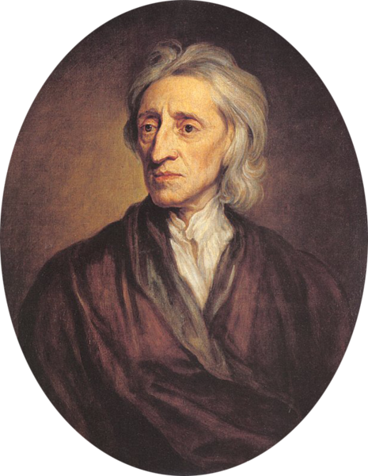
Key Concept 2.3, II Cont.
Reasons for resistance to British imperial control:
Salutary neglect led to colonial assemblies had significant power, often viewed themselves as “Parliament”
The Enlightenment led many to question governments and desire more rights and new forms of government
The Great Awakening created more religious diversity and a questioning of authority
Colonists often saw themselves as “Englishmen,” even though English officials did not always agree

Slide 9
Test Tips
Multiple-Choice and Short Answer Questions :
Impact of the Enlightenment:
How did ideas spread? Why were they appealing?
Essay Questions:
Reasons for and effects of new colonial identity

Slide 10
Thanks for watching!
Subscribe to my channel
Help spread the word
Questions? Comments?
Leave in comments
Natural Rights include, life, liberty, and subscribing to Adam Norris
Subscribe
Down here!

