Slide 1
Apush review: Metacom’s (king Philip’s) War
Everything You Need To Know About King Philip’s War To Succeed In APUSH

Slide 2
King Philip’s War and the APUSH Curriculum
Key Concept 2.1, III, E. “British conflicts with American Indians over land, resources, and political boundaries led to military confrontations, such as Metacom’s War (King Philip’s War) in New England.”
Page 32 of the curriculum framework

Slide 3
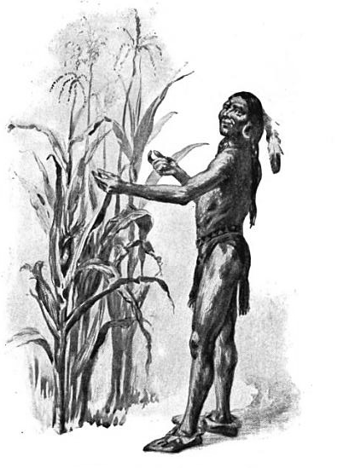
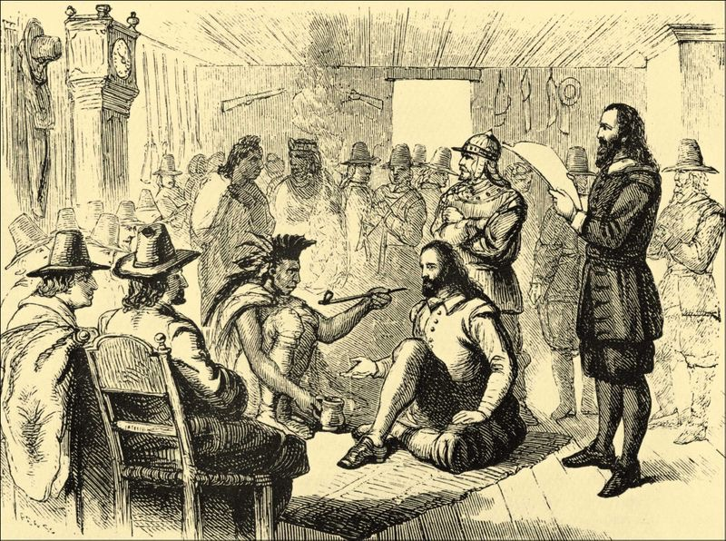
Key Ideas Before The War
Massasoit was the leader of the Wampanoag Indians and maintained peace with the New Englanders
His son, Metacom, called King Philip by colonists, became chief in 1662
Like his father, Metacom sought to continue living in harmony with colonists
However, colonial encroachment (from Plymouth colony also) led Metacom to resist the encroachment
By the mid 1670s, Natives were outnumbered by colonists, 50,000 to 20,000

Slide 4
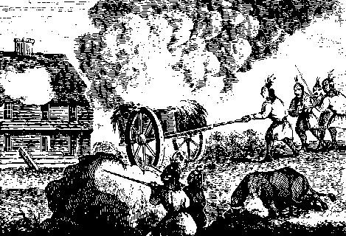
The War (1675 - 1678)
In 1675, 3 Wampanoags were hanged in Plymouth
Metacom allied with neighboring tribes and attacked towns in New England
Initially, Metacom’s side was successful
Colonists were pushed back east towards the Atlantic coast
The Iroquois Indians provided aid to the colonists
This developed into an alliance with New York

Slide 5
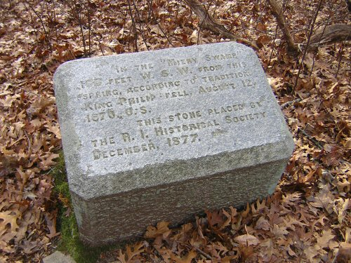
Effects of the War
In 1678, the war ended
Metacom was captured and killed
Colonists retaliated by destroying Native villages
Many Native men, women, and children were killed or sold into slavery in the West Indies
Including Metacom’s wife and son

Slide 6
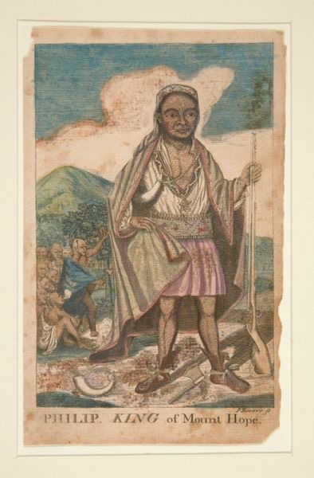
Significance of the War
The war reinforced the image of Natives as “savages” in the eyes of many colonists
Native American resistance decreased in New England
Colonists continued to expand on Native land after the war

Slide 7
Test Tips
Multiple-Choice and Short Answer:
Causes and impacts
Connecting the result to another time period (battles)
Essay Questions:
Could be included in an essay about European/colonial relations with Natives
Synthesis point - connecting the war to another time:
Battle of Wounded Knee - Natives lost, little resistance to the American government afterwards, no longer a significant military threat

Slide 8
Short Answer Question
Metacom’s (King Philip’s) War was one of the bloodiest wars between Native Americans and New England colonists.
Briefly explain one cause of Metacom’s (King Philip’s) War.
Briefly explain one short-term impact of the war.
Briefly explain one long-term impact of the war.
Check the description for a link to potential answers

Slide 9
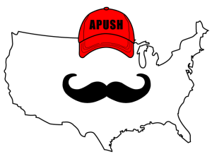
Thanks for Watching!
Check the description for other helpful videos
Good luck in May
Please subscribe and share
Check out APUSHReview.com for many more resources
New Short Answer Question every Monday!

