Slide 1
APUSH Review: Key Concept 3.2
www.Apushreview.com
Period 3: 1754 – 1800
Everything You Need To Know About Key Concept 3.2 To Succeed In APUSH

Slide 2
The New Curriculum
Key Concept 3.2 “In the late 18th century, new experiments with democratic ideas and republican forms of government, as well as other new religious, economic, and cultural ideas, challenged traditional imperial systems across the Atlantic World.”
Page 34 of the Curriculum Framework
Big ideas:
How did Enlightenment ideas help lead to the American Revolution?
How was the Constitution able to pass in light of conflicting interests? (North v. South, Federalists v. Anti-Federalists)

Slide 3
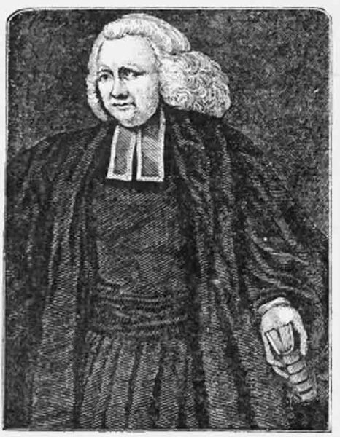
Key Concept 3.2, I
“During the 18th century, new ideas about politics and society led to debates about religion and governance, and ultimately inspired experiments with new government structures.” - Page 34 of the Curriculum Framework
Protestant evangelical religious fervor (1st Great Awakening) helped promote a new “American” identity
Less of a focus on Anglican Church; 10,000s of colonists converted
Appealed to women and younger sons (those that were not given as much land as first-born son)
“New Lights” challenged “Old Lights”
“The Enlightenment inspired American political thinkers to emphasize individual talent over hereditary privilege” – page 34
Similar to the Great Awakening, The Enlightenment challenged traditional authority
Jean-Jacques Rousseau:
Enlightenment thinker that advocated legal and political equality for all, as well as the end of special privileges for elites
After the Revolutionary War, primogeniture was outlawed in many states
Eldest son inherits most, if not all, of property

Slide 4
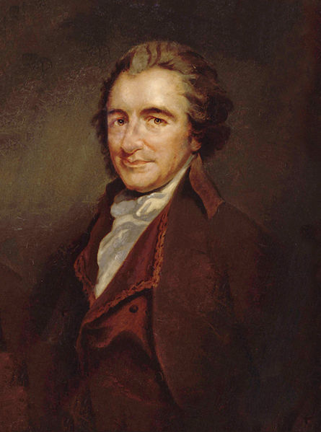
Key Concept 3.2, I Cont.
Colonial legislatures allowed for a significant amount of self-governing, which most colonists held dear
As Britain began to tax more, colonists resisted these acts
They were ok with colonial legislature taxes, NOT Parliament taxes
Colonial legislatures were elected by colonists, Parliament was not
Thomas Paine’s Common Sense:
Challenged KG3 – it was “common sense” to break away from the corrupt monarch
A little island could not rule a larger continent
Declaration of Independence:
Inspired by Enlightenment ideas – John Locke – and Thomas Paine
All men had natural rights of “Life, liberty, and the pursuit of happiness”
Articles of Confederation and state constitutions:
Feared strong centralized power a la Britain
Articles and state constitutions had strong legislative branches
Property requirements for voting and citizenship – fear of the masses

Slide 5
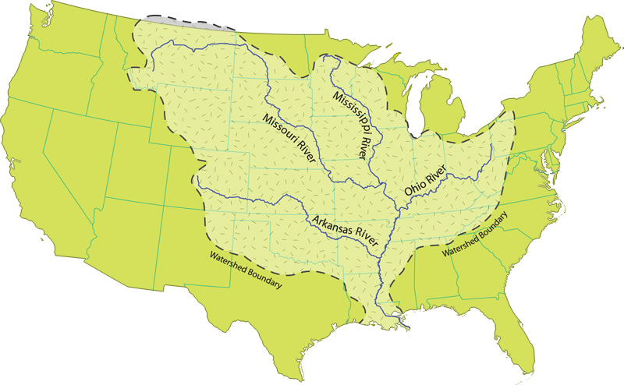
Key Concept 3.2, II
“After experiencing the limitations of the Articles of Confederation, American political leaders wrote a new Constitution based on the principles of federalism and separation of powers, crafted a Bill of Rights, and continued their debates about the proper balance between liberty and order.” - Page 34 of the Curriculum Framework
Challenges under the Articles:
Trade: each state could places tariffs on goods from other states – discouraged trade between states
Finances: each state could coin its own $ - differing values, high inflation in some states, also discouraged trade
Many states had debt from Revolutionary War – increased taxes
Federal government could not require taxes
Foreign Relations:
Britain – refused commercial treaties with US, Congress could not control commerce (sanctions against Britain)
Spain – cut off access to Mississippi River
Both countries supplied Native Americans with weapons
Internal unrest:
Shays’ Rebellion: - MA farmers demanded debt relief, attacked court houses
These challenges helped many Americans realize a stronger central government was needed……..

Slide 6
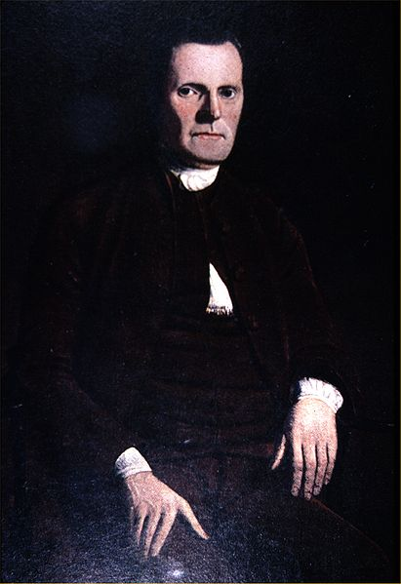
Key Concept 3.2, II Cont.
Compromises at the Constitutional Convention:
Great Compromise (Connecticut Compromise) – Roger Sherman
Combined VA Plan (large-states) and NJ Plan (small-states)
Created a bicameral legislature with one house based on population (House of Reps) and one with equal representation (Senate)
A census would be taken every ten years to determine population
3/5 Compromise:
For the purpose of representation, 3/5 slaves would count as 1 person in the South
BOTH THE GREAT COMPROMISE AND 3/5 COMPROMISE SETTLED THE ISSUE OF REPRESENTATION
Limits on federal power under constitution:
Federalism – division of power between state and federal governments
Specific powers for both the federal and state governments
Why was the Constitution finally ratified?
Federalists (those that favored the constitution) promised to add a Bill of Rights that protected liberties
The 1st 10 amendments were added shortly after the Constitution was ratified

Slide 7
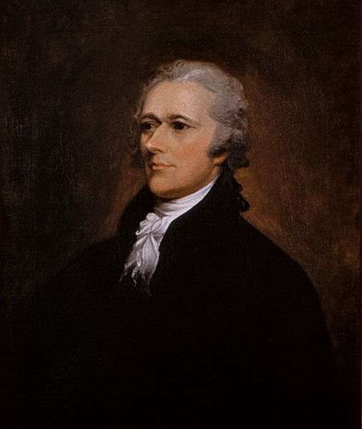
Key Concept 3.2, II Cont.
Political parties emerged over the following issues:
Relationship between national government and states – Federalists favored a stronger national government, Democratic-Republicans favored a smaller gov
VA and KY Resolutions – belief that states could nullify federal laws
Economic Policy – Hamilton’s Financial Plan (Federalists) would strengthen the federal government – the creation of the BUS was NOT mentioned in Constitution
Hamilton argued the Necessary and Proper, or elastic clause
Foreign Affairs – Federalists favored Great Britain – trade and $, Democratic-Republicans favored France – saw French Rev. as an extension of American Rev.

Slide 8
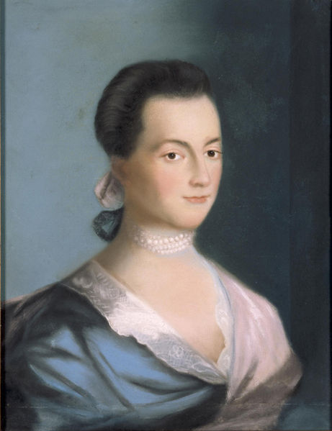
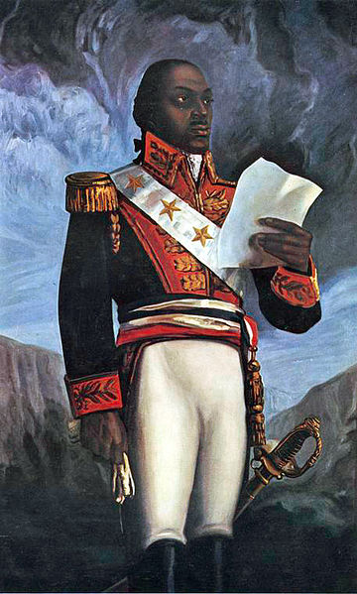
Key Concept 3.2, III
“While the new governments continued to limit rights of some groups, ideas promoting self-government and personal liberty reverberated around the world.” - Page 35 of the Curriculum Framework
The push for equality after the Revolutionary War:
Some individuals called for the abolition of slavery
Pennsylvania’s Gradual Abolition Law (1780):
Prohibited importation of slaves into PA
ALL children born in PA would be free, regardless if their parents were slaves
Model for other northern states to follow
Increased calls for greater political democracy:
Abigail Adams’ “Remember the Ladies”
Judith Sargent Murray advocated education for females
The Constitutional framers postponed a solution to slavery:
Since slavery was allowed under the Constitution, it led to conflicts in the 19th century, and ultimately, the Civil War
Influence of the American Revolution and Declaration of Independence?
Inspired revolutions across the world
French Revolution in 1789
Haiti – Toussaint L’Ouverture helped Haiti gain independence in 1804
Latin America – many Spanish colonies gained independence in the early 19th century

Slide 9
Test Tips
Multiple-Choice and Short Answer Questions:
Issues with the Articles of Confederation
Common Sense
Constitutional compromises
Social impacts of the Rev. War
Essay Questions:
Issues that led to the creation of political parties

Slide 10
Thanks for watching!
Subscribe to my channel
Help spread the word
Questions? Comments?
Leave in comments
It’s Common Sense to subscribe!
Subscribe
Down here!

