Slide 1
APUSH Review: Key Concept 3.3
www.Apushreview.com
Period 3: 1754 – 1800
Everything You Need To Know About Key Concept 3.3 To Succeed In APUSH

Slide 2
The New Curriculum
Key Concept 3.3 “Migration within North America, cooperative interaction, and competition for resources raised questions about boundaries and policies, intensified conflicts among peoples and nations, and led to contests over the creation of a multiethnic, multiracial national identity.”
Page 36 of the Curriculum Framework
Big ideas:
How was Native American life affected after the removal of the French?
What led to the development of the first political parties?
How did “republican motherhood” affect the roles of women?

Slide 3
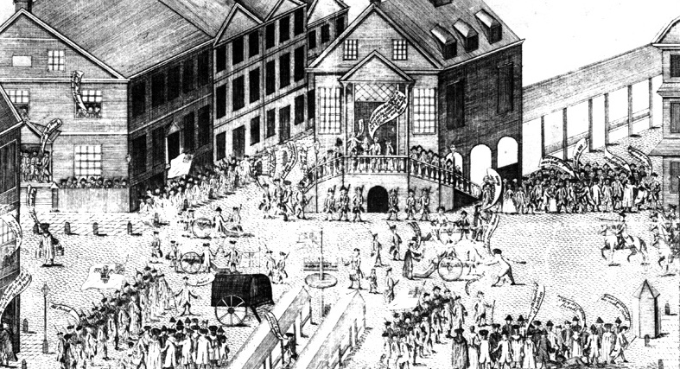
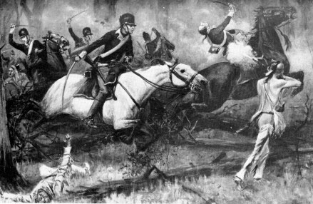
Key Concept 3.3, I
“As migrants streamed westward from the British colonies along the Atlantic seaboard, interactions among different groups that would continue under an independent United States resulted in competition for resources, shifting alliances, and cultural blending.” - Page 36 of the Curriculum Framework
After the French lost the 7 Years War, white-Indian conflicts arose and continued throughout the late 18th century:
Paxton Boys (Pennsylvania):
Scots-Irish group that was upset with Pennsylvania’s leniency towards Native Americans
Murdered 20 Native Americans, then marched to Philadelphia with demands
Ben Franklin helped quell the march by promising to consider their issues
Battle of Fallen Timbers (1794 - Ohio):
Native Americans, led by Little Turtle defeated Americans – 630 Americans were killed
In 1794, the Indians were finally defeated and signed the Treaty of Greenville
Natives ceded a significant amount of land, were allowed to retain some land, which was later encroached upon

Slide 4
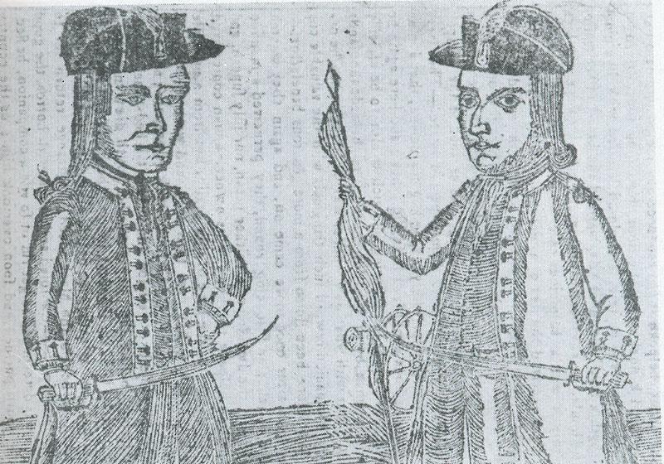
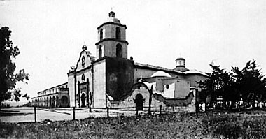
Key Concept 3.3, I Cont.
Due to migration within North America and around the world, new Backcountry cultures emerged:
Often fueled social and ethnic tensions
Scots-Irish:
Tended to settle on the frontier (edges of settlement)
Settled on land without regard for ownership (government, natives, etc.)
Displaced and suppressed Native Americans
Shays’ Rebellion:
Rebellion of farmers that demanded an end to foreclosures, imprisonment for debt, and paper currency
Closed courts
These illustrated tensions between poor (backcountry) and wealthy (interior)
Spain expanded settlements into California (1760s):
Missions, or forts were created and trade expanded
Many natives died from disease, others were forced to convert to Christianity

Slide 5
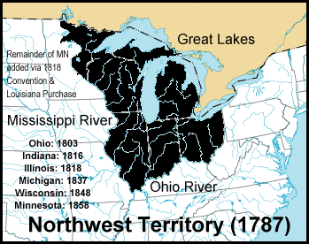
Key Concept 3.3, II
“The policies of the United States that encouraged western migration and the orderly incorporation of new territories into the nation both extended republican institutions and intensified conflicts among American Indians and Europeans in the trans-Appalachian West.” - Page 36 of the Curriculum Framework
Northwest Land Ordinance (1787):
Created a process to admit new states (once a population of 60,000 was reached)
Guaranteed freedom of religion and trial by jury (this was before the Bill of Rights)
A portion of land sales went to fund education
Slavery was abolished in the territory
Native Americans’ legal standing was not well-defined
Natives were not “foreign nations”; did not have representation in government
No mention of Native Americans and land in the Constitution
Led to conflicting treaties and encroachments on Native’s lands over the years
Spain and the Mississippi River, and the British presence in North America:
Jay’s Treaty – helped settle conflict between US and Britain (Britain was attacking US ships, still had a presence in key posts)
Pinckney’s Treaty – Spain, fearing a British-US alliance, signed Pinckney’s Treaty
US could navigate the Mississippi, given right of deposit in New Orleans, Florida boundary was fixed where America wanted it

Slide 6
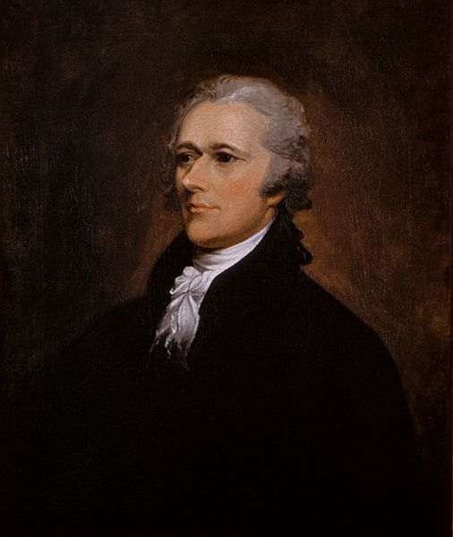
Key Concept 3.3, III
“New voices for national identity challenged tendencies to cling to regional identities, contributing to the emergence of a distinctly American cultural expressions.” - Page 37 of the Curriculum Framework
Reasons for the development of political parties:
Regional reasons for political parties –
Urban, wealthy, and upper-class individuals tended to be Federalists (merchants and trading)
Rural, farmers, and lower and middle-class tended to be Democratic-Republicans (Jefferson believed farmers should be the backbone of the economy)
Economic – Federalists favored Hamilton’s Financial Plan, which included the BUS, Democratic-Republicans were wary of it
Political – Federalists advocated a strong central government
Foreign policy – Federalists were pro-British (trade), Democratic-Republicans were pro-French (saw the French Rev. as similar to the American Rev.)
Cotton became a staple crop of the South
Like tobacco, it exhausted land, plantations spread further west
Soon, slavery was abolished in the North, regional differences emerged on the view of slavery
Many southerners saw it as a “necessary evil” and later, a “positive good”
I
trading with Britain!

Slide 7
Key Concept 3.3, III Cont.
**“Republican Motherhood”**
Emerged during and after the Revolutionary War
Belief that it was the duty of mothers to raise “good” citizens
Women became a leading teacher of their children of values and citizenry
As a result, women gained more access to education

Slide 8
Test Tips
Multiple-Choice and Short Answer Questions:
Native American interactions under the New Nation
Reasons for the development of political parties
Republican Motherhood – how were women viewed?
Essay Questions:
Issues that led to the creation of political parties

Slide 9
Thanks for watching!
Subscribe to my channel
Help spread the word
Questions? Comments?
Leave in comments
I
to subscribe to Adam Norris
Subscribe
Down here!

