Slide 1
APUSH Review: Key Concept 4.2
www.Apushreview.com
Period 4: 1800 – 1848
Everything You Need To Know About Key Concept 4.2 To Succeed In APUSH
Shout-out to Mrs. Vaughn. Thanks for your support. Good luck to you and your students!

Slide 2
The New Curriculum
Key Concept 4.2 “Developments in technology, agriculture, and commerce precipitated profound changes in U.S. settlement patterns, regional identities, gender and family relations, political power, and distribution of consumer goods.”
Page 40 of the Curriculum Framework
Big ideas:
What were the social and economic impacts of the Market Revolution on immigrants, men, women, Natives, and African Americans?
Why did the South develop a separate identity from other regions?
Why did sectionalism develop during this time? Was the government successful at reducing sectional tensions? Why?

Slide 3
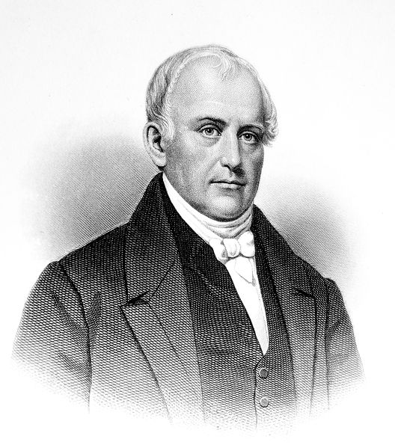
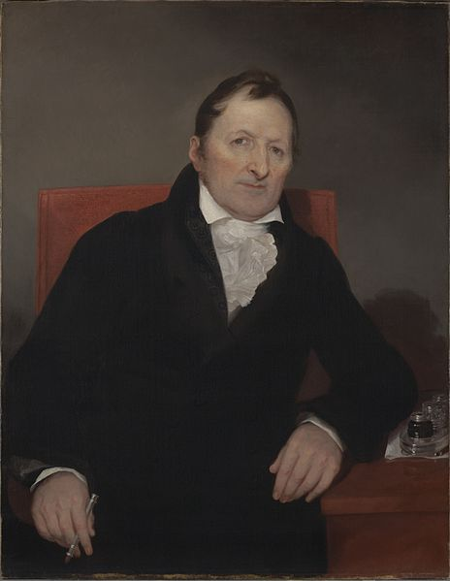
Key Concept 4.2 I
“A global market and communications revolution, influencing and influenced by technological innovations, led to dramatic shifts in the nature of agriculture and manufacturing.” – pg 40 of the curriculum framework
Technological innovations that increased efficiency and extended markets
Textile machines – made production faster – Spinning Jenny
Steam engines – Allowed boats to go against the current
Interchangeable parts – Eli Whitney – increased production
Canals – shipping goods farther – Erie Canal
Railroads – increased drastically
Telegraph – information spread more rapidly
Samuel Slater – father of the factory system
More and more Americans shifted from subsistence farming to producing goods; some entrepreneurs focused on financing
Lowell System – factory system in MA; farmers daughters worked in factories in 8 hour shifts; boarding houses and dormitories

Slide 4
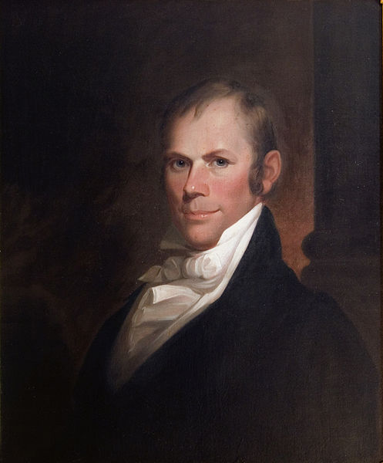
Key Concept 4.2 II
“Regional economic specialization, especially the demands of cultivating southern cotton, shaped settlement patterns and the national and international economy.” – page 40 of the curriculum framework
Impacts of cotton:
Raw material used in textile production in the Northeast
Economic ties increased (specialization for each region)
Trade with European countries (Britain and France) shaped international economy
The internal slave trade increased as demand for slaves increased (especially post 1808 – why?)
Efforts to create a unified national economy never fully came to fruition:
The North and Midwest were linked together more than with the South
Henry Clay’s American System:
Focused on three parts:
Internal improvements – roads, canals, etc.
Tariffs – (1816) goal was to use to fund internal improvements
Bank of the United States
The American System had its critics: inter vs. intra state trade
Andrew Jackson and the Maysville Road Veto

Slide 5
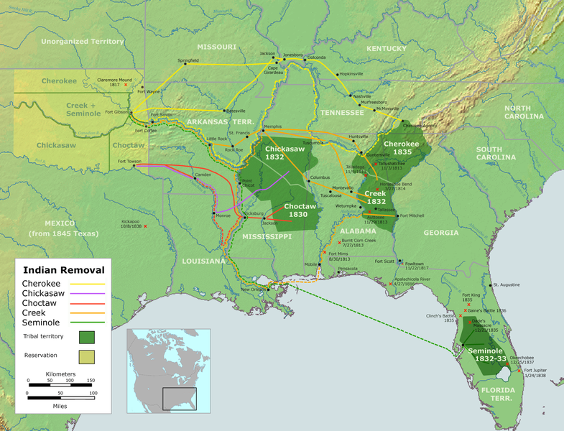
Key Concept 4.2 II (Cont.)
Impacts of seeking natural resources:
Free migration of people – as the population grew, and threats were removed (War of 1812), more Americans expanded West
Infrastructure (roads, canals – Erie) helped encourage westward expansion
Forced migration of people:
Slavery expanded further and further west – cause of Civil War
Native Americans – Indian Removal Act and the Trail of Tears
New labor systems:
Unions – Commonwealth v. Hunt – MA State Supreme Court decision ruling that labor unions were legal
Labor unions became more common and influential in later years

Slide 6
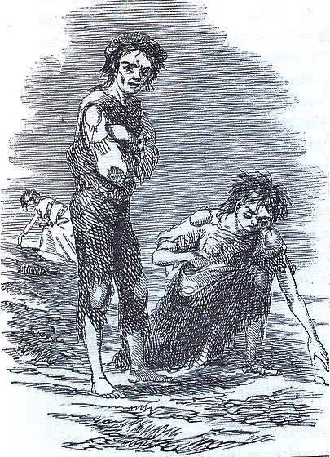
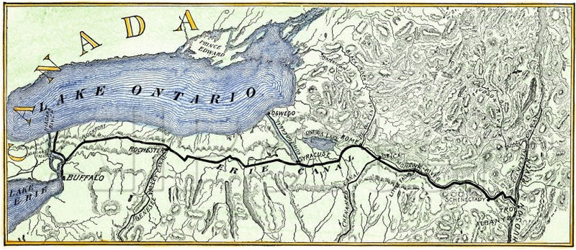
Key Concept 4.2 III
“The economic changes caused by the market revolution had significant effects on migration patterns, gender and family relations, and the distribution of political power.” – page 41 of the curriculum framework
Canals (Erie!) and roads increased American migration westward:
Easier for westward expansion and shipment of goods
New community systems developed that replaced old family and local relationships
Examples: churches, schools, taverns, etc. develop
Religion played an instrumental role – gatherings for bible readings
Immigrants from Europe tended to settle in the East and Midwest:
Increased interdependence between Northeast and Old Northwest
Germans – Ohio as farmers
Irish – cities as urban workers (Potato famine – 1840s and 1850s)
The South remained distinct compared to other regions:
Culturally: plantations helped define the region – so economically profitable
Many wealthy whites viewed themselves as “aristocrats”
Politically: Plantation owners had significant power; laws protected and reinforced slavery
Ideologically: Honor in the South was different than North; dueling persisted
George Fitzhugh – defender of slavery; said of women, “Women, like children, have but one right, and that is the right of protection. The right to protection involves the obligation to obey.”
Exports to Europe fueled economic growth (King Cotton)

Slide 7
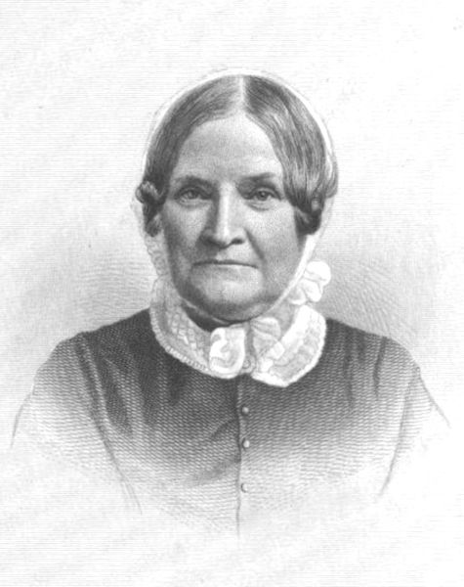
Key Concept 4.2 III Cont.
“The economic changes caused by the market revolution had significant effects on migration patterns, gender and family relations, and the distribution of political power.” – page 41 of the curriculum framework
As a result of the Market Revolution:
Gap between rich and poor increased
A new, emerging middle class developed
Home and workplace became more separated
People worked outside the home more often
Gender and family roles and expectations changed drastically
Cult of Domesticity – Separate Spheres for women; expectation was to be subordinate to men and raise children
Lydia Maria Child – abolitionist and women’s rights activists
Sectionalism, not nationalism, was a major focus for many political leaders stances on several issues:
Slavery – increasing tensions between the North and South as the 19th century went on (Fugitive Slave Law)
National Bank – Northeast tended to favor the BUS, South was against
Internal Improvements – many in the west (Henry Clay) favored; the West was not as developed as other areas
Tariffs – favored by Northern manufacturers; disliked by Southerners

Slide 8
Test Tips
Multiple-Choice and Short Answer Questions:
Impact of technology on industry and agriculture
Reasons for immigration and westward expansion
Impact of Market Revolution
American System!
Essay Questions:
Reasons for sectional tensions/emergence of unique regional identities
Impact of Market Revolution

Slide 9
Thanks for watching!
Subscribe to my channel
Help spread the word
Questions? Comments?
Leave in comments
Good luck on your tests, especially the one in May!
Subscribe
Down here!

