Slide 1
Government In America: Chapter 11, 15th Edition
Interest Groups

Slide 2
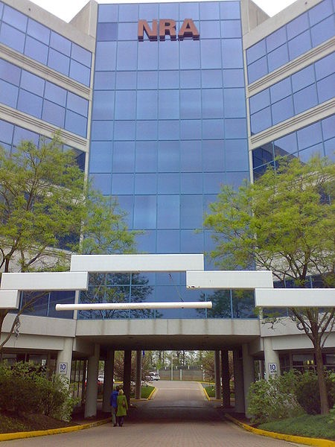
The Role of Interest Groups
What is an interest group?
Group of people that share policy goals and engage in politics to meet their goals
Interest groups are protected via the 1st amendment - organize (assembly)
What are the goals of interest groups?
To change policy on the national, state, and/or local levels
How are interest groups different than political parties?
Interest groups don’t run their own candidates
Interest groups are specialized in one, or a few, policies

Slide 3
Theories of Interest Group Politics
Pluralism
Believe that interest groups help bring inspiration to all
Group Theory of Politics:
Groups link people and government
Groups compete
Hard for one group to dominate
Groups follow the rules
Groups use resources to their advantage
Labor using numbers vs. Big Business using $

Slide 4
Theories of Interest Group Politics
Elitism
View many interest groups as insignificant
Few people and groups have real power
How elitists view interest groups:
The number of groups doesn’t matter, only which ones are powerful
Large corporations have tremendous power
Interlocking directorates have power - individuals sit on boards of similar organizations
Corporations prevail on big issues

Slide 5
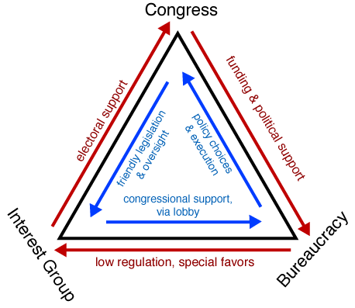
Theories of Interest Group Politics
Hyperpluralism
Belief that interest groups contribute to gridlock - too many views to appease
Iron Triangle:
Relationship between interest groups, Congress, and the bureaucracy (government agencies that carry out legislation)
All parts of the iron triangle protect their own interests
Hyperpluralists view of interest groups:
Groups become powerful as government seeks to appease all
Policy that is confusing and contradictory often emerge as a result

Slide 6
What Makes an Interest Group Successful?
The Surprising Ineffectiveness of Large Groups
Smaller groups are often more successful at organizing than larger groups
Potential groups - people who could be members
Actual groups - those that do join a group
Collective goods:
Something that benefits everyone, regardless if they are in a potential or actual group
Example: Higher minimum wage helps those in and not in unions
Free-rider problem:
Not joining a group because an individual could still benefit
Why are smaller groups often more successful than larger groups?
More to gain/lose
Class-action lawsuit spread across millions of people is a small amount of $, but could be substantial to companies
Selective Benefits:
Organizations can restrict benefits to members only (AAA - special trip discounts)

Slide 7
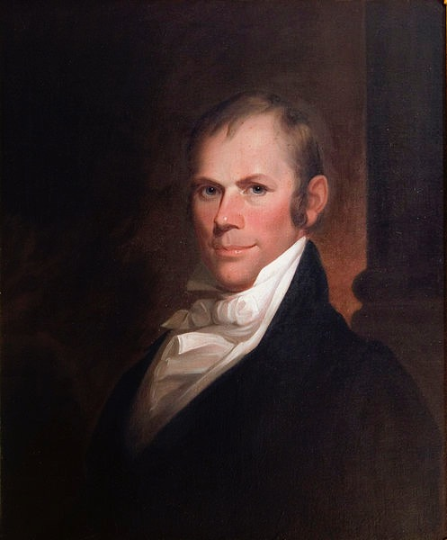
What Makes an Interest Group Successful?
Intensity
Politicians are more likely to react to groups that show they care
Single-issue group:
Tend to focus on one issue (abortion)
Hesitant to compromise
Financial Resources
Interest groups tend to favor the wealthy
However, interest groups aren’t always successful
Interest groups often square off against each other

Slide 8
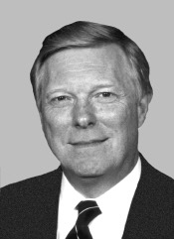
How Groups Try to Shape Policy
Lobbying
Hope to influence government to achieve their goals
Many former members of Congress are lobbyists
Two types of lobbyists:
Those that are paid by a group, regular employee
Those that are hired on a temporary basis
Lobbying Disclosure Act of 1995:
Certain organizations must report:
Their clients and amount of $ paid
4 ways lobbyists can help Congressmen and women
Provide valuable information (experts on certain policies)
Help provide strategies to pass legislation
Provide campaign strategy
Provide ideas and innovations

Slide 9
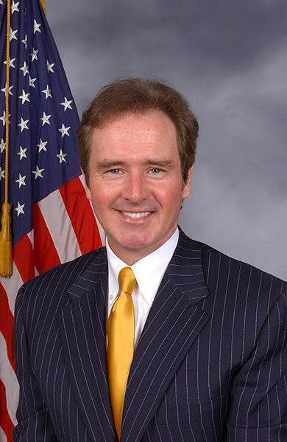
How Groups Try to Shape Policy
Electioneering
What is it?
Financially assisting candidates (Political Action Committees - PACs)
Almost 1/2 of House Members get most of their campaign $ from PACs
$305 million from PACs in 2008!
PACs overwhelming support incumbents
Why do PACs choose certain candidates?
Similar interests
Support issues they support
Have a geographic connection (from a district where PAC does business)
Involved in agencies that affect the PAC
Influential leadership positions
Interest groups also are involved with elections through:
Recruit candidates for office, endorse individuals, help volunteer, etc.

Slide 10
How Groups Try to Shape Policy
Litigation
When interest groups fail, courts are often an avenue for change
Civil Rights Movement of the 1950s and 1960s
**Amicus Curiae briefs*** (Friend of the court)
Allows groups to file briefs to the court to give their opinion
Class action lawsuits:
Combines people in similar situations into one large case
Example - Former NFL players suffering from concussions
Going Public
Interest groups often use their image to help sway public opinion

Slide 11
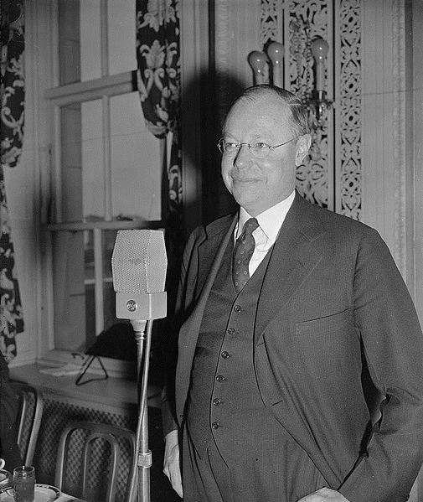
Types of Interest Groups
Economic Interests
The government provides subsidies to many different groups
Labor
Unions seek better working conditions, higher wages, and fewer hours
Union shop - requires workers to join a union
Right-to-work-laws - does not require workers to join unions
Taft-Hartley Act (1947) - allowed states to pass right-to-work laws
Decline of union membership:
Lower wages in other countries affects employment in US (outsourcing)
Many workers don’t believe they will benefit from unions

Slide 12
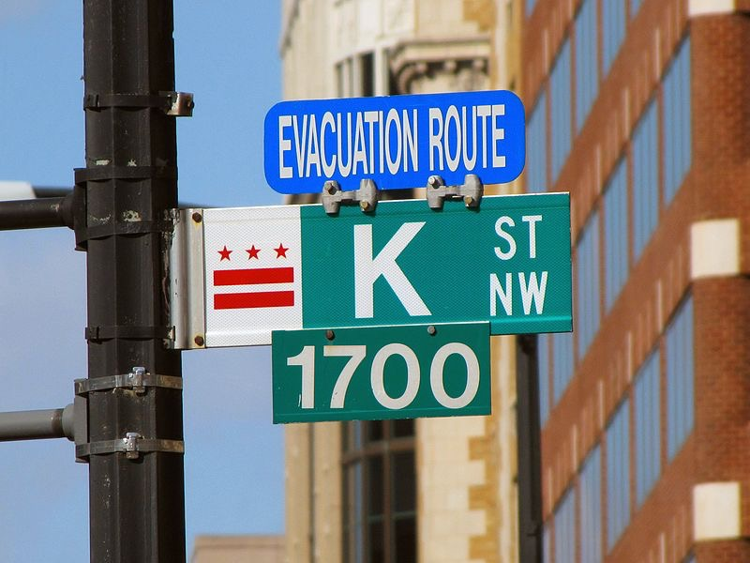
Types of Interest Groups
Business
Many corporations have offices in D.C.
Businesses often have differing goals:
RRs don’t want more highways, trucking companies do
Environmental Interests
Seek to combat pollution and global warming
Oppose off-shore drilling

Slide 13
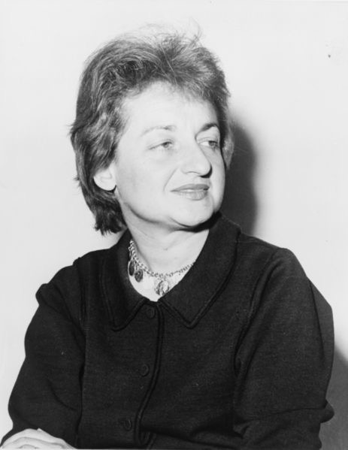
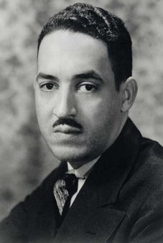
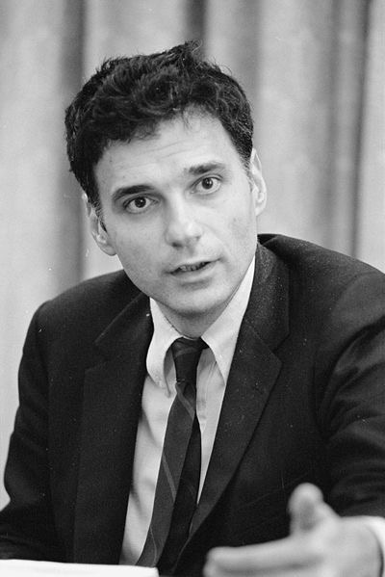
Types of Interest Groups
Equality Interests
National Association for the Advancement of Colored People (NAACP)
Argued before the Supreme Court in Brown v. Board
Fought discrimination throughout the US
National Organization for Women (NOW)
Advocate the passage of the Equal Rights Amendment (ERA)
Consumer and Other Public Interest Lobbies
Public Interest Lobbies - organizations that seek to a collective good, and which members of the organization do not directly benefit
Example - consumer advocate groups - Unsafe at Any Speed
Consumer Product Safety Commission - created by Congress to regulate consumer products
Other public interest groups:
Christian Coalition - advocate moral standards, Common Cause - Advocate for a more transparent government

Slide 14
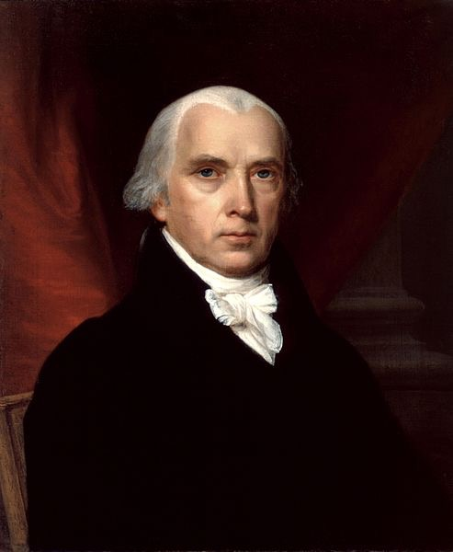
Understanding Interest Groups
Interest Groups and Democracy
Madison argued in Federalist 10 that opposing interest groups would counterbalance each other
Elite theorists argue that interest groups corrupt American politics
Hyperpluralists argue that policymakers seek to appease powerful interest groups
Interest Groups and the Scope of Government
Interest groups increase the size of government - ensure that certain government programs never go away
As the federal government expands, so does the number of interest groups

Slide 15
Quick Recap
Interest groups vs. political parties
Pluralist, Elitist, and Hyperpluralist views of interest groups
Free-rider problem
Single-issue groups
Lobbyists - types and goals
PACs and campaign spending
Amicus Curiae Briefs
Union Shops

Slide 16
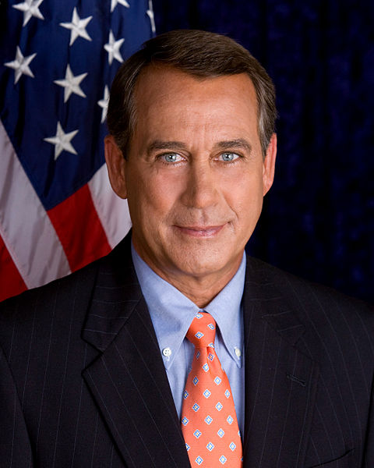
See You Back Here For Chapter 12!
Thanks for Watching
Please subscribe, share with others
Check out all my videos related to the new curriculum
Best of luck on all your tests!

