Slide 1
Government in America: Chapter 12, 15th Edition
Congress

Slide 2
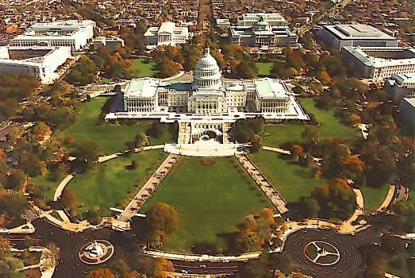
The Representatives and Senators
The Members:
535 in total - 100 Senators and 435 members of the House
Requirements to be a member of Congress:
House Requirements - at least 25 years old, citizen for 7 years
Senate Requirements - at least 30 years old, citizen for 9 years
All members must live in the state they represent
Most members are white males
Descriptive representation - being nearly identical to constituents in terms of personal and political characteristics
Rarely happens
Substantive representation - represent interests of groups
Why Aren’t There More Women in Congress?
Women are nominated by major parties at a smaller rate (31% in 2008)
Women with children tend to be less ambitious than those without when it comes to running for office

Slide 3
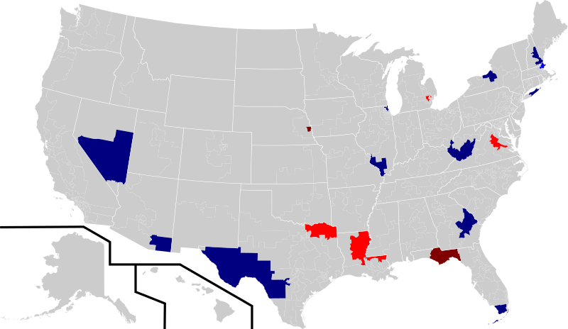
Congressional Elections
Who Wins Elections?
Incumbents - those that hold an office and are running for re-election
Incumbents often win elections
1994 Congressional Elections - significant changes
92% of senators and 89% of representatives won that were incumbents
Incumbency is more powerful in the House than Senate - why?
Senate serves a larger, more diverse population
Senators tend to have less contact with constituents
Senate seat is more prestigious, tend to get more competition

Slide 4
Congressional Elections
The Advantages of Incumbency:
Name recognition - sort of - 28% of Americans could name their House member
Members focus on advertising, credit claiming, and position taking
Advertising
Frequent contact with constituents
**Franking privilege** - using mail without having to pay for postage
Recorded messages, emails, and other technology are often used
Credit Claiming
Casework - helping individuals or groups achieve a goal
Helping an individual get $ from Social Security on time
Pork Barrel - Federal $ for local projects - bridges, roads, infrastructure
Position Taking
State where they stand on certain issues and topics

Slide 5
Congressional Elections
Weak Opponents
House members especially are likely to face weak opponents that have little $
Campaign Spending
House winners spend over $1.5 million, Senators over $8 million!
Open seat (no incumbent)? The one who spends the most usually wins
The Role of Party Identification
For those that identify with a party, they overwhelmingly vote for a House member of the same party
Defeating Incumbents
Negative publicity about incumbent helps challengers
States that lost population may see incumbents challenge each other for a seat
Political shifts - 1994 and 2006 midterm elections
Open Seats
Largest cause of turnover in Congress is when there is no incumbent
Stability and Change
Is stability good? Can gain more expertise, but also become more entrenched

Slide 6
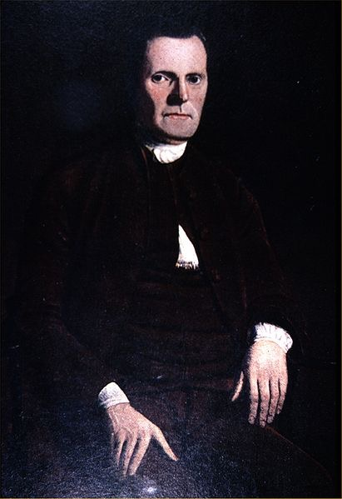
How Congress is Organized..
American Bicameralism
Bicameral - two house legislature
2 Senators per state, House is based on population - Great Compromise
A bill must pass each part of Congress
The House
Parties play an important role - often voting occurs along lines
House can impeach and revenue bills originate here
House Rules Committee:
Determines when bills will be voted on and how much debate time
Members are appointed by the Speaker of the House
The Senate
Can ratify treaties, appointments, and try impeachment cases
Filibuster - provides unlimited debate on bills - Stom Thurmond’s 24 hour and 18 minute filibuster
Cloture - 60 members can vote to end a filibuster; rarely used

Slide 7
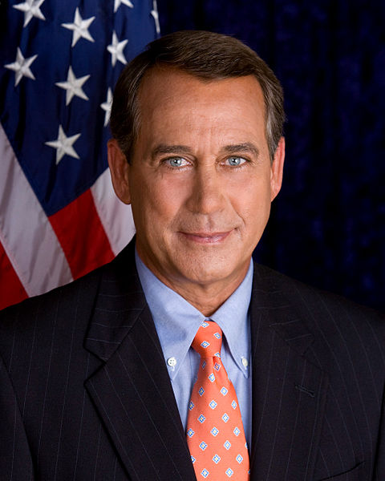
How Congress is Organized..
Congressional Leadership
Party Leadership plays a significant role
The House
Speaker of the House - chosen by the majority party
Often, (s)he is the senior member, 2nd in succession to the presidency
Chooses committee assignments
Majority Leader schedules bills, gains support for votes
Whips - carry messages to party members, count votes prior to being cast
Minority Leader - similar role to Majority leader to the party not in power
The Senate
VP is the president of the Senate
Majority Leader - provides a key role in committee assignments, scheduling, etc.
Congressional Leadership in Perspective
Members of Congress still have autonomy in light of the influence of parties in Congress

Slide 8
How Congress is Organized..
The Committees and Subcommittees
Standing Committees - deal with different bills (Agriculture committee, Budget, etc.)
Joint Committees - Members are from both the House and Senate
Conference Committees - formed to reconcile different bills passed by both Houses
Select Committees - have a specific duty - intelligence
Legislation and Oversight
9,000 bills submitted over 2 years!
Committees often change bills
Legislative oversight - monitor agencies and policies established by Congress
Getting on a Committee
Members, especially new ones, want to be appointed to relevant committees
Committees help members take part in credit claiming to constituents
Committee Chairs and the Seniority System
Committee Chairs - schedule hearings, appoint subcommittees, etc.
Seniority System - generally used to select chairs, but not required
Term limits have been established on committee chairs

Slide 9
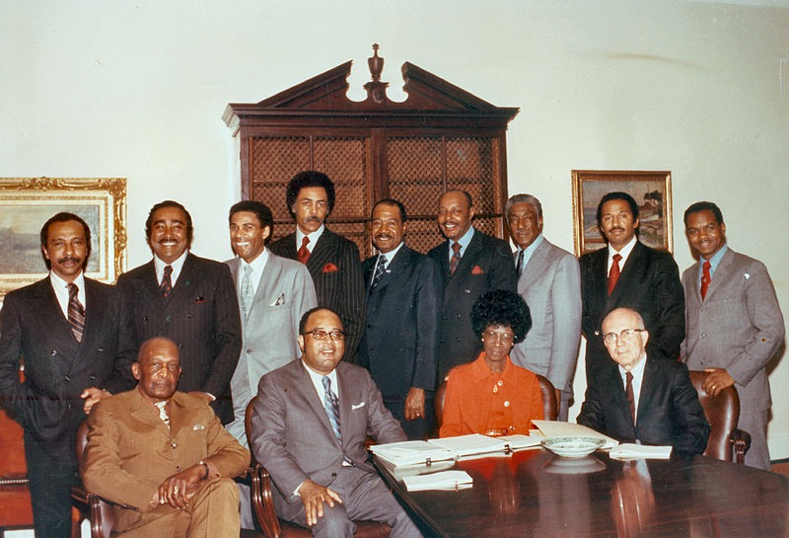
How Congress is Organized..
Caucuses: The Informal Organization of Congress
Caucus - Congress members that have similar interests of characteristics
Caucuses promote interests of their group, similar to an interest group, but members are Congress people
Examples? Black caucus, Hispanic caucus, Sunbelt, etc.
Congressional Staff
Personal Staff
House members- 17 staff members, Senators - 40!
Staff members often help constituents directly, have offices in the districts they represent
Also help draft legislation
Committee Staff
2,000 staff members - help draft reports
Lobbyists often focus on committee staff members
Staff Agencies
Congressional Research Service - tracks the progress of bills
Government Accountability Office - provides legal options and settles claims against the government
Congressional Budget Office - analyzes the president’s budget

Slide 10
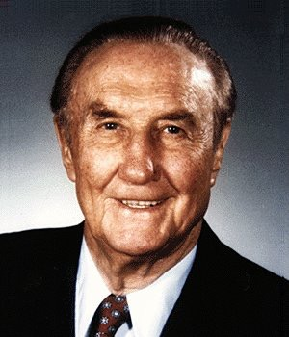
The Congressional Process
Bill - a proposed law
Although anyone can draft (write) a bill, only Congress members can submit them
Assigning a bill to multiple committees simultaneously helps bring more attention to the bill
Presidents and Congress: Partners and Protagonists
President is often called the chief legislator - can and does propose many bills
White House staff members lobby Congress
Party, Constituency, and Ideology
Party Influence
Parties are often united in electing Congressional leaders
They often disagree on other issues - civil rights
Polarized Politics
Differences between parties have increased in recent years - Republicans move to the Right, Democrats to the Left
Compromise is more difficult to obtain
State legislatures create House boundaries - often have become increasingly partisan

Slide 11
The Congressional Process
Party, Constituency, and Ideology
Constituency Opinion Versus Member Ideology
Views of Representatives:
Trustees - “using their best judgement to make policy in the interests of the people” (356)
Instructed delegates - “Mirroring the preferences of their constituents” (356)
Politicos - a mix of trustee and instructed delegates
Personal ideology is the biggest factor in how a member of Congress votes
If a constituency has strong preferences on an issue, members of Congress usually follow through with those beliefs
Lobbyists and Interest Groups
Lobbyists tend to focus on those members of Congress that share similar beliefs
Over the years, lobby regulations have increased, restricting benefits that politicians can receive

Slide 12
Understanding Congress
Congress and Democracy
Americans have little influence over how Congress is run - committee appointments, leaders, etc.
People from Montana have more power over Senators than people from California
Representativeness Versus Effectiveness
Congress and committees often have competing interests
Critics argue Congress appeases to many people and groups, thus the government spends to much $
Opponents argue that there is no oligarchy (rule by a few people or groups)
Congress and the Scope of Government
Pork barrel projects are favorable to members of Congress - does this encourage the government to increase its size?
Many Americans want lower taxes, but want to keep a significant amount of government programs

Slide 13
Quick Recap
Requirements to run for Congress
Power of incumbents - why do they win?
Franking privilege
Campaign spending (PACs)
Differences between House and Senate (revenue bills, impeachment, etc.)
Leadership in each house of Congress
Role of committees in each house
Role of staff members

Slide 14
See You Back Here For Chapter 13!
Thanks for watching!
Subscribe and share
Questions? Comments? Ideas for videos?
Good luck in May!

