Slide 1
Government in America; 15th Edition Chapter 1
www.Apgovreview.com
Introducing Government in America
Follow me on Twitter @AdamNorrisAP

Slide 2
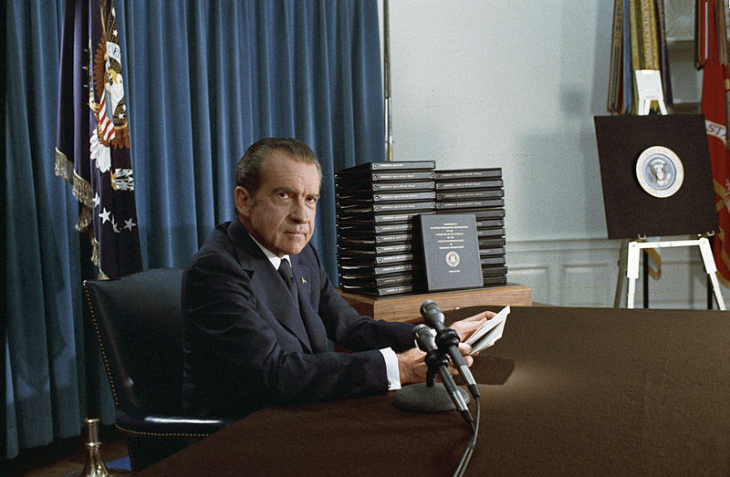
Politics and Government Matter
Big Ideas:
Many Americans under 30 don’t vote or follow politics
Many Americans over 65 do
Why the discrepancy?
Apathy for young voters
Senior citizens are interested in issues that affect them (Social Security, Medicare)
Although there are more news outlets, news itself can be avoided more than in the past
Cable TV, sports, computers, phones, etc.
Nixon averaged a rating of 50 for his addresses; Obama averaged 24

Slide 3
Government
What is government?
“The institutions that make decisions for a society collectively” (p. 8)
The federal government is made up of Congress, the President, courts, and agencies
What do all governments have in common?
Providing a national defense – US spends $650 billion a year
Provide public services – roads, libraries, schools, etc.
Preserve order – National Guard could be used in rioting
Socialize the young – provide education
Collect taxes – used to pay for public goods and services

Slide 4
Politics
What is politics?
“Determines whom we select as our government leaders and what policies these leaders pursue.” (p. 9)
Media focuses on the “who” of politics:
Voters, candidates, parties, etc.
“What” of politics:
Benefits, taxes, etc.
“How” of politics:
Ways of participation – voting, lobbying, etc.
Single-issue groups:
Supporters who vote for a candidate usually on the basis of one issue (abortion, gun laws, etc.)

Slide 5
The Policymaking System
How do people get involved in a democracy?
Voting, involvement in parties, interest groups, etc.
Linkage Institutions:
Groups that let policymakers in government know the preference of Americans
Linkage Institutions include parties, media, etc.
Policy Agenda:
“Issues that attract the serious attention of public officials and other people actively involved in politics at a given time” (p. 11)
Americans tend to vote for candidates that support their major concerns
Bad news affects policy agenda
Policymaking Institutions:
Congress, President, Courts, (some argue bureaucracy – government agencies as well)
Most policies involve multiple institutions’ involvement

Slide 6
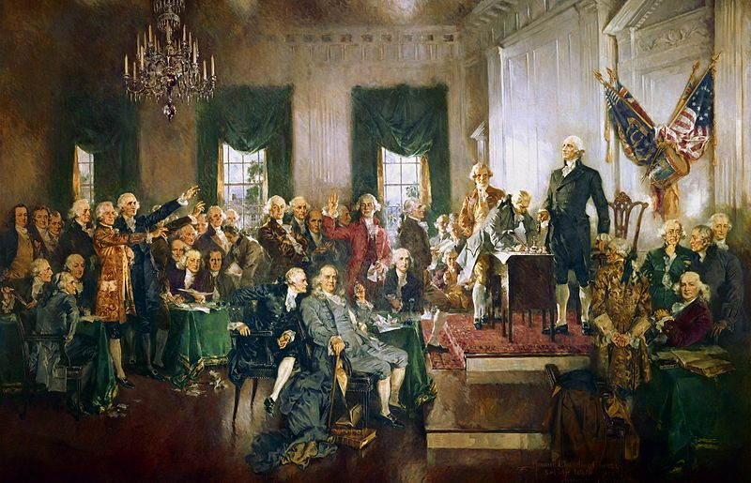
Democracy
What is democracy?
“A system of selecting policymakers and of organizing government so that policy reflects citizens’ preference.” (p. 13)
Originally, the framers feared giving people many democratic elements we have and know today
5 criteria of an “ideal democratic process” (p. 14)
Equality in voting
Effective participation
Enlightened understanding – free press and free speech
Citizen control of the agenda – 1 group should not control policy
Inclusion
Restraints protecting the minority from the majority:
1st amendment
In a representative government, the officials should reflect the will of citizens

Slide 7
Democracy Continued
3 theories of American Democracy
Pluralism:
Interest groups can influence public policy (NRA, NOW, UAW)
Groups can heavily influence policy (Civil Rights in the 1950s and 1960s) through various government avenues (courts)
Critics of pluralism argue that certain groups have too much power
Elitism:
Belief that upper-class has too much power
Argue that a few people are the decision makers in government
Hyperpluralism:
Belief that the government is weaker due to the many groups
Too many groups leads to nothing getting done
Overlapping powers by governments makes it hard to implement policy

Slide 8
Democracy Continued
Challenges to Democracy
Increased Complexity of Issues:
So many complex issues leads to elite experts
Limited Participation in Government:
Low voter turnout by youths can lead to challenges in the future
Escalating Campaign Costs:
Political Action Committees (PAC’S) fund campaigns and are very influential
Diverse Political Interests:
Can lead to policy gridlock in which nothing gets done

Slide 9
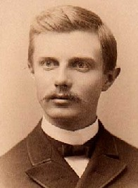
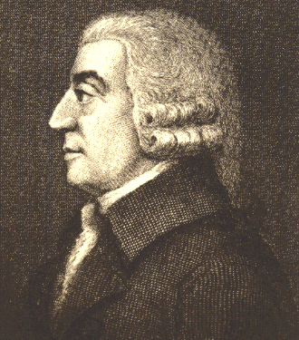
Democracy Continued
American Political Culture and Democracy
5 elements
Liberty:
Immigrants mostly say freedom when asked why they came to America
Freedom of speech and religion
Egalitarianism:
Equal opportunity due to lack of monarchy or aristocracy
Equality is not and cannot be guaranteed, but everyone can have a chance to be successful
Individualism:
American has a unique identity, in large part, due to the frontier
Frederick Jackson Turner
Laissez-faire:
Preference for limited government and free markets
Americans pay less taxes than other democracies
Populism:
Advocates the rights of average citizens against the privileged elites
William Jennings Bryan

Slide 10
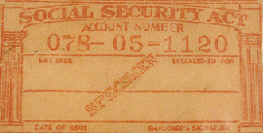
The Scope Of Government In America
Governments spend about 1/3 of GDP
24 million Americans are government employees
Social Security consumes 1/5 of the national budget – Baby Boomers
Except for a few Clinton surpluses, the government has run deficits since 1969

Slide 11
Thanks for watching!
Subscribe to my channel
Help spread the word
Questions? Comments?
Leave in comments
Follow me on twitter @AdamNorrisAP
Subscribe
Down here!

