Slide 1
Government in America; 15th Edition Chapter 10
www.Apgovreview.com
Elections and Voting Behavior

Slide 2
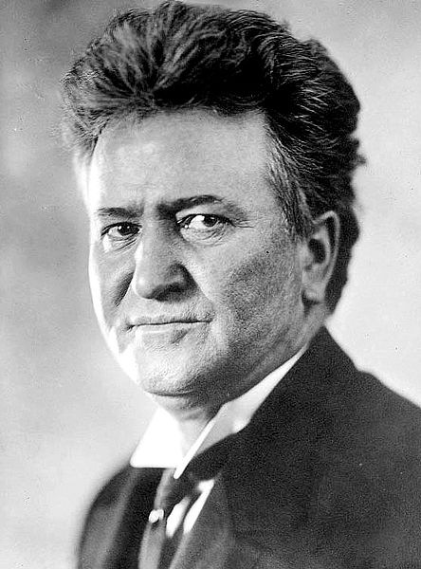
How American Elections Work
3 Types of Elections:
Primary – determines party nominations
General – Determines the winner between parties
Specific policy questions – voters vote on issues
Referendum – voters can pass or deny a law (bonds, decriminalization of drugs, etc.)
Initiative Petition – citizens can propose laws if they receive signatures equal to 10% of previous election’s voters
Grass-roots

Slide 3
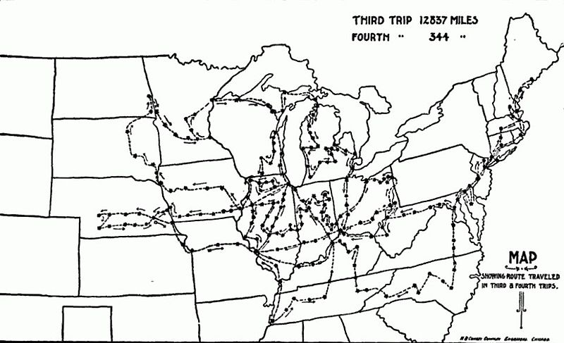
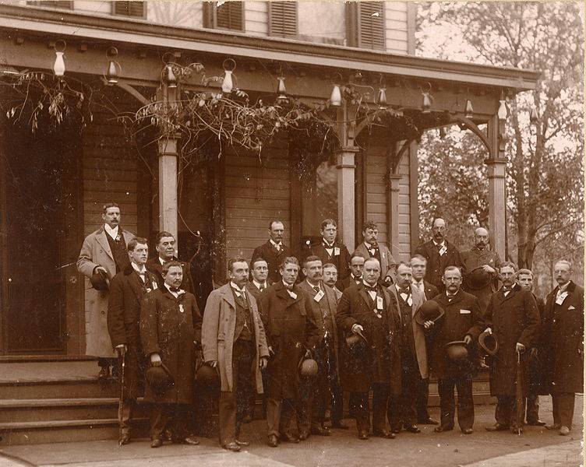
A Tale of Three Elections
1800:
Adams vs. Jefferson
No campaigning by the candidates
Jefferson wins – “Revolution of 1800” peaceful transition of power
Burr and Jefferson tied in the Electoral College – House chose Jefferson after 35 ballots
1896:
McKinley (R) v. Bryan (D)
Issues were tariffs and the gold standard
McKinley campaigned at home via “front-porch”
Bryan campaigned heavily across the country by train – 18,000 miles
80% voter turnout
McKinley beat Bryan
2008:
McCain (R) v. Obama (D)
Obama narrowly defeated Hillary Clinton in the primaries
McCain was tied to the Bush Administration
Obama ran on “Change” and won

Slide 4
Whether to Vote: A Citizen’s First Choice
Over time, suffrage has expanded greatly
1800 – only white, property-owning males 21 and older could vote
Today – virtually all citizens 18 and older
As suffrage expanded, the voter turnout rate has decreased
Deciding Whether to Vote:
Potentially high opportunity cost to voting
Debates about whether to have election day be a holiday or on a weekend
Political efficacy – the belief that an individual can have an impact on the government
The higher one’s political efficacy, the more likely one is to vote
Some people vote out of civic duty, even if they feel their vote won’t make much of a difference

Slide 5
Whether to Vote: A Citizen’s First Choice
Registering to Vote:
Voter Registration Laws:
Created to help prevent voter corruption
Vary by states
Some states made it more difficult to register
Motor Voter Act (1993) – states are required to allow registration on driver’s license applications
Who Votes?
Categories related to voter turnout:
Education – the higher the education, the higher the turnout
Age – The older an individual, the more likely they are to vote
Race – minorities usually vote less often (African Americans voted in high numbers in 2008)
Gender – Women vote at slightly higher rates than men
Marital status – married couples vote more often
Government Employees – vote more often as well
These categories are cumulative – the more one belongs to, the more likely they will vote

Slide 6
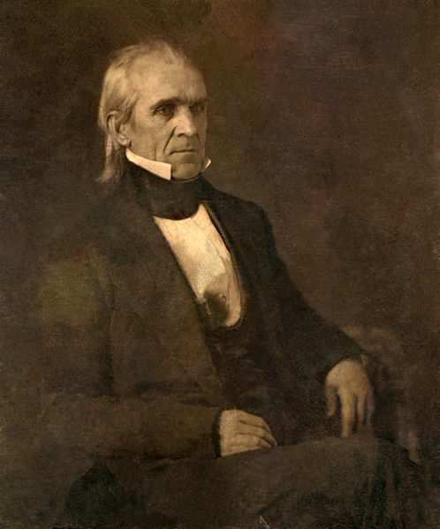
How American’s Vote: Explaining Citizens’ Decisions
Mandate Theory of Elections – belief that the winning candidate has a mandate (authority) to carry out their platform
Polk and Manifest Destiny in 1844
Bush in 2004
Party Identification:
Party identification helps voters decide who to vote for when little is known about a candidate
Over time, people vote for candidates of different parties rather than just one party (ticket-splitting or floating voters)
Candidate Evaluation…..
3 aspects of a candidates image that are important to the public:
Integrity – the higher the perceived integrity, the more likely a candidate is to receive votes
Reliability – The more reliable a candidate is perceived to be, the more likely they are to receive votes (Kerry as a “flip-flopper” in ’04)
Competence – arguably the most influential of the 3; perceived intelligence matters for candidates

Slide 7
How American’s Vote: Explaining Citizens’ Decisions
Policy Voting:
The idea that how people vote is based on their preferences of issues
4 Conditions of policy voting:
Voters understand their own positions on policies
Voters know where candidates stand on issues
Voters see differences on issues between candidates
Voters vote for the candidate that matches up with their policy preferences
It is not always easy to meet all 4 conditions
Obstacles to policy voting:
Candidates are often ambiguous on issues

Slide 8
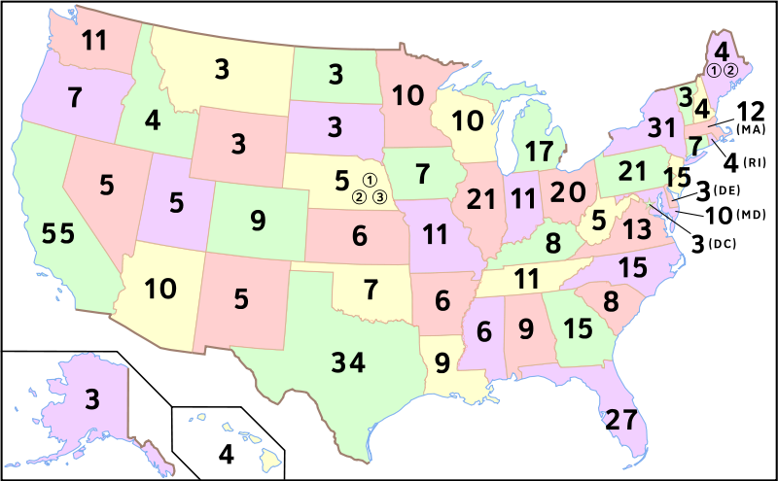
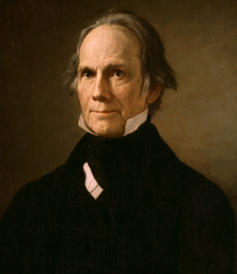
The Last Battle: The Electoral College
Why is there an electoral college?
Framers did not want the people to elect the president
How are electoral votes determined?
2 Senators per state, plus number of members of the House
538 electoral votes total (100 Senators + 435 members of the House + 3 for D.C.)
1 more than half electoral votes needed to win the presidency (270)
State parties select electoral voters
Winner-take-all approach:
48 states give all electoral votes to the candidate that wins the most popular votes in the state
ME and NE divide up votes based on winners of congressional districts
No electoral majority?
The House of Representatives (12th Amendment) chooses among the top 3 candidates (see “Corrupt Bargain of 1824”)
Impact of Electoral College?
Smaller states are often overlooked in campaigns
Candidates often campaign mostly in close “swing” states
Smaller states are often overrepresented due to the electors for Senators
Helps reinforce the two-party system

Slide 9
Understanding Elections and Voting Behavior
Elections not only select policymakers, but they shape public policy
Democracy and Elections:
Retrospective voting – “what have you done for me lately?”
The economy has a huge impact on incumbent politicians
Elections and the Scope of Government:
Those that believe they can influence the government tend to believe the government should have increased power

Slide 10
Quick Recap
3 types of elections
Referendum
Initiative
Political Efficacy
Motor Voter Act
Categories related to voter turnout
Electoral College - Impacts

Slide 11
Thanks for watching!
Subscribe to my channel
Help spread the word
Questions? Comments?
Leave in comments
Congrats, you are half-way done with this book!

