Slide 1
Government in America; 15th Edition Chapter 2
www.Apgovreview.com
The Constitution
Follow me on Twitter @AdamNorrisAP

Slide 2
Politics in Action: Amending the Constitution
What is a constitution?
“A nation’s basic law. It creates political institutions, allocates power within government, and often provides guarantees to citizens.” (p. 30)
The US Constitution is the supreme law of the land
Guarantees individual rights
Even unpopular opinions (Texas v. Johnson)
Limits power of the government

Slide 3
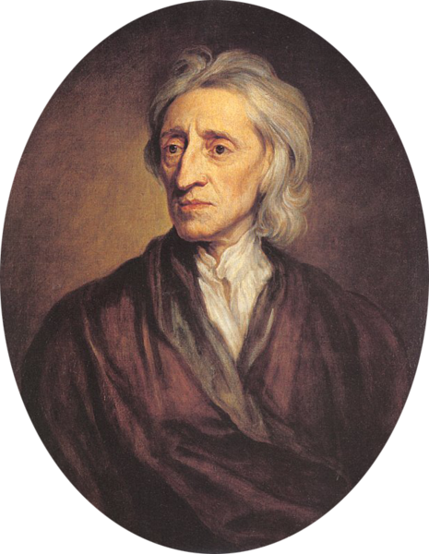
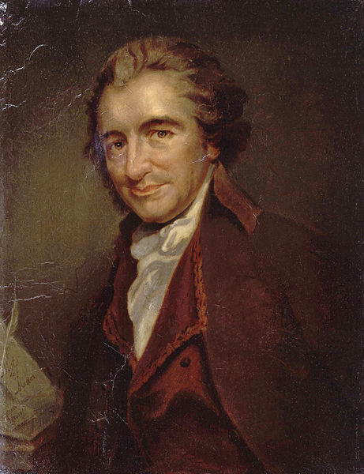
The Origins of the Constitution
The British/colonial relationship changed after the French and Indian War
Britain began implementing taxes
Common Sense:
T-Paine, influenced the Declaration of Independence
Written by many, mostly Thomas Jefferson
List of grievances against the King
John Locke:
The Second Treatise of Civil Government
Natural Rights – inherent rights, not dependent on government – life, liberty, and property
Consent of the governed – people decide on government officials
Limited government – restrictions on what government can do
Must post laws
Cannot take property without consent
Revolting should be saved until injustices are severe

Slide 4
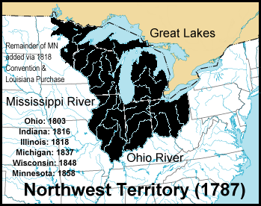
The Government That Failed
Articles of Confederation:
National legislature with one house – each state received one vote
No executive branch or national court
States had much power – fear of a strong central government
Required unanimous consent to amend the Articles
Other problems?
No national military – Shays’ Rebellion
Federal government could not collect taxes
Northwest Land Ordinance of 1787:
Process for adding new land to the union

Slide 5
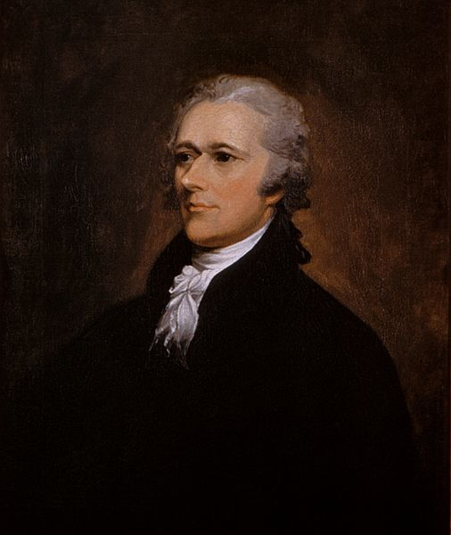
The Government That Failed
Many states added their own bill of rights
Many freedoms similar to the Bill of Rights
Many state legislatures were powerful – more accountable to voters
Shays’ Rebellion:
MA rebellion against foreclosures on farms
Rebellion attacked courthouses
Demonstrated a major weakness of the Articles
In a sense, Shays’ was instrumental in the Constitutional Convention
Annapolis Convention:
Purpose was to discuss the Articles, only 5 states showed up
Promise to meet in Philadelphia the following year (Constitutional Convention)

Slide 6
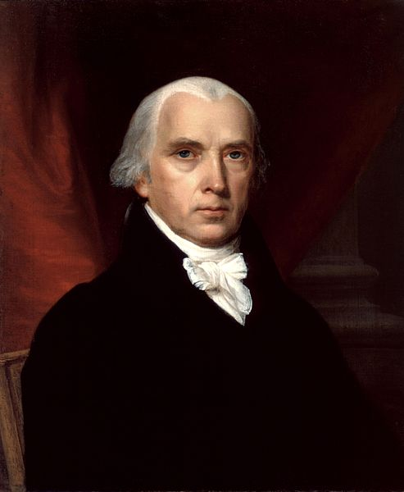
Making a Constitution: The Philadelphia Convention
All states except RI showed up
4 philosophies of government:
Human Nature – belief that people were self-interested
Political Conflict – Madison believed the distribution of wealth was the cause of conflict
Leads to a rise of factions
There were ways to check the power of factions (Federalist #10)
Objects of Government – belief that government should preserve right to achieve wealth
Nature of Government – balanced government – separation of powers

Slide 7
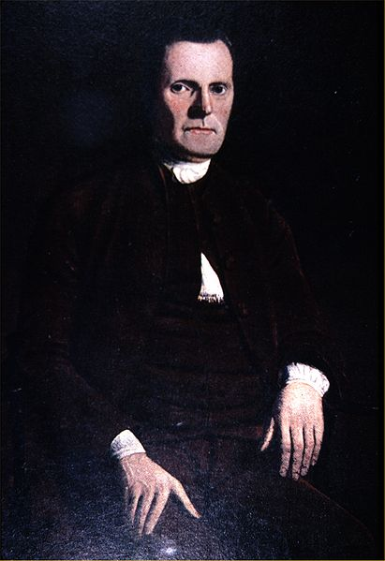
Critical Issues at the Convention
Representation!!!
NJ Plan (small state) William Patterson
Proposed a unicameral legislature with equal representation per state (similar to Articles)
Virginia Plan (large state) Edmund Randolph
Proposed a bicameral legislature with representation to be based on population
Connecticut Compromise (Great)
Created a bicameral legislature (House – based on population, Senate – equal representation)
Citizens in smaller states have more power over Senators than larger states
Slavery:
1787, only MA outlawed slavery
Constitution banned the importation of slaves after 1808
3/5 Compromise:
3 out of 5 slaves would be counted towards representation in the House
Voting requirements were left to states

Slide 8
Critical Issues at the Convention
Economic Issues:
Under Articles, each state could:
Create tariffs on goods from other states
Issue own currency
Congress was in charge of virtually all economic policies
Taxing, borrowing, appropriating $
Punish counterfeiters, patents and copyrights
**Regulate interstate trade**
Personal Freedoms under the ratified Constitution:
Prohibits suspension of writ of habeas corpus in most cases
Cannot pass bills of attainder (no judicial trial)
Prohibits passage of ex post facto laws
Strict rules for conviction of treason
Trial by jury in almost all cases

Slide 9
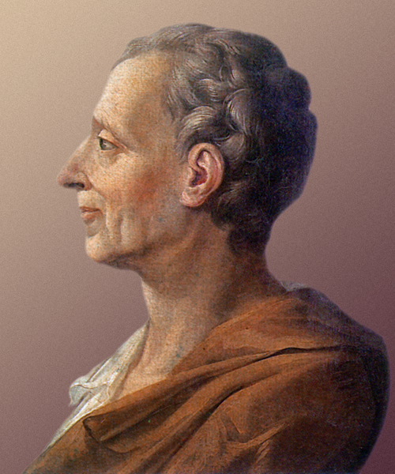
The Madisonian System
Many framers feared the power of the non-wealthy majority
***Safe-guards were set up ***
Most government was beyond control of the majority - Separation of Powers
Checks and balances
Limiting Majority Control
House of Reps was only part of 3 branches directly elected by the people
Occurred every 2 years, whereas Senators are 6 years, with 1/3 up for reelection every 2 years
Judges serve for life
Separating Powers:
3 branches each having distinct powers
Creating Checks and Balances:
Using power against power to limit government actions
Federal System (Federalism)
Established to divide power between the federal and state governments

Slide 10
The Madisonian System
The Constitution created a republic, not a direct democracy
Republic – using the consent of the governed to elect representatives to make decisions
Direct Democracy – citizens voting on issues
Checks and Balances makes change more difficult
Laws must pass through a series of obstacles
Both houses, president signing, possible court case later….

Slide 11
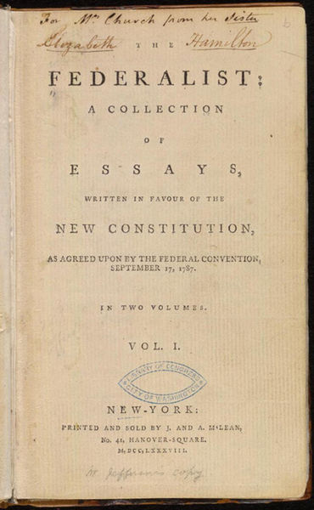
Ratifying the Constitution
Federalists – those that supported the Constitution
Anti-Federalists – those that opposed the Constitution
Federalist Papers
Written by Alexander Hamilton, James Madison, and John Jay
Purpose was to try to persuade the ratification of the Constitution
85 essays total - #10 and #51 most popular
#10 – factions are inevitable
#51 – separation of powers
Why did Anti-Federalists oppose the Constitution?
Fear of strong central government
Lack of protection of liberties
The solution?
The Bill of Rights!
George Washington became president on April 30, 1789

Slide 12
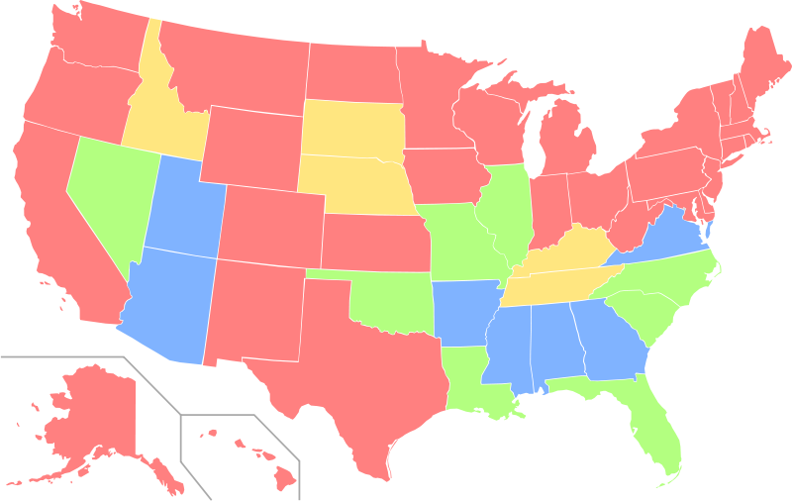
Changing the Constitution
2 ways to amend the Constitution:
2/3 of Congress can propose an amendment -> ¾ of state legislatures or ¾ of state conventions must ratify
National Convention of 2/3 states can propose -> ¾ of state legislatures or ¾ of state conventions must ratify
The president and Supreme Court has NO role in the amendment process
Most amendments have expanded liberty and equality
Bill of Rights, Reconstruction amendments – 13 – 15
Equal Rights Amendment (ERA):
Proposed but never ratified

Slide 13
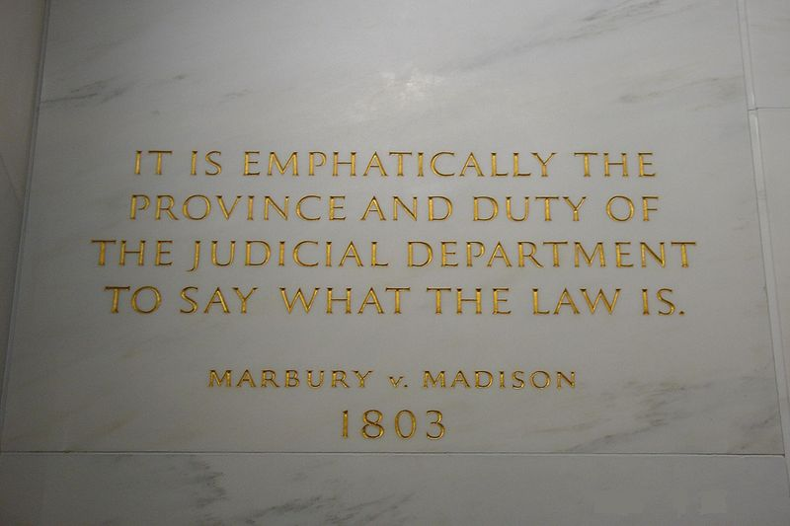
Changing the Constitution
Informal Process of Constitutional Change
Judicial Interpretation:
**Judicial Review – established through Marbury v. Madison**
Plessy v. Ferguson – Supreme Court stated separate but equal did NOT violate the 14th amendment
later reversed in Brown v. Board
Changing Political Practice:
After 1800, political parties require electors for the electoral college to vote for the state’s popular vote winner
Technology:
Media can reach Americans on issues
Presidential powers have increased (weapons)
Increasing Demands on Policymakers:
Presidential powers during war increases
Patriot Act – powers for wiretapping and surveillance of suspected terrorists
The Constitution is flexible and has the oldest functioning Constitution

Slide 14
Understanding the Constitution
Since its inception, the Constitution has become much more democratic
5 of the last 17 amendments expand the electorate
15 – suffrage for African American males
19 – women’s suffrage
23 – electoral votes for D.C.
24 – eliminated poll taxes
26 – lowered voting age to 18

Slide 15
Quick Recap
Influences of the Enlightenment – John Locke and Thomas Paine
Articles provided a weak central government and were ineffective
Shays’ Rebellion influenced the Constitution
Compromises at the Constitution were based on representation
The Federalist Papers #10 and #51 – factions are unavoidable, can be checked
Be able to identify specific checks and balances
Marbury v. Madison established judicial review

Slide 16
Thanks for watching!
Subscribe to my channel
Help spread the word
Questions? Comments?
Leave in comments
Follow me on twitter @AdamNorrisAP
Subscribe
Down here!

