Slide 1
Government in America; 15th Edition Chapter 3
www.Apgovreview.com
Federalism
Follow me on Twitter @AdamNorrisAP

Slide 2
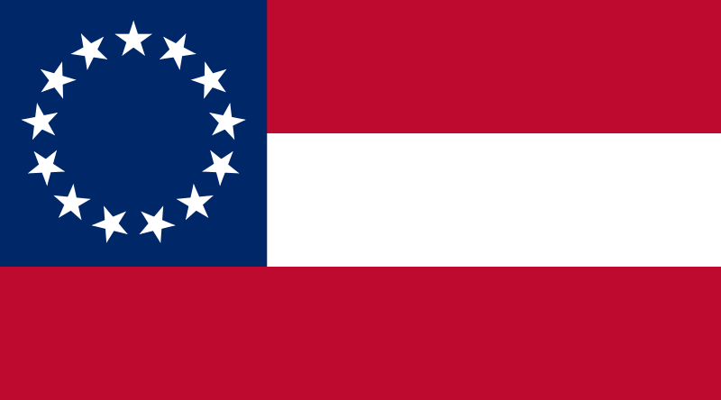
Defining Federalism
What is it?
“a way of organizing a nation so that two or more levels of government have formal authority over the same area and people.”
Essentially it’s the division of power between different levels of government (federal and states)
Most nations do not use federalism
Unitary governments – the central government has all the power (France)
Confederation – weak federal government, most power is in states or similar entity
Intergovernmental relations – interactions among federal, state, and local governments

Slide 3
Defining Federalism Cont.
Importance of Federalism:
Decentralizes politics – senators elected to represent states, not the nation
Strengthens the judicial branch – settles disputes
Federal government can influence state policies
Drinking age was raised to 21, based on federal funding for highways
States have influenced almost all national policy
Child labor, minimum-wage, unemployment, etc. began in states prior to adoption at the national level

Slide 4
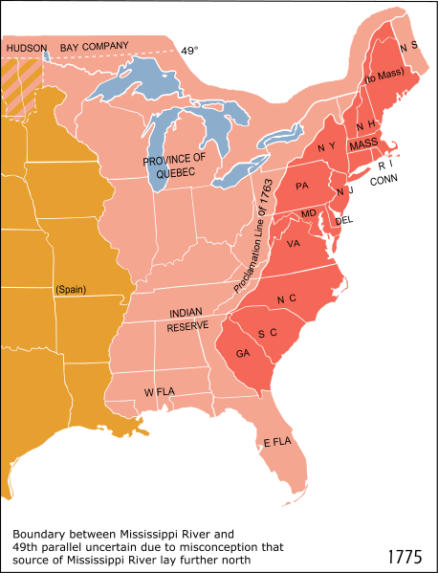
The Constitutional Basis of Federalism
Why did federalism develop?
Large area of land, widely dispersed population
What are powers given to states?
Intrastate commerce, elections (both state and national), reserved powers – education, etc.
What are powers given to the federal gov’t? (Enumerated Powers)
Coin money, declare war, interstate commerce, make treaties, etc.
What are powers given to both?
Tax, borrow money, make laws, etc.
Supremacy Clause:
The constitution, laws of the national government, and treaties are supreme law of land

Slide 5
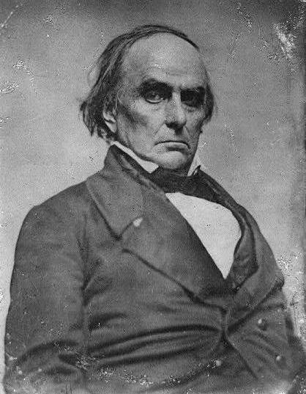
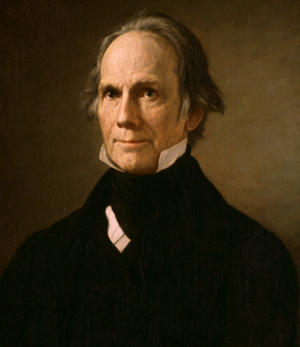
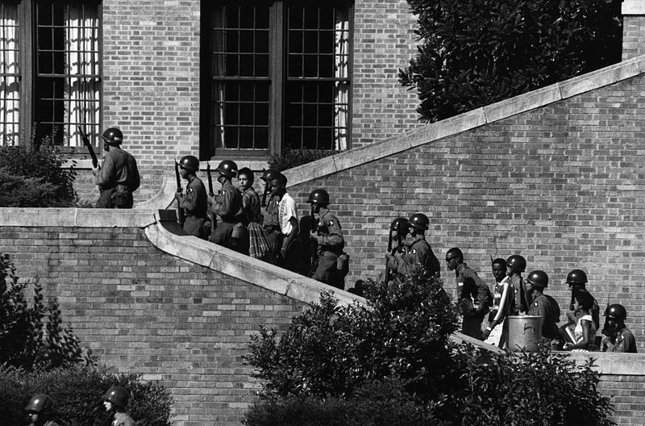
The Constitutional Basis of Federalism
10th amendment:
Powers reserved for the states; all powers not granted to federal government are given to the states - education
The Supreme Court has ruled this amendment does NOT mean that states are superior to federal gov’t
11th amendment:
Prohibits individual damage suits against state officials
How has National Supremacy been established?
Implied Powers:
Congress has the power to make “all laws necessary and proper….” (elastic clause)
Used to uphold the constitutionality of the BUS in McCulloch v. Maryland
Helped establish the superiority of federal over state power
Commerce Power:
Gibbons v. Ogden – the Supreme Court ruled that Congress, not individual states could control interstate commerce
This is used today to regulate TVs, radios, phones, etc.
Huge source of power for the federal government
The Civil War:
Helped settle the states vs. federal gov’t argument
The struggle for racial equality:
The federal government stepped in during the Civil Rights Movement of 1950s and 1960s
Brown v. Board, national guard used to ensure students were allowed to attend schools

Slide 6
The Constitutional Basis of Federalism Cont.
Obligation of states to one another:
Full Faith and Credit:
States recognize public acts, records and other proceedings of other state (marriage and driver’s licenses)
However, Congress created the Defense of Marriage Act (DOMA) which allowed states to not acknowledge gay marriages, and would not allow the federal government to recognize gay marriage
Latter part of DOMA was declared unconstitutional in 2013
Extradition:
States regularly ship criminals to other states for crimes committed there
Privileges and Immunities:
Prevents a state from discriminating against citizens of another state
This is often very complicated (in-state vs. out of state tuition for college)
However, the Supreme Court (Saenz v. Roe) ruled that California could NOT require a waiting period for welfare benefits for new residents

Slide 7
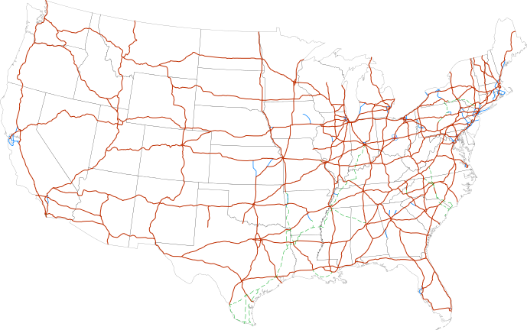
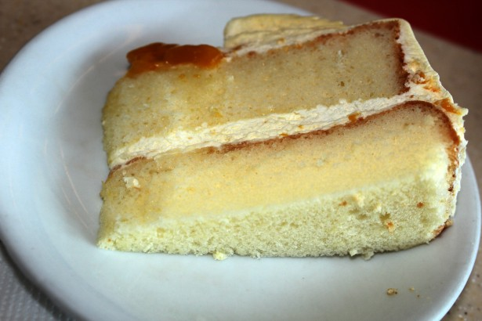
Intergovernmental Relations Today
Dual Federalism:
State and federal government are supreme in their own sphere
Layer cake
Federal government is responsible for foreign policy, states are responsible for education
Cooperative Federalism:
State and federal government share responsibilities
Marble cake
Law enforcement post-9/11
Examples of the transition to Cooperative:
National Defense Education Act (1958):
Federal government increased grants and loans for college, and $ for science in primary and secondary schools
Interstate Highway System (1956)
Cooperative Federalism shares costs and share administration between state and federal governments
Often, states must follow federal guidelines to receive $

Slide 8
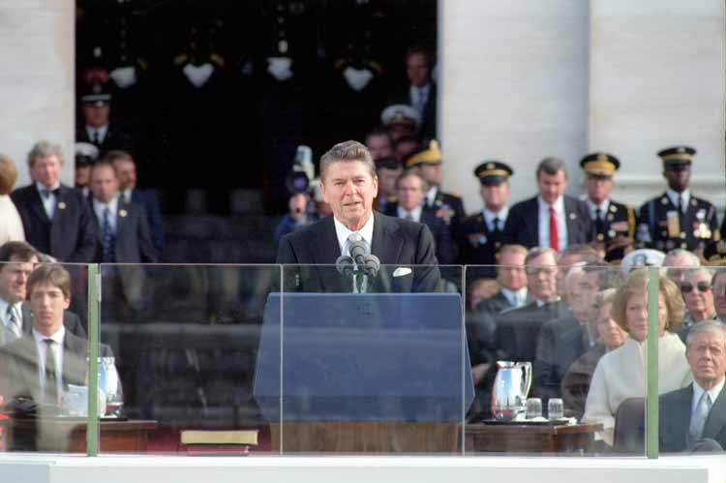
Intergovernmental Relations Today
20th century politics:
Democrats favor increasing power federal gov’t policies (child labor laws, education, etc.)
Republicans oppose those programs and favor states taking responsibility
Seen in Reagan’s inaugural address
Devolution – transferring the responsibilities of policies from the federal government to states – advocated by Republicans
Since the 1990s, Republicans have increased the role and power of the federal gov’t – No Child Left Behind, etc.
Fiscal Federalism – “spending, taxing, and providing grants in the federal system.” (p. 77)
The federal gov’t has enormous influence over states via $
“In this present crisis, government is not the solution to our problems; government is the problem.”

Slide 9
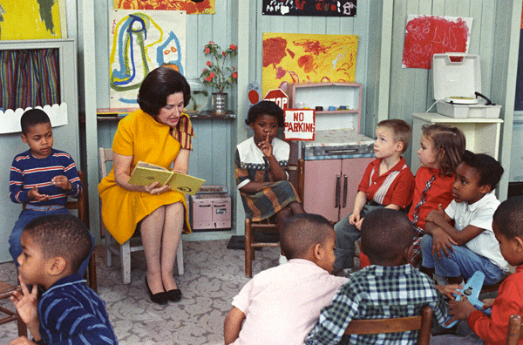
Intergovernmental Relations Today
Grants: $ from federal gov’t to state and local
***Categorical grants*** – must be used for specific purposes for state spending; way to influence policy (Head Start)
Project grants – given based on applications (Race to the Top)
Formula grants – $ distributed based on a formula, no applying is necessary (Medicaid)
***Block grants*** - $ given to states with discretion to states with how to spend
Crossover Sanctions – influencing policy by using money in one program (raising drinking age was attached to highway $)
Crosscutting Requirements – conditions are required to be met in all activities (discrimination in one are of a university will affect ALL areas that receives federal $)

Slide 10
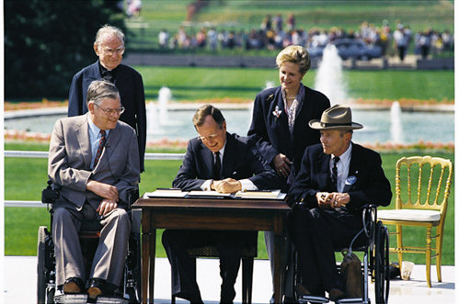
Intergovernmental Relations Today
Roughly $600 billion in federal funds led to many state and local groups that lobby for money
Universalism – The idea that everyone benefits on some level from grants
Mandates – requirements put on states and local governments to provide certain services
Penalties may arise if requirements are not met
Unfunded mandates – requirements from the federal government with no $ provided (Americans With Disabilities Act, 1990 – required access to public facilities)
Mandates can increase the burden on state budgets

Slide 11
Understanding Federalism
With so many levels in federalism, there are more opportunities for participation
Most citizens have better access to state gov’t officials
Positives of Federalism:
Political parties can have influence in state gov’ts, even if they do not in the national gov’t
States can make changes that the national level has not:
Minimum wage – federal is $7.25/hour; NY - $8.00 (will go to $8.75 on 12/31/14)
Negatives of Federalism:
States can be discouraged to provide benefits:
States with better welfare benefits can attract people from other states, which can negatively affect the state’s budget
There are 89,527 American governments – can be burdensome, expensive to operate
Why is the federal gov’t often asked to solve issues?
States do not have resources and $ that the fed gov’t does

Slide 12
Quick Recap
Supremacy Clause
The federal government uses the commerce and elastic clauses to increase its powers
Gibbons v. Ogden, Bank of the US
Be able to identify enumerated, reserved, and concurrent powers
Dual federalism – layer cake
Cooperative – marble cake
Categorical grants - $ used for specific purpose
Block grants – more leeway for states to spend $
Federalism helps increase participation in government

Slide 13
Thanks for watching!
Follow me on twitter @AdamNorrisAP
Subscribe to my channel
Help spread the word
Questions? Comments?
Leave in comments
I still live on in AP Gov too!
Subscribe
Down here!

