Slide 1
Government in America; 15th Edition Chapter 5
www.Apgovreview.com
Civil Rights and Public Policy

Slide 2
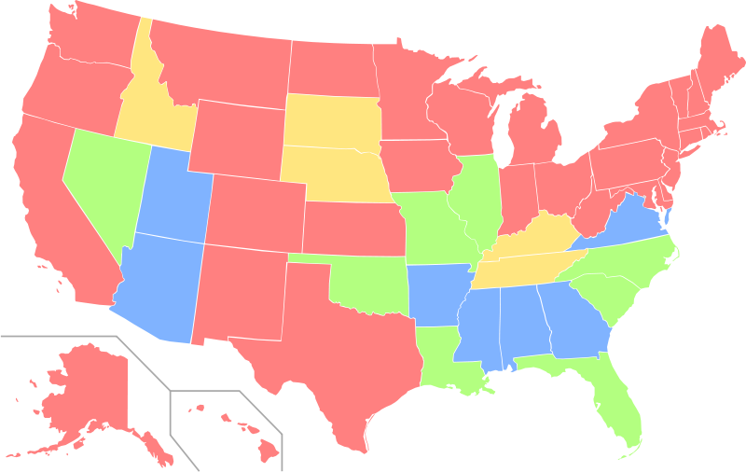
Politics In Action: Launching The Civil Rights Movement
Civil Rights – protections of individuals from arbitrary (random) discrimination by government or people
Debates about equality:
Racial and ethnic discrimination – Affirmative Action
Gender discrimination – equal rights for women is not guaranteed under the Constitution (failed ERA)
Age, disability, and sexual orientation discrimination

Slide 3
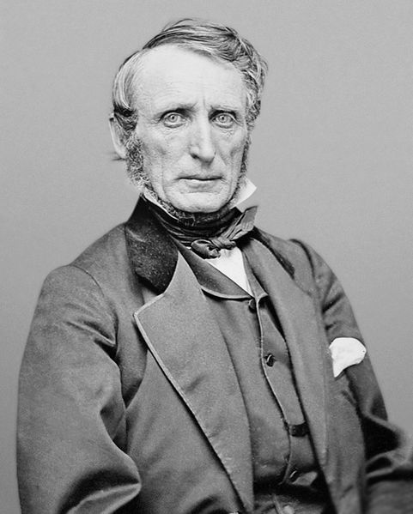
The Struggle for Equality
Conceptions of Equality:
Equal rights does not translate to equal rewards
Most people favor equality of opportunity
The Constitution and Inequality:
Equality is only mentioned in the 14th amendment
Forbids the denial of “equal protection of the laws”
Laws that classify people must not be arbitrary
Can’t focus on skin color, religion, etc.
However, classifying adults as those 18 or older is OK
Standards of Review:
Reasonable – easy to meet (restricting the voting age to 18)
Inherently suspect – difficult to meet (race and ethnicity) – these will be deemed invalid
Intermediate scrutiny – moderately difficult to meet (gender) – military draft for males only; meets a substantial relationship to government purpose
John Bingham - OH

Slide 4
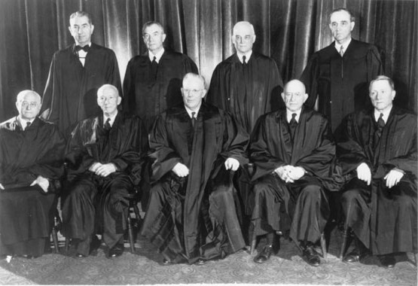
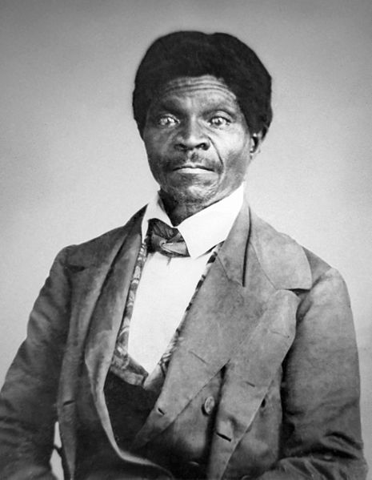
African Americans’ Civil Rights
The Era of Slavery:
Dred Scott v. Sandford – blacks had no rights under the Constitution
14th amendment – granted citizenship to blacks
The Era of Reconstruction and Segregation:
Jim Crow laws – legalized segregation
Segregation existed in the federal government (military, housing, etc.)
Civil Rights Cases –private businesses and individuals could discriminate
Plessy v. Ferguson – “separate but equal”
FDR and Truman slowly began to desegregate areas of the government
Equal Education:
Brown v. Board – reversed Plessy’s “separate but equal” doctrine
“All deliberate speed”
De jure segregation – segregation by laws
De facto segregation – segregation that exists, but not by law

Slide 5
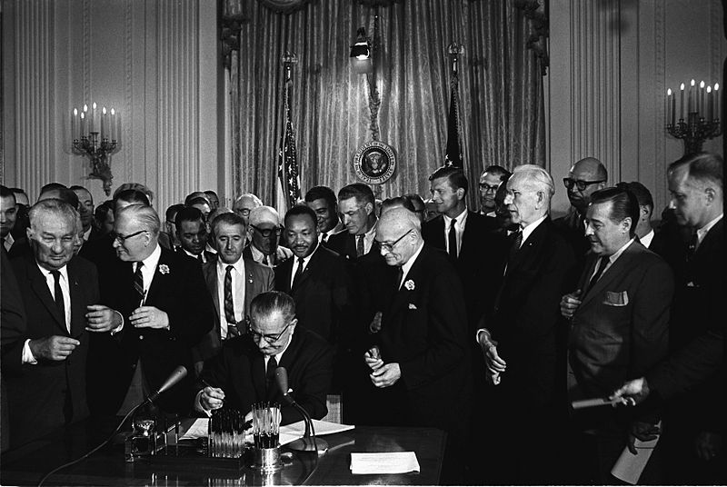
African Americans’ Civil Rights
The Civil Rights Movement and Public Policy:
Civil Rights Act of 1964:
Discrimination in public accommodations and employment was illegal
Equal Employment Opportunity Commission (EEOC)
Funds would be cut off to state and local governments that practiced discrimination
Open Housing Act of 1968 – made discrimination in housing sales and rentals illegal
Voting Rights:
15th amendment – suffrage for black males
South got around it – poll taxes, literacy tests, and white primaries
24th amendment – poll taxes are illegal
Voting Rights Act of 1965:
Government could not deny an individual the right to vote based on race or color
Literacy tests were illegal
Federal Government could use elections inspectors

Slide 6
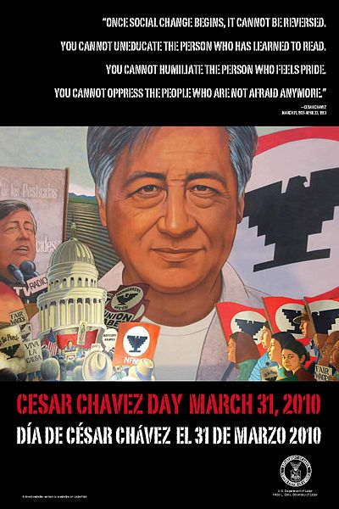
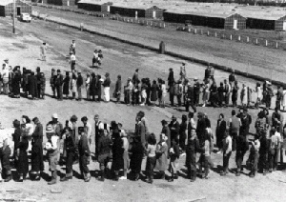
The Rights of Other Minority Groups
Native Americans:
1924, Natives became citizens and granted suffrage
Indian Bill of Rights – most Bill of Rights were applied to tribes
Some natives have been given certain exemptions (gambling, taxes, etc.)
Hispanic Americans:
Largest minority group
Used similar tactics as African Americans during the Civil Rights Movement to gain rights (sit-ins, boycotts, etc.)
Cesar Chavez – brought attention to migrant farm workers
Children of illegal immigrants cannot be denied enrollment in schools (Plyler v. Doe)
Asian Americans:
Korematsu v. US (1944) – relocation and internment of Japanese-Americans during WWII was upheld
Arab Americans and Muslims:
Have faced discrimination similar to other groups, especially post 9/11

Slide 7
Women and Public Policy
Coverture – married women did not have their own identity separate from husband’s
The Battle for the Vote:
19th amendment (1920) – women’s suffrage; many western states allowed women’s suffrage prior to the 19th amendment
The “Doldrums”: 1920 – 1960:
Goals of women diverged after the 19th amendment
Equal Rights Amendment (ERA) – proposed in 1923, passed Congress in 1972; never ratified by states
The Second Feminist Wave:
Betty Friedan’s The Feminine Mystique, NOW
Craig v. Boren (1976) – helped set the standard for gender discrimination (intermediate discrimination)
Women in the Workplace:
Civil Rights Act of 1964 – also banned gender discrimination in work
Title IX – outlaws gender discrimination in education (athletics as well)

Slide 8
Women and Public Policy
Wage Discrimination and Comparable Worth:
Women earn less than men for comparable jobs
Sexual Harassment:
Deemed a form of gender discrimination in 1986 by the Supreme Court
Employees are safe from retaliation by employers if they file a claim
Women in the Military:
Women served in units separate from men
Are not required to register for the draft
Prohibited from serving in combat
Women play important roles – pilots
Plans to change combat restrictions by 2016

Slide 9
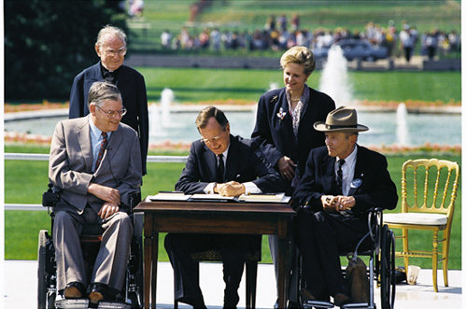
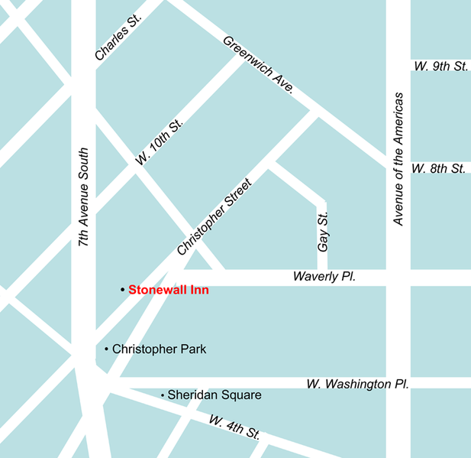
Other Groups Active Under the Civil Rights Umbrella
Civil Rights and the Graying of America:
Age Discrimination Act (1975) – federal funds would be denied to institutions that engaged in discrimination against people over 40
Most jobs cannot require forced retirements unless employers can show age and ability are related
Civil Rights and People with Disabilities:
Rehabilitation Act of 1973 – those with disabilities were protected from discrimination
Americans with Disabilities Act (ADA – 1990) – public facilities must make “reasonable accommodations” and prevent discrimination in the workplace
Think back…… what type of mandate was this?
Unfunded
Gay and Lesbian Rights:
Stonewall Riots (1969), Matthew Shepard (1998)
Don’t Ask, Don’t Tell – repealed by Obama in 2010

Slide 10
Affirmative Action
Executive Order 11246 (LBJ – 1965):
Banned discrimination based on race, color, religion, sex, or national origin in federal contractors
Employers must have goals to increase the number of women and minorities
Affirmative Action:
The goal is to increase employment, opportunities, and protection for groups that have been discriminated against
Equal opportunity -> Equal results
Regents of the University of California v. Bakke (1978)
UC Davis had a quota for 16 out of 100 applicants reserved for “disadvantaged groups”
Declared unconstitutional, however……
Race could be used as one part of admission process
Affirmative Action is a highly debated topic and the court has made different interpretations over the years

Slide 11
Understanding Civil Rights and Public Policy
Civil Rights and Democracy:
Essential rights and liberties have pushed for reforms in America (1st amendment, not suffrage helped African Americans and women)
Civil Rights and the Scope of Government:
Civil Rights issues increase the size and power of the government
Post-Civil War – 13 – 15 amendments
1950s – 1960s – Civil Rights and Voting Rights Acts

Slide 12
Quick Recap
14th amendment
Standards of review – reasonable, inherently suspect, and intermediate scrutiny
Brown reversed Plessy
De jure v. de facto segregation
Civil Rights Act, Voting Rights Act, and the 24th amendment
Title IX
ADA
Regents of the University of California v. Bakke (1978)

Slide 13
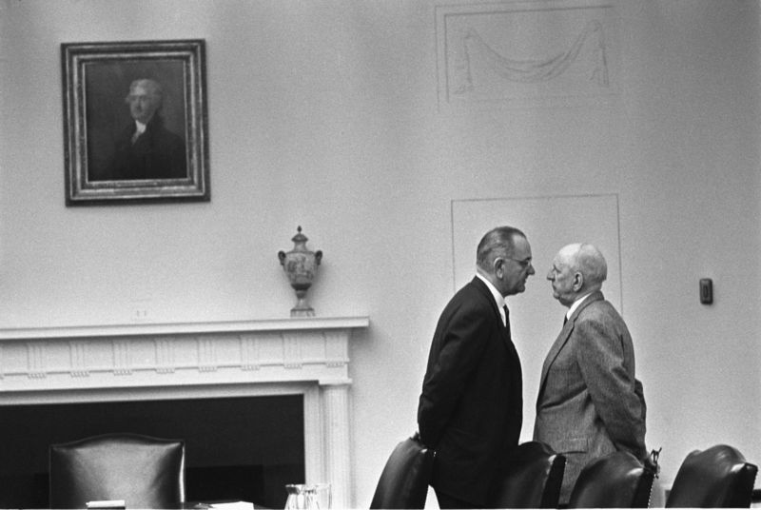
Thanks for watching!
Subscribe to my channel
Help spread the word
Questions? Comments?
Leave in comments
Subscribe
Down here!

