Slide 1
Government in America; 15th Edition Chapter 6
www.Apgovreview.com
Public Opinion and Political Action

Slide 2
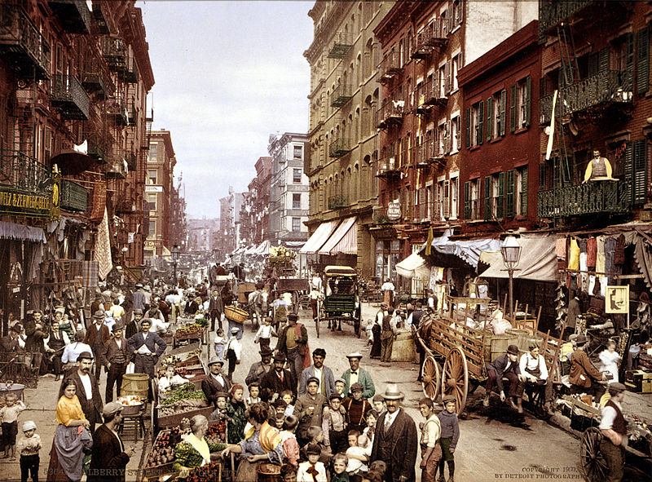
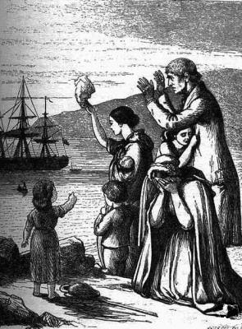
The American People
Census – required by law to be taken every ten years
Helps determine how much $ each state gets – and representatives
The Immigrant Society:
1,000,000 immigrants can come to the US by law
California has the highest percentage of immigrants
Immigration throughout US History:
“Old Immigration” Northern and Western Europe (Irish, Germans, British)
“New Immigration” Southern and Eastern Europe (Italians, Russians, Jews)
1960s – present day: Hispanics and Asians
The American Melting Pot:
Melting pot – many different cultures blend into one
Minority majority – America will no longer have a white majority
African Americans are no longer the largest minority – Hispanics
Illegal Immigration – 10.8 million in 2009
Simpson-Mazzoli Act – requires employers to keep track of the citizenship of employees

Slide 3
The American People
The American Melting Pot (Continued):
Asian Immigrants tend to be highly skilled
Native Americans – 4.5 million Americans
Face obstacles – health, education, financial
The Regional Shift:
Reapportionment – changing the number of members in the House based on the census
Since WWII, the South and West saw in increase in population (Sun Belt)
The Graying of America:
Baby Boomers – those born between 1945 – 1964 (fastest growing group)
Social Security is the 2nd most costly public policy
Senior Citizens vote more than any other group

Slide 4
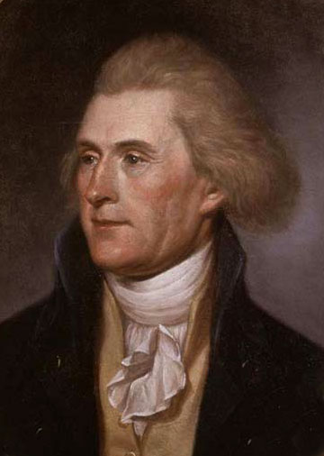
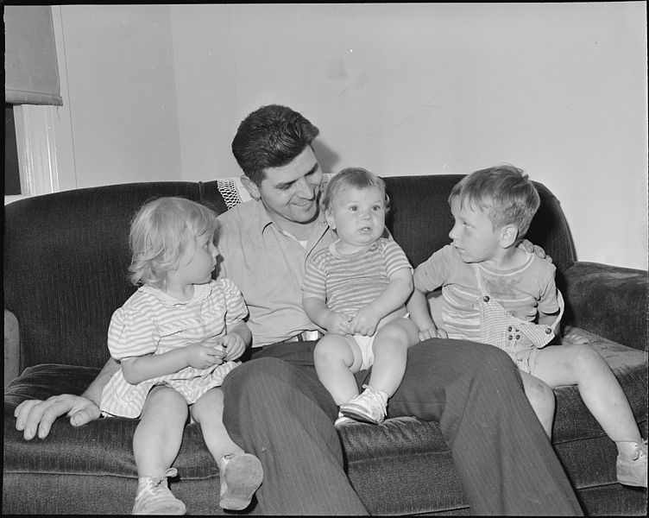
How Americans Learn About Politics: Political Socialization
Political Socialization:
How a person learns or decides their political beliefs
The Process of Political Socialization:
The Family: (seen on m.c. portion of released exams)
Very influential, young individuals tend to vote how their parents vote
The Mass Media:
Very influential, not just news stations
School:
Education plays a large role in socialization – Jefferson wanted an educated electorate
The more educated an individual, the more likely they are to vote in elections
Political Learning over a Lifetime
As individuals age, they tend to become more involved in politics

Slide 5
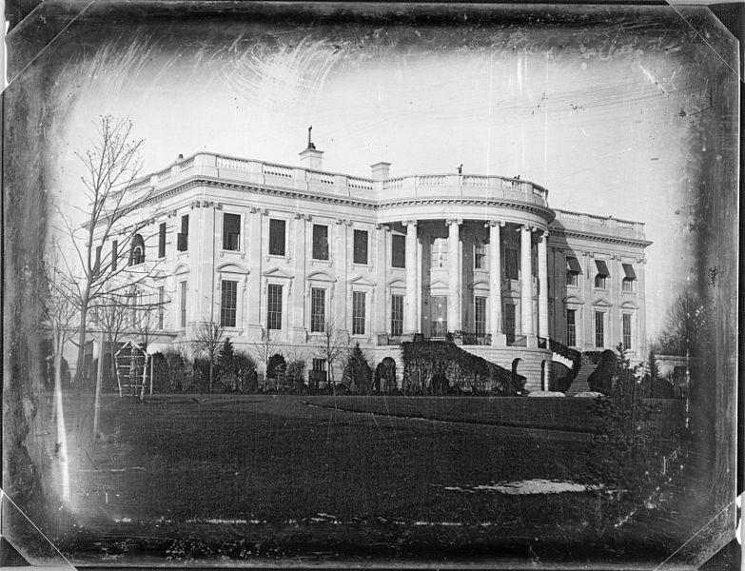
Measuring Public Opinion and Political Information
How Polls Are Conducted
Gallup Polls – take a sample of the population
Random Sampling – everyone has the possibility of being part of the sample
Sampling Error – typically 2-3%
Polls must keep with changing times (cell phones v. home phones)
The Role of Polls in American Democracy:
Do politicians follow polls too much?
Polls may create a bandwagon effect
Exit Poll – heavily criticized, those on the West Coast still need to vote
Wording of polls can influence answers
What Polls Reveal About Americans’ Political Information:
Who lives at 1600 Pennsylvania Avenue? Who lives in a pineapple under the sea?

Slide 6
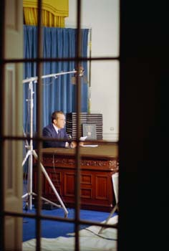
Measuring Public Opinion and Political Information
The Decline of Trust in Government:
Since the 1960s, public trust in government has declined
Gulf of Tonkin, Watergate, Iran Hostage Crisis, etc.
Many Americans believe that government solutions to problems are wasteful

Slide 7
What Americans Value: Political Ideologies
Political Ideology:
Liberals – favor larger central government, conservatives – favor smaller central government
Who are the Liberals and Conservatives?
More often than not, Americans choose conservatives
African Americans tend to be more liberal, as do women
Gender Gap – women are more likely to support Democrats
The importance of religion in a person’s life influences their views
What religion they are is less important, rather how religious they are
The more religious, the more conservative (typically)
Do People Think in Ideological Terms?
Many voters do not connect ideology to voting

Slide 8
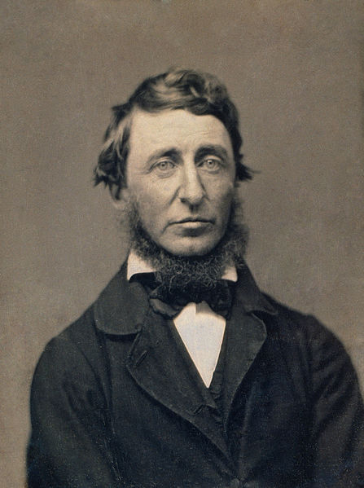
How Americans Participate in Politics
Political Participation:
More than just voting – protest, writing government officials, etc.
Conventional Participation:
Voting, door to door campaigning
Unconventional – protesting, civil disobedience
Majority of Americans vote (only form of participation that a majority participate in)
Protest as Participation:
Unconventional, seeks to change policy
Civil disobedience – Henry David Thoreau, Gandhi, MLK Jr.
Class, Inequality, and Participation:
The higher the economic status, the more likely one is to participate in politics
Blacks are more likely to vote than whites
The higher the voter turnout for a group, the more politicians pay attention

Slide 9
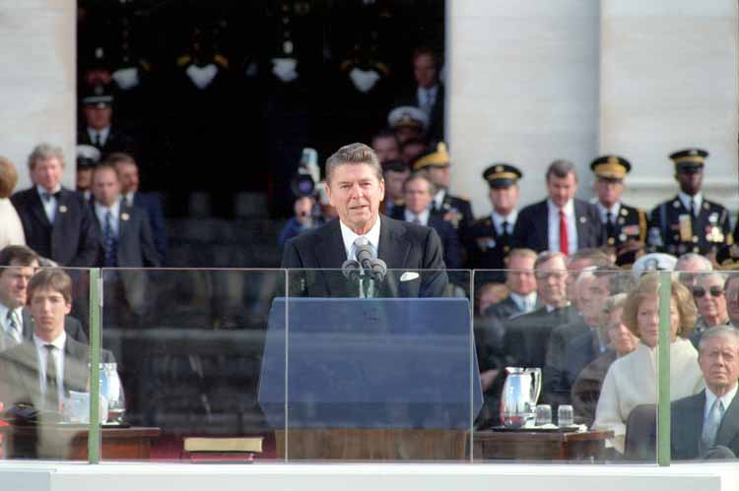
Understanding Public Opinion and Political Action
Public Attitudes Toward the Scope of Government:
Reagan’s inaugural address
Barry Goldwater in 1964
1980 – 50% of Americans felt the government was too powerful
Many people today feel it is too big, yet want more spending on certain programs
“In this present crisis, government is not the solution to our problems; government is the problem.”

Slide 10
Quick Recap
Melting Pot
Immigration throughout History
Political Socialization – families
Polls and Sampling Errors
Liberals vs. Conservatives
Religion and Politics
Conventional vs. Unconventional Participation

Slide 11
Thanks for watching!
Subscribe to my channel
Help spread the word
Questions? Comments?
Leave in comments

