Slide 1
Government in America; 15th Edition Chapter 7
www.Apgovreview.com
The Mass Media and the Political Agenda

Slide 2
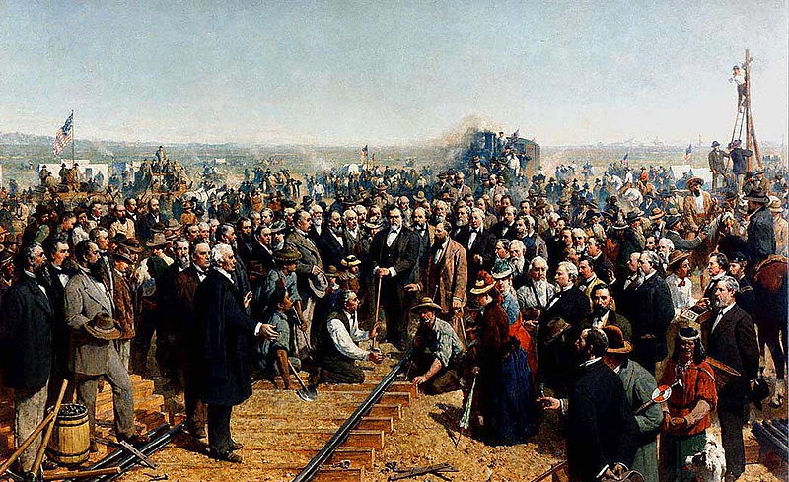
The Mass Media Today
Media Event – set up in order to be covered
Example – candidate campaigning door to door
60% of campaign spending for Presidents is spent on tv advertisements
Especially in swing states
Most of the ads are negative towards the opponent
Image of candidates is of the utmost importance

Slide 3
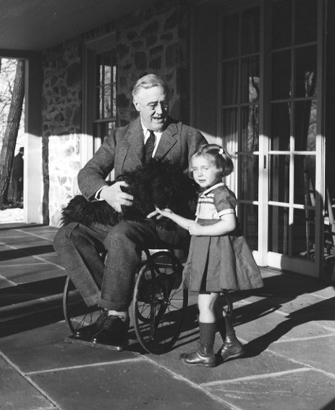
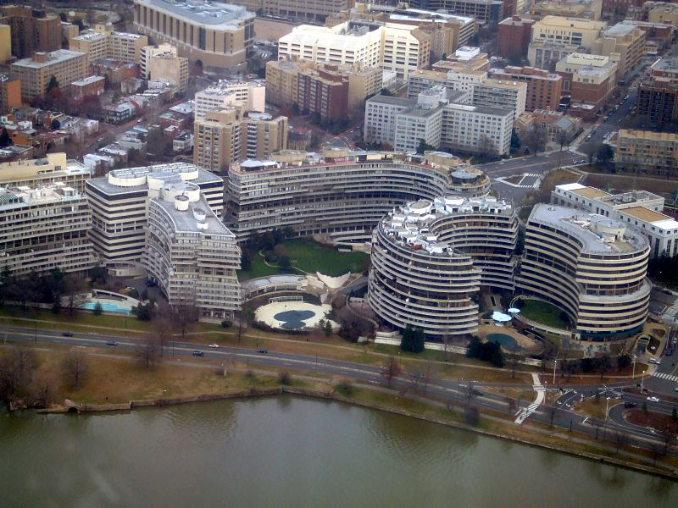
The Development of Media Politics
Franklin Roosevelt changed the relationship between presidents and the media
2 press conferences a week
Press did not reveal he was disabled
Vietnam and Watergate changed Presidential press reporting
A president’s personal life became fair game
Clinton-Lewinsky scandal
Investigative journalism – reporters investigating the truth of government officials
Since 1960, coverage of presidents has become less favorable
2 types of media
Print – newspapers and magazines (less popular)
Electronic – TV and Internet (more popular)

Slide 4
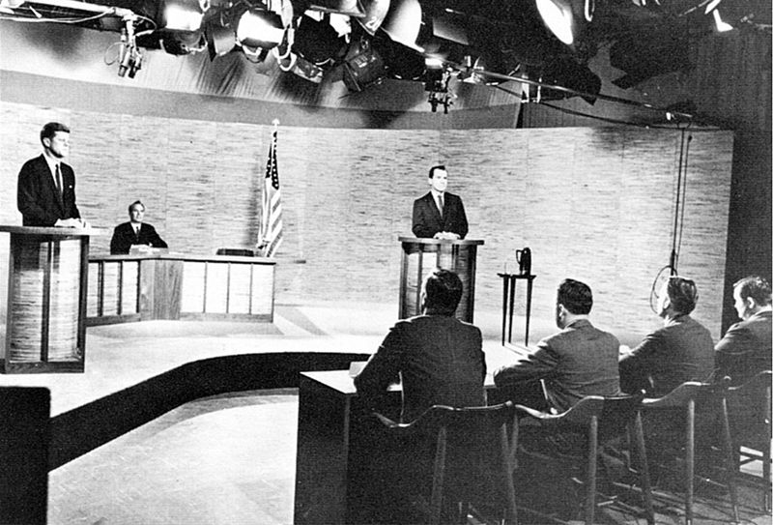
The Development of Media Politics Cont.
The Print Media:
1st amendment is instrumental in the media today
Citizens that read newspapers are better informed
Circulation of print media has declined in recent years
The Emergence of Radio and Television:
Radio ownership is nearly universal
Impact of TV on politics?
1960 election
Coverage of Vietnam
Government Regulation of Electronic Media:
Federal Communications Commission (FCC) – regulates TV, radio, phones, satellites, and cable

Slide 5
The Development of Media Politics Cont.
From Broadcasting to Narrowcasting….:
Broadcasting – signal is sent to a broad audience (ABC, NBC, CBS)
Narrowcasting – sent to a smaller audience (MTV, ESPN, cable news)
Many young adults are more engaged in narrowcasting
The Impact of the Internet:
Availability of information does not translate to acquisition of information
Blogs have increased the influence of average citizens
Private Control of the Media:
Many countries have government-owned news stations (BBC)
Public ownership has its benefits – news is not reliant on advertisers

Slide 6
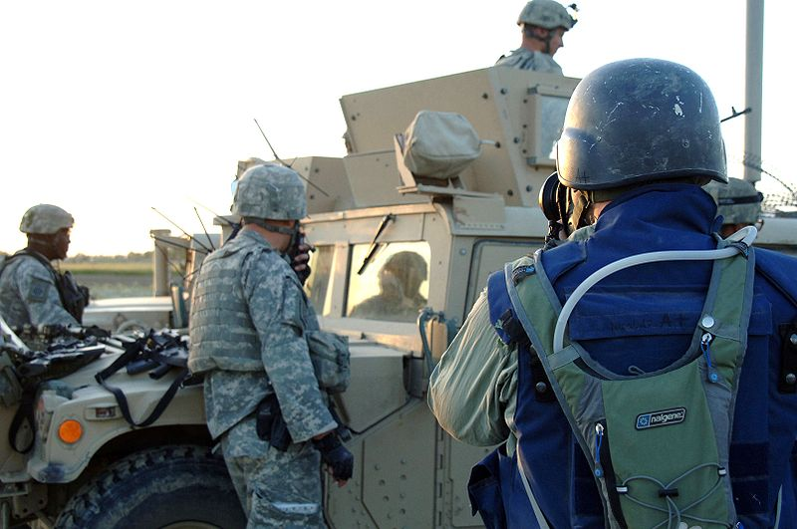
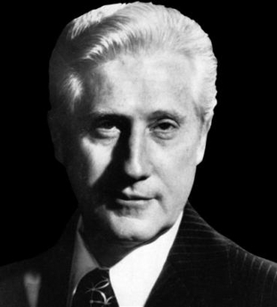
Reporting the News
News is reported when it is different
President Bush in Japan in 1992
Many networks choose to air what is entertaining
Finding the News:
Trial balloons – purposely leaking information to the public to test the political reaction
Embedding of reporters – in order to increase access to war coverage, reporters were embedded with troops
Sources wanting to expose the truth are rare, but do happen – “Deep Throat” in the Watergate Scandal

Slide 7
Reporting the News
Presenting the News:
Most news coverage is superficial and lacks substance
More technology has not meant more coverage, rather the opposite is true
More likely to see sound bites of a speech than the speech itself
1992 – 24.6 minutes per night of the presidential campaign, 2000 – 12.6 minutes per night
Bias in the News:
Bias – advocating a certain perspective
Mainstream media is often accused of being liberal

Slide 8
The News and Public Opinion
The media can (and does) influence how the public views politicians:
Choose the stories and can increase attention to certain problems
Focusing on unemployment vs. low inflation (1992)
If a politician misstates something, the Media can focus heavily on that
Policy Entrepreneurs and Agenda Setting
Policy Agenda:
Set of issues that politicians and others deem important and focus on (healthcare, Middle East, etc.)
This is fluid and can (and does) often change based on circumstances
Policy entrepreneurs – people that bring attention to an issue via
Use press releases, conferences, and letter writing to bring attention to their cause

Slide 9
Understanding Mass Media
The Media and the Scope of Government:
Americans view positively the media keeping politicians in check
The media’s “watchdog philosophy” can increase the size of government by encouraging the government to solve problems
Individualism and the Media:
The media focuses on individuals more than groups
A politician’s image is more important than ever – especially the President
Democracy and the Media:
Access to information does not equate to an informed society
Those that access information are more likely to vote and help dictate policy

Slide 10
Quick Recap
Media Event
TV’s impact on politics – 1960 election
More access does not equate to more knowledge
Bias
Politician’s image

Slide 11
Thanks for watching!
Subscribe to my channel
Help spread the word
Questions? Comments?
Leave in comments
If only Nixon subscribed….

