Slide 1
Government in America; 15th Edition Chapter 8
www.Apgovreview.com
Political Parties

Slide 2
The Meaning of Party
What is a political party?
People trying to win office and control the government
Party in the electorate:
Any American can be a member of any party at any time – membership cards or dues are not required
Party as an organization:
Parties have national and local offices and staffs
Party in government:
Those that are elected
Tasks of the Parties:
Linkage institutions – way that people’s concerns help become political issues
Parties decide candidates – presidential nominees are chosen by the public
Run campaigns – on all levels
Provide info to the public
Articulate policies via platforms
Coordinate policymaking between the legislative and executive branches

Slide 3
The Meaning of Party Cont.
Rational-Choice Theory:
Voters want their policies to be adopted by the government, parties want to win elections
Most Americans identify themselves as centrists or just to one side
Parties with extreme ideas are rarely successful
The Prohibition Party received only 519 votes in the 2012 Presidential Election.

Slide 4
The Party In The Electorate
Party image:
Idea that individuals have a certain image of each political party
Party identification:
Preference for a party
Most voters vote for candidates of the party they identify with
Ticket Splitting:
Voters that vote for one party for an office and another party for another office
Occurs most often with Independents

Slide 5
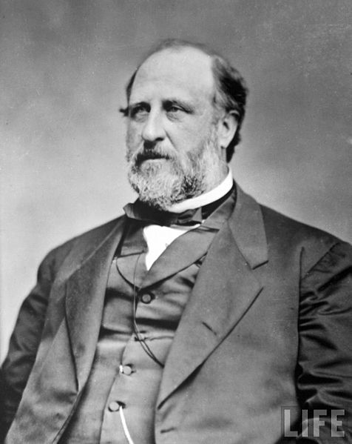
The Party Organizations: From Grass Roots to Washington
Local Parties
Party Machines:
Organization that would reward members in some way
Rely on ethnic support – Irish – Tammany Hall
Most often, patronage is used
Patronage:
Jobs given to political supporters
Boss Tweed sold jobs for $
Merit system is often used today
Parties In The States:
States decide election procedures for parties
Open primary: any voter can participate in the primary
Closed primary: only registered party members can vote in primaries
National Party Organizations:
National Convention:
Occurs every 4 years, writes the party’s platform
National Committee:
Run the party between conventions
Made up of representatives from the states
National Chairperson:
Hires staff and takes care of day-to-day business of the party

Slide 6
The Party in Government: Promises And Policy
Coalition:
Individuals that support the party based on the party’s track record
This can (and often does) change based on the fulfillment of promises (LBJ promising not to send Americans to Vietnam, Bush’s “Read my lips”)
More often than not, presidential platforms meet many of the promises of the campaigns
Clinton’s gun control
Bush’s tax cuts

Slide 7
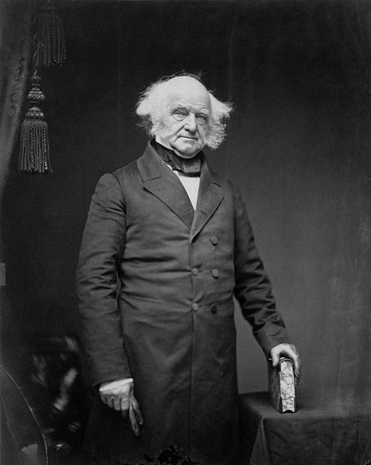
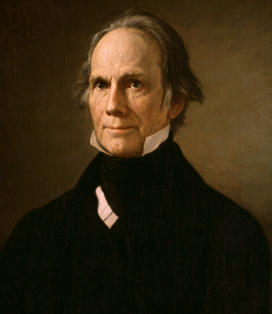
Party Eras in American History
Throughout American history, a two-party system has dominated
Even though Washington warned of political parties in his “Farewell Address”
1796 – 1824: The First Party System:
Federalists (Hamilton) vs. Democratic-Republicans (Jefferson)
1828 – 1856: The Democrats and Whigs
During Jackson’s presidency, the Democratic party was born
Many voting requirements were eliminated for adult, white males
Martin Van Buren was the architect of the party
Whigs – Henry Clay! – formed in opposition to Jackson
1860 – 1928: The Two Republican Eras:
Republican Party formed in the 1850s – opposed the expansion of slavery
Favored high tariffs, internal improvements, and gold standard

Slide 8
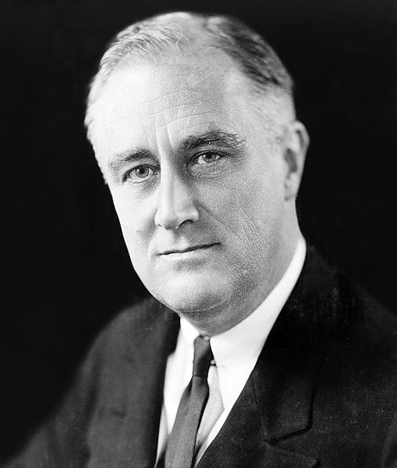
Party Eras in American History
1932 – 1964: The New Deal Coalition:
The Great Depression and New Deal shifted party loyalties
Democrats favored increased government involvement
New Deal Coalition:
Those that began to vote Democratic included:
Those living in cities, unions, poor individuals, blacks, etc.
The Great Society continued ideas of the New Deal and added civil rights legislation
1968 – Present: Southern Realignment…..:
Since Nixon’s 1968 election, most often a single party does NOT control the White House and both houses of Congress
Political dealignment:
Idea that many people are moving away from the two political parties

Slide 9
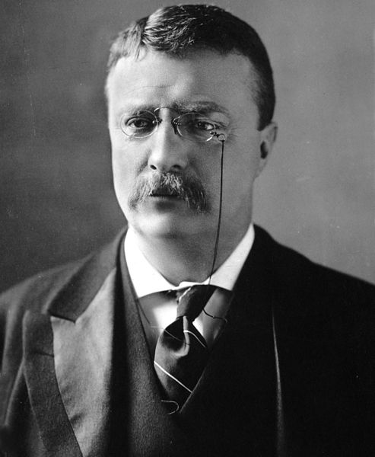
Third Parties: Their Impact on American Politics
Third Parties: 3 Main Types:
Promote a certain cause (pro-life, prohibition, etc.)
Splinter parties – split from a major party (Bull Moose Party)
Based on an individual hoping to be president (Ross Perot in the 1990s)
Often, the two parties do not take a stand on controversial issues
Fear of losing many voters

Slide 10
Understanding Political Parties
Responsible Party Model:
Idea that a majority party would implement its programs
All members of the party would be united with the program
The minority party would let the public know what it would do
The majority party is responsible for the actions of the government
Not all party members always agree on platforms
Southern Democrats tend to be more fiscally conservative than their counterparts

Slide 11
Quick Recap
Linkage Institutions
Ticket Splitting
Party Machines
Patronage
The New Deal Coalition
Types of third parties

Slide 12
Thanks for watching!
Subscribe to my channel
Help spread the word
Questions? Comments?
Leave in comments
I hope you haven’t forgotten about me…..

