Slide 1
Government in America; 15th Edition Chapter 9
www.Apgovreview.com
Nominations and Campaigns

Slide 2
The Nomination Game
Nomination – party endorsement for office
Campaign strategy – ways a candidate tries to win nomination
Deciding to Run:
Campaigns in other countries last two months
Presidential candidates in US campaigns for at least a year
Competing for Delegates:
National Party Convention – meets every four years; nominates president and VP, and creates the party’s platform
Delegates to the convention used to be chosen by political leaders
McGovern-Fraser Commission – helped allow for more input from public for Democratic Conventions (result of 1968 convention)
Delegate selection must not be done in secret – primary election or open meeting
Superdelegates – guaranteed to be delegates to the convention based on their position (member of Congress or member of national committee)
19% of Democrats and 6% of Republicans
Can support ANY candidate

Slide 3
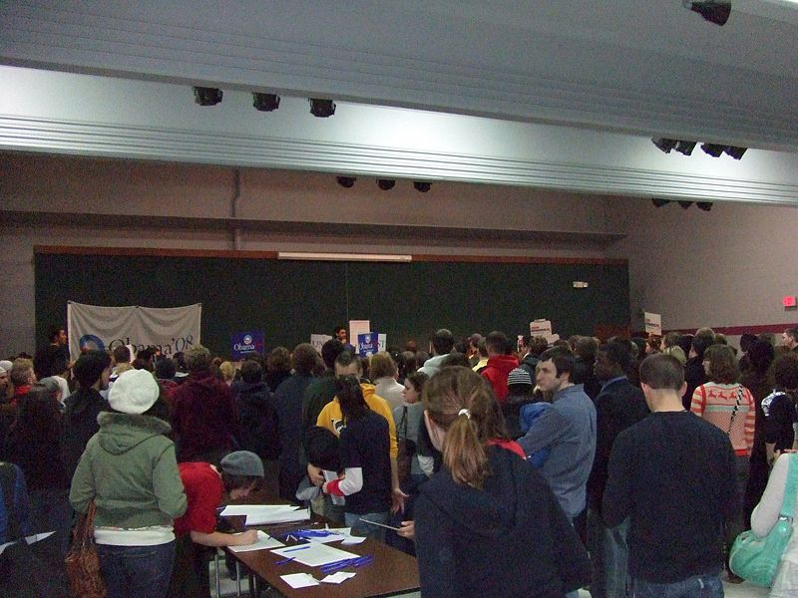
The Nomination Game Cont.
The Caucuses and Primaries (dependent on each state)
Caucus – voters attend an open meeting to choose their candidate for president
Much more time consuming than primaries
Iowa caucus is the first step in the nomination process for candidates every 4 years
Campaigns could be made (Jimmy Carter, 1976) or broken here
As a result, Iowa receives a of of $ and attention during primary season
Presidential Primaries – voters go to polls to vote for candidates
NH is traditionally the first primary
Like Iowa, they receive a lot of $ and attention from candidates
Winning Iowa and/or New Hampshire helps build a candidate’s image
Frontloading – states moving primaries earlier to gain more media attention
a majority of delegates are chosen in the first 6 weeks of the season
As the primary season goes on, more and more candidates drop out - $$$
Evaluating the Primary and Caucus System:
Criticisms include: too much attention spent on early contests, difficult for politicians to run and complete their duties, $ is too significant, voter participation is low, media is very powerful

Slide 4
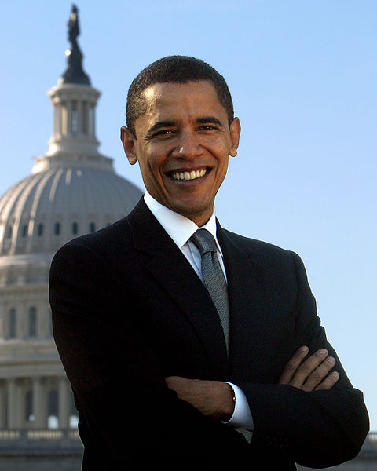
The Nomination Game Cont.
The Convention Send-Off
Prior to the Convention, there is virtually no doubt who will win the nomination
38 million people (little more than 10% of population) watched Obama receive nomination in 2008
In years past, virtually all delegates where white males over 40
The weeklong convention (infomercial for the Party)
Day 1: keynote speaker (2004)
Day 2: Party Platform – outlines the goals and policies
Day 3: nomination of the candidate
The final step is the candidate giving his/her speech

Slide 5
The Campaign Game
The High-Tech Media Campaign:
TV is most common way to reach voters
Internet is incredibly important – spread news and raise $
Smaller donations, but many more people can be reached
Direct mail – potential supporters are targeted via mail and asked to donate
The importance of media:
Provides a source of advertisement, and “free” advertising via news
Half of presidential campaign $ is spent on TV ads
News coverage does not always focus on issues, but rather campaign details
Organizing the Campaign:
Requirements to run an effective campaign:
Campaign manager, fund-raiser, campaign lawyer, media expert, campaign staff – many young volunteers, research staff and advisers, pollster, press secretary, website…….
All of this costs $, lots of $
Great Movie – Ides of March – George Clooney, Ryan Gosling, and CINCINNATI!

Slide 6
The Campaign Game Cont.
The Maze of Campaign Finance Reforms:
Federal Election Campaign Act (1974):
Created the Federal Election Commission (FEC) – administers and enforces campaign laws
Created the Presidential Election Campaign Fund: FEC gives $ to candidates ($3 on tax returns)
Provides partial public funding for presidential primaries: matching funds - $250 for candidates that raise $5,000 in at least 20 states; candidates must limit spending to receive matching funds
Bush in 2000 refused matching funds
Provides full public financing for major party candidates in election: grant to candidates ($85 million in 2008)
Obama in 2004 refused the $85 million
Requires full disclosure of who contributes and how much $
Limited contributions: limits individual contributions to campaigns ($2,300 in 2008)
Buckley v. Valeo:
SC ruled that individuals could contribute as much to their own campaign as they wish (Ross Perot spent $60 million in 1992)

Slide 7
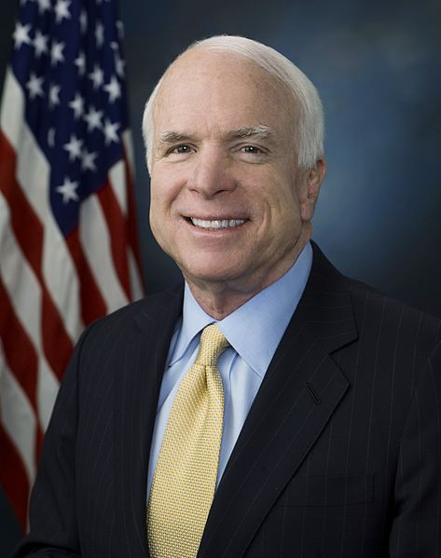
The Campaign Game Cont.
Soft Money – money not given to a specific candidate, but party expenses – no limits on contributions
McCain-Feingold Act – banned soft $ contributions and limited corporations and unions ability to pay for ads 60 days prior to an election
The second part was later overturn in Citizens United v. Federal Election Commission (2010)
527 groups:
Independent groups that have no restriction on funding, provided they do not explicitly endorse a candidate (Swift Boat Veterans for Truth – 2004, Kerry; Moveon.org – 2004, Bush)
501(c) groups:
Groups that can receive unlimited contributions and do not have to report them, provided no more than half of money spent is on political activities

Slide 8
The Campaign Game Cont.
The Proliferation of PACs:
Political Action Committee (PAC):
Can donate $5,000 per candidate in primary and general elections
Interest groups can form PACs to support favorable candidates
Especially influential in Congressional elections
FEC receives reports of all PAC spending
Are Campaigns Too Expensive?
2008 costs for Congress and Presidential campaigns?
$5 billion
.05% of the GDP
Why is campaign finance reform difficult to achieve?
Congress is hesitant to tie their own hands

Slide 9
The Impact of Campaigns
3 effects of campaigns on voters:
Reinforcement: campaigns can reinforce a person’s preference for a candidate
Activation: campaigns can get voters to get involved by spending $ or volunteering
Conversion: campaigns can change voters’ minds
Out of the 3, campaigns most often do NOT convert voters
Selective Perception – paying attention to issues that people agree with or are interested in
Buying a car – see that car everywhere

Slide 10
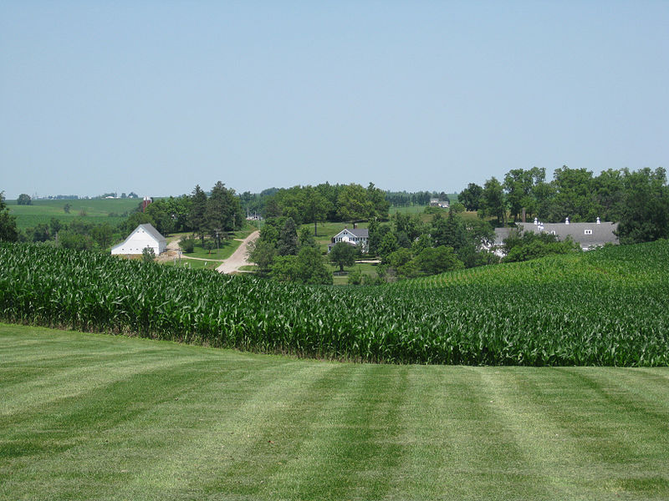
Understanding Nominations and Campaigns
Are Nominations and Campaigns Too Democratic?
In most countries, nomination is still controlled by a select few
Many unknowns can, and do, become president (Carter, Clinton)
Some believe America is in a “permanent campaign”
Some Americans suffer paralysis by analysis and do nothing
Do Big Campaigns Lead to an Increased Scope of Government?
Campaigning can lead to many more promises
Farm subsidies in Iowa
These promises increase the involvement of federal government in local affairs

Slide 11
Quick Recap
Primary vs. caucus
Delegate vs. Superdelegate
Importance of image during primaries
Role of Media in Campaigns
Federal Election Commission
527 groups
501(C) groups
PACs
Benefits and weaknesses of American campaigns vs. other countries

Slide 12
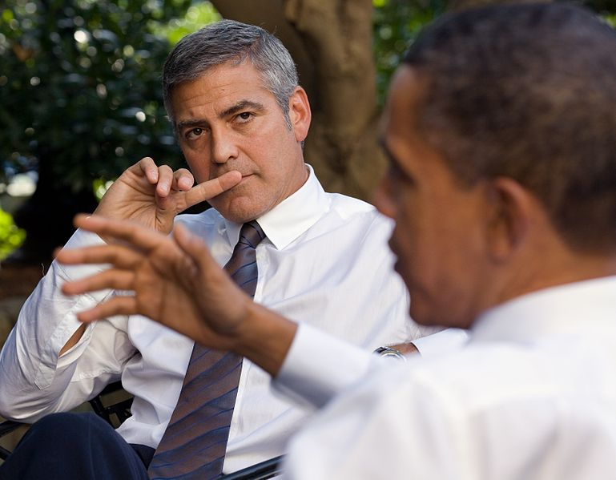
Thanks for watching!
Subscribe to my channel
Help spread the word
Questions? Comments?
Leave in comments

