Slide 1
APUSH Review: Key Concept 5.3, revised 2015 (Most up-to-date video)
Everything You Need To Know about key concept 5.3 to succeed

Slide 2
Key Concept 5.3
“The Union victory in the Civil War and the contested reconstruction of the South settled the issues of slavery and secession, but left many questions about the power of the federal government and citizenship rights.”
Page 57
Big Idea Questions
Why did the North prevail in the Civil War?
What impacts did the 13-15 amendments have on women and African Americans?
What were ways the South resisted the amendments?

Slide 3
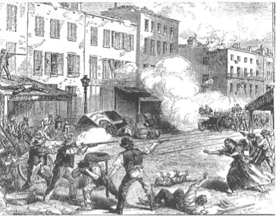
Key Concept 5.3, I
“The North’s greater manpower and industrial resources, the leadership of Abraham Lincoln and others, and the decision to emancipate slaves eventually led to the Union military victory over the Confederacy in the devastating Civil War.” - page 57
A) North and South dedicated their economies and societies to fighting the war
Conscription (draft) instituted in both regions
Opposition persisted in both regions
In the North:
MD newspapers were shut down by Lincoln, NYC Draft Riots - “Rich man’s war, but a poor man’s fight”
In the South:
Many farmers refused to fight, would not let slaves fight

Slide 4
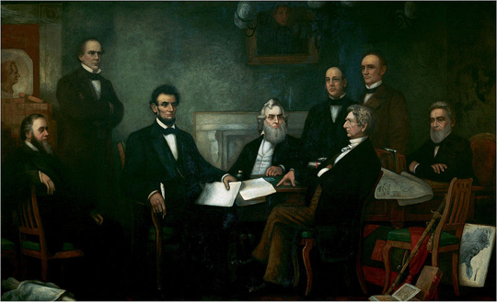
Key Concept 5.3, I
B) Evolvement of Lincoln’s war goals:
Initially, the war was fought to preserve the union
Emancipation Proclamation - issued on 9/22/1862
Helped change the purpose of the war
Kept European powers from siding with the South
Many African Americans enlisted in the Union Army
C) While the war raged on, Lincoln sought to reunify the country
Gettysburg Address - referenced a “new birth of freedom” - sought to ensure all men truly are equal

Slide 5
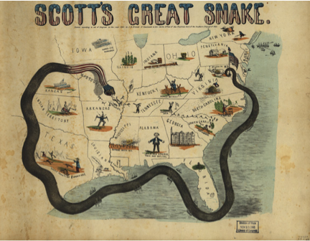
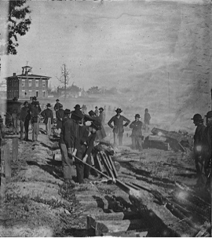
Key Concept 5.3, I
D) Early on, the Confederacy had successes, but the Union prevailed due to:
Improvements in leadership and strategy:
Sherman and Grant
Anaconda Plan - blockade
Key Victories:
Antietam - tie, strategic victory for the North (morale boost, kept Europe out of the war)
Gettysburg - issuance of the Gettysburg Address
Greater resources:
Larger population and significantly more factories
Destruction of the South’s infrastructure:
Sherman’s “March to the Sea”

Slide 6
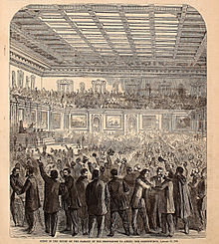
Key Concept 5.3, II
“Reconstruction and the Civil War ended slavery, altered the relationships between the states and the federal government, and led to debates over new definitions of citizenship, particularly regarding the rights of African Americans, women, and other minorities.” - page 58
A) Reconstruction Amendments:
13th - abolished slavery
14th - born in US? You’re a citizen!; equal protection under the law
15th - universal adult male suffrage

Slide 7
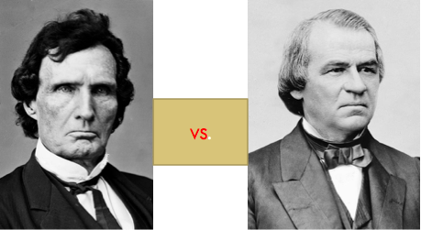
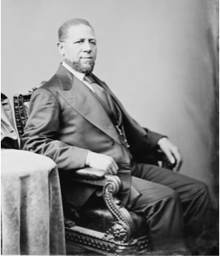
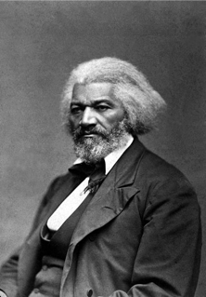
Key Concept 5.3, II
B) Impact of the 14th and 15th amendments on the Women’s Rights Movement?
Frederick Douglass and others favored black suffrage PRIOR to women’s suffrage
Elizabeth Cady Stanton and Susan B. Anthony feared women’s suffrage would not be granted any time soon
C) Effects of Republican Congress?
Change in the balance of power between the Presidency and Congress
Presidential v. Radical Reconstruction - Congress determined when to re-admit states
Johnson’s vetoes and Congressional overrides
Impeachment of Andrew Johnson
Increased political opportunities for blacks:
Robert Smalls - steamer pilot that brought a ship to the Union Navy during the Civil War; later became a Congressman
Hiram Revels - Senator from MS (Jefferson Davis’ state), first African American to serve in the Senate

Slide 8
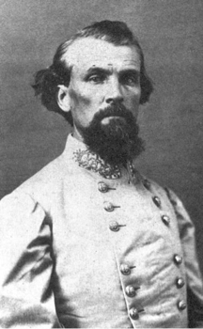
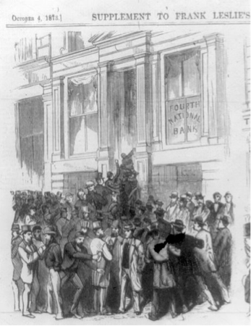
Key Concept 5.3, II
C)
Why did Reconstruction ultimately fail?
Determined Southern Resistance:
“Redeemer” governments:
Local and state governments ousted Republican governments
Often done through violence and intimidation
KKK terrorized blacks and Republicans
North’s waning resolve:
Death of Charles Sumner in 1874
Panic of 1873 - tainted the Republican Party and many called for a smaller government

Slide 9
Key Concept 5.3, II
D) Land distribution post in the South Civil War:
Plantation owners owned a majority of the land
Former slaves had difficulty acquiring land:
High interest rates - (crop lien system)
Sharecropping:
Freedmen worked on farms and exchanged labor for using land and housing
Half of their crops were typically given to the land owner
If cotton prices fell (as did in the 1870s), perpetual debt was common for most sharecroppers
Most Southern blacks were sharecroppers by 1890

Slide 10
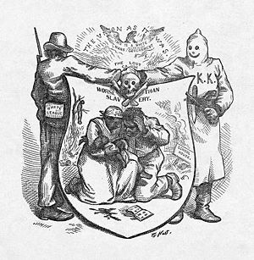
Key Concept 5.3, II
E) Ways the 14th and 15th amendments were restricted:
Segregation:
Jim Crow laws - upheld by Plessy v. Ferguson - “Separate but equal”
Violence:
KKK and White League - intimidated African Americans from voting
Supreme Court decisions:
Civil Rights Cases - individuals and private businesses could discriminate
Local political tactics:
Poll taxes, literacy tests, and grandfather clauses
However, these amendments would be used in the 20th century to uphold civil rights
Brown v. Board - overturned “separate but equal”

Slide 11
Test Tips
Multiple Choice and Short Answer:
Reasons for the Union’s victory in the Civil War
Ways Southern governments restricted 13-15 amendments
WANING!
Essays:
Reconstruction as a turning point - discussing before and after
Connecting Reconstruction Amendments to Civil Rights Movement of the 1950s and 1960s

Slide 12
See You Back Here For Key Concept 6.1!
Thanks for watching!
Best of luck in May

