Slide 1
APUSH Review: Key Concept 6.1
www.Apushreview.com
Period 6: 1865 – 1898
Everything You Need To Know About Key Concept 6.1 To Succeed In APUSH
Shout Out to Lia F., Stone K., and Davood P. Thanks for your support, you rock!

Slide 2
The New Curriculum
Key Concept 6.1 “The rise of big business in the United States encouraged massive migrations and urbanization, sparked government and popular efforts to reshape the U.S. economy and environment, and renewed debates over U.S. national identity.”
Page 60 of the Curriculum Framework
Big ideas:
What was the relationship between businesses and government?
What were reasons for migration within the country and immigration during this time?
In what ways did the South change and remain the same? (Change and Continuity over time)

Slide 3
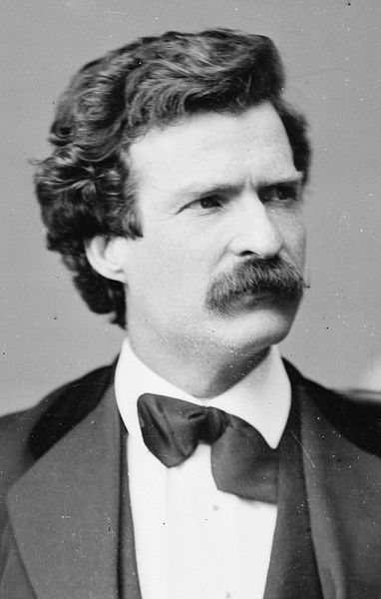
Key Concept 6.1 I
“Large-scale production – accompanied by massive technological change, expanding international communication networks, and pro-growth government policies – fueled the development of a ‘Gilded Age’ marked by an emphasis on consumption, marketing, and business consolidation.”
– pg 60 of the curriculum framework
What is a “Gilded Age?” (1870s – 1900)
Term coined by Mark Twain
Increase in industrialization
Many things appeared to be good on the surface, but many problems were below
A: Government subsidies for transportation and communication systems:
Government provided $ and land for construction of RRs
Impacts of subsidies – opened new markets in North America
Farms, lumber, and growth of cities
Redesigned financial and management structures:
Monopolies – sought to have sole control over an industry
Maximize exploitation of resources and labor force
Carnegie – steel, Rockefeller - oil

Slide 4
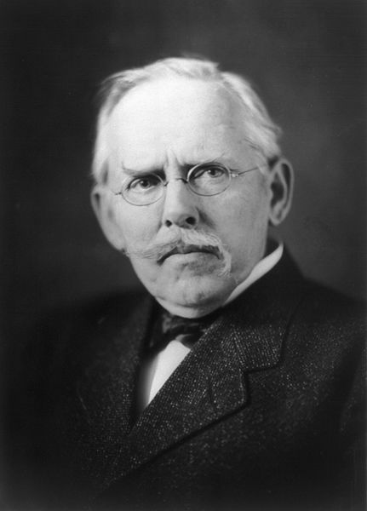
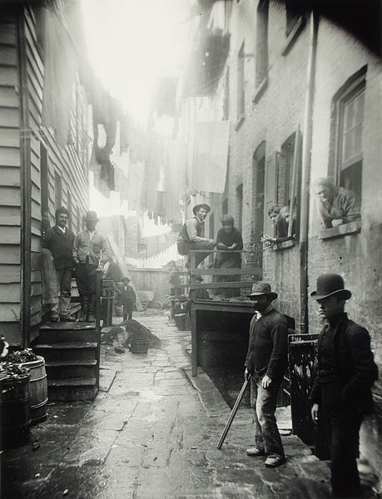
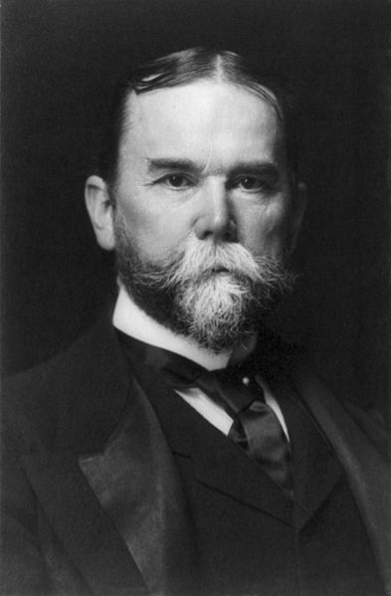
Key Concept 6.1 I Cont.
Trust = developed by Rockefeller, several companies would sell their shares and be under the control of one executive board
B: Businesses and foreign policy makers looked outside US borders to gain influence and control in markets
Pacific: Hawaii – calls for annexation in the 1890s (sugar)
Asia: Philippines – gained after the Spanish American War
1899 – Open Door Policy in China; US could trade freely with China
Latin America: American-owned sugar plantations in Puerto Rico
C: Emergence of trusts and holding companies:
Very powerful business organizations, controlled many aspects of industries
How did business leaders defend their status?
Social Darwinism – rich argued they were a result of natural selection
D: “Conspicuous consumption” vs. relative poverty in cities and society
Wealthy encouraged cities to spend $ on museums, libraries, etc.
Elaborate houses, clothing, etc.
Those living in poverty often lived in tenement houses
Jacob Riis – How the Other Half Lives (1890)

Slide 5
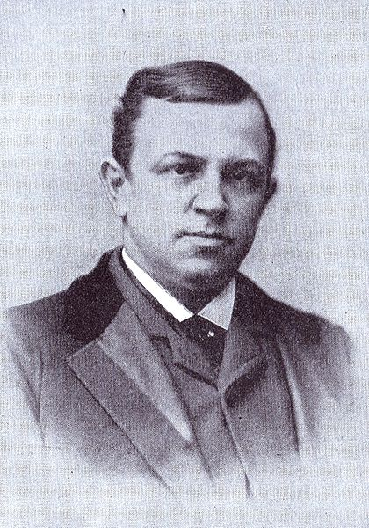
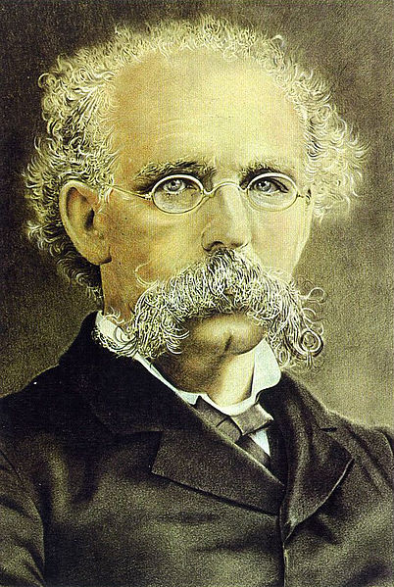
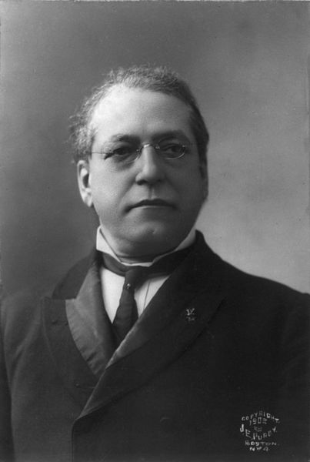
Key Concept 6.1 II
“As leaders of big business and their allies in government aimed to create a unified industrialized nation, they were challenged in different ways by demographic issues, regional differences, and labor movements.” – pg 61 of the curriculum framework
A: Expansion of workforce:
Internal migration: farmers moved to cities in increased numbers to work in factories
Immigrants (across national borders): “New” Immigration – predominantly Southern and Eastern Europe; China as well
Impact of workforce expansion?
Diverse workforce, lower wages, more child labor
Huge supply of workers led to lower wages
B: Labor vs. Management:
Battles over wages, working conditions
Local and national unions emerged to confront businesses
Knights of Labor – Terrance Powderly, skilled AND unskilled workers, women and African Americans; downfall was the Haymarket Square Riot
American Federation of Labor – Samuel Gompers, skilled workers only; “bread and butter issues”
C: The South had some areas of industrialization
Leaders called for a “New South” – Henry Grady, editor of the Atlantic Constitution, called for increased industrialization in the South; textile factories began to appear in the South
Sharecropping and tenant farming remained dominant
Payment in land in the form of cash (tenant) or crops (sharecropping)
Many African Americans were stuck as sharecroppers throughout the 1800s

Slide 6
Key Concept 6.1 III
“Westward migration, new systems of farming and transportation, and economic instability led to political and popular conflicts.” – pg 61 of the curriculum framework
A: Government agencies and conservationist organizations sought to extend public control over natural resources:
U.S. Fish Commission – created in 1871 to promote and preserve fisheries in the US
Sierra Club – founded by John Muir in 1892, advocate the protection of wild places on earth
B: Farmer organizations to resist corporate control of agricultural markets: (RRs)
The Grange (1860s): sought to bring farmers together to share techniques
Hoped to elect state legislators favorable to their programs
Granger laws – state laws that regulated RRs
Southern Farmers’ Alliance: mostly a local organization
Established stores and banks
Excluded blacks…..
Colored Farmers’ Alliance:
Mostly in the Southern US

Slide 7
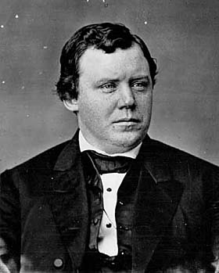
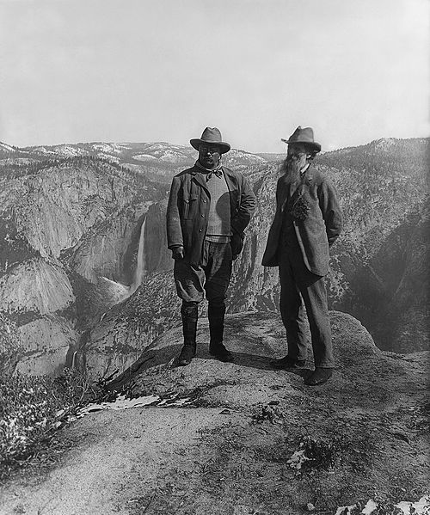
Key Concept 6.1 III
C: Creation of the People’s (Populist Party)
Mostly farmers
Causes:
Growth of corporate power
(RRs) – high rates often hurt farmers
Economic instability
Panics of 1873 and 1893 hurt farmers
Goals:
Political reform – direct election of senators; government ownership of RRs, telephones, and telegraphs
Stronger government role in American economic system
Graduated income tax; inflation of currency, :free silver”; abolishment of national banks
D: Business interests vs. conservationists
Establishment of national parks and other conservationist and preservationist measures
National Reclamation Act (Newlands Act) – federal $ for construction of dams, canals, and reservoirs
Park system grew under Teddy Roosevelt
Roosevelt used executive powers to restrict development of land

Slide 8
Test Tips
Multiple-Choice and Short Answer Questions:
Changes in business structure and their effects
Role of government during the Gilded Age
Plight of farmers
Goals of Labor Unions
Essay Questions:
Comparing government during the Gilded Age vs. other time periods
Ways farmers and laborers resisted corporations

Slide 9
Thanks for watching!
Subscribe to my channel
Help spread the word
Questions? Comments?
Leave in comments
On a scale of 1-10, how sweet is my mustache?
Subscribe
Down here!

