Slide 1
APUSH Review: Key Concept 6.3
www.Apushreview.com
Period 6: 1865 – 1898
Everything You Need To Know About Key Concept 6.3 To Succeed In APUSH
Shout out to Mr. Carr and his class. Thanks for your support!

Slide 2
The New Curriculum
Key Concept 6.3 “The ‘Gilded Age’ witnessed new cultural and intellectual movements in tandem with political debates over economic and social policies.”
Page 63 of the Curriculum Framework
Big Idea Questions:
Why did more citizens call for increased control of the government?
What were different examples of discrimination that various groups faced in the late 19th century?
How did business leaders and the wealthy justify their wealth?

Slide 3
Key Concept 6.1 I
“Gilded Age politics were intimately tied to big business and focused nationally on economic issues – tariffs, currency, corporate expansion, and laissez-faire economic policy – that engendered numerous calls for reform.”
– pg 63 of the curriculum framework
A. Government corruption encouraged the public to demand more control – some minor, some major changes to the capitalist system
Reforms affected local, state, and national government
Examples:
Referendum:
Citizens could vote on laws
Interstate Commerce Act:
Created to regulate RRs, more symbolic at first
Required RRs to publish their rates

Slide 4
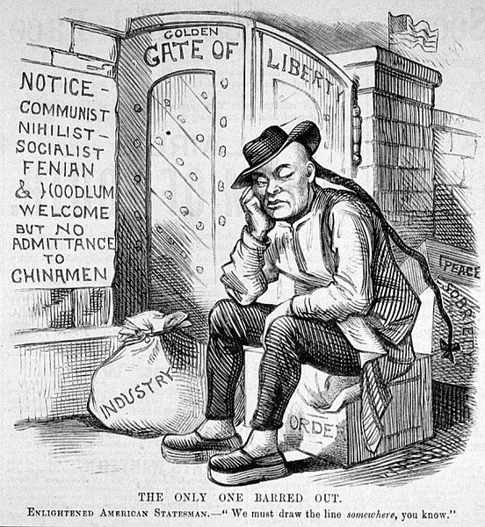
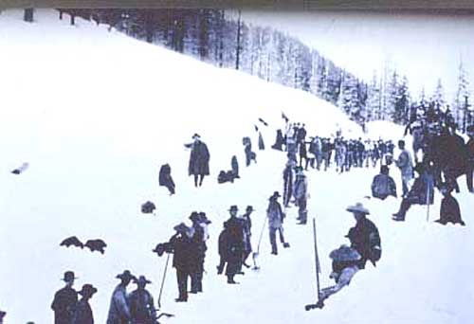
Key Concept 6.3 I Cont.
B: Racism, nativism, and Supreme Court decisions (Plessy) were used to justify violence, discrimination, and segregation
Examples:
American Protective Association (APA):
Similar to the Know-Nothing Party of the 1850s
Wanted to ban Catholics from holding office and halt immigration
Chinese Exclusion Act (1883):
Prohibited Chinese immigration
Example of Nativism
Plessy v. Ferguson (1896):
Upheld the constitutionality of Jim Crow Laws
“Separate but equal”

Slide 5
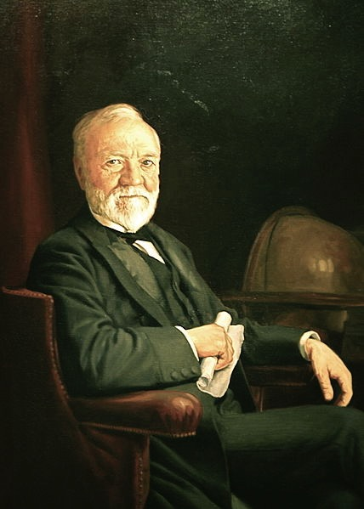
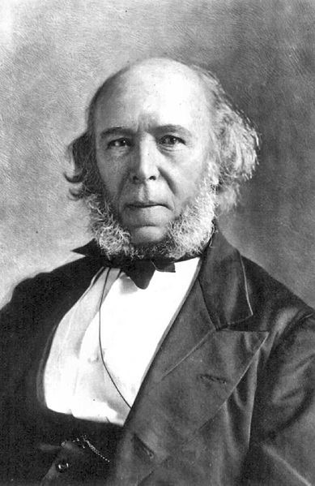
Key Concept 6.3 II
Best sideburns ever?
“New cultural and intellectual movements both buttressed (supported) and challenged the social order of the Gilded Age.” – pg 64 of the curriculum framework
A: Arguments used to justify success of the wealthy:
Social Darwinism:
Survival of the fittest
Could use any business tactics to prosper
Horatio Alger books:
Hard work brings success
“Rags to riches” stories
A (Cont.): Some advocated that the wealthy was obligated to help less fortunate:
Gospel of Wealth:
Andrew Carnegie
Advocated philanthropy – duty of the wealthy to donate $ to help out with economic inequality
Gave $ for 100s of libraries throughout the US

Slide 6
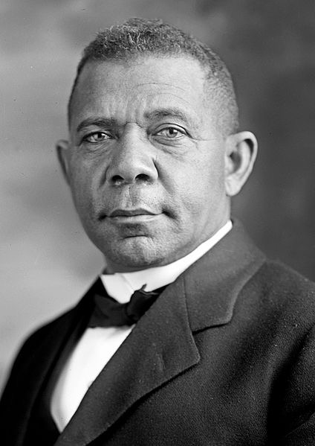
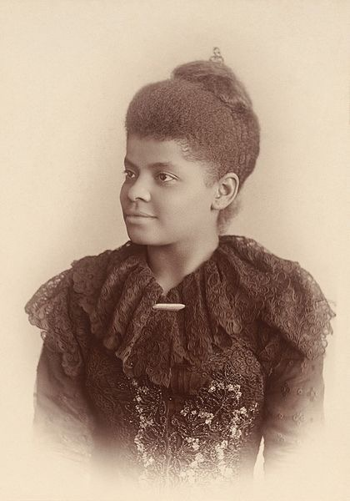
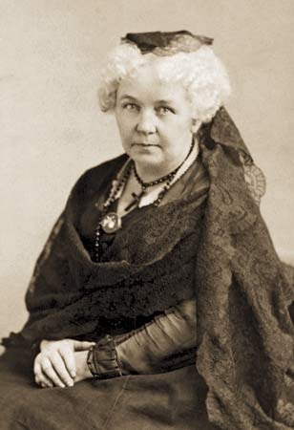
Key Concept 6.3 II Cont.
B: Many challenged corporate ethic and capitalism, and offered alternate visions of good society through:
Social Gospel:
Protestant Church movement that sought to end social injustice
Focused on poverty, economic inequality,
C: Women and African American challenged their “place” in society politically, socially, and economically:
Examples:
Booker T. Washington:
Advocated vocational training for blacks
Ida B. Wells-Barnett:
Journalist, outspoken critic of lynching, advocated a federal anti-lynching law
Elizabeth Cady Stanton
Leading suffragist, advocate of interracial marriage

Slide 7
Test Tips
Multiple-Choice and Short Answer Questions:
Plessy V. Ferguson - impacts
Examples of discrimination (APA, Chinese Exclusion Act)
Essay Questions:
Comparing forms of discrimination with other time periods
Experiences of “Old” immigrants and “New” immigrants

Slide 8
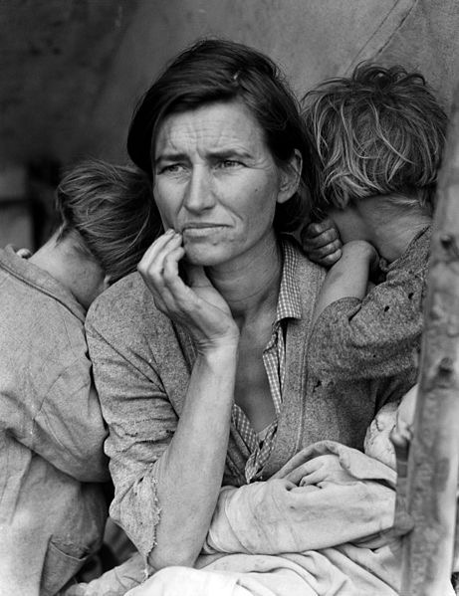
See You Back Here for Period 7!
Thanks for Watching
Please subscribe, share with others
Check out all my videos related to the new curriculum
Best of luck on all your tests!

