Slide 1
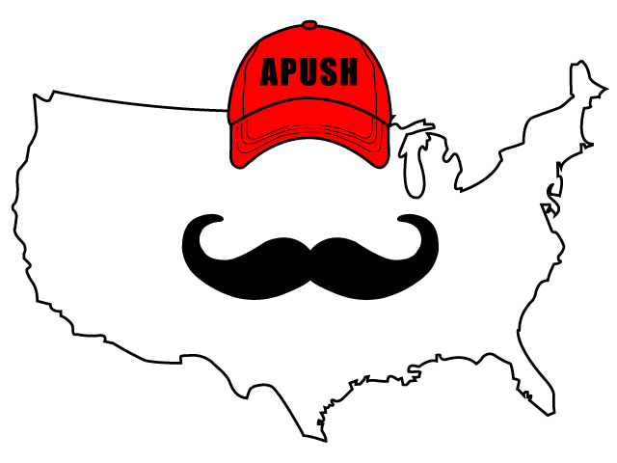
APUSH Review: Key Concept 7.1
Period 7: 1890 - 1945
Everything You Need To Know About Key Concept 7.1 To Succeed In APUSH
Huge shoutout to Mr. Flynn’s Class. Thank you for watching!

Slide 2
The New Curriculum
Key Concept 7.1 “Governmental, political, and social organizations struggled to address the effects of large-scale industrialization, economic uncertainty, and related social changes such as urbanization and mass migration”
Page 66 of the Curriculum Framework
Big Idea Questions:
Why did citizens and government officials call for increased intervention in the economy?
Why did the US transform from a rural to industrial society? How did this affect the lives of women and other Americans?
How did the New Deal change the relationship between the government and the economy?

Slide 3
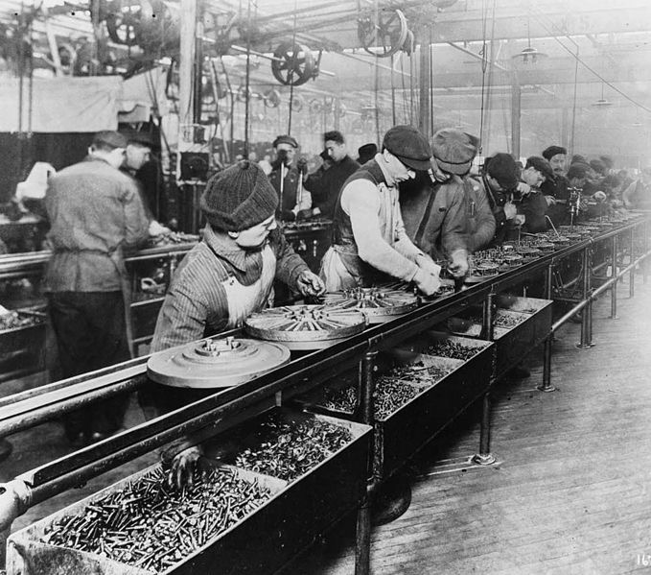
Key Concept 7.1, I
“The continued growth and consolidation of large corporations transformed American society and the nation’s economy, promoting urbanization and economic growth, even as business cycle fluctuations became increasingly severe.”
Page 66
A: Large corporations dominated the economy:
Production of consumer goods increased drastically
1920s - cars, radios, refrigerators
New technologies and manufacturing techniques:
Assembly line

Slide 4
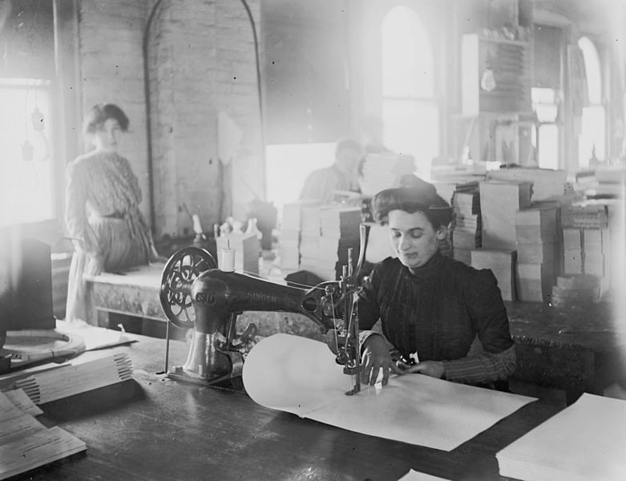
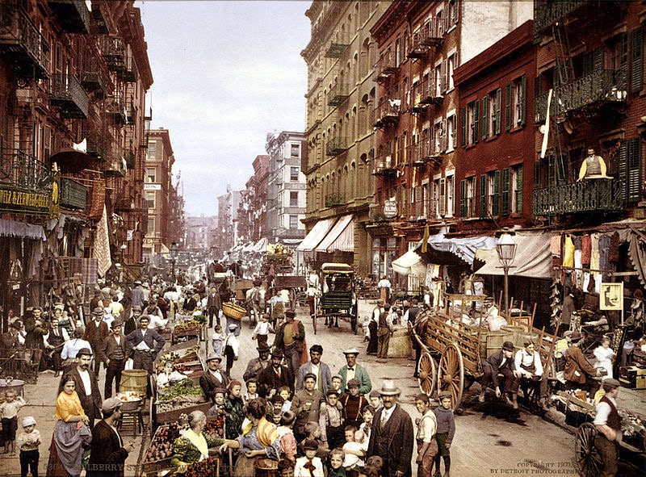
Key Concept 7.1, I
B: US transformation from rural to urban society:
By 1920, more Americans lived in cities than rural areas for the first time in the nation’s history
This transformation provided opportunities for:
Women:
Work in factories (textile - Shirtwaist factories)
Internal migrants:
African Americans moving north as well as farmers to cities
International migrants:
“New” immigrants moved to cities to work in factories

Slide 5
Key Concept 7.1, I
C: Economic downturns led to calls for government involvement and the creation of a stronger financial regulatory system:
Federal Deposit Insurance Corporation (FDIC)
Created to insure bank deposits
Drastically decreased the number of bank failures

Slide 6
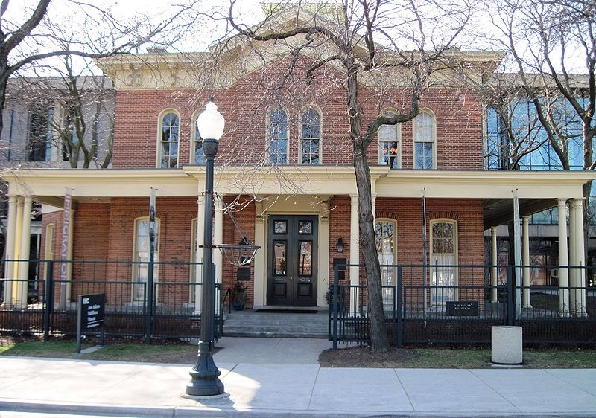
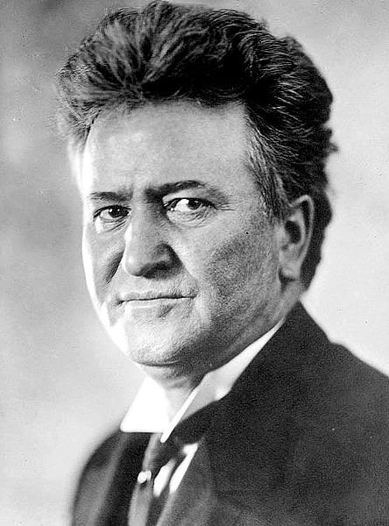
Key Concept 7.1, II
“Progressive reformers responded to economic instability, social inequality, and political corruption by calling for government intervention in the economy, expanded democracy, greater social justice, and conservation of natural resources.” - page 66
A: Progressive reformers reformed institutions at various levels by creating new organizations that sought to address social problems associated with an industrial society:
Characteristics of Progressive reformers - predominantly middle class, women, and lived in cities
Examples of reforming social institutions:
Jane Addams’ Hull House and other settlement houses
Examples of reforming political institutions:
State - initiative, referendum, and recall - Wisconsin
Federal - Seventeenth amendment - direct election of senators

Slide 7
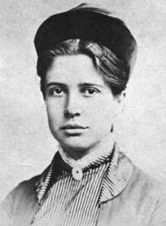
Key Concept 7.1, II
B: Progressive proposed to regulate the economy, environment, and expand democracy
Examples:
Clayton Antitrust Act:
Strengthened the Sherman Antitrust Act, exempted unions from prosecution
Florence Kelley:
Key member of the National Consumers League - focused on child labor, food safety, poor working conditions
Federal Reserve Bank:
In charge of controlling the $ supply
1st central bank since the 2nd BUS

Slide 8
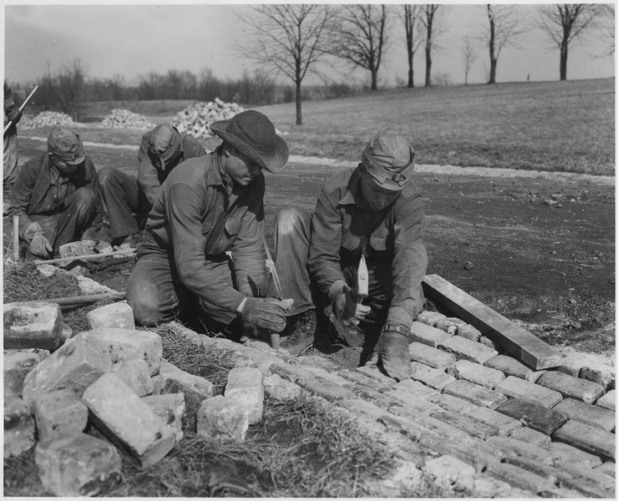
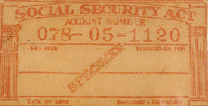
Key Concept 7.1, III
“National, state, and local reformers responded to economic upheavals, laissez-faire capitalism, and the Great Depression by transforming the U.S. into a limited welfare state.” - page 67
A: FDR’s New Deal:
Was inspired in part by Progressive ideas
Brought varied approaches to try to address the causes and effects of the Great Depression
Increased government power to:
Aid the poor:
Social Security - provided income for elderly Americans
AAA - paid farmers to NOT overproduce goods
Stimulate the economy:
Provided jobs to the unemployed through the Civilian Conservation Corps (CCC), and Public Works Administration (PWA)
FDR embraced Keynesian deficit spending to “prime the pump”
Reform the American economy:
Securities and Exchange Commission (SEC) - established to regulate the stock market and prevent fraud
FDIC

Slide 9
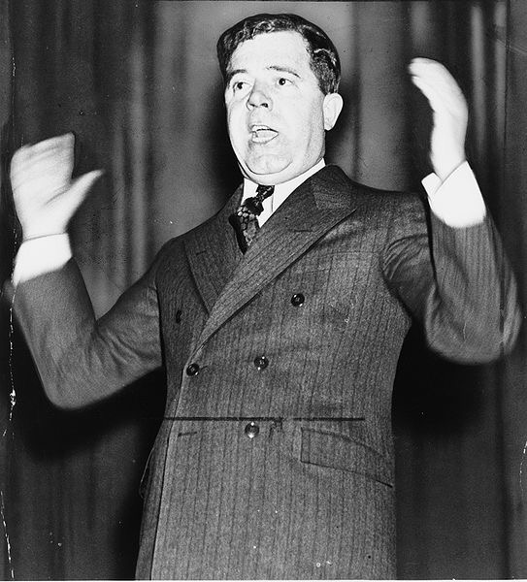
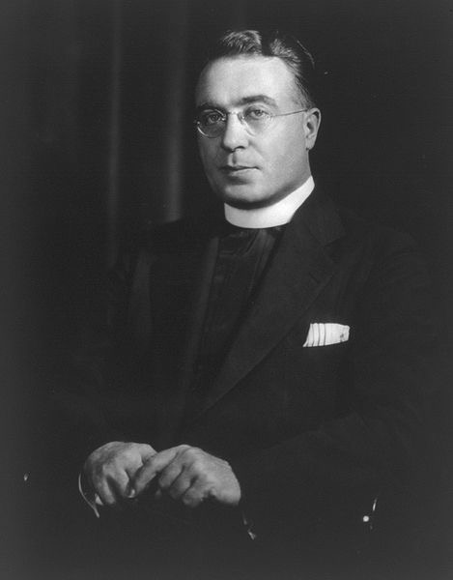
Key Concept 7.1, III
B: Movements that pushed for more reforms included:
Unions, populists, and radicals
Examples:
Huey Long:
Governor and Senator from LA
“Every Man A King” - proposed giving giving $5,000 to citizens by taxing wealthy
Father Charles Coughlin:
Argued that the government should nationalize banks
Some in Congress and the Supreme Court hoped to limit the New Deal
Example:
Supreme Court:
Schechter Poultry v. US - Overturned the NRA
US v. Butler - Overturned the AAA

Slide 10
Key Concept 7.1, III
C: Legacy of the New Deal?
Did not solely end the Great Depression
New reforms and agencies (still around today - Social Security, FHA, , FDIC, etc)
**Change in voting patterns**:
African Americans switched from the Republican to Democratic Party in LARGE numbers
Many ethnic groups began to identify with Democrats
Working-class communities (labor unions) did as well (Wagner Act)

Slide 11
Test Tips
Multiple-Choice and Short Answer Questions:
Identify and explain opportunities for women, African Americans and immigrants in cities
Successes, failures, and critics of the New Deal
Government reforms during the Great Depression
Essay Questions:
Comparing and contrasting government response during Great Depression to other time periods
Causes and effects of various migrations (internal and international)

Slide 12
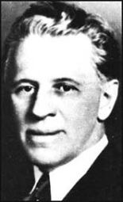
See You Back Here for Key Concept 7.2!
Thanks for Watching
Please subscribe, share with others
Check out all my videos related to the new curriculum
Best of luck on all your tests!

