Slide 1
APUSH Review: Key Concept 7.2
www.Apushreview.com
Everything You Need To Know About Key Concept 7.2 To Succeed In APUSH
Period 7: 1890 - 1945
Shoutout to Coach Locklin and Nighthawk. I appreciate the support!

Slide 2
The New Curriculum
Key Concept 7.2 “A revolution in communications and transportation technology helped to create a new mass culture and spread ‘modern’ values and ideas, even as cultural conflicts between groups increased under the pressure of migration, world wars, and economic distress.”
Page 67 of the Curriculum Framework
Big Idea Questions:
How did technology transform the standard of living in the United States?
What factors led to immigration restrictions during the 1920s?
What caused internal migration to increase drastically in the United States during the first half of the 20th century?

Slide 3
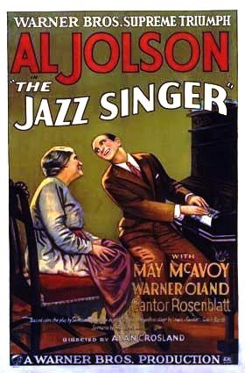
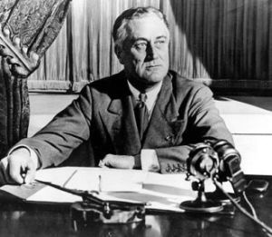
Key Concept 7.2, I
“New technologies led to social transformations that improved the standard of living for many, while contributing to increased political and cultural conflicts.”
Page 67 of the new curriculum
A: New technologies increased living standards, improved mobility, and better communication
Examples:
Radio:
Large source of entertainment (War of the Worlds - 1938, “Fireside Chats,” Father Charles Coughlin)
Motion Pictures:
“Nickelodeons”
Movies entertained many during the Great Depression
The Jazz Singer - 1927 - first movie with sound
Automobiles:
Mass-production popularized by Henry Ford
Allowed for vacations (personal mobility,) and later the expansion of suburbs

Slide 4
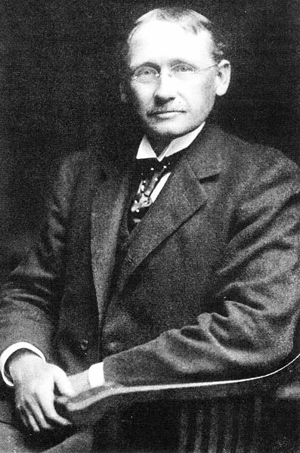
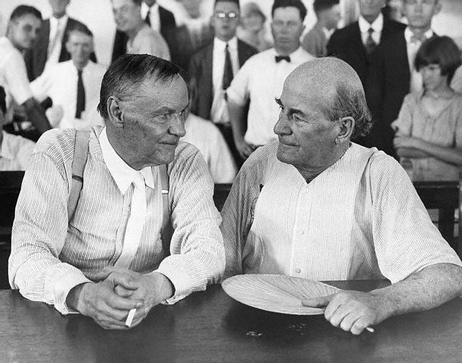
Key Concept 7.2, I
B: Political and cultural conflicts emerged over: technological change, modernization, and changing demographics
These conflicts were evident in:
Tradition v. innovation:
Less autonomy for many workers - Scientific management and assembly line
Urban v. rural:
More people lived in cities in the 1920s for the 1st time
More freedom and experiences in cities
Fundamentalism Christianity v. Scientific Modernism:
Scopes Trial
Literal interpretation of the bible vs. evolution

Slide 5
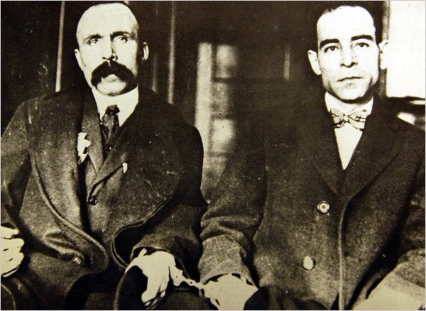
Key Concept 7.2, I
B: Political and cultural conflicts emerged over: technological change, modernization, and changing demographics
These conflicts were evident in:
Management v. labor:
Unions membership decreased, associated with radicalism
Native-born v. new immigrants:
Nativism in the 1920s increased drastically
KKK
Immigration quota acts of 1921 and 1924 were very restrictive
Sacco and Vanzetti
White vs. black:
Great migration post WWI - African American migration to northern cities ->
Red Summer (Race riots - Chicago)
Idealism v. disillusionment:
Lost Generation of the 1920s - criticized middle class values

Slide 6
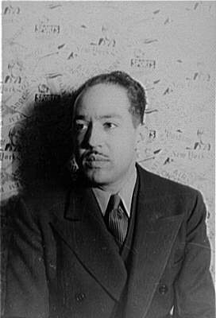
Key Concept 7.2, I
C: Rise of African American artists:
Harlem Renaissance:
Celebration of African American culture through writing, music, and art:
Langston Hughes, Zora Neale Hurston
National culture was affected by art, cinema, and mass media:
Examples:
Yiddish theater - portrayed experiences of American Jews
Influenced English-speaking theaters later in America
Edward Hopper - focused on the loneliness of the modern city

Slide 7
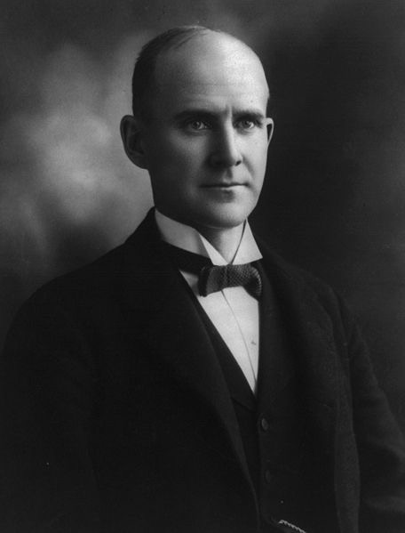
Key Concept 7.2, II
“The global ramifications of World War I and wartime patriotism and xenophobia, combined with social tensions created by increased international migration, resulted in legislation restricting immigration fromAsia and from southern and eastern Europe.”
Page 67 of the new curriculum
A: WWI and Civil Liberties
Remember, during times of war and crisis, liberties typically decrease
Restrictions of freedom of speech:
Sedition Act of 1918
Upheld by the Supreme Court in Schenk v. US

Slide 8
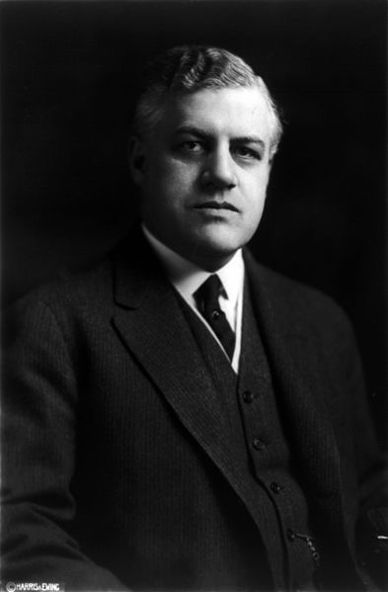
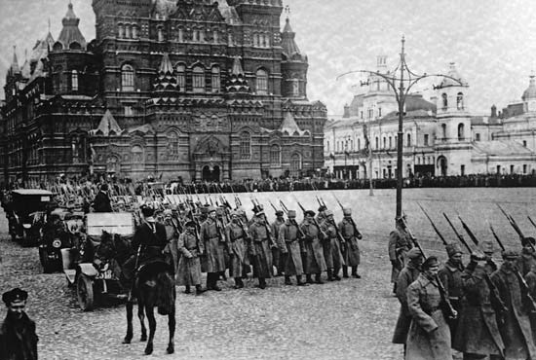
Key Concept 7.2, II
B: The First Red Scare:
Caused by:
Bolshevik Revolution in Russia (1917)
Labor strikes were associated with communism
Effects:
Many radicals and immigrants were targeted
Palmer Raids: 1,000s of immigrants and suspected communists were arrested

Slide 9
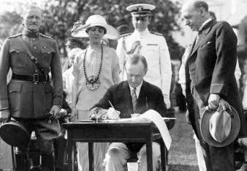
Key Concept 7.2, II
C: Acts of Congress that established immigration quotas:
1921:
Restricted immigration to 3% of a country’s population in the US according to 1910 census
1924
Further restricted immigration to 2% of a country’s population in the US, used 1890 census instead
Immigration from Latin America and Mexico remained unrestricted
US sought to have a cheap labor supply

Slide 10
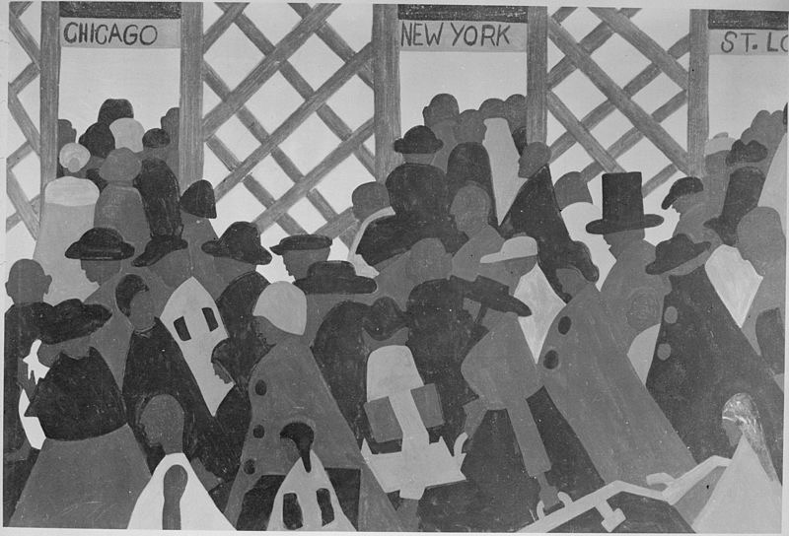
Key Concept 7.2, III
“Economic dislocations, social pressures, and the economic growth spurred by World Wars I and II led to a greater degree of migration within the United States, as well as migration to the United States from elsewhere in the Western Hemisphere.”
Page 68 of the new curriculum
A: Great Migration:
Some African Americans sought to leave the segregation and racial violence of the South
Searched for new economic opportunities in northern cities during and after WWI
Many factories provided jobs during the war
Many still faced discrimination in the north

Slide 11
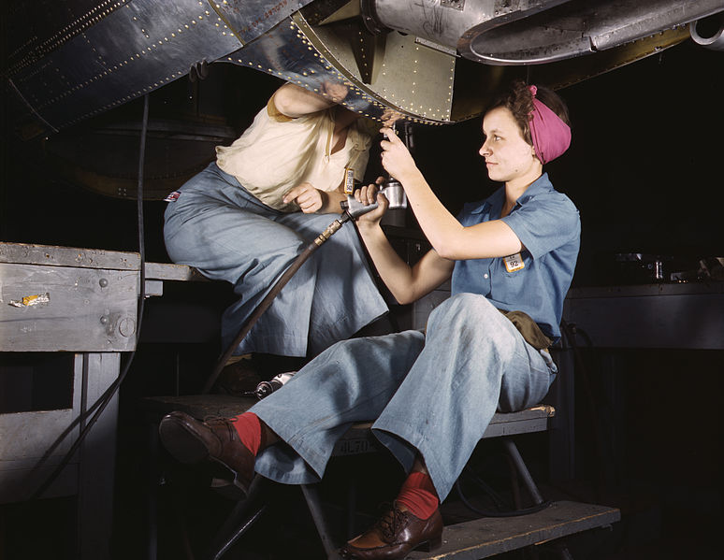
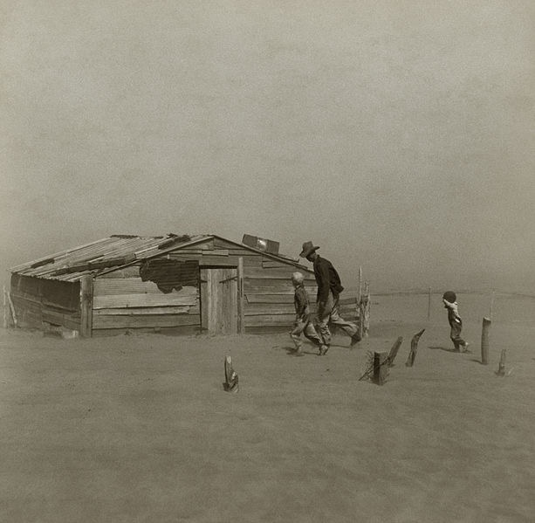
Key Concept 7.2, III
B: Many Americans migrated within the country due to economic struggles:
During the Great Depression:
The Dust Bowl:
“Okies” to California - The Grapes of Wrath
During WWI and WWII for wartime production:
Continual movement from rural to urban areas to work in factories:
15 million Americans moved during the WWII
New opportunities for women:
Rosie the Riveter (WWII)
Worked in healthcare, and other jobs during the wars
Often paid less than men

Slide 12
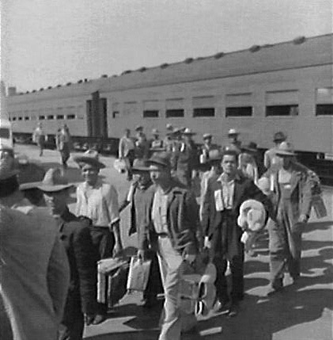
Key Concept 7.2, III
C: Many Mexicans came to the US for economic opportunities
They faced ambivalent (contradictory) government policies in the 1930s and 1940s:
Many (500,000) were deported during the Great Depression - labor shortage
Bracero Program:
US encouraged Mexican immigration during WWII as a labor source
Many worked as farmers

Slide 13
Test Tips
Multiple-Choice and Short Answer Questions:
Identify changes in technology
Identify and explain causes of political and cultural conflict
Harlem Renaissance
Red Scare - led to increased scrutiny of immigrants and radicals
Immigration Acts - connect to nativism and “New Immigration”
Great Migration - reasons for and impacts
Essay Questions:
Migration opportunities (as part of larger essay on WWI and/or WWII)
Comparing 1920s with 1950s
Cultural conflicts between groups

Slide 14
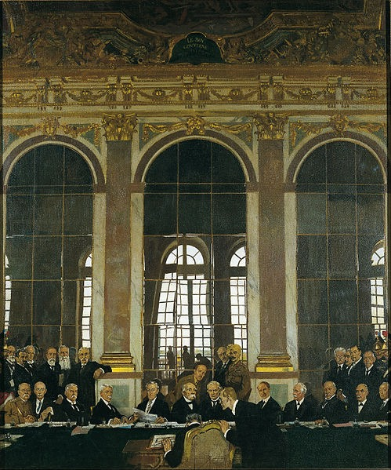
See You Back Here For 7.3!
Thanks for watching!
Please subscribe, share with others
Check out other videos in the description
Best of luck on all your tests!

