Slide 1
APUSH Review: Key Concept 7.3
Shoutout Time!
Mr. Foley, Elise from Mrs. Richard’s class, and Mrs. Staup’s class at Manvel High School. Thank you all!
Everything You Need To Know About Key Concept 7.3 To Succeed In APUSH
Period 7: 1890 - 1945

Slide 2
The New Curriculum
Key Concept 7.3 “Global conflicts over resources, territories, and ideologies renewed debates over the nation’s values and its role in the world, while simultaneously propelling the United States into a dominant international military, political, cultural, and economic position.”
Page 67 of the Curriculum Framework
Big Idea Questions:
What were arguments for US expansion overseas in the late 19th, early 20th centuries?
How did WWI challenge the US’ tradition of neutrality? What ways did the US change its views and remain the same?
What impacts did WWII have on the US position in the world?

Slide 3
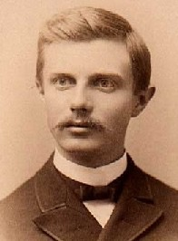
Key Concept 7.3, I
Key Concept 7.3, I “Many Americans began to advocate overseas expansionism the late 19th century, leading to new territorial ambitions and acquisitions in the Western Hemisphere and the Pacific.”
pg 70
A: Arguments for US expansion of culture and norms
Perception that the frontier was “closed”
1890 census - Frederick Jackson Turner, many Americans believed opportunities dried up
Economic motives - American companies sought markets overseas - US plantation owners in HI
Competition with other European imperialist ventures
Racial theories - some sought to “Civilize” nonwhite nations

Slide 4
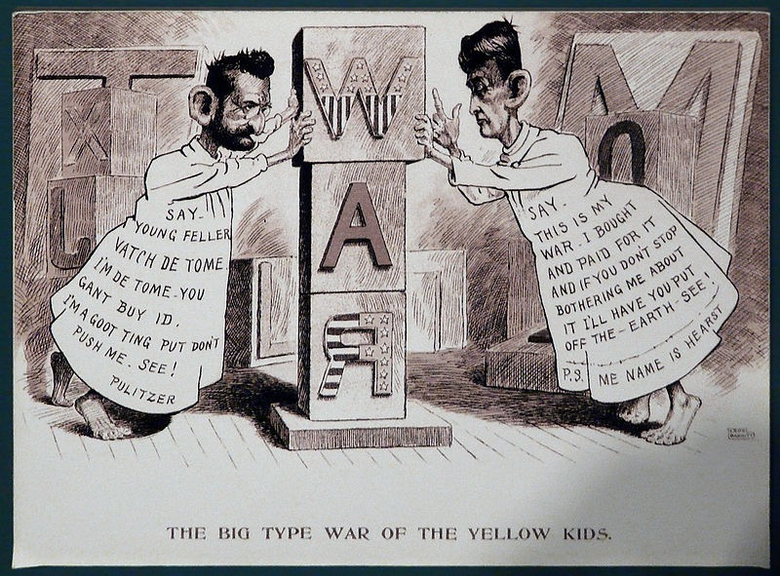
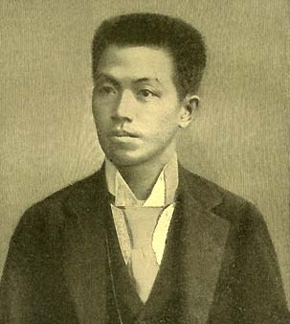
Key Concept 7.3, I
B: Spanish American War (1898)
US defeated the Spanish in 4 months
Causes - Maine, Yellow Journalism, De Lome letter
US gained many territories - Cuba, Guam, Puerto Rico, and the Philippines
Effects of the war:
US presence in the Caribbean and Latin America increased significantly (Roosevelt Corollary)
Protracted insurrection in the Philippines - Emilio Aguinaldo - guerrilla warfare
Increased involvement in Asia - Open Door Policy in China

Slide 5
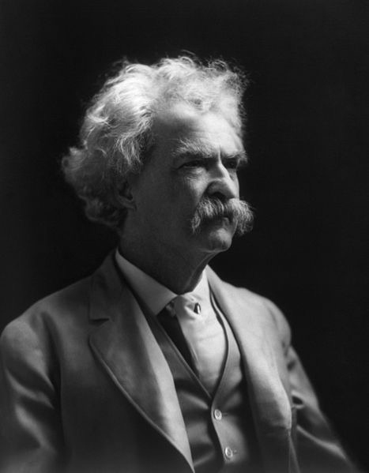
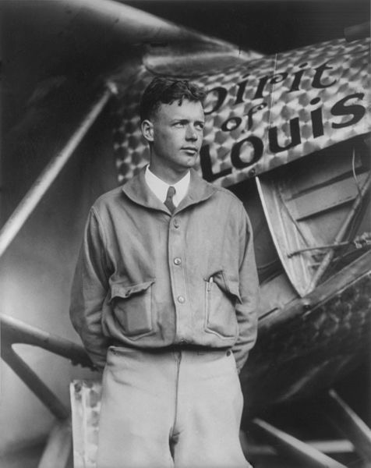
Key Concept 7.3, I
C: Debates emerged over America’s role in the world:
Imperialists:
Advocated US expansion, “Civilize” non-“civilized” areas of the world, spread Christianity, gain markets
Anti-imperialists:
Anti-Imperialist League - Mark Twain, Samuel Gompers, Presidents of Harvard and Stanford, William Jennings Bryan
Against acquisition of territories - violated “consent of governed”
Interventionists (WWII):
Committee to Defend America- advocated aid to allies, especially Great Britain
Isolationists:
America First Committee - AGAINST US intervention in WWII
Charles Lindbergh, Robert Taft (Ohio)

Slide 6
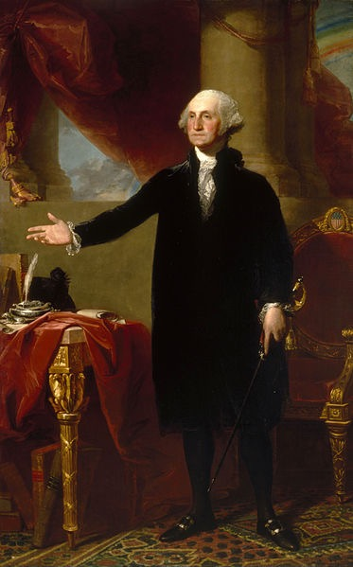
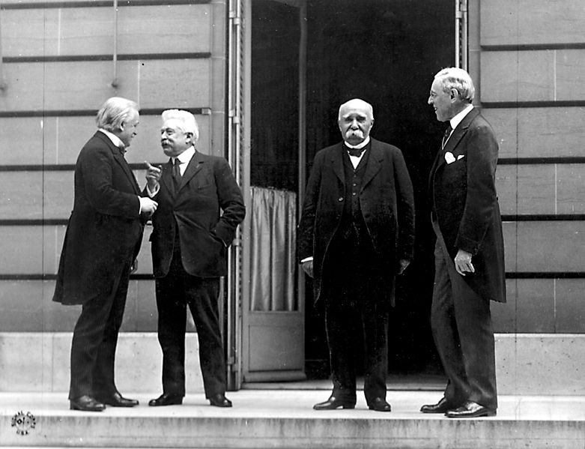
Key Concept 7.3, II
Stay out of entangling alliances
Sorry bro, gotta make the world safe for democracy
Key Concept 7.3, II “World War I and its aftermath intensified debates about the nation’s role in the world and how best to achieve national security and pursue American interests.”
pg 70
A: US was initially neutral in WWI
Upon entry, the US departed from tradition of noninvolvement in European affairs (Washington’s Farewell Address)
Wilson’s call for humanitarian and democratic principles
14 Points

Slide 7
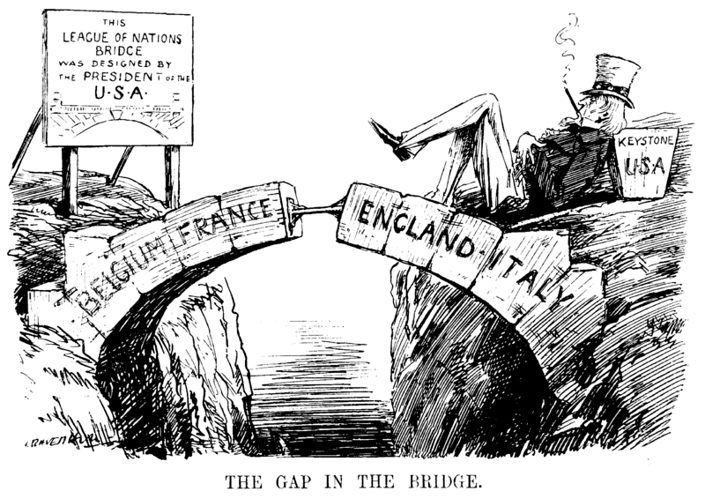
Key Concept 7.3, II
B: US played a “relatively limited role in the war,” however, the US was heavily involved in post-war negotiations
Treaty of Versailles:
Ended WWI, punished Germany severely, ultimately the US did not approve the treaty
League of Nations:
Major component of Wilson’s 14 Points, international organization
Ultimately, the US did NOT join - Congress would lose war making power, tradition of neutrality
Both of these resulted in heavy debate in the US
Henry Cabot Lodge, the “Irreconcilables”

Slide 8
Key Concept 7.3, II
C: Post WWI, the US promoted a vision of international order by:
International investment:
Continuing Dollar Diplomacy - US banks investing in foreign countries
Peace Treaties:
Washington Naval Conference (5 power and 9 power treaties) - determined the number of battleships the US, Britain, and Japan could build (5:5:3 ratio)
Select military intervention:
Mostly in Latin America - Nicaragua (1912 - 1933)
The US still continued an isolationist policy into the late 1930s
Neutrality Acts of 1930s forbid trade with warring (belligerent) countries
Stimson Doctrine (1932) - US refused to acknowledge Japan’s newly acquired territory in Asia

Slide 9
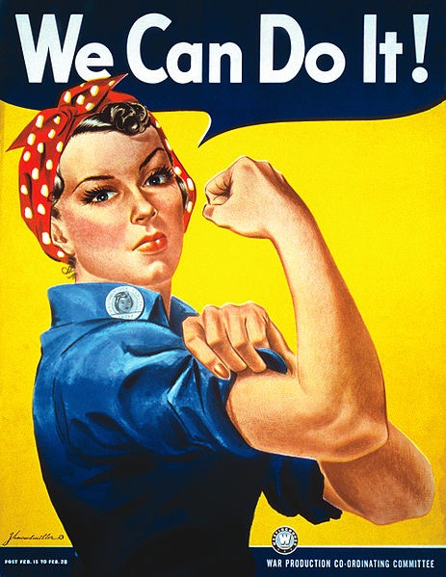
Key Concept 7.3, III
“The involvement of the United States in World War II, while opposed by most Americans prior to the attack on Pearl Harbor, vaulted the United States into global political and military prominence and transformed both American society and the relationship between the United States and the rest of the world.”
page 71
A: Mass mobilization of American society provided:
Significant amount of troops for the war effort
Increased workforce that ended the Depression
Opportunities for women and minorities to improve their socioeconomic positions:
Women worked in factories - “Rosie the Riveter” and health care during the war
African Americans worked in factories, served in the military

Slide 10
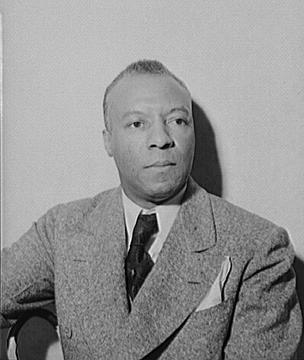
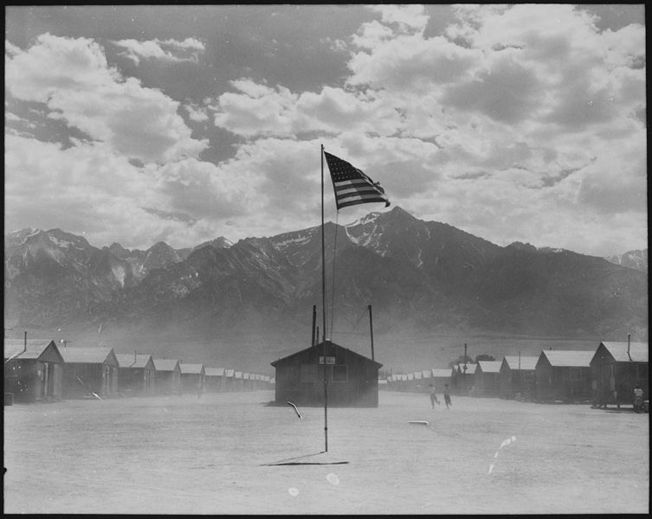
Key Concept 7.3, III
B: Wartime experiences:
Japanese Internment:
Forced movement of Japanese-Americans (2/3 Nisei) to camps during the war
Upheld by Korematsu v. US
Challenges to civil liberties:
Zoot Suit Riots - Conflict between Mexican Americans and US military personnel in Southern California
Debates over race and segregation:
A. Philip Randolph helped lead to Executive Order 8802 - eliminated discrimination in defense industries
Double V Campaign - Victory over Fascism abroad, Victory over racism at home
Military remained segregated until the Korean War (E.O. 9981)
Decision to drop the atomic bomb:
Many arguments - To save American lives, cost of Manhattan Project - $2 billion, demonstrate power to the Soviet Union, end the war quickly

Slide 11
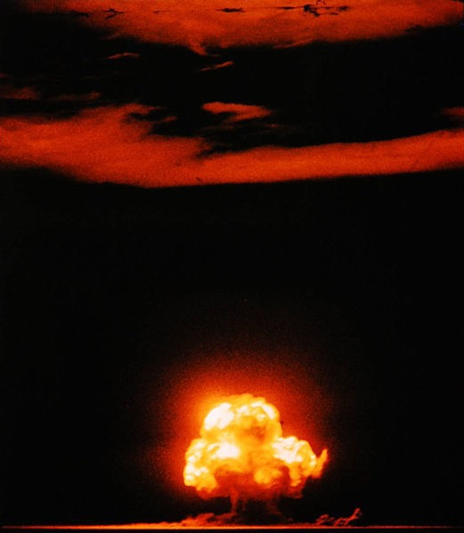
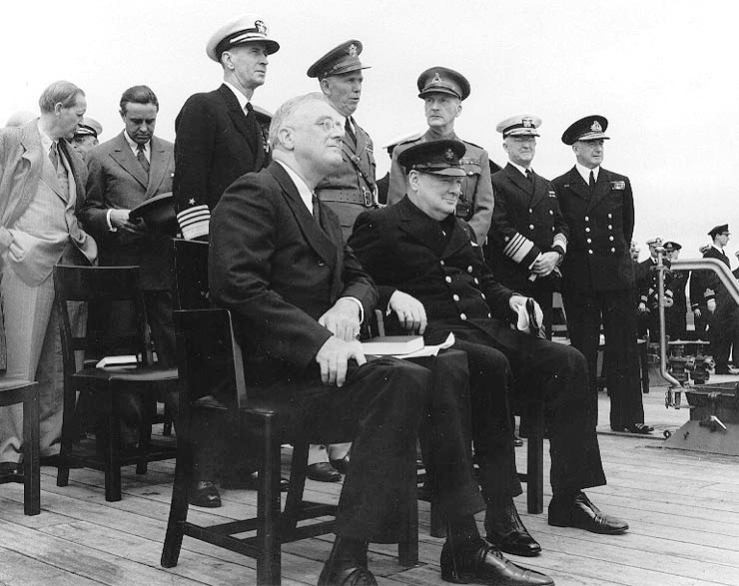
Key Concept 7.3, III
C: The Allies won because:
Political and military cooperation:
US, GB, France, and the Soviet Union
Tehran Conference - “Big 3” meeting; agreed to invasion of Europe in 1944
Industrial production:
US factories were dedicated to the war effort
Ford and GM converted to military production
Technological and scientific advances:
Manhattan Project - $2 billion to develop the atomic bomb
Sonar - used against German submarines
Popular commitment to advancing democratic ideals:
Atlantic Charter - US and GB, goals for post-WWII world
Ideas such as self-determination, economic cooperation

Slide 12
Key Concept 7.3, III
D: The US emerged from the war as a superpower due to:
Dominant role in the Allied victory and role in postwar peace settlements:
Creation of the United Nations
US became a permanent member of the security council
Departure from Washington’s Farewell Address
Europe and Asia was severely damaged from the war

Slide 13
Test Tips
Multiple Choice and Short Answer:
Arguments for and against US expansion overseas
Treaty of Versailles and the 14 Points
Isolationists vs. Interventionists
Essays:
Comparing and contrasting the US’ role in the world post-WWI and post-WWII
Social impacts of WWII (Japanese Americans, Women, African Americans)

Slide 14
Practice Short Answer
Answer all three parts
Following the Spanish-American War, the United States increased its presence around the world
a) Briefly explain one argument in favor of US expansion during this time
b) Briefly explain one argument against US expansion during this time
c) Briefly explain one impact of US expansion, providing one piece of historical evidence.

Slide 15
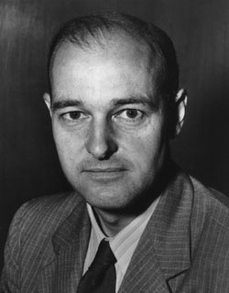
See You Back Here For Period 8!
Thanks for watching!
Please subscribe, share with others
Check out other videos in the description
Best of luck on all your tests!

