Slide 1
APUSH Review: Key Concept 8.2 (Period 8: 1945 - 1980)
Everything You Need To Know About Key Concept 8.2 To Succeed In APUSH
Shoutout Time! Elise from Mrs. Richard’s Class, Mr. McCullough in West Shamokin, and Professor Butler’s Class!

Slide 2
Key Concept 8.2
“Liberalism, based on anticommunism abroad and a firm belief in the efficacy of governmental and especially federal power to achieve social goals at home, reached its apex in the mid-1960s and generated a variety of political and cultural responses.”
Page 74 of the Curriculum Framework
Big Idea Questions:
What were some examples of successes during the Civil Rights Movement? How did the federal government contribute to this?
How did awareness for groups such as Latinos, American Indians, Asian Americans, women, and gays and lesbians change during this time?
Why were some people on the left and right assailing liberalism?

Slide 3
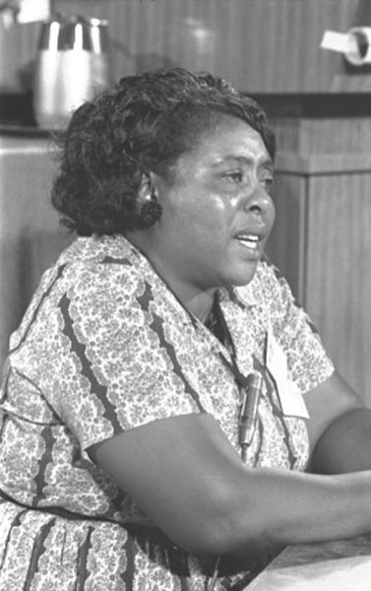
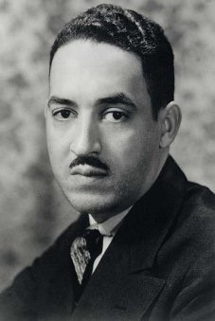
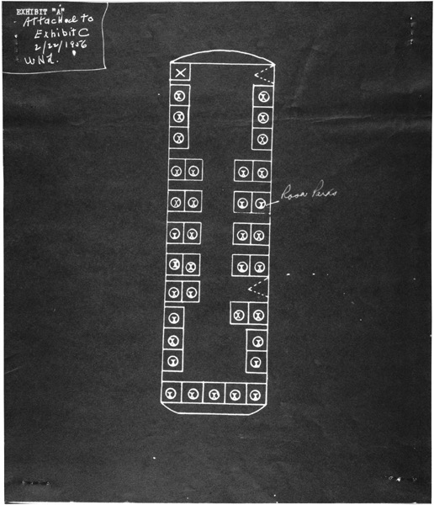
Key Concept 8.2, I
“Seeking to fulfill Reconstruction-era promises, civil rights activists and political leaders achieved some legal and political successes in ending segregation, although the progress toward equality was slow and halting.” - page 74
A: After WWII, civil rights activists used a variety of strategies to challenge racial segregation
Legal challenges: NAACP cases, led by attorney Thurgood Marshall, future Supreme Court Justice
Direct action: Fannie Lou Hamer and Freedom Summer
Sought to increase the number of African Americans registered to vote in Mississippi
Nonviolent Protest tactics:
Montgomery Bus Boycott
Sit-ins - Greensboro, NC -> sit-ins across the country

Slide 4
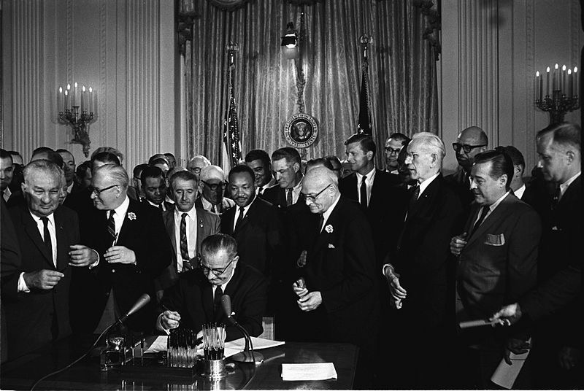
Key Concept 8.2, I
B: All 3 branches helped promote greater racial justice:
Executive - Harry Truman’s Executive Order 9981 desegregated the US military in 1948
Judicial - Brown v. Board - ruled that segregation was inherently unequal, overturned Plessy v. Ferguson (1896 - period 6)
Legislative - Civil Rights Act of 1964 - part of LBJ’s Great Society, which was an extension of the New Deal, and focused on Civil Rights
Discrimination in the workplace became illegal
Guaranteed equal access to public accommodations

Slide 5
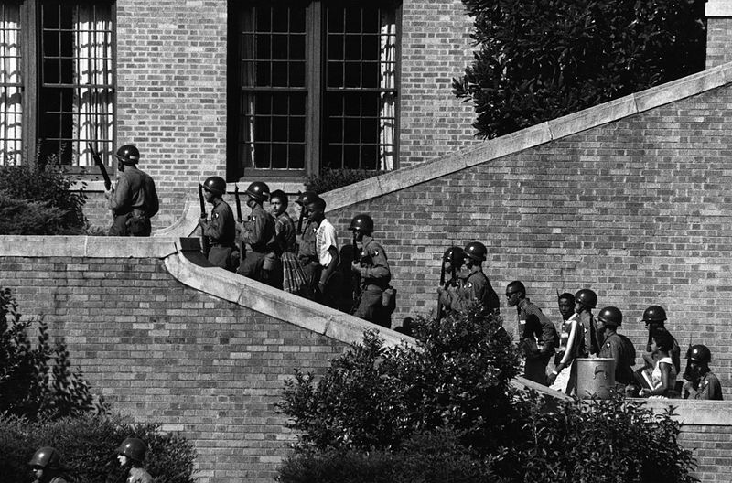
Key Concept 8.2, I
C: White resistance slowed efforts at desegregation
“Massive Resistance” - Southern schools would shut down before desegregating
Southern Manifesto - 101 Congressmen that believed the Supreme Court overstepped its power
Little Rock Nine - Governor Orville Faubus refused to integrate schools, Eisenhower sent troops to enforce integration
Post-1965 (riots in cities, increased involvement in Vietnam) debates emerged among activists over tactics and philosophy:
MLK - still urged nonviolence, but some urban protestors were frustrated
Black Panthers - advocated armed self-defense to violence

Slide 6
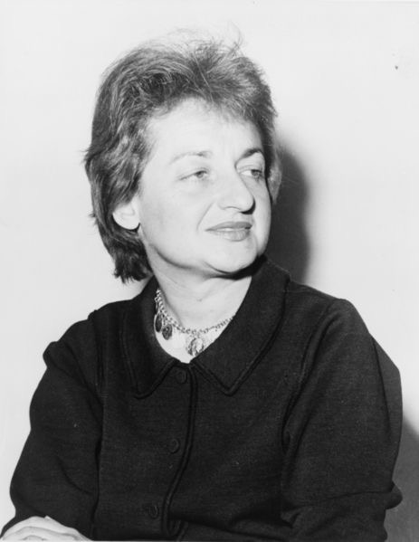
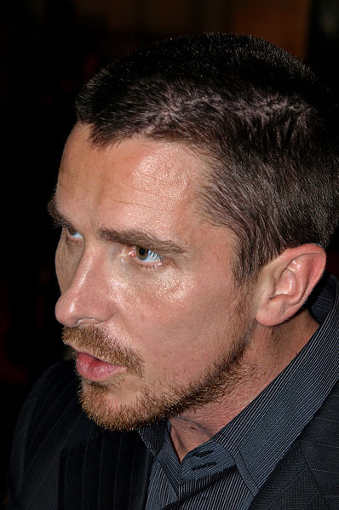
Key Concept 8.2, II
“Stirred by a growing awareness of inequalities in American society and by the African American civil rights movement, activists also addressed issues of identity and social justice, such as gender/sexuality and ethnicity.” - page 74
A: Challenges to society’s assumptions about gender
Betty Friedan’s The Feminine Mystique - argued that many housewives (especially suburban) were not happy and felt they lived unfulfilled lives
Gloria Steinem - helped create the National Women’s Political Caucus
Supports women that seek to be involved in politics
Step-mother of Christian Bale!
Calls for social and economic equality for gays and lesbians:
Stonewall Riots (1969) - birth of the Gay Rights Movement

Slide 7
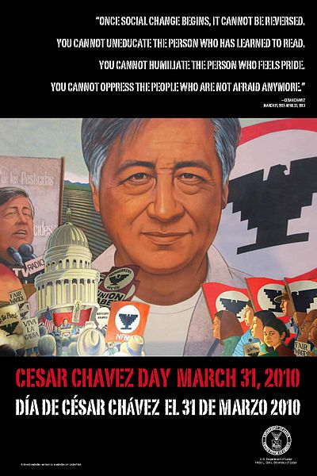
Key Concept 8.2, II
B: Groups that demanded social and economic equality and to redress past grievances included:
Latinos:
Cesar Chavez and the United Farm Workers
Led a grape pickers’ strike to bring attention to the plight of Mexican-American workers
American Indians:
Indians of All Tribes (IAT) and American Indian Movement (AIM) used protests to bring attention to the struggles of Native Americans
IAT took over Alcatraz Island in 1969
Asian Americans:
California overturned its Alien Land Law - forbade Japanese immigrants from owning land

Slide 8
Key Concept 8.2, II
C: Although it appeared there was overall affluence, poverty was a national issue, and efforts began to address it
Michael Harrington’s The Other America
Helped influence LBJ’s Great Society
Argued 25% of the nation and 40% of African Americans lived in poverty
Native Americans were the hardest hit group

Slide 9
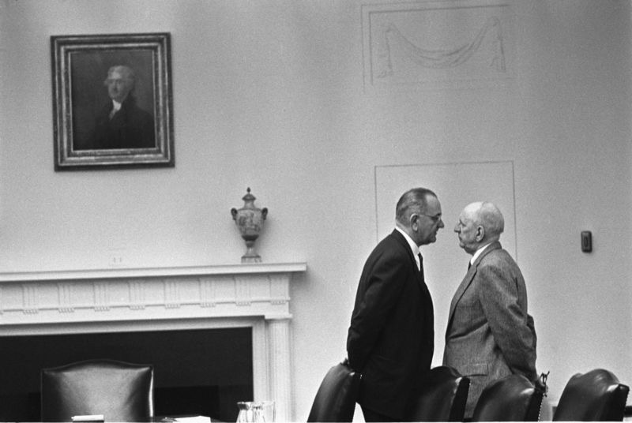
Key Concept 8.2, III
“As many liberal principles came to dominate postwar politics and court decisions, liberalism came under attack from the left as well as from resurgent conservative movements.” - page 75
A: LBJ’s Great Society was the high point of liberalism and sought to:
Use federal power to end racial discrimination:
Civil Rights Act of 1964 - banned discrimination in public facilities
Voting Rights Act of 1965 - eliminated literacy tests, federal government could register voters
24th Amendment - eliminated poll taxes
Eliminate poverty:
Head Start Program, HUD
Foodstamps, Medicare, and Medicaid
Address other social issues and attack communism abroad:
Education - provided $ for primary and secondary education
Vietnam War - sought to keep communism from spreading

Slide 10
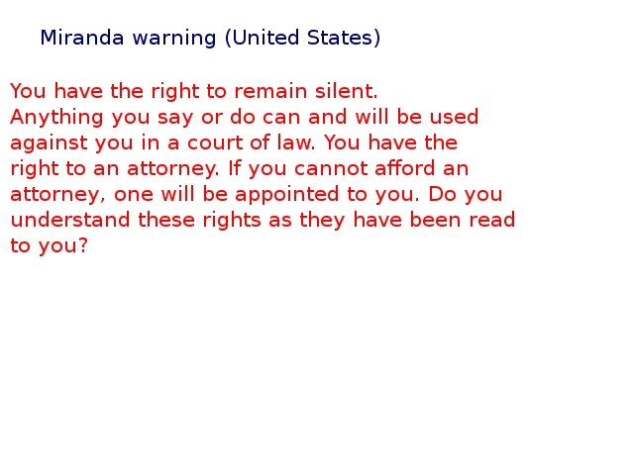
Key Concept 8.2, III
B: Liberal ideas were aided by:
Supreme Court Decisions that expanded democracy and individual freedoms
Miranda v. Arizona - those arrested must be made aware of their rights
Griswold v. Connecticut - struck down a law forbidding contraception; determined the Constitution established a “right to privacy”
Great Society social programs and policies
Power of the federal government
Impacts of those above?
Emergence of a conservative movement that focused on:
Defending traditional visions of morality
Debating the proper role of state authority

Slide 11
Key Concept 8.2, III
C: Groups on the left assailed liberals because they believed:
Liberals did not transform the racial and economic status quo at home
Black Panthers - urged arming of African Americans for self defense; created free breakfast programs in urban areas
Liberals pursued immoral policies abroad (Vietnam War)
Students for a Democratic Society (SDS) - protested the Vietnam War as the US increased involvement; criticized the gap between the rich and poor
Inspired march-ins, sit-ins, and teach-ins

Slide 12
Test Tips
Multiple-Choice and Short Answer:
Examples of strategies used by Civil Rights Activists - direct action, legal challenges, and nonviolent protest
How all three branches contributed to the Civil Rights Movement
Great Society - EVERYTHING
Criticisms of liberalism on the left and right
Essay and DBQ:
Comparing the Civil Rights movement with earlier time periods (1890s - 1920s - Booker T., W.E.B., etc.)
Comparing the Women’s Rights movement with earlier time periods (1840s, 1920s, etc.)

Slide 13
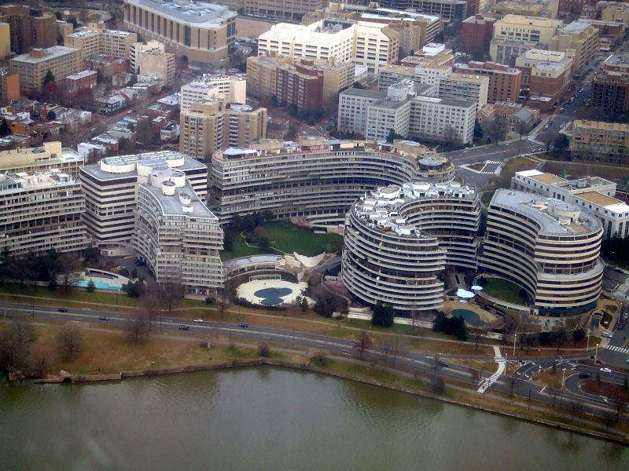
See You Back Here For 8.3!
Thanks for watching!
Subscribe and share
Good luck on all your tests and in May!

