Slide 1
APUSH Review: Key Concept 8.3 (Period 8: 1945 - 1980)
WWW.APUSHREVIEW.COM
Everything You Need To Know About Key Concept 8.3 To Succeed In APUSH

Slide 2
Key Concept 8.3
“Postwar economic, demographic, and technological changes had a far-reaching impact on American society, politics, and the environment.”
Page 76
Big Idea Questions:
How did economic growth impact American society and American values?
How did new immigration laws in 1965 impact immigrants? (Change and continuity)
How did the counterculture impact on American society?

Slide 3
Key Concept 8.3, I
“Rapid economic and social changes in American society fostered a sense of optimism in the postwar years, as well as underlying concerns about how these changes were affecting American values.”
Page 76
A: Economic Growth increased due to:
Federal spending, baby boom generation, prosperous private businesses
Impacts of this growth?
Suburbanization, higher education opportunities, “Sun Belt” gaining influence (at expense of the “Frost Belt”)

Slide 4
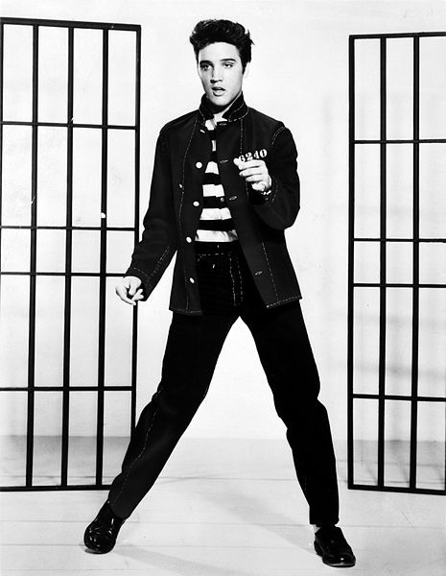
Key Concept 8.3, I
B: The rise of a homogeneous mass culture
Was caused by:
Economic and Social Changes
Anxiety over the Cold War
Was challenged by artists, intellectuals, and youth
Beat Movement - writers that challenged middle class conformity
The Affluent Society (1958) - brought attention to income disparity in post-WWII US
Rock and roll music - Elvis Presley, Beatles

Slide 5
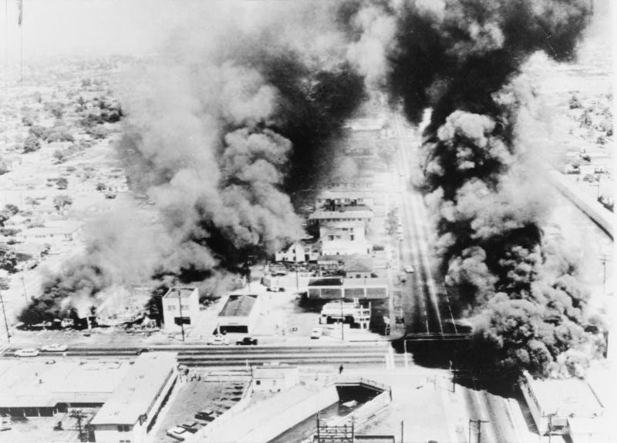
Key Concept 8.3, I
C: Rise of a conservative movement:
Was caused by:
Urban unrest - riots in cities (Watts), increase in violence
Juvenile delinquency
Challenges to the traditional family - increase in divorce rate and births out of wedlock
Promoted their own agenda:
Smaller government, tougher stance on crime

Slide 6
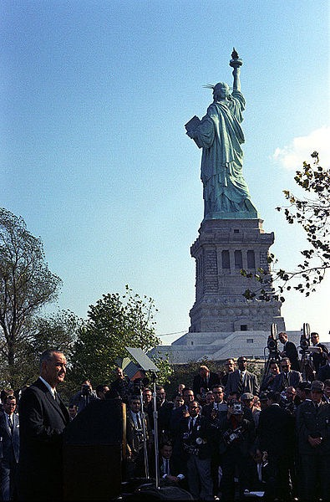
Key Concept 8.3, II
“As federal programs expanded and economic growth reshaped American society, many sought greater access to prosperity even as critics began to question the burgeoning use of natural resources.”
Page 76
A: Internal and International immigration increased -> economic opportunities
Immigration Law of 1965:
***Abolished the quota system from the 1920s***
Families of legal immigrants living in the US were given preferential treatment
Especially benefited immigrants from Latin America and Asia

Slide 7
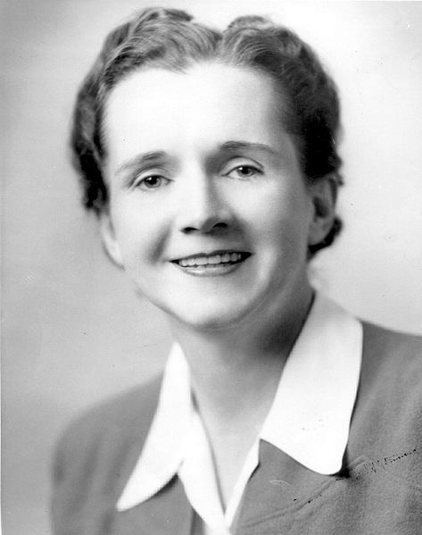
Key Concept 8.3, II
B: Increased calls for conservation and fighting pollution:
Caused by:
Abuse of natural resources
Environmental problems:
Rachel Carson and Silent Spring - wrote about the dangers of pesticide
Helped inspire the EPA
Led to:
Clean Air Act:
Environmental Protection Agency (EPA):
Created under Nixon’s administration
Purpose is to help protect the environment and human health

Slide 8
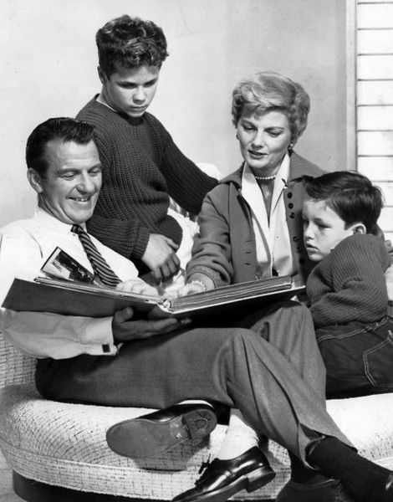
Key Concept 8.3, III
“New demographic and social issues led to significant political and moral debates that sharply divided the nation.”
Page 77
A: The American family structure was not always what was perceived
Image: traditional nuclear family
As seen in many TV shows: Leave It To Beaver, Father Knows Best
Changes to the American family:
More and more women increasingly worked outside the home (especially in the 1970s)
Divorce rates increased

Slide 9
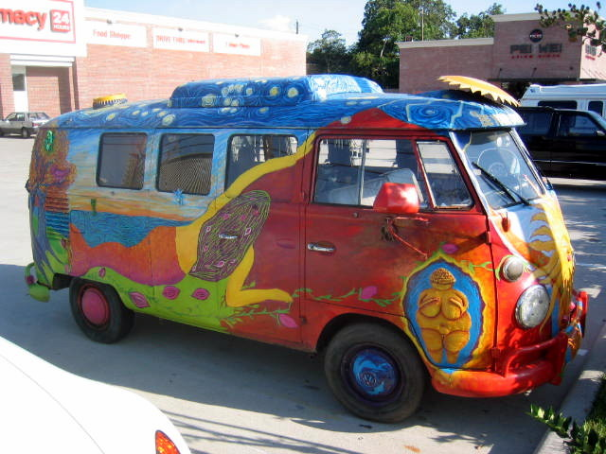
Key Concept 8.3, III
B: Counterculture of the 1960s (“Hippies”)
Rejected many of their parents generations’ values
Social - used marijuana; new music (Woodstock)
Economic - rejected materialism, sought to live a simpler life
Political - protested the Vietnam War; active in civil rights, promoted women’s rights;
Initiated:
A sexual revolution
Greater informality into US Culture

Slide 10
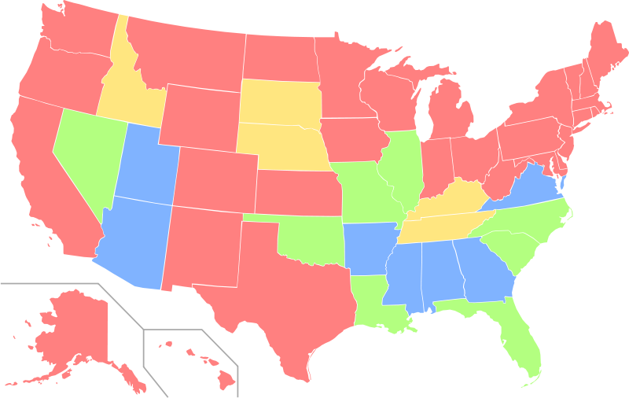
Key Concept 8.3, III
C: Clashes between liberals and conservatives:
Power of the presidency and the federal government:
Movements for greater individual rights:
Bakke v. University of California - Supreme Court upheld affirmative action, however, it ruled that quotas were not allowed
Phyllis Schlafly - Critic of the Equal Rights Amendment (ERA)
Argued that the ERA would hurt women by taking away certain benefits
Her campaign helped lead to the defeat of the ERA

Slide 11
Test Tips
Multiple-Choice and Short Answer:
Rise of the conservative movement
Causes of the environmental movement
Family structures and counterculture
Essays:
Immigration - comparing post 1965 with prior time periods (1920s immigration quotas)
Rise of the conservative movement (making connections to the 1960s under LBJ)

Slide 12
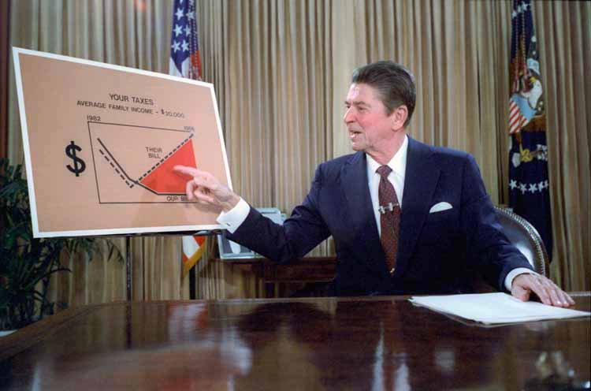
See You Back Here For 9.1!
Thanks for watching!
Subscribe and share
Check out my other videos (end of year reviews)
Good luck in May!

