Slide 1
APUSH Review: Key Concept 8.1 (Period 8: 1945 - 1980)
Period 8: 1945 - 1980
Everything You Need To Know About Key Concept 8.1 To Succeed In APUSH
Shoutout time! Brandon and the rest of Mr. Matthews’ class, Mr. Gunkel in Alaska, Ms. Schouvieller’s class, and Mr. Peters’ class. Thank you all for your support!

Slide 2
Key Concept 8.1
“The United States responded to an uncertain and unstable postwar world by asserting and attempting to defend a position of global leadership, with far-reaching domestic and international consequences.”
Page 72
Big Idea Questions:
What were different ways the US sought to “contain” communism, both domestically and abroad?
How did independence movements throughout the world affect the Cold War?
How did the Vietnam War impact domestic life?

Slide 3
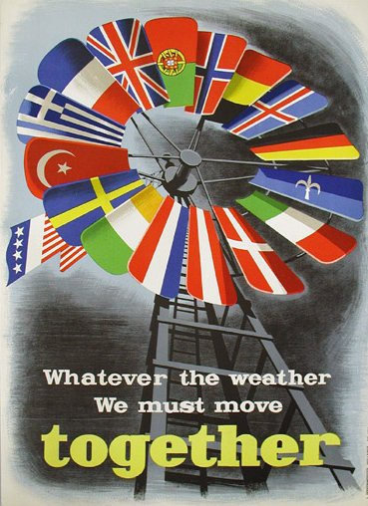
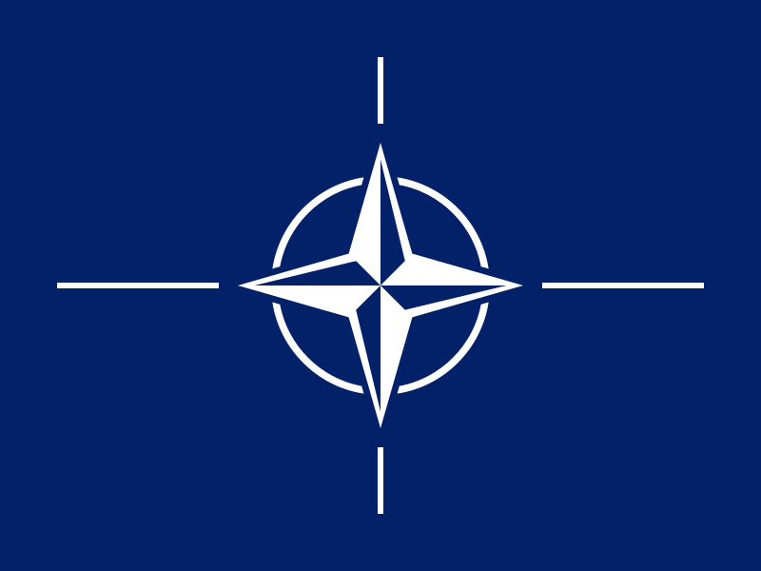
Key Concept 8.1, I
“After World War II, the United States sought to stem the growth of Communist military power and ideological influence, create a stable global economy, and build an international security system.”
Page 71
A: US foreign policy was based on:
Collective Security:
North Atlantic Treaty Organization (NATO) - an attack on one country was an attack on all
Multilateral economic framework that bolstered non-Communist nations:
Marshall Plan - provided billions of $ to Europe to rebuild war-torn countries
Truman Doctrine - $400 million in military aid to Greece and Turkey

Slide 4
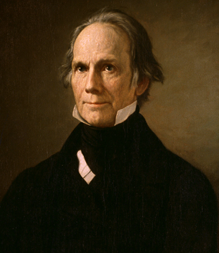
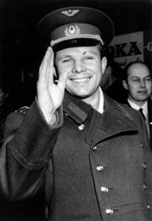
Key Concept 8.1, I
Happy Birthday Me!
B: US “contained” communism through:
Military engagements in Korea and Vietnam:
Domino theory - fear if one country became communist, then surrounding countries would
Massive Retaliation:
The US would respond with more force if attacked
The Ron Burgundy, “That escalated quickly.”
Space Race:
Reaction to Sputnik and Yuri Gagarin
US built up space program AND education in the US

Slide 5
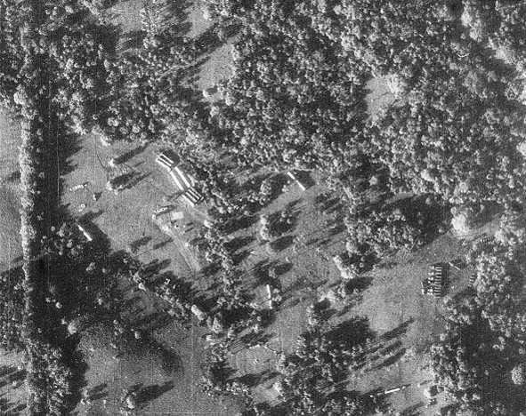
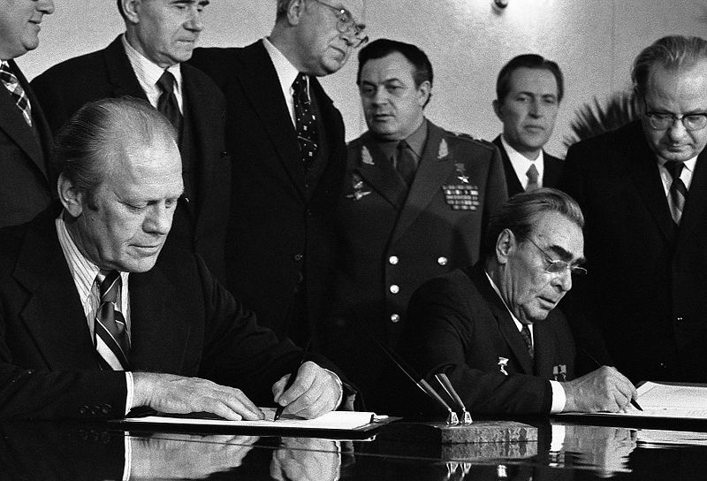
Key Concept 8.1, I
C: Cold War fluctuated between direct and indirect military confrontations:
Cuban Missile Crisis:
13 days in October, 1962
Closest the US and Soviet Union came to war
Detente: easing of tensions between superpowers
SALT (Strategic Arms Limitation Talks) -> Treaties:
Began with Nixon’s administration and continued through Carter’s
Agreements to limit certain arms

Slide 6
Key Concept 8.1, II
“As the United States focused on containing communism, it faced increasingly complex foreign policy issues, including decolonization, shifting international alignments and regional conflicts, and global economic and environmental changes.”
Page 72
A: Impacts of postwar decolonization movements in Asia, Africa, and the Middle East:
US and USSR sought allies among the new nations, although many remained neutral
The US immediately recognized Israel in 1948
Many revolutions were seen as pawns of the Soviet Union

Slide 7
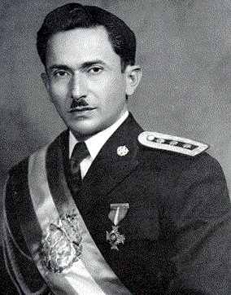
Key Concept 8.1, II
B: Cold War in Latin America:
“US supported non-communist regimes with varying levels of commitment to democracy.”
1954 - overthrow of Arbenz in Guatemala
He was democratically elected and nationalized land owned by the United Fruit Company
He was replaced with a military dictator, Armas

Slide 8
Key Concept 8.1, II
C: US involvement in the Middle East was shaped by Ideological, military, and economic concerns
Suez Crisis - Nasser of Egypt nationalized the Suez Canal, Britain and France attacked
The US helped end the conflict -> fear the Soviets would get involved
Oil crises helped initiate attempts at creating a national energy policy
Organization of Petroleum Exporting Countries (OPEC):
Cartel formed by mostly Middle Eastern countries to control the supply of oil
After the US supported Israel in 1973 (Yom Kippur War), OPEC placed an oil embargo on the US, drastically raising gas prices

Slide 9
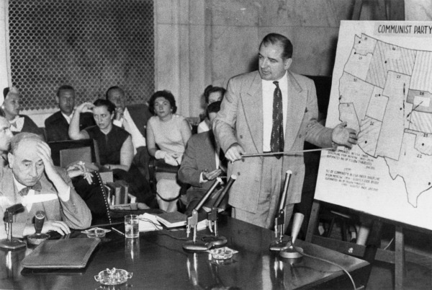
Key Concept 8.1, III
“Cold War policies led to continued public debates over the power of the federal government, acceptable means for pursuing international and domestic goals, and the proper balance between liberty and order.”
Page 73
A: Debates over methods to root out domestic Communists:
Truman’s Executive Order 9835 - “Loyalty Oath” for Federal employees
2nd Red Scare:
HUAC and the “Hollywood Ten”
McCarthyism
Both political parties supported containing Communism
Eisenhower (R) in Iran and Guatemala
Truman in Korea (D) and LBJ (D) in Vietnam

Slide 10
Key Concept 8.1, III
B: Domestic opposition to wars:
The Korean War produced only minor opposition
Vietnam saw violent protests that increased as the war went on
Especially after the Tet Offensive (January 1968)
Students for a Democratic Society (SDS) - used violence as time went on to protest
Kent-State Protests (May, 1970) - reaction to Cambodia Bombings

Slide 11
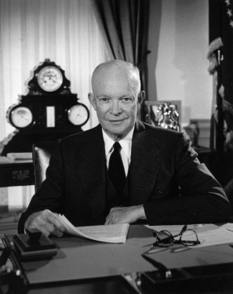
Key Concept 8.1, III
C: Americans began to debate:
The merits of a large nuclear arsenal
The “military-industrial complex”
Buildup of military and industries throughout the US
Eisenhower warned of this in his farewell address
Power of executive branch in foreign and military policy
Congress reversed the Gulf of Tonkin Resolution with the War Powers Act

Slide 12
Test Tips
Multiple-Choice and Short Answer:
Ways the US sought to “contain” communism -
Korea and Vietnam; Marshall Plan and Truman Doctrine
Detente
Military industrial complex
Essay Questions:
Change and Continuity post WWII
Comparing and contrasting post-WWI with post-WWII

Slide 13
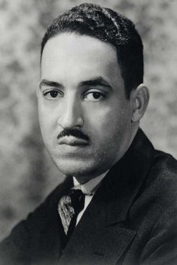
See You Back Here For 8.2!
Thanks for watching
Subscribe and Share
Best of luck
Good luck in May!

