Slide 1
APUSH Review: Key Concept 9.1 (1980 - Present)
Everything You Need To Know About Key Concept 9.1 To Succeed In APUSH
Shoutout Time! Ms. Hammond’s class at Newnan High School. Thanks, you rock!

Slide 2
Key Concept 9.1
“A new conservatism grew to prominence in U.S. culture and politics, defending traditional social values and rejecting liberal views about the role of government.”
Page 78
Big Idea Questions:
What were reasons for the growth of conservatism in the 1980s?
How successful was the conservative movement in achieving their goals?

Slide 3
Key Concept 9.1, I
“Reduced public faith in the government’s ability to solve social and economic problems, the growth of religious fundamentalism, and the dissemination of neoconservative thought all combined to invigorate conservatism.”
Page 78
A: Public faith in government declined in the 1970s due to:
Economic challenges:
OPEC oil embargo (1973) - result of US supporting Israel in the Yom Kippur War
Led to drastically long lines at gas stations, huge increase in gas prices
Stagflation of the 1970s - unemployment, slow economic growth, and high inflation
Political Scandals:
Watergate, pardon of Richard Nixon
Foreign policy “failures”:
Iran Hostage Crisis - a response to the US’ decision to give treatment to the Shah of Iran
Hostages were freed after 444 days during Reagan’s inauguration
A sense of social and moral decay

Slide 4
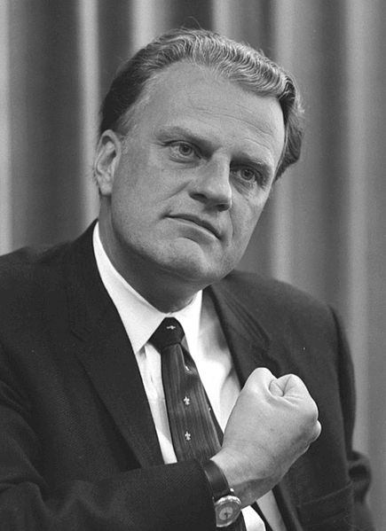
Key Concept 9.1, I
B: Increased opposition to liberal social and political trends
Caused by:
Growth of evangelical and fundamentalist Christian churches:
Going back to Billy Graham (1940s and 1950s)
Increase in number of “Born-again Christians”
Increased political participation of the groups as seen in:
Moral Majority - opposed ERA, SALT, abortion, and homosexuals - supported Reagan in his elections
Focus on the Family - Promotes abstinence, same-sex marriage, and is pro-life

Slide 5
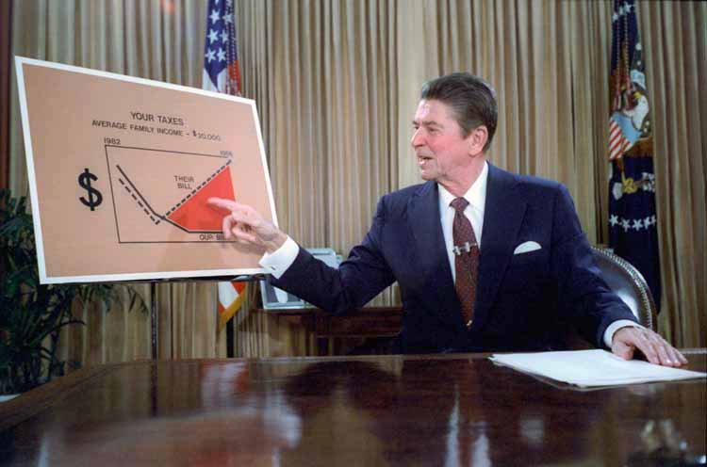
Key Concept 9.1, II
“Conservatives achieved some of their political and policy goals, but their success was limited by the enduring popularity and institutional strength of some government programs and pubic support for cultural trends of recent decades.”
Page
A: Conservative victories:
Taxation - “Reaganomics”, “supply-side”, or “trickle-down” economics under Ronald Reagan and George W. Bush
Tax cuts for wealthy in order to stimulate economic growth
Tax rates were cut in the 1980s
Similar to tax policies of the 1920s under Secretary of Treasury Andrew Mellon
Deregulation of industries:
Shrinking the size of the government and bureaucracy
Conservative opposition:
Advancing moral ideals:
Planned Parenthood v. Casey - Supreme Court ruled that a 24-hour waiting period before an abortion is OK

Slide 6
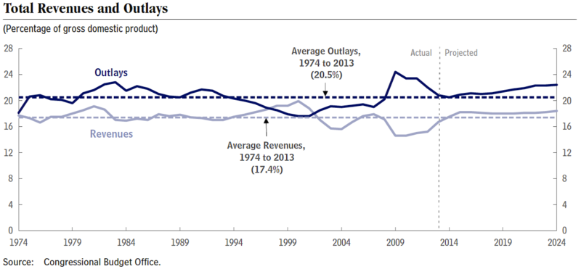
Key Concept 9.1, II
B: The size of the federal government grew after 1980, despite Republicans condemning “big government”
Growth of the budget deficit:
Due to increased military spending, continuation of Social Security, decrease in tax revenues
Many programs were popular and were difficult to eliminate
Expansion of medicare and medicaid

Slide 7
Test Tips
Multiple-Choice and Short Answer:
Impact of religion on the conservative movement
Successes/failures of the conservative movement
Long Essay/DBQ
Not exclusively on period 9
Could be part of larger idea (debates over scope and size of the federal government since WWII)

Slide 8
See You Back Here For Key Concept 9.2
Thanks for watching
Subscribe and share
Check out all my period review videos
Good luck in May!

