Slide 1
APUSH Review: Key Concept 9.2 (Period 9: 1980 - Present)
Everything You Need To Know About Key Concept 9.2 To Succeed In APUSH
Shoutout Time! Ms. Boyea’s class in CT, Ms. Maupin’s class - you deserve extra credit!, Mr. Earley’s class in Shanghai!, Mrs. Brantley’s class, and Casey and Laura and New Egypt High School!

Slide 2
Key Concept 9.2
“The end of the Cold War and new challenges to U.S. leadership in the world forced the nation to redefine its foreign policy and global role.”
Page 79
Big idea questions:
How did Ronald Reagan interact with the Soviet Union in the 1980s?
What led to the “war on terror” and what were its impacts domestically as well as internationally?

Slide 3
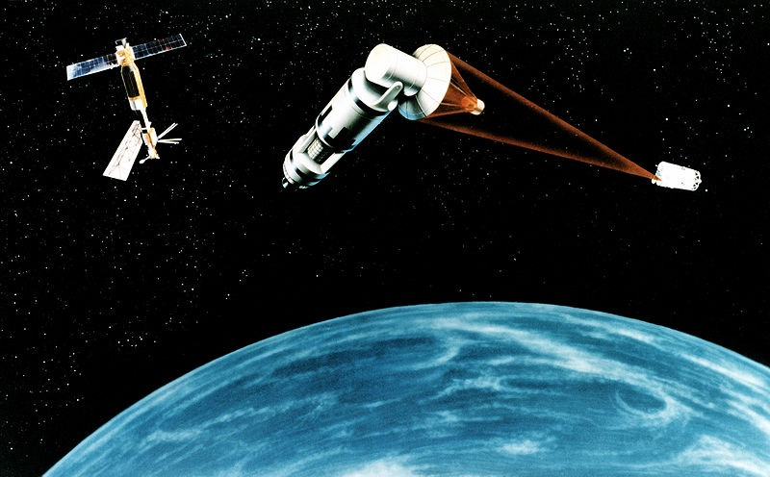
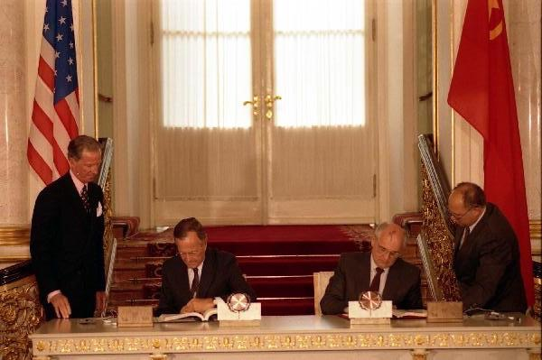
Key Concept 9.2, I
“The Reagan administration pursued a reinvigorated anti-Communist and interventionist foreign policy that set the tone for later administrations.”
Page 79
A: Reagan initially rejected detente by:
Increasing defense spending - “Star Wars” - idea to destroy Soviet nuclear weapons after they were launched
Military action
Bellicose rhetoric - aggressive language, “Evil Empire”
Later on, he had a positive relationship with Mikhail Gorbachev, and both countries significantly reduced their arms
Start I - Idea proposed by Reagan to reduce arms (signed by President H.W. Bush)

Slide 4
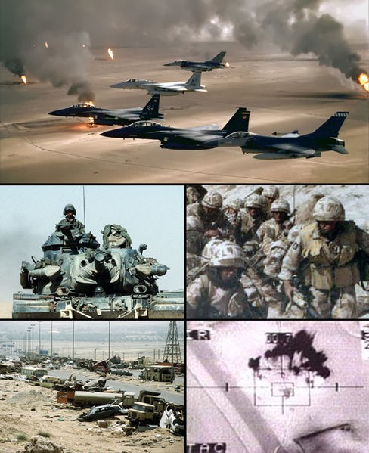
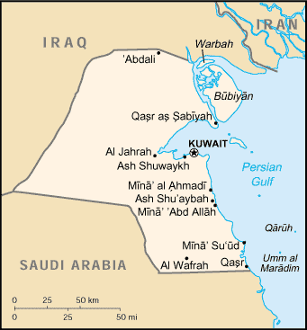
Key Concept 9.2, I
B: Impacts of the end of the Cold War:
New diplomatic relationships
Improved relationships with Russia, former Soviet Bloc countries - some even joined NATO
U.S. military and peacekeeping interventions
Iraq in 1991, Nato bombing of Yugoslavia in 1999
Debates over the nature and extent of American power in the world
Could be connected to foreign policy pre and post WWII

Slide 5
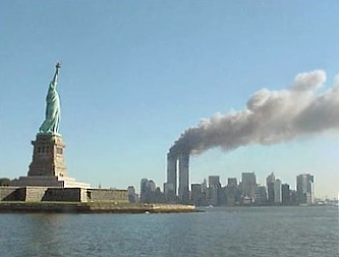
Key Concept 9.2, II
“Following the attacks of September 11, 2001, U.S. foreign policy and military involvement focused on a war on terrorism, which also generated debates about domestic security and civil rights.”
Page 80
A: Attacks on 9/11
Al Qaida led attack on US - World Trade Center, Pentagon, and in PA
Conflict in Afghanistan
Response to the Taliban holding Osama bin Laden -> lengthly conflict
Conflict in Iraq
US-led conflict against Saddam Hussein -> suspected WMDs and connections to terrorism

Slide 6
Key Concept 9.2, II
B: Impacts of the war on terrorism?
Hoped to improve security in the US
Raised questions about protection of civil liberties and human rights
Civil Liberties - Patriot Act, increases power of the federal government to wiretap without warrant
“Roving wiretap” - focuses on the person, not the device

Slide 7
Test Tips
Multiple-Choice and Short Answer
Detente, bellicose rhetoric, and friendly relationship with Gorby
US in the post-Cold War world
Essay Topics:
Not exclusively on this time period
Part of bigger theme
Cold War policy - End of the War
Civil Liberties post-WWII - Present
Foreign policy post WWII - debates/changes

Slide 8
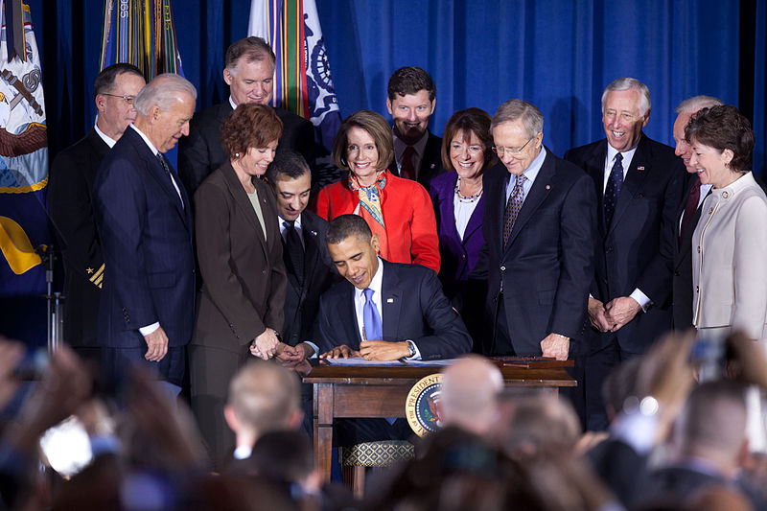
See You Back Here For 9.3!
Thanks for watching!
Subscribe to my channel
Check out my other videos (Periods 1 - 5, Periods 6 - 9)
Good luck in May!

