Slide 1
APUSH Review: Key Concept 9.2, Revised
Shoutout Time! Jackson and everyone in Mrs. Anthony’s class, Mr. Sacco’s class from CA, Mrs. Wolfman’s class in Idaho, Mr. Hanrahan’s class in IL, Mrs. Beichner’s class, Mr. Potter’s class in WNY, Mrs. Marlar’s class in TX, and Mr. Lundequam’s class in Barron WI. Best of luck to you all, you are BRILLIANT and will do GREAT!
Everything You Need To Know About Key Concept 9.2 To Succeed In APUSH

Slide 2
Key Concept 9.2
“Moving into the 21st century, the nation experienced significant technological, economic, and demographic changes.” page 86
Big Idea ?s:
How has the economy changed since 1980?
What are the impacts of internal migration and immigrants on the US?

Slide 3
Key Concept 9.2, I
“New developments in science and technology enhanced the economy and transformed society, while manufacturing decreased.” page 86
A: Why did American participation in worldwide economic opportunities increase? (Globalization)
Economic productivity increased
Digital communications increased
Computers, email, phones, etc. connected the world instantly

Slide 4
Key Concept 9.2, I
B. Impact of technological innovations?
Increased access to information:
Many print newspapers shut down and are being replaced
New social behaviors and networks
C. Increase of service sector employment, decrease in manufacturing and union membership declined
Rust Belt - Northern cities that lost manufacturing jobs - Buffalo, Cleveland, Detroit

Slide 5
Key Concept 9.2, I
D. Economy in post 1980:
Wages stagnated (stopped)
Increase in economic inequality

Slide 6
Key Concept 9.2, II
“The U.S. population continued to undergo demographic shifts that had significant cultural and political consequences.” page 87
A: Population growth in the South and West post 1980 (Sunbelt)
Increase influence politically, economically, and culturally
More representation in the House, more businesses

Slide 7
Key Concept 9.2, II
B: Immigration from Latin America and Asia increased drastically
Traditionally underrepresented groups
Result of 1965 Immigration Act
Helped supply the US with an important labor force
C.Political debates continued over immigration policy, diversity, gender roles, and family structures::
Immigration Reform and Control Act of 1986
Penalties for employers that hire illegal immigrants
Don’t Ask, Don’t Tell - banned openly gay individuals from serving in the military
Overturned under Obama’s Administration

Slide 8
Test Tips
Multiple-Choice and Short Answer:
Impact of technology
Demographic changes - Sun Belt, Rust Belt
Economy since 1980
Essays:
Not exclusively on period 9
Part of a larger theme
Immigration post WWII

Slide 9
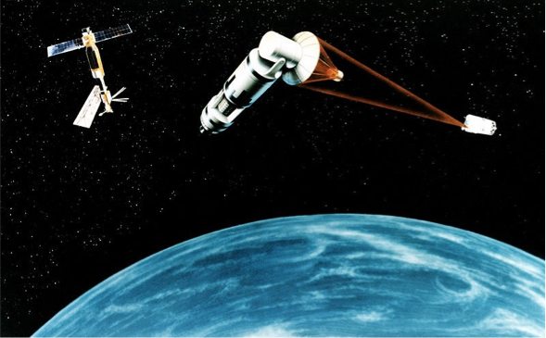
See You Back Here For Key Concept 9.3!
Thanks for watching
Best of luck!
Check out my massive review videos in the curriculum

