Slide 1
APUSH Review: Give Me Liberty!, Chapter 9, 4th Edition
Market Revolution
Railroads
Steam Boats
Adams-Onis Treaty
Please check out the description for additional videos related to this chapter and other resources!
Eli Whitney
Samuel Slater
Irish and German Immigrants
2nd Great Awakening

Slide 2
A New Economy
Market Revolution - Economic changes which saw work done increasingly outside the home and improvements in transportation
Roads in the early 19th century were very primitive
Cincinnati to NYC = 50 days!
Roads and Steamboats
New improvements - canal, railroad, telegraph
Originally, most roads were built by local and state governments, or private companies
Federal government did NOT fund intrastate improvements
National Road - connected MD to the Old Northwest
Clermont - allowed for travel against the current
The Erie Canal
Albany to Buffalo, 363 miles
Connected NYC to Midwest
Built by NY, no federal funding

Slide 3
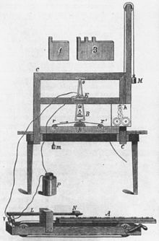
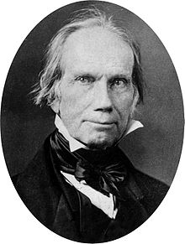
A New Economy
Railroads and the Telegraph
B&O Railroad - 1828
30,000 miles of RRs by 1860
Telegraph - 1844: “What hath god wrought?”
Massive increase in the spread of information
The Rise of the West
Westward expansion increased rapidly after the War of 1812
Farmers moved to AL, MS, LA, and AR - cotton plantations
Free and forced migration of individuals
Adams-Onis Treaty of 1819 - US gained FL from Spain
Many prominent politicians were born on the east coast and moved to western states

Slide 4
A New Economy
The Cotton Kingdom
Deep South (states just mentioned) had favorable climate for cotton
Cotton gin - drastically increased the demand for slavery and cotton
1808 - end of the International Slave Trade
Increase in domestic slave trade - break up of families
The Unfree Westward Movement
Slave Coffles - forced march of slaves to the Deep South
Continued the breakup of families and communities
As the US expanded westward, so did cotton plantations in the South

Slide 5
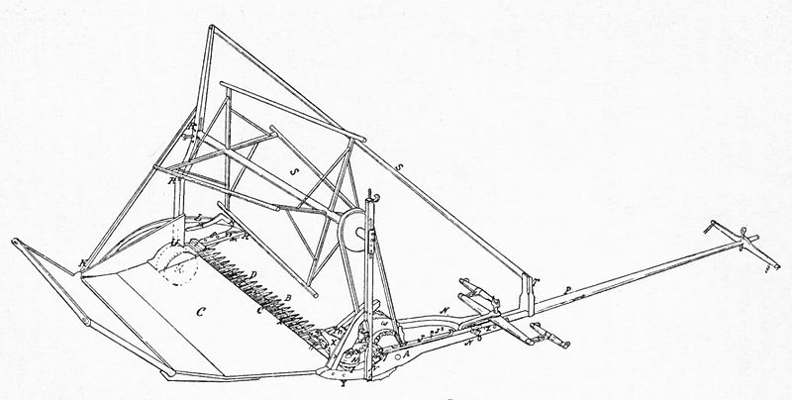
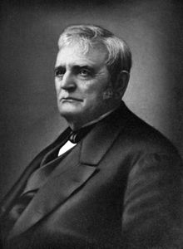
A New Economy
Market Society
Banking and transportation systems revolved around cotton
Financed purchase of new plantations and slaves
Commercial Farmers
Old NW and East became more interconnected than the South
Key inventions:
Steel Plow - John Deere - break ground for farming easily
McCormick Reaper - increased harvest rate for farmers
West produced wheat, eastern farmers focused on dairy, fruit, and veggies

Slide 6
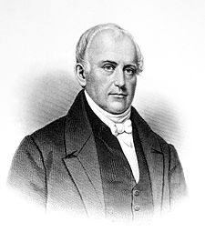
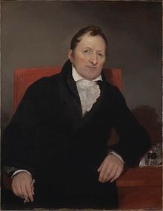
A New Economy
The Growth of Cities
Growth of cities that became important in trade - CINCINNATI and St. Louis
Goods were produced more quickly as the process was broken down into several steps
The Factory System
Samuel Slater - “Father of the American Factory System”
Memorized plans for the Spinning Jenny
Lowell, MA - emergence of textile factories
Located along waterways
Interchangeable Parts - Eli Whitney
Allowed for the mass-production of goods using identical parts
Factories in the first half of the 19t century were limited to mostly NE

Slide 7
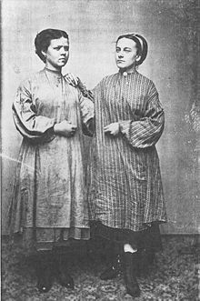
A New Economy
The Industrial Worker
Leisure and work time became increasingly separated in city life
Wages were paid in hourly rates
The “Mill Girls”
Lowell Factory employed farmers’ daughters
Single women, lived in boarding houses with rules regulating behavior
Afforded an opportunity to make income on their own
The Growth of Immigration
1840 - 1860: 4 million immigrants came to US - mostly Germans and Irish
Settled mostly in the North and Midwest
Loss of land in Europe forced many to emigrate to the US

Slide 8
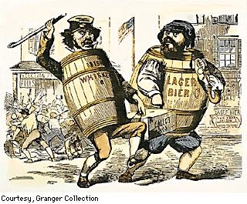
A New Economy
Irish and German Immigrants
Irish Potato Famine - 1 million Irish died, 1 million more emigrated
Irish immigrants built American infrastructure - canals and railroads
Irish settled in cities in the Northeast - NYC, Boston, etc.
Germans - craftsmen and farmers, settled on the frontier
The Rise of Nativism
Hatred and fear of foreigners - heavy nativism against Catholics
Parochial schools, fear of the pope
Immigrants often “stole” jobs and voted Democratic
The Transformation of Law
Corporation - owners are not liable for a company’s debts
Commonwealth v. Hunt - MA state supreme court upheld the legality of labor unions

Slide 9
The Free Individual
The West and Freedom
Manifest Destiny - John L. O’Sullivan - God-given right for US to expand
The west provided opportunity for individuals and families to move in tough economic times
Abundance of land, far from factory labor; opportunity for economic independence
The Transcendentalists
Focus on individual, rather than social traditions
Famous writers such as Emerson and Thoreau
Individualism
Emerson criticized materialist possessions, argued to focus on nature
Thoreau escaped to nature for two years - Walden

Slide 10
The Free Individual
The Second Great Awakening
Religious revival aimed at low church attendance
Charles G. Finney - evangelist in NY State
Like the 1st Great Awakening, the 2nd saw an increase in religious sects
Unlike the 1st G.A., the 2nd preached free will by individuals
The Awakening’s Impact
Salvation could be attained through faith and good deeds
Greed was seen as selfish and a sin
Revivals were popular in areas affected by the Market Economy
The Emergence of Mormonism
Church of Latter-Day Saints - founded by Joseph Smith in NY
Focus on family, rejection of alcohol
-Practice of polygamy upset Smith’s neighbors - he and his followers moved to IL, where he was murdered
Brigham Young led the Mormons to Utah

Slide 11
The Limits of Prosperity
Liberty and Prosperity
John Jacob Astor - became wealthy by shipping furs all over the world
$10 million at time of death ($100s of billions in today’s dollars)
Example of a self-made man
Race and Opportunity
Blacks often lived in the poorest sections of cities and were subjected to violence
Richard Allen - founded the African Methodist Episcopal Church after being barred for praying at a white alter rail
Blacks were barred from skilled employment - competition with whites
Some states even barred free blacks from entering the state
The Cult of Domesticity
Emerged out of the Market Economy
Women were expected to foster love and friendship - similar to “Republican Motherhood” from post Rev. War

Slide 12
The Limits of Prosperity
Women and Work
Married women could not sign contracts
Work outside the home was mostly limited to domestic servants, factory workers, and seamstresses
Middle-class women were expected to remain at home
The Early Labor Movement
Market Revolution increased the gap between the wealthy and poor
Those that couldn’t pay debts were sent to jail
Workingmen’s Parties - hoped to gain political support for free education and end to imprisonment for debt
The “Liberty of Living”
Lowell Women went on strike in 1834
Market Revolution increased opportunities for white men, but limited opportunities for women and blacks

Slide 13
Quick Recap
Market Revolution
Steel plow, McCormick reaper, cotton gin, interchangeable parts
Lowell Factory System
Irish and German Immigrants
Nativism - what is it? Reasons for?
Transcendentalism
2nd Great Awakening
Mormons

Slide 14
See You Back Here For Chapter 10!
Thanks for watching
Subscribe and share
Check out other videos in the description
Good luck in May!

