Slide 1
APUSH Review: Breaking Down Bartlomé de Las Casas’ Writing
Everything You Need To Know About Bartlomé de Las Casas’ Writing To Succeed In APUSH
Want more document analysis? Take my FREE course at APUSHREVIEW.COM

Slide 2
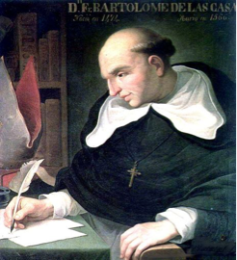
Background On Bartlomé de Las Casas
Originally a slave owner, later gave up his encomienda
Bishop, present-day Mexico
Argued that Natives deserved equal treatment
Helped end the encomienda system

Slide 3
Bartlomé de Las Casas’ Writing
“He (Columbus) introduced and commenced to establish such beginnings, and sowed such seeds from which originated and grew such deadly and pestilential herbs producing from themselves such deep roots, that is has been enough to destroy and devastate all these Indies, without human power being enough to prevent or overcome such supreme and irreparable injuries.
“I do not doubt that if the Admiral had believed that such pernicious harm would follow as did follow, and had known as much of the simple conclusions of natural and divine right as he knew of cosmography and other human sciences, that he would never have dared to introduce nor begin a thing which must occasion such calamitous injuries.”

Slide 4
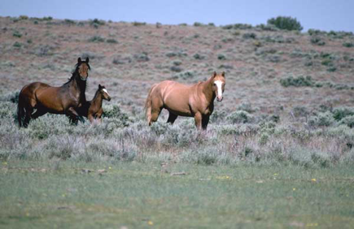
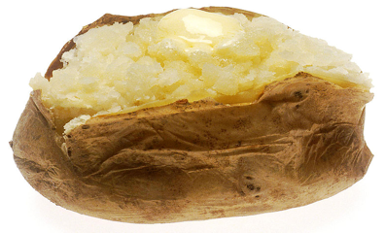
Document Analysis Questions
1. To what is de Las Casas referring in his writing?
Columbian Exchange
2. What was introduced from Europe to the Americas?
Horses, pigs, wheat
3. What was introduced from the Americas to Europe?
Corn, potato, tobacco

Slide 5
HIPP IT UP!
What is the Historical Context?
European exploration, Columbian Exchange
Who is the Intended Audience?
Europeans, people in the Americas
What is the Purpose?
To portray the effects of colonization as not foreseen
What is the Point of View?
Defending Columbus

Slide 6
That’s It!
Thanks for watching!
Best of luck this year

