Slide 1
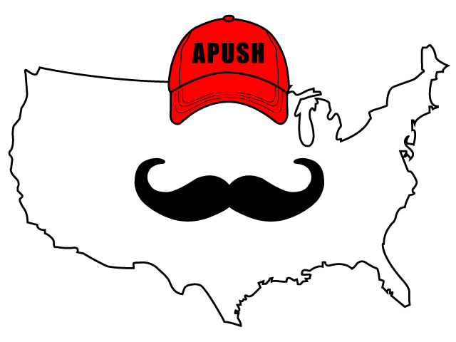
APUSH Review: Breaking Down John Winthrop’s “A City Upon A Hill”
Everything You Need To Know About John Winthrop’s “A City Upon A Hill” To Succeed In APUSH
Want more document analysis? Take my FREE course at APUSHREVIEW.COM

Slide 2
Background On John Winthrop
Puritan leader
Governor of Massachusetts Bay Colony
Did NOT favor religious toleration

Slide 3
“A City Upon A Hill” - 1630
“For we must consider that we shall be as a city upon a hill. The eyes of all people are upon us. So that if we shall deal falsely with our God in this work we have undertaken, and so cause Him to withdraw His present help from us, we shall be made a story and a by-word through the world.”

Slide 4
Document Analysis Questions
How does Winthrop view his people?
As God’s chosen people
What would happen to Winthrop’s people if they did not follow through with their mission?
Lose support of God, be made an example of

Slide 5
HIPP Time!
Historical Circumstance?
Puritans came in large numbers from England (1620 - 1643) - sought to purify the Anglican Church
Intended Audience?
Puritans
Point of View?
Puritans are a special group
Purpose?
To explain to Puritans why they came to MBC
To encourage good behavior

Slide 6
Thanks For Watching!
Best of luck on all assessments!

