Slide 1
APUSH Review: Breaking Down “King Andrew I” Political Cartoon

Slide 2
King Andrew I

Slide 3
Document Analysis Questions
1. What is the point of view of the cartoon? (Positive? Negative? How do you know?)
The image depicts a negative image of Andrew Jackson. He is depicted as a King and is standing on top of the Constitution.
2. What political party would support the image above?
The Whig Party. They were created in response to “King” Andrew Jackson, especially after he vetoed the 3rd BUS
3. What political party would oppose the image above?
The Democratic Party.

Slide 4
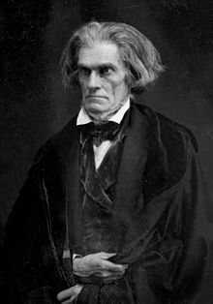
Document Analysis Questions
I would agree with the depiction. Jackson threatened to hang me and others that wanted to nullify the tariffs of 1828 and 1832.
4. Would the following people/groups agree or disagree with the depiction of Andrew Jackson in the image? Why?
• Native Americans such as the Cherokees:
They would agree. Jackson forced them to move West, in spite of the Supreme Court’s decision stating they did not have to. That is something a “king,” or someone who abuses their power would do
• Individuals that opposed the BUS:
They would disagree. They would appreciate Andrew Jackson vetoing the recharter BUS, even though the Supreme Court upheld the Constitutionality of it.
John C. Calhoun and his supporters:

Slide 5
Document Analysis Questions
5. What are SPECIFIC historical examples that support the depiction of Andrew Jackson in the cartoon?
Jackson defying the Supreme Court and forcing Natives to move West; Jackson providing jobs to political supporters (spoil system); Jackson vetoing the BUS re-charter because he did not like it; etc.
6. What are SPECIFIC historical examples that do NOT support the depiction of Andrew Jackson in the cartoon?
Under Jackson, universal white male suffrage increased - eliminated property requirements for voting; Jackson was seen as a “Common Man” president

Slide 6
That’s It!
See You Back For More Document Analysis

