Slide 1
APUSH Review: The Compromise of 1877
www.Apushreview.com
Everything You Need To Know About The Compromise of 1877To Succeed In APUSH

Slide 2
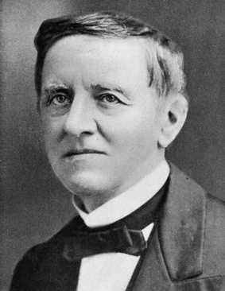
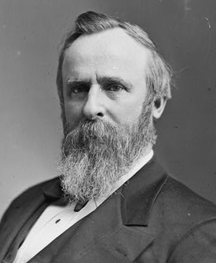
Background Info
Election of 1876:
Samuel Tilden (Democrat from NY)
Rutherford B. Hayes (Republican from Ohio)
Samuel Tilden received more popular votes
To receive an electoral majority, one needed 185 electoral votes
Tilden – 184
Hayes - 165
However, 3 states had disputed election returns:
FL, LA, SC
20 electoral votes were up for grabs
VS.

Slide 3
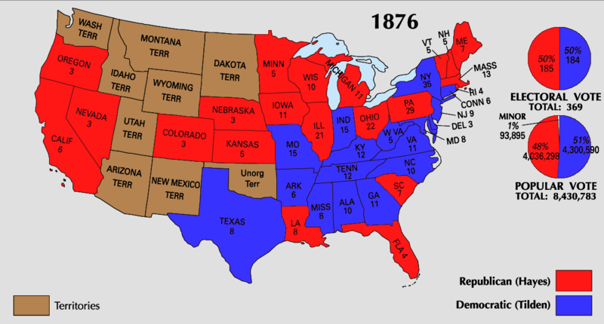
The Commission
A commission is set up to settle the electoral dispute
8 Republicans, 7 Democrats
On March 2, 1877 (2 days before the inauguration) all 20 votes were awarded to Hayes
Hayes wins 185 - 184

Slide 4
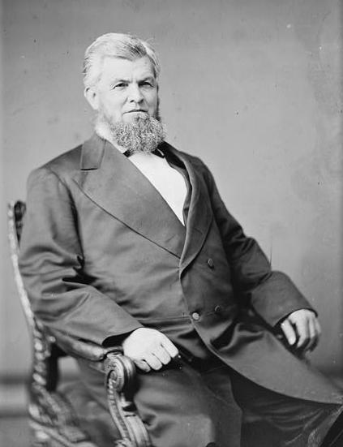
The Compromise…..
In return for Hayes becoming President, the following conditions were met:
All remaining federal troops were withdrawn from the South (Reconstruction ENDS!!!!!)
As a result, African American rights decrease drastically
“The Great Betrayal”
Hayes would appoint a southerner to his cabinet
David McKendree – TN, Postmaster General
The South would receive $ for a railroad

Slide 5
Thanks for watching!
Subscribe to my channel
Help spread the word
Questions? Comments? Ideas for videos?
Leave in comments
Subscribe
Down here!

