Slide 1
American History: Chapter 11 Review Video
www.Apushreview.com
Cotton, Slavery, and the old South

Slide 2
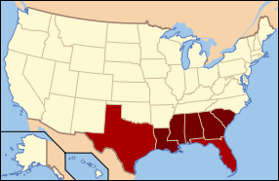
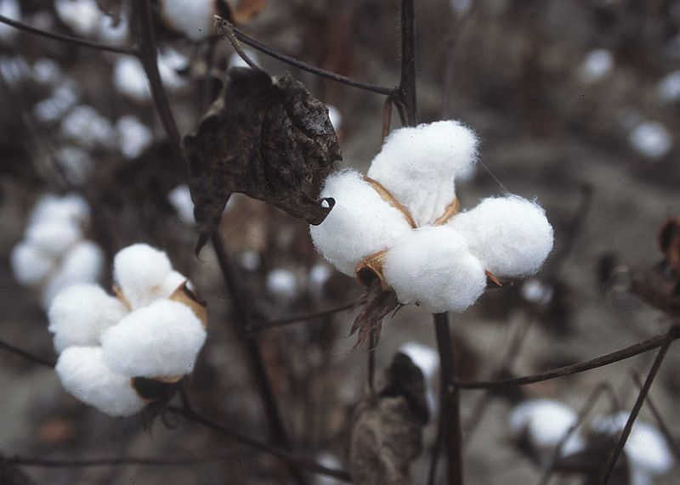
The Cotton Economy
Why was cotton so popular?
Tobacco exhausted land, fluctuated in price
Sugar and rice cultivation was difficult
Industrial Revolution created a new, large, demand
Spread of cotton
By 1850, cotton became the dominant crop of the South
Deep South saw most production
Alabama, Mississippi, Louisiana
Southern Industry:
Mostly agriculture
Some commerce developed, but it served the “plantation economy”

Slide 3
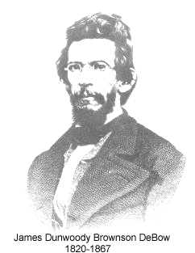
The Cotton Economy Cont.
Why did the South not industrially develop ?
$ could be made in agriculture
Capital was tied up in farming
Lack of adequate infrastructure (railroads, canals, etc.)
James B. De Bow:
Warned of the dependence on the North
Favored economic independence for the South

Slide 4
White Society in the South
Roughly 1 out of 4 whites owned slaves
An even smaller portion owned plantations
Those that did had tremendous power and influence
George Fitzhugh:
Southern writer, defended slavery and subordination of women
Women had few opportunities at education
Those that did, focused on being “good wives”

Slide 5
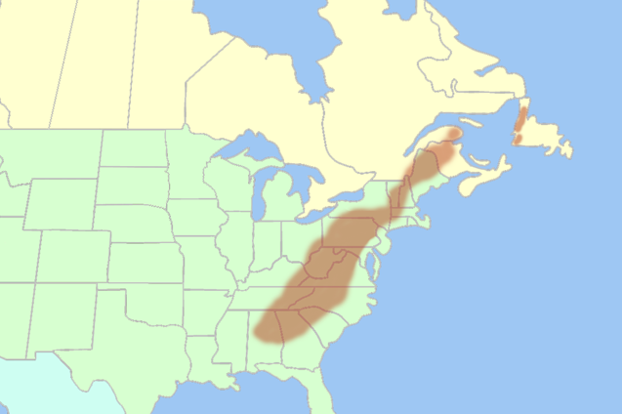
White Society in the South Cont.
The Plain Folk:
Mostly subsistence farming, some cash-crop
Few educational opportunities in the rural south
“Hill People”:
Lived in the Appalachian Mountain region
Opposed the planter elite
Resisted secession leading to the Civil War
Why were plantation owners so influential?
They controlled markets, credit, machines
They often had many relatives in town

Slide 6
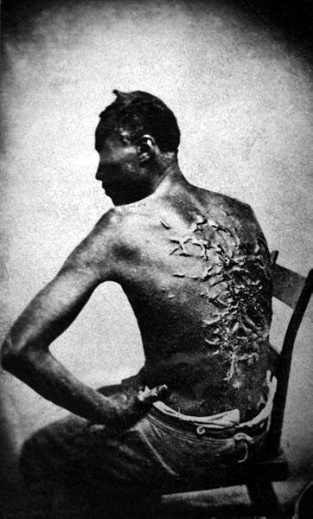
Slavery: The “Peculiar Institution”
In the mid-19th century, slavery was illegal in the Western world, except for US, Brazil, Cuba, and Puerto Rico
Slave Codes:
Regulated behavior of slaves:
Could not own property, be out after dark, strike a white person, receive an education
Overseers:
In charge of slaves in fields, often harsh and brutal towards slaves

Slide 7
Slavery: The “Peculiar Institution” Cont.
Slave Life:
Living conditions were harsh
Women often worked in fields with men, then did housework
House Slaves:
Closer proximity to owners often led to more punishments
Often isolated from other slaves
Female house slaves were subject to harsh treatment from owners and white women
Slaves in Cities:
Fewer than in rural areas
Fear of insurrections

Slide 8
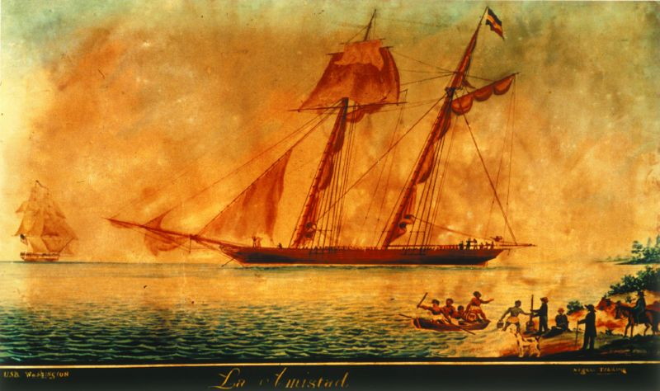
Slavery: The “Peculiar Institution” Cont.
The Slave Trade
International slave trade was outlawed in 1808
Domestic slave trade continued
Humiliating experience
Separated families
Amistad
1839 slave revolt aboard a ship in Cuba
John Quincy Adams argued that the slaves should be freed
Former slaves were returned to Africa

Slide 9
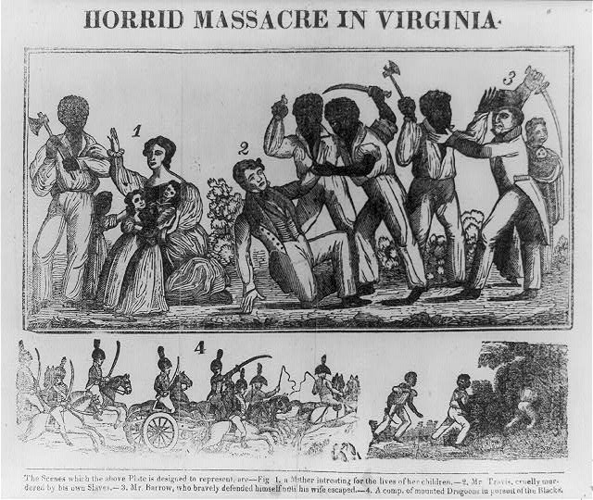
Slavery: The “Peculiar Institution” Cont.
Resisting slavery:
Resistance took many forms:
Passive – working slowly, faking illness
Running away
Breaking tools
Although slave revolts did happen, they were rare
Gabriel Prosser (1800):
Rebellion stopped before it occurred, Prosser and 35 others were hanged
Denmark Vesey (1822):
Planned a rebellion, but word leaked out
Nat Turner (1831):
Armed revolt, killing 60 people in Virginia
Led to restricting African Americans’ rights

Slide 10
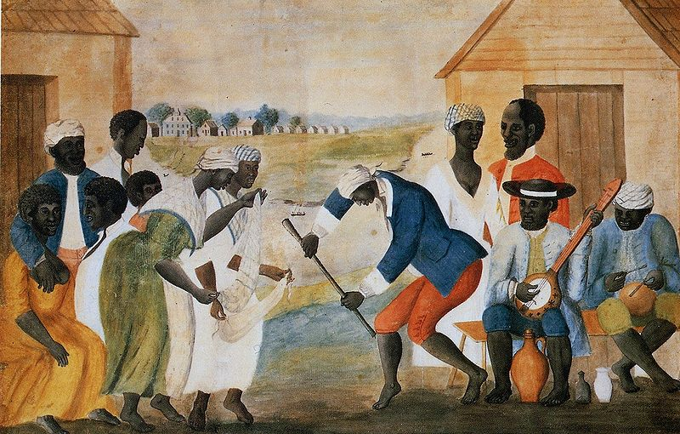
The Culture of slavery
A unique language that combined English and African language developed
Music played a large role in daily life:
Way to communicate
Helped pass time in fields
Religion:
Virtually all slaves were Christian
African American religion was often emotional
Slave family life:
Slaves could not legally marry
1/3 of all families were broken up due to slave trade
A frequent cause of running away was to be reunited with family

Slide 11
Thanks for watching!
Subscribe to my channel
Help spread the word
Questions? Comments? Ideas for videos?
Leave in comments
Subscribe
Down here!

