Slide 1
Chapter 17 Review

Slide 2
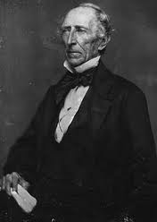
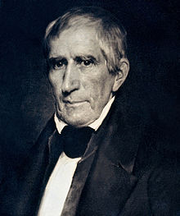
“Tyler Too”
Election of 1840: WHH wins, dies 30 days into office
John Tyler becomes President, blocked Webster and Clay’s plans
John Tyler
Former Jacksonian Democrat, switched to the Whigs because he didn’t like Jackson
Leads to conflict with Whigs, claiming he was still a Democrat

Slide 3
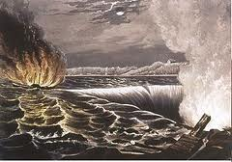
Trouble with Britain
British travel books ridiculed America: lynching, slave auctioneering, eye gouging, etc.
1837, Caroline incident:
British force attacked ship on Niagara River, set the ship on fire
Creole incident:
130 slaves rebelled and captured the ship, Britain offered asylum to the slaves
Fear that Caribbean would be a haven for slaves like Canada

Slide 4
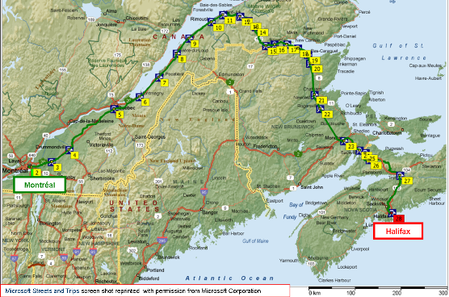
Manipulating the Maine Maps
“Aroostook War”:
Dispute n ME between American and Canadian lumberjacks threatened all-out war
Webster-Ashburton Treaty (1842)
Americans retained 7,000 square miles of the 12,000 in dispute
British got the Halifax-Quebec route

Slide 5
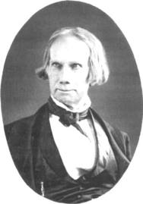
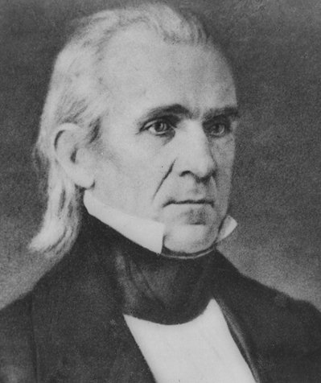
Election of 1844
Election of 1844: James K. Polk (Democrat) vs. Clay (Whig), Polk wins
As a lame duck president, Tyler believed he should acquire Texas
Texas was annexed by a joint resolution which required a majority in both houses, rather than a treaty which requires 2/3 approval in the Senate
1845 Texas was invited to be the 28th state

Slide 6
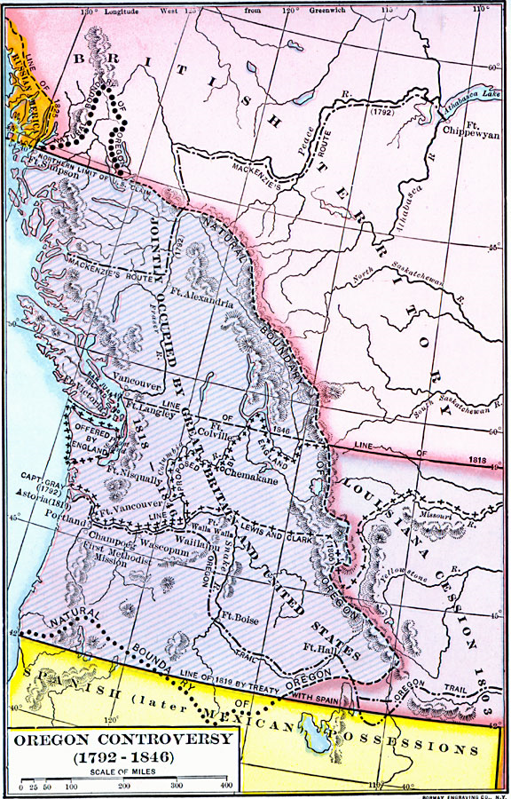
Polk the Purposeful
Polk’s presidency can be summarized as COIL:
California
Oregon
Independent Treasury
Lower tariffs
Reduced tariffs to 25% from 1842’s 32%
Restored the Independent Treasury (killed by Tyler)
Acquired California
Settled Oregon territory dispute

Slide 7
Misunderstandings with Mexico
Polk wanted to buy CA, but Mexico was reluctant to sell
Mexico still viewed Texas as theirs
Rumors of Britain buying or seizing California scared Americans
US envoy instructed to offer $25 million for California

Slide 8
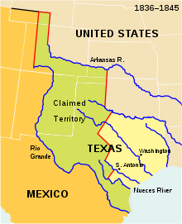
American Blood on American (?) Soil
Polk orders General Zachary Taylor (future president) to march near Mexico TX boundary
What former Presidents were also Generals?
April 25, 1846 Mexican troops attacked Taylor’s troops killing or wounding 16
Polk urges Congress to go to war
Many in Congress, including Lincoln want to know exact spot attack occurred (Spot Resolutions)

Slide 9
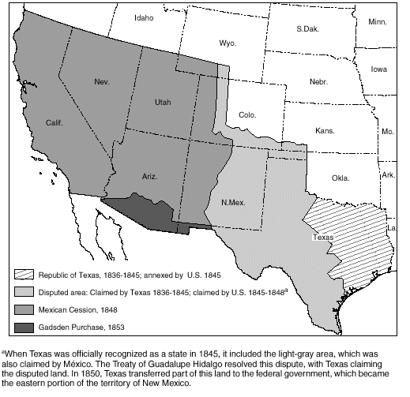
Fighting Mexico for Peace
Nicholas Trist negotiated treaty with Mexico
Treaty of Guadalupe Hidalgo
U.S. gained California, and modern-day NM, AZ, UT and NV -- ½ of Mexican territory
U.S. to pay $15 million

Slide 10
Wilmot Proviso (So important it gets its own slide)
David Wilmot, representative from PA was afraid of slavery expanding
Introduced an amendment that stipulated that “slavery should never exist in any form of the territory to be wrestled from Mexico”
Wilmot Proviso never becomes federal law, but endorsed by most free states
Ideas later adopted by Free-Soil Party

