Slide 1
Chapter 26 Review Video

Slide 2
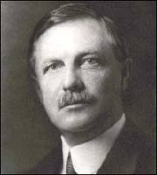
Frederick Jackson Turner
"Up to our own day American history has been in a large degree the history of the colonization of the Great West. The existence of an area of free land, its continuous recession, and the advance of American settlement westward, explain American development."
Argued closing of the frontier had ended an era in American history.
Used census report of 1890 to explain that settlement of the frontier had created the American character and spurred American development.
Frontier promoted democracy

Slide 3
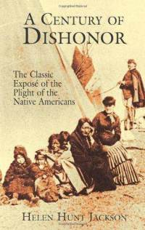
Native Americans
Populations continued to dwindle due to disease, fighting, etc.
Shrinking bison population affected Natives
Nomadic lifestyle
“Buffalo Bill” Cody
US military and Natives engaged in several battles during the late 1800s
Wounded Knee, Battle of Little Big Horn
***Helen Hunt Jackson wrote A Century of Dishonor***
Chronicled record of government ruthlessness and deceit toward Native Americans

Slide 4
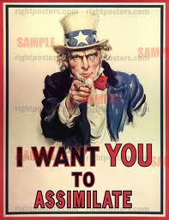
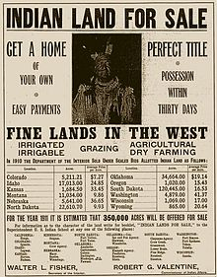
***Dawes Severity Act of 1887***
Dissolved many tribes as legal entities
Wiped out tribal ownership of land
Set up Indian family heads with 160 free acres
Impact
Completely altered way of Natives’ lives
Basically, this act tried to “Americanize” Natives, or tried to make them act “white” (Assimilation)

Slide 5
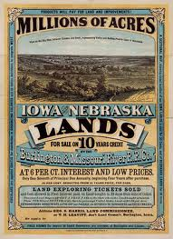
Homestead Act of 1862
Encouraged settlement of western land by:
Granting 160 acres of land by living on it for five years, improving it, and paying small fee of $30
Impact of Act
In theory, favorable to those who could not afford to buy land
500,000 took advantage of it
Land was not always the best: rain-scarce
RR companies created phony people to acquire land

Slide 6
**1890 Census**
Used in Frederick Jackson Turner’s thesis
For first time in US history, frontier line was no longer discernible
Safety-valve theory:
Supposedly, during depressions, city unemployed moved west to farm and prospered.
In reality, few city folk in eastern centers migrated to frontier during depressions.
In fact, near century’s end, many farmers moved to the city.

Slide 7
One More Term To Know
"Crop lien" system: basis of the commercialization of southern agriculture.
A planter or merchant extended a line of credit (at high interest rates) to a struggling farmer.
Impossible for farmer to get out of debt.
Resulted in many poor white and black farmers becoming landless tenant farmers or sharecroppers.

Slide 8
Politics of the 1890s

Slide 9
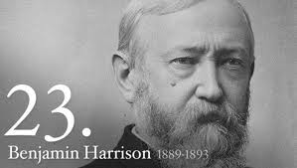
Benjamin Harrison1889 - 1893
Key accomplishments, laws, and acts:
Sherman anti-trust act (RR monopolies)
Sherman Silver Purchase Act
Increased supply of silver (Westerners liked it in hopes of inflating currency)
Remember people who owe $ want inflated currency)
The Grange:
Provided social and economic opportunities for FARMERS
Sought to end monopolies in RR, wanted government ownership of businesses
Prelude to Populist party

Slide 10
Key Court Cases
Munn v. Illinois: (1877)
State governments can regulate industries when in best interest of public
Wabash Case: (1886)
Yet again, states cannot regulate interstate commerce (overturned Munn decision)

Slide 11
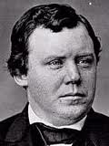
3rd parties
Greenback Labor Party:
Wanted to increase supply of $
Didn’t receive many votes, but ideas later absorbed
Populist Party
Absorbed some ideas from farmers
Omaha Platform (written by Ignatius Donnelly)
Free and unlimited coinage of silver at ratio of
A graduated income-tax (redistribute wealth)
Gov’t ownership of the telephone and telegraph, and railroads.
Initiative, referendum and recall
Postal savings banks (safe repository run by gov’t)
Limiting gov’t land grants to settlers rather than railroads
Direct election of senators
8-hour work day

Slide 12
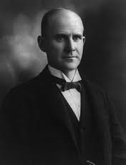
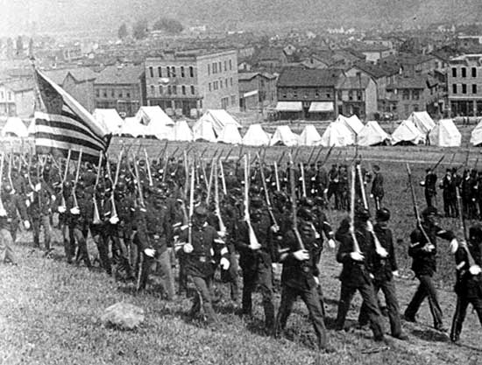
Strikes
Homestead Strike
1892, Pittsburgh, PA at Carnegie’s steel plant
State gov’t sided with owners, strike organizers were charged with various crimes
Remember, when in doubt, the government sides with businesses in labor disputes (except when we get to TR)
Pullman Strike
Eugene V. Debs (Person not a court case)
Federal gov’t sent in military, said strike interfered with US mail

Slide 13
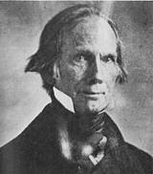
Panic of 1893
WOOOOHOOOO! I’m back! APUSH, you can’t get rid of me!!
Causes:
Who would have guessed it, overspeculation
Stock-market crash
Overproduction
Basically, same as 1929
Results:
Gov’t repeals Sherman Silver Act
William Jennings Bryan’s Cross of Gold (Like Henry Clay, he ran for President three times and lost!)
"We will answer their demands for a gold standard by saying to them: ‘You shall not press down upon the brow of labor this crown of thorns, you shall not crucify mankind upon a cross of gold."

Slide 14
Legacy of Populism
Populism failed as a 3rd Party cause but had a political influence for 25 years after its defeat in the 1896 elections.
Populist ideas that carried forward during the Progressive Era (1900-1920):
Railroad legislation
Graduated income tax
Direct election of Senators
Initiative, referendum and recall

Slide 15
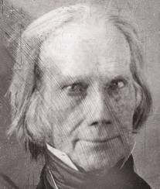
That’s it!
Subscribe to my channel
Help spread the word
Questions? Comments? Ideas for videos?
Email or leave in comments
Every time you don’t spread the word, I get uglier……
Subscribe
Down here!

