Slide 1
Chapter 36: The Cold War
1945 – 1952
Brought to you by www.Apushreview.com

Slide 2
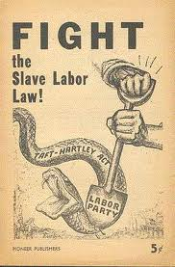
Postwar Economic Anxieties
After WWII, there was fear that the economy would falter
Millions returning home from overseas
What would they do for jobs?
Taft-Hartley Act:
Passed over Truman’s veto
Outlawed “closed” shop (requiring companies to only hire union employees
Reversed gains from Wagner Act
GI Bill:
Helped veterans attend schools (technical and vocational)
Veteran’s Administration (VA): loans to veterans to buy homes, farms, and small businesses

Slide 3
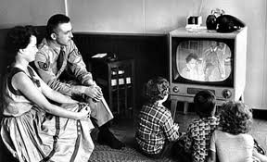
The Long Economic Boom, 1950 – 1970
America quickly became wealthiest nation
6% of world’s people owned 40% of the wealth
Middle-class grew at high rate
60% of people by mid 1950s
90% of families owned tvs
Women still expected to play traditional roles
Helps lead to the feminist revolt of the 1960s

Slide 4
The Roots of Postwar Prosperity
Huge military budgets accounted for the economic upturn of the 1950s
10% of GNP was devoted to defense spending
Worker productivity increased in all professions
Farmers could produce for 3 times as many people compared to 10 years before
By 1970, 90% of school-aged children were enrolled in educational institutions

Slide 5
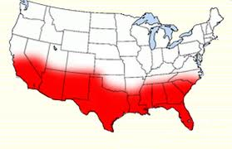
The Smiling Sunbelt
Sunbelt:
15 state area from VA, through FL, all the way to CA
Grew at a rate twice as fast as the Northeast (Frostbelt)
California: Electronics industry
Southwest: Military industries
FL and TX: aerospace complexes (NASA)

Slide 6
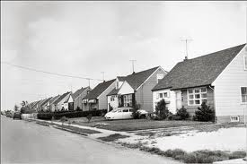
The Rush to the Suburbs
By 1960, ¼ Americans lived in suburbs
Spurred by highways, FHA
Levittown:
Cookie-cutter houses in suburban Long Island, duplicated in many other cities
African Americans were forbidden from buying homes in Levittown
“White Flight”
Many White families moved to the suburbs
Blacks (especially from the South, moved to cities)

Slide 7
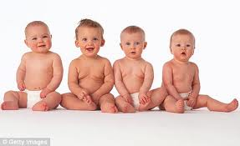
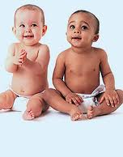
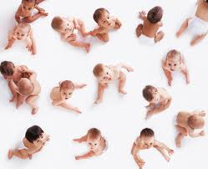
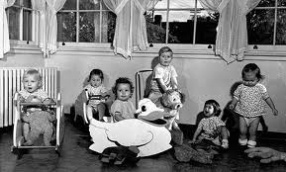
The Postwar Baby Boom
1945 – end of 1950s:
50 million babies!!!!!!
Impact of boom:
Increase in school enrollments
Canned food and baby products increase
1960s: $20 billion spent on clothes and rock music
Currently: Social Security

Slide 8
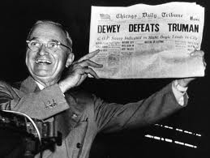
Truman: The “Gutty” Man from MO
First president without a college education in many years
“Accidental” President
5’ 8”
“The Buck Stops Here”
“If you can’t stand the heat, get out of the kitchen”

Slide 9
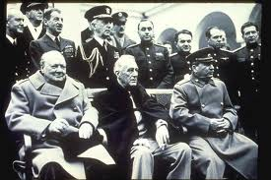
Yalta: Bargain or Betrayal?
Yalta, February 1945:
Truman, Churchill, and Stalin met to discuss post war plans
Final plans for Germany, as well as the fate of Poland (representative government) was agreed upon
A-bomb not yet tested, fear of high American casualties if Japan was invaded

Slide 10
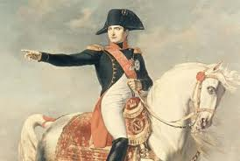
The US and the USSR
Communism v. Capitalism forever
Soviet Resentment towards US over:
Delays in opening second front in WWII
Termination of lend-lease aid
US development of A-bomb without Stalin’s help
Stalin wanted friendly governments in Eastern Europe:
Multiple invasions, dating back to Napoleon

Slide 11
Shaping the Postwar World
Breton Woods, NH (1944)
IMF: encouraged world trade
World Bank: promote economic growth in war-ravaged and underdeveloped areas
US supplied most of funding, USSR did not participate
San Francisco meeting:
UN established (5 permanent security council members)
UN approved by Senate unlike League of Nations

Slide 12
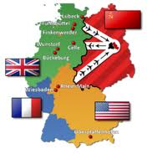
The Problem of Germany
Nuremberg Trials
Punished German Nazi Leaders (12 leaders were hanged, 7 served life sentences)
4 countries controlled Germany
US, England, France (Western Germany)
Soviet Union (Eastern Germany)
Berlin Airlift
Soviet Union froze Western countries out of Berlin (also divided into 4 zones)
US and allies fly planes with supplies
Lasts roughly a year

Slide 13
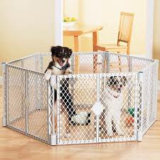
The Cold War Congeals (Holy cow is this important stuff)
***George F. Keenan***
Creator of “Containment”
Belief that USSR wanted to expand and expansion must be stopped
***Truman Doctrine:***
US provided $ and military aid (but not troops) to Greece and Turkey so they would not become Communist
If Greece fell, Turkey may too
Impact of Containment:
Divided world into pro-Soviet and pro-US camps
Set the foreign policy for decades to come

Slide 14
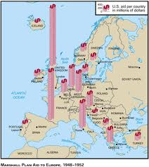
Continued
Marshall Plan:
Secretary of State George C. Marshall
US would provide financial aid to countries
(another way to keep Communism from spreading)
Middle East:
Truman recognized Israel on May 14, 1948
“Should Israel be born, the Arabs will lay siege to it until it dies of famine”
Sign of things to come

Slide 15
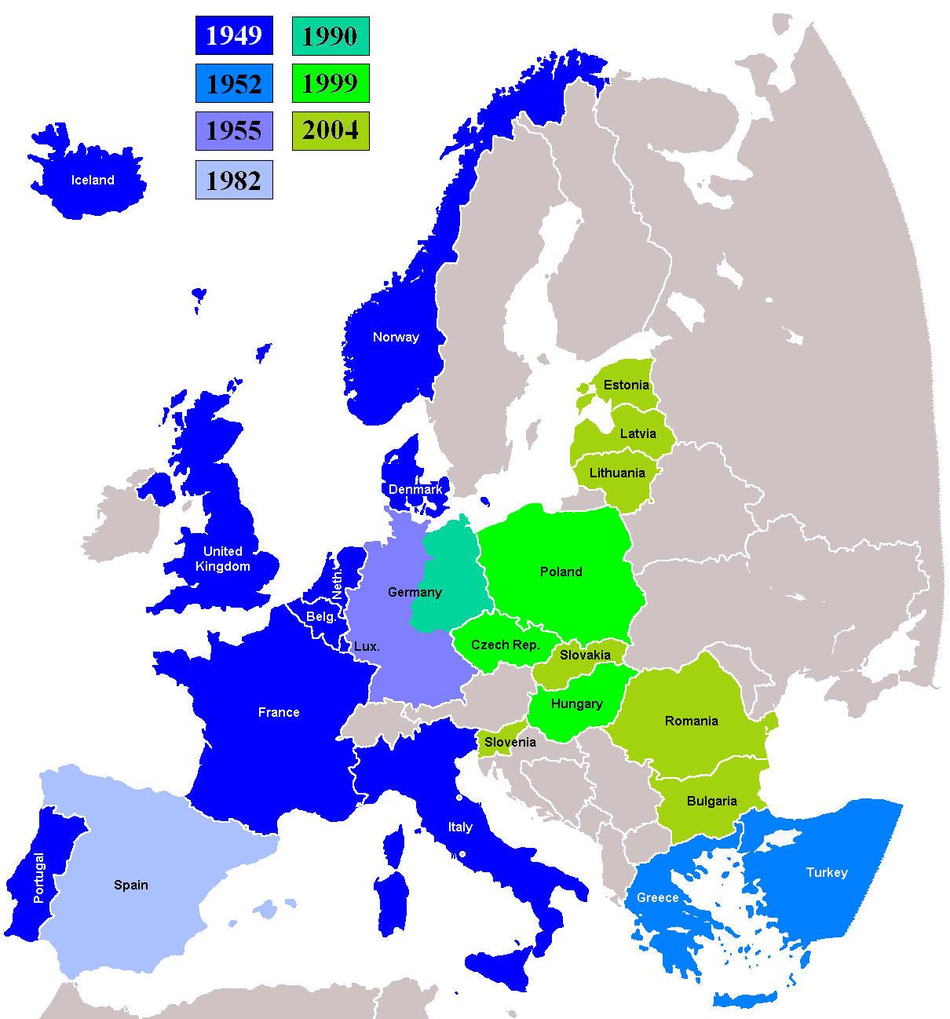
America Begins to Rearm
1947 National Security Act created:
The Department of Defense
National Security Council
Central Intelligence Agency (CIA)
“Voice of America”
American radio broadcasts broadcasted beyond Iron Curtain
NATO (April 4, 1949):
US and 11 other members of Western Europe
“An attack on one is an attack on all”
Membership increased as years went on

Slide 16
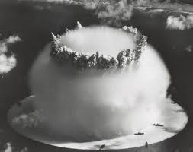
Reconstruction and Revolution in Asia
5 star General MacArthur (Bonus Army squasher)
In charge of reconstruction of Japan
Japan becomes one of leading industrial powers
1949: China becomes Communist, Truman blamed, anti-Communism hysteria across US
Soviet Union developed a-bomb as well
1952: US develops H-bomb
1953: USSR develops H-bomb

Slide 17
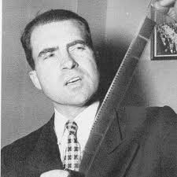
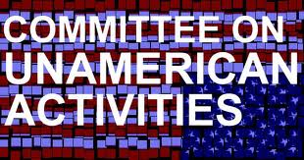
Ferreting Out Alleged Communists
1947: Loyalty Program:
3 million federal employees investigated
Smith Act of 1940: (Pre-WWII)
1st peacetime anti-sedition law since 1798
Dennis v. US
Upheld the Smith Act
**Committee on Un-American Activities (HUAC)**
Leading member, Richard Nixon accused Alger Hiss of being communist
Many activities became associated with Communism: declining religious sentiment, increased sexual freedom, agitation for civil rights

Slide 18
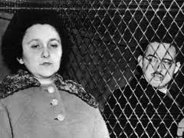
Julius and Ethel Rosenberg
Convicted in 1951 of espionage
1953: both were killed by electric chair
Only people in American history executed in peacetime for espionage

Slide 19
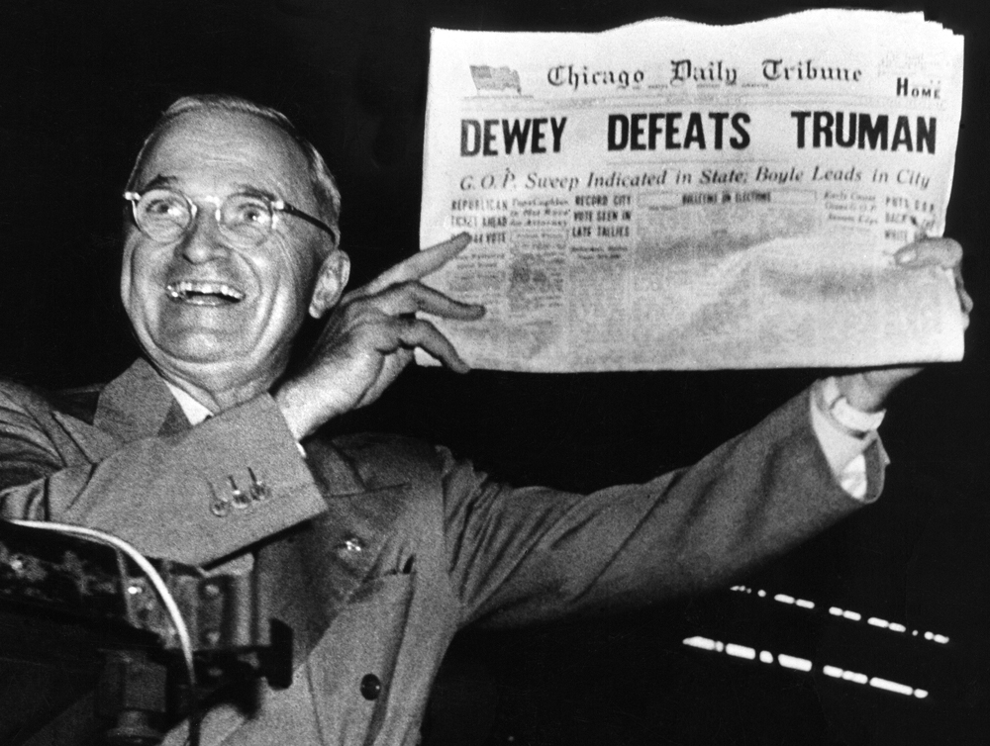
Democratic Divisions in 1948
3 way Democratic Race:
Incumbent Harry S Truman
Former VP Henry A. Wallace
Strong Thurmond (SC Governor, later turned 100 years old as senator)
Dewey (R) was believed to have won election
Truman surprisingly wins(303 – 189)

Slide 20
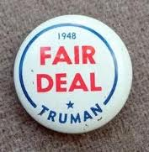
Truman’s “Fair Deal”
Other famous “Deals?”
Square Deal, New Deal
Called for improved housing, higher minimum wage, extension of Social Security
***Only major success came in raising minimum wage***

Slide 21
The Korea Volcano Erupts
US became involved (CONTAINMENT!)
***National Security Council Memorandum Number 68, (NSC-68)***
US should quadruple defense spending
Helped define Cold War policies (MILITARIZATION)

Slide 22
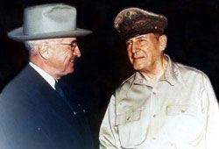
Military Seesaw in Korea
North and South exchange gains
North retreats, China comes to its aid
MacArthur (Bonus Army dude) wants to fight a large-scale war, Truman does not
MacArthur gets canned
Armistice ends the war, two sides separated at 38 parallel
(Other famous parallels?)
54°40
36°30
49°

Slide 23
Quick Review of Key Ideas
Containment
Truman Doctrine
Marshall Plan
“Loss” of China
Rosenbergs
NSC – 68
“Fair Deal”
Yalta Conference
HUAC
NATO
GI Bill
Levittown

Slide 24
Thanks for watching!
Subscribe to my channel
Help spread the word
Questions? Comments? Ideas for videos?
Leave in comments
Subscribe to this channel!
Subscribe
Down here!

