Slide 1
Chapter 4

Slide 2
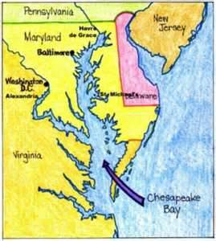
Life in Chesapeake
Shorter life span due to spread of disease
½ people did not live until 20
Few people had grandparents unlike New England Colonies
Tobacco exhausted land, -> people move west -> Native American land -> conflict
More tobacco = more land
Indentured Servants
Paid passage in exchange for several years service
Headright System
50 acres of land to whoever (plantation owner) pays the passage of an immigrant (indentured servant)
Who does this benefit? Why?

Slide 3
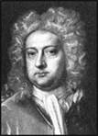
Bacon’s Rebellion (Virginia)
Event
Bacon’s crew goes on a killing spree of Natives, burns down Jamestown
Causes
More and more settlers didn’t have land (indentured servants, immigrants from Headright system)
Governor William Berkeley too friendly Native Americans, angers settlers
Effects
A new labor force- slaves from Africa.
Why?
Significance:
Shows class tensions between rich and poor

Slide 4
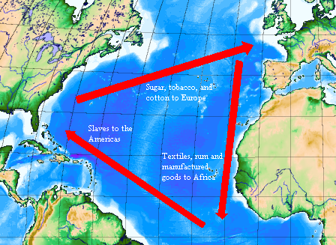
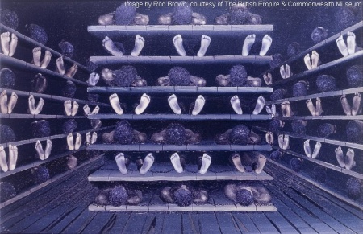
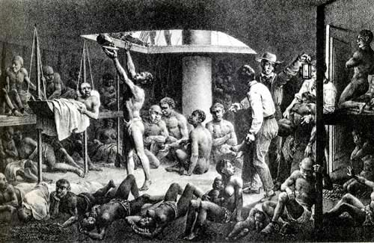
Middle Passage
Part of the journey on the triangular trade
20% of captives died on this part of the journey
Tight living quarters

Slide 5
Africans in America Contd:
Rebellions did occur, although not frequently
Why?
New York City (1712):
Dozen whites are killed in rebellion, 21 blacks were executed
Stono River Uprising (South Carolina –1739)
50 blacks rebelled and tried to go to Spanish Florida, stopped by militia
*****No slave revolt in history matched the scale of Bacon’s Rebellion****

Slide 6
The New England Family
Towns = more families living closer
Education is of great importance; 50 families = mandated schools
Clean water and cool temperature slowed the spread of killer diseases
Life expectancy is higher, immigrants added 10 years to their lives
Longer life expectancy = closer-knit families
Population increased from procreation, not just immigration
Women gave up property rights when marries

Slide 7
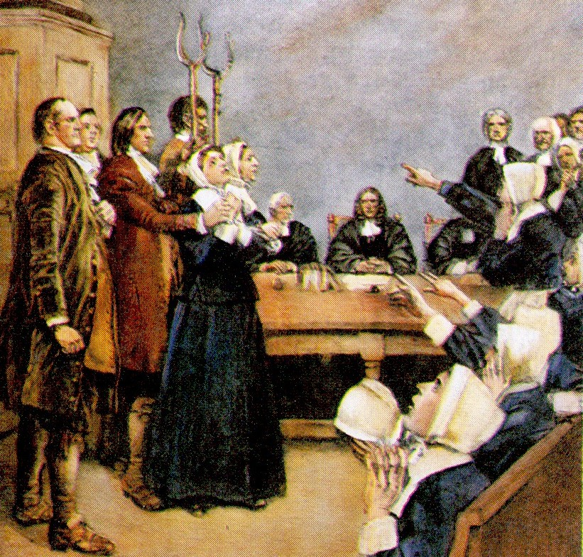
The Half-way covenant and the Salem Witch Trials
Half Way Covenant – increased membership, but sacrificed religious purity
Increase in membership separates “elect” from members of society
Salem Witch Trials
Most of the accused were from merchant class making $; accusers were mostly farmers
Illustrates tensions between rich and poor

Slide 8
That’s It!
Questions? Comments? Suggestions?
Email me, or leave in comments
Please subscribe!
Good luck!
You love……..

