Slide 1
Key Court Cases Under John Marshall
Brought to you by www.apushreview.com

Slide 2
Key Ideas Under John Marshall
The Supreme Court helped increase the power of the Federal Government
Decisions helped promote business and the economy
Federal Government became more powerful at the expense of the state governments

Slide 3
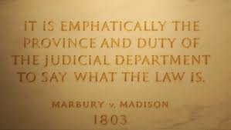
Marbury v. Madison (1803)
Summary of Case:
“Midnight Judge” Marbury (Federalist) was not given his appointment by Madison (Jefferson’s Secretary of State)
Significance:
Established the principle of judicial review
The Supreme Court can declare laws unconstitutional
Increased the power of the Supreme Court

Slide 4
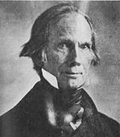
McCulloch v. Maryland (1819)
Summary of Case:
Dealt with the 2nd BUS (Thanks Henry Clay!)
Maryland taxed the BUS, hoping to destroy it
Significance:
Supreme Court sides AGAINST Maryland
Supremacy of Federal government over state governments
BUS is constitutional

Slide 5
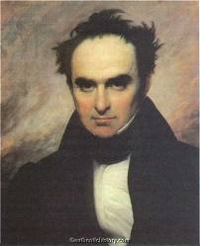
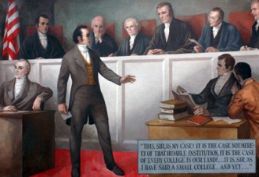
Dartmouth College v. Woodward (1819)
Summary of Case:
Issue over NH trying to change charter of the college
Significance:
Marshall says the charter was a contract
“The Constitution protected contracts against state encroachments”

Slide 6
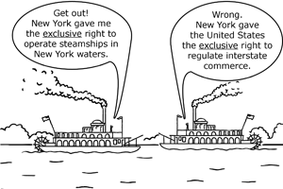
Gibbons v. Ogden (1824)
Interstate Trade:
Trade BETWEEN states (2 or more)
Intrastate Trade:
Trade WITHIN a state (only 1)
Summary of Case:
NY grants monopoly to boat company on Hudson (involving trade between NY and NJ)
Can a state control interstate trade?
Significance:
Marshall says NO! Congress has sole control over interstate trade

Slide 7
Cherokee Nation v. Georgia (1831)
Summary of Case:
Court ruled that the Cherokee nation was not a foreign nation with the right to sue in Federal Court
Significance:
Cherokee must follow Georgia law, could be forced to move West

Slide 8
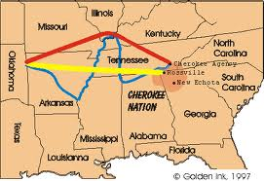
Worcester v. Georgia (1832)
Summary of Case:
Ruled that the laws of Georgia had no force within the boundaries of the Cherokee land and the Cherokee could not be required to move West.
Significance:
Jackson: "John Marshall has made his decision; let him enforce it."
Natives are forced to move west
Led to the “Trail of Tears”

Slide 9
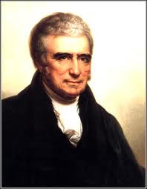
Thanks for watching!
Subscribe to my channel
Help spread the word
Questions? Comments? Ideas for videos?
Leave in comments
Not spreading the word would be unconstitutional!
Subscribe
Down here!

