Slide 1
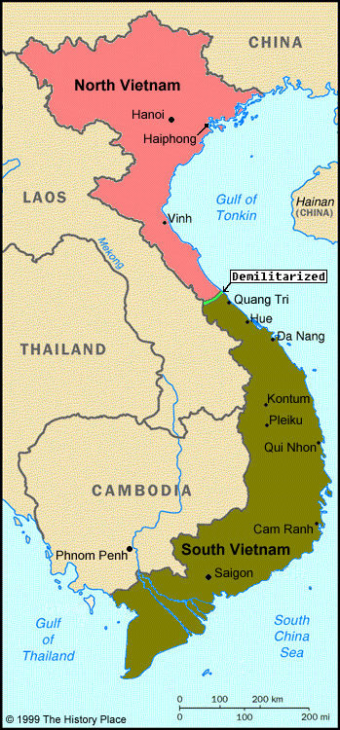
Vietnam War Review
Everything You Need To Know For Your APUSH Exam

Slide 2
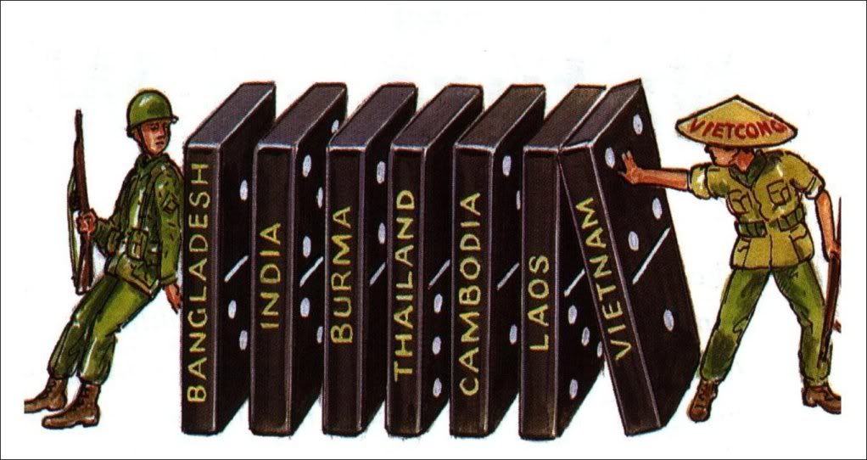
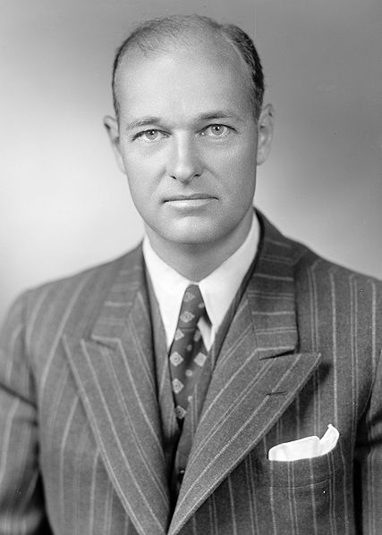
Key Ideas Before the War
Containment:
Policy of keeping communism from spreading
George Kennan
Dien Bien Phu Falls (1954):
France withdrew from French Indochina (Vietnam)
US presence in Vietnam increases
“Domino Theory”
Idea that if Vietnam became communist, surrounding countries will also
North Vietnam = Communist
South Vietnam = Noncommunist
Hawks – those that supported the war
Doves – those that were against the war

Slide 3
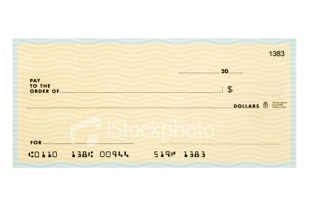
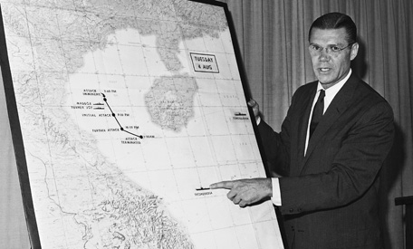
**Gulf of Tonkin Resolution (1964)**
Background info:
US alleged that American ships were attacked by North Vietnam
Different accounts of what happened
What did the resolution do?
Allowed Johnson to do anything necessary to prevent future attacks
Impact of the resolution?
Increases power of president
Johnson escalates US involvement in Vietnam
Congress
President Johnson
Unlimited Power
Gulf of Tonkin

Slide 4
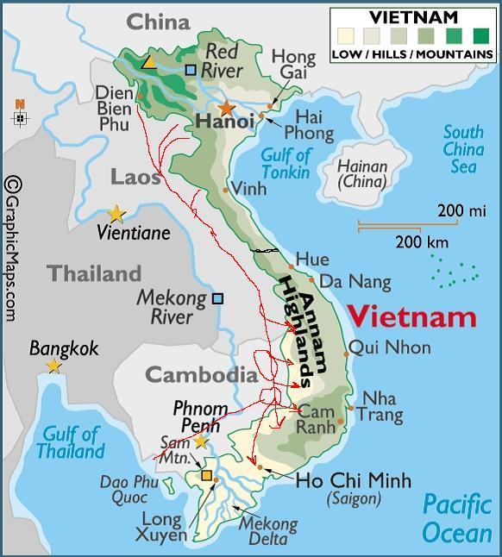
Key Battles During the War
Tet Offensive (1968)
North Vietnam launched a surprise attack on the Vietnamese New Year
Public opinion on the war decreased and protests increased
Invasion of Cambodia (1970)
Nixon’s authorized the bombing of neighboring Cambodia
Leads to……
Kent State protests:
Students protested the Cambodia bombings
4 students killed by the National Guard in the process
RESULT OF THE BOMBING OF CAMBODIA!

Slide 5
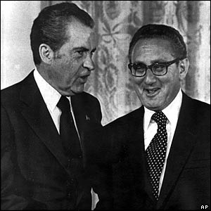
Nixon and Vietnamization
What was it?
Nixon’s plan to gradually withdraw US troops from Vietnam and replace with trained South Vietnamese troops.
Nixon campaigned on “Peace with Honor”
War Powers Act (1973)
Essentially overturned “Gulf of Tonkin” Resolution
Limited the President’s involvement in wars
Must inform Congress before war actions are taken

Slide 6
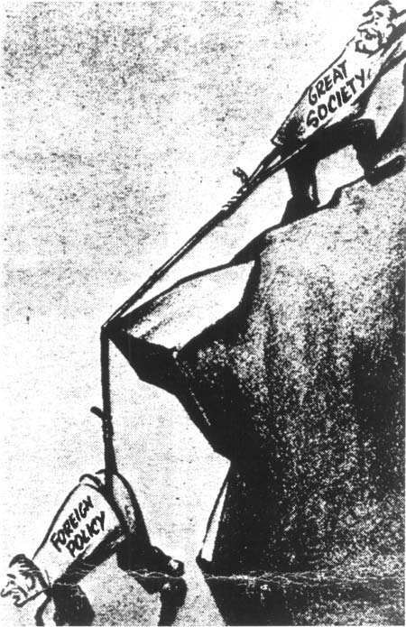
Effects of the War
During LBJ’s Presidency:
Money that could have been used on the Great Society went to Vietnam instead
Johnson did not run for election in 1968
On the Economy:
High inflation
Domestic Impact:
Distrust of the government

Slide 7
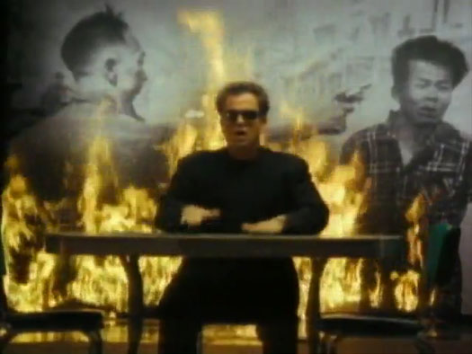
Thanks for watching!
Subscribe to my channel
Help spread the word
Questions? Comments? Ideas for videos?
Leave in comments
Subscribe
Down here!

