Slide 1
APUSH Review: Brown v. Board of Education (1954)
www.Apushreview.com
Everything You Need To Know About Brown v. Board To Succeed In APUSH

Slide 2
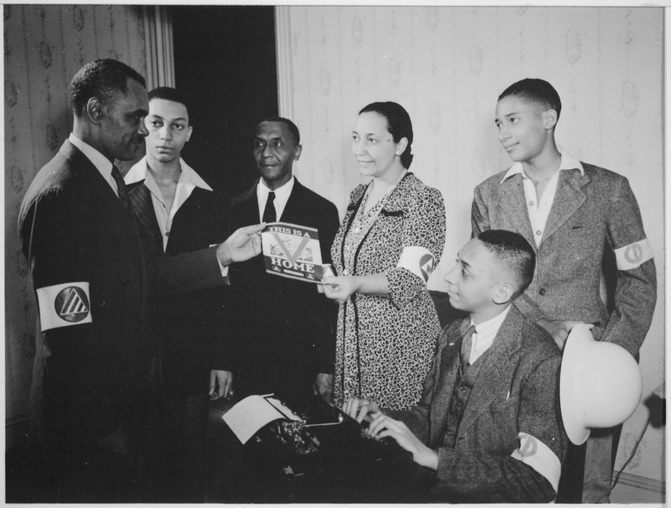
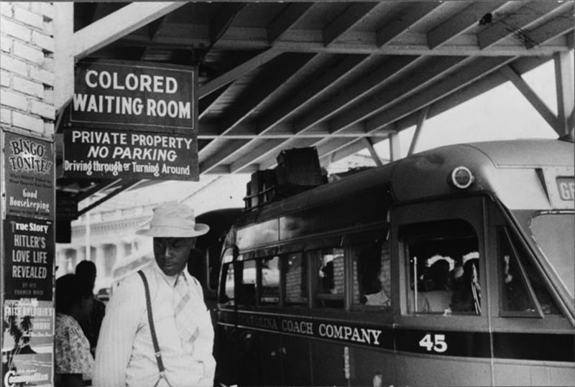
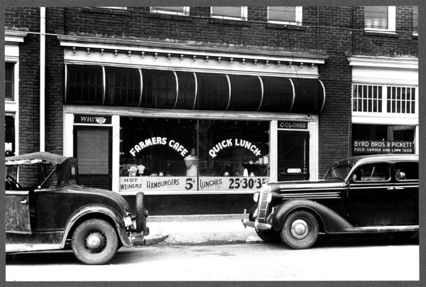
Key Ideas Before The Case
Jim Crow Laws
  Southern laws that legally segregated individuals based on race
Plessy v. Ferguson
  Established “Separate, But Equal”
Double V Campaign
  Victory over fascism and victory over discrimination in the US

Slide 3
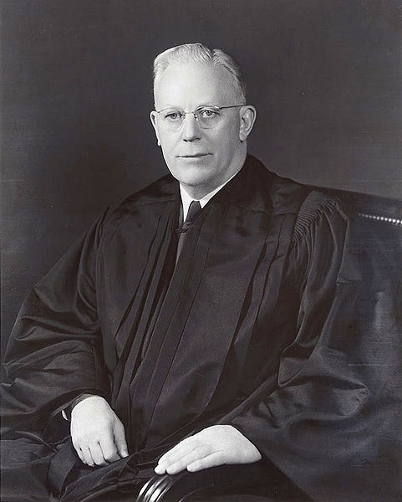
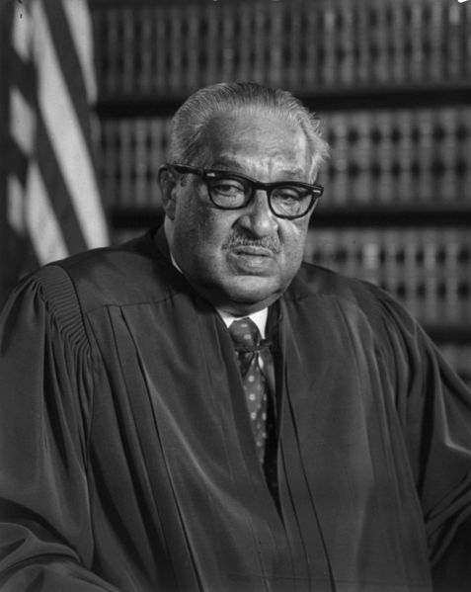
Key People
Oliver Brown
  lead plaintiff, although it was a class-action law suit involving many individuals
Thurgood Marshall
  Lawyer for Brown, future justice on the Supreme Court
Earl Warren
  Chief Justice

Slide 4
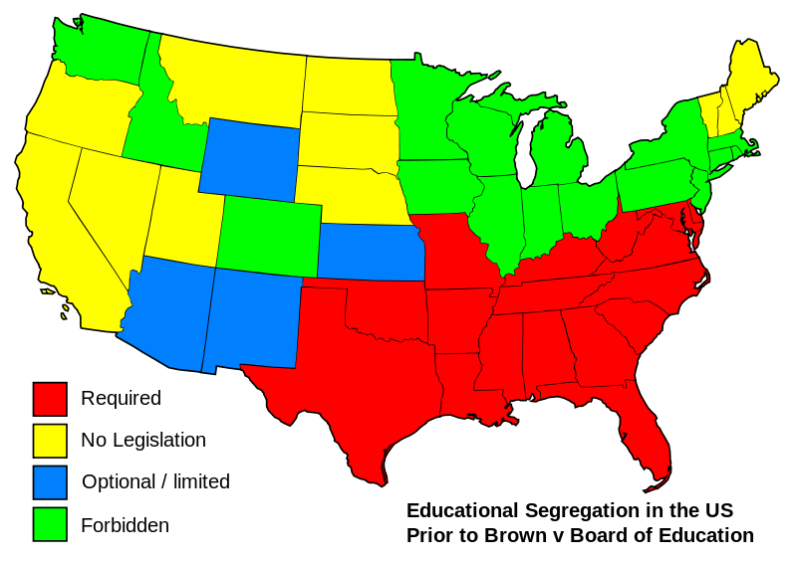
The Supreme Court Decision
In a unanimous decision, the Supreme Court reversed the Plessy v. Ferguson decision
“Separate but equal” facilities were inherently unequal
States must desegregate schools with “all deliberate speed”
De jure segregation is a violation
  Segregation by government law

Slide 5
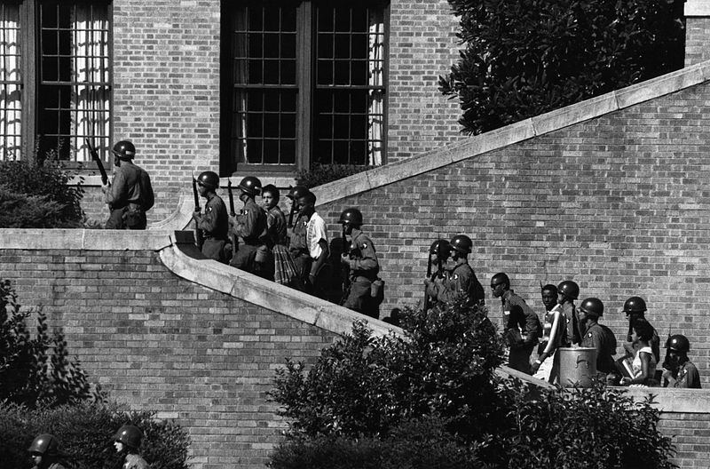
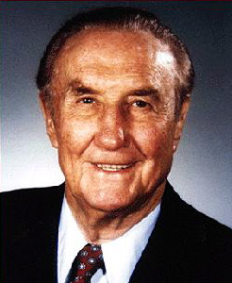
Effects of the Court Case
Many Southern states resisted integration
  “Massive Resistance”
  Favoring closing schools rather than desegregating them
“Little Rock Nine”
Southern Manifesto:
  99 Southern politicians signed a document protesting the Court’s decision
Desegregation focused on public and private facilities
  Sit-ins, wade-ins, bowl-ins, etc.
Civil Rights Acts of the 1960s helped end other forms of discrimination
"The original Constitution does not mention education. Neither does the 14th Amendment nor any other amendment. The debates preceding the submission of the 14th Amendment clearly show that there was no intent that it should affect the system of education maintained by the States."

Slide 6
Thanks for watching!
  Subscribe to my channel
  Help spread the word
Questions? Comments? Ideas for videos?
  Leave in comments
Subscribe
Down here!

