Slide 1


APUSH Review: Sectional Conflict: 1820 - 1860
Shout-out Time! Dr. Lopez’s class in Albuquerque and Mr. Horton’s class from South, Ms. Holliday’s class in Sacramento. Thank you for the support, best of luck in May!
Everything You Need To Know About Sectional Conflict between 1820 and 1860
Explain the reasons for the growth of sectional conflict between 1820 and 1860.

Slide 2
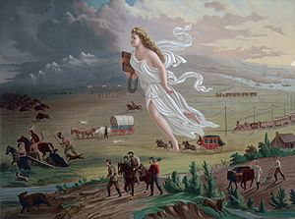

Big Ideas To Know
Westward expansion (Manifest Destiny) was a HUGE cause of conflict
  Would the new land be free or slave?
The Mexican-American War was a watershed event (turning point)
As time went on, Compromises did not solve issues, but made them worse (Fugitive Slave Act - 1850, Kansas-Nebraska Act)
Abe Lincoln campaigned on the nonextension of slavery (free-soil platform)

Slide 3
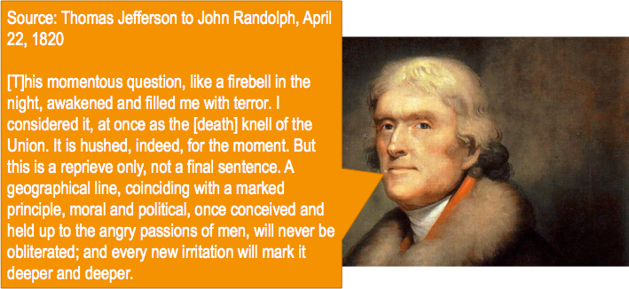
Missouri Compromise (1820)
Missouri applied to be a state in the Louisiana Territory - would upset balance of free and slave states
Tallmadge Amendment - would allow for emancipation of children of slaves
  House approved, Senate rejected
The Compromise?
  MO enters as a slave state
  ME added as a free state
  36°30’ - above would be free, below would be slave
How did it lead to increased tensions?
  Desire to keep a balance of free and slave states
  Overturned by KS-NB Act

Slide 4
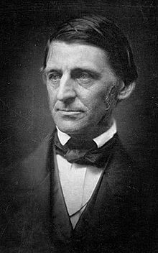
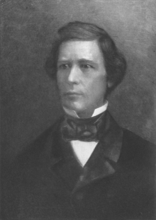
The Mexican-American War (1846 - 1848)
The United States will conquer Mexico, but it will be as the man swallows the arsenic, which brings him down in turn. Mexico will poison us.
US won the war, gained Mexican Cession
Wilmot Proviso:
  Proposed banning slavery in all territory gained from Mexico
  Passed the House, not the Senate
At the end of the war, TX claimed much more land than they have today
How did this lead to increased tensions?
  Ralph Waldo Emerson

Slide 5
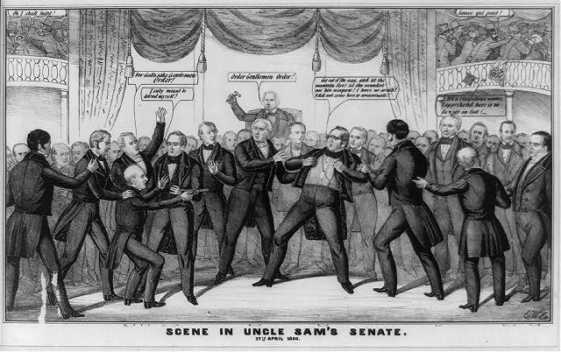
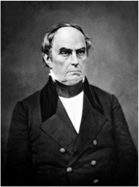
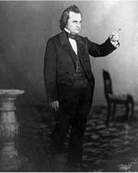
Compromise of 1850
Series of laws passed in response to Mexican-American War - 5 parts
Popular Sovereignty in Mexican Cession
**More strict Fugitive Slave Act**
  Webster’s “7th of March Speech”
Slave trade was abolished in D.C.
CA was added as a free state
TX paid $ to give up territory
How did this lead to tensions?
  Fugitive Slave Law -> Personal Liberty Laws
  Many Northerners turned abolitionists
  Tensions in Congress

Slide 6
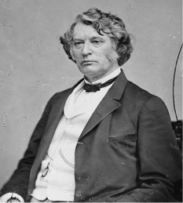
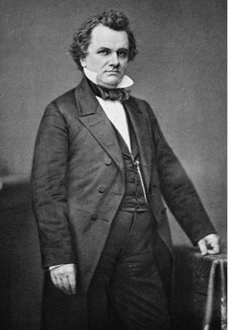
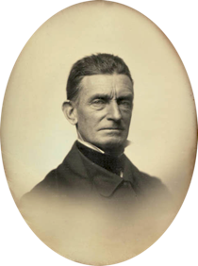
Kansas-Nebraska Act (1854)
Both Kansas and Nebraska were above the 36°30’ in LA Purchase
Act allowed for popular sovereignty in KS and NB
  Assumption was KS would be slave, NB would be free
How did this lead to increased tensions?
  Fighting breaks out in Kansas
  Caning of Charles Summer
  Republican Party formed as a result - free-soil platform

Slide 7
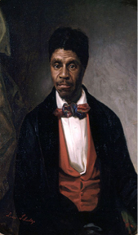
Dred Scott (1857)
Supreme Court ruled that:
  Slaves were property and could not be taken away
  ALL African Americans are NOT citizens
  Congress could not legislate slavery in the territories (Compromise of 1820 was unconstitutional)
How did it lead to increased tensions?
  North was furious, many still advocated popular sovereignty (Stephen Douglas)

Slide 8
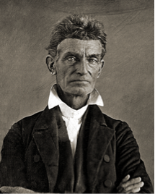
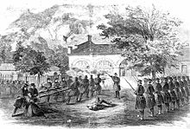
Harpers Ferry (1859)
John Brown and others tried to lead a slave rebellion
Took over the 2nd largest arsenal
Eventually captured, hanged
How did it lead to increased tensions?
  The South saw many in the North as “John Browns”

Slide 9
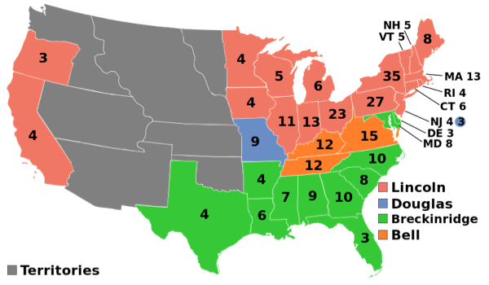
Election of 1860
4-way race
  Douglas, Lincoln, Bell, Breckinridge
Since the Democrats were split, Lincoln won without winning a single Southern state
  Lincoln ran on a FREE-SOIL platform
How did it lead to increased tensions?
  Many in the South feared Lincoln would abolish slavery
  Beginning with South Carolina, Southern states began to secede

Slide 10
Quick Recap
Westward expansion = debates over slavery
3 parts of the Missouri Compromise
Mexican-American War as a Turning point
Compromise of 1850
Kansas-Nebraska Act -> “Bleeding Kansas”
Dred Scott
Harpers Ferry
***Election of 1860***

Slide 11
Thanks For Watching!
Best of luck!

